Slide 1


DAI LOC DEPARTMENT OF EDUCATION AND TRAINING
DAI QUANG PRIMARY SCHOOL
WELCOME TO OUR CLASS !
Subject: English 3
Class: 3E
Teacher: Pham Thi My Chau

Slide 2

Warm-up

Slide 3

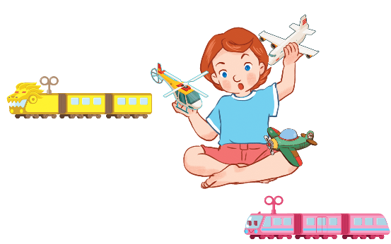
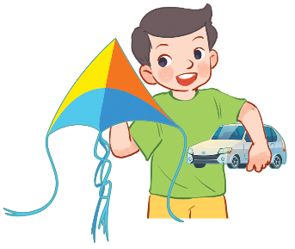
Let’s sing.
Their toys
A kite and a car.
A kite and a car.
He has a kite and a car.
He has a kite and a car.
Trains and planes.
Trains and planes.
She has trains and planes.
She has trains and planes.

Slide 4


Monday, April 1st , 2024
UNIT 17 : OUR TOYS
*Lesson 2:
Part: 1, 2 & 3

Slide 5

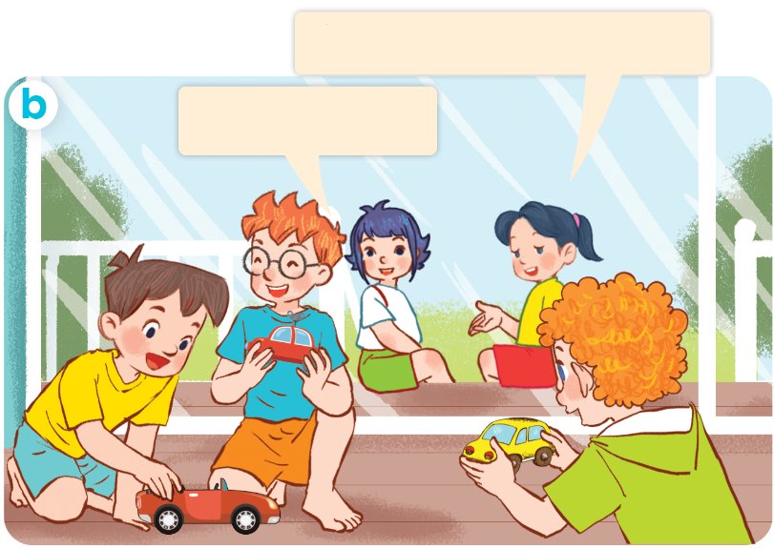
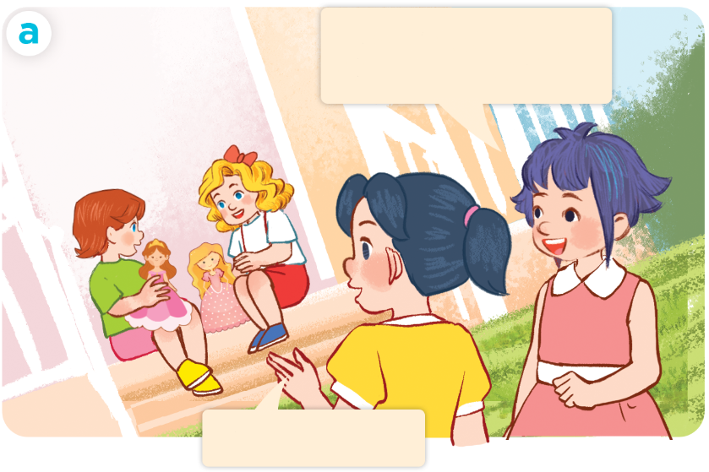
1. Look, listen and repeat.
They have three cars.
Lucy and Mary
have two dolls.
Yes, they do.
Yes, they do.
Who are they?
Where are they?
What are they doing?

Slide 6
Vocabulary

Slide 7

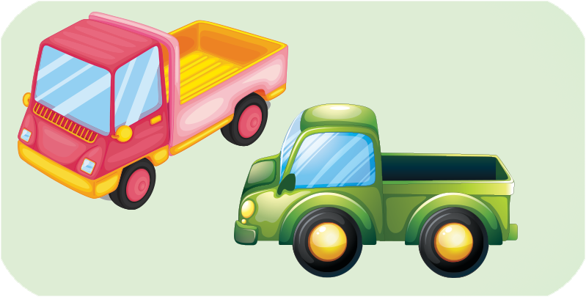
truck
trucks
/trʌk/
/trʌks/

Slide 8
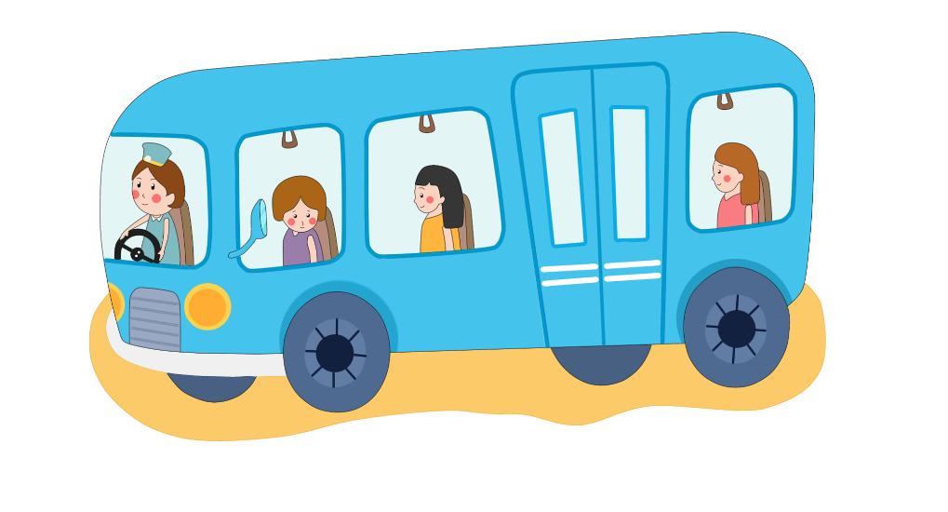
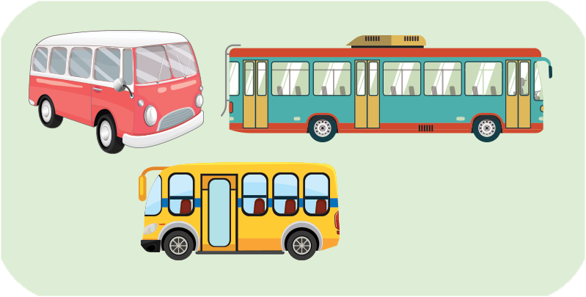
bus
buses
/bʌs/
/bʌsɪz/

Slide 9

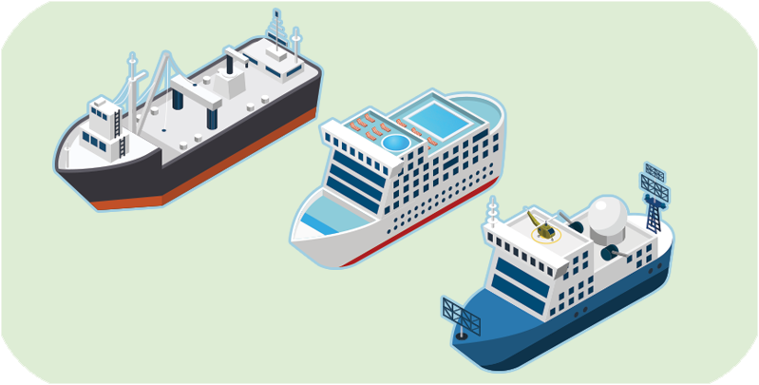
ship
ships
/ʃɪp/
/ʃɪps/

Slide 10
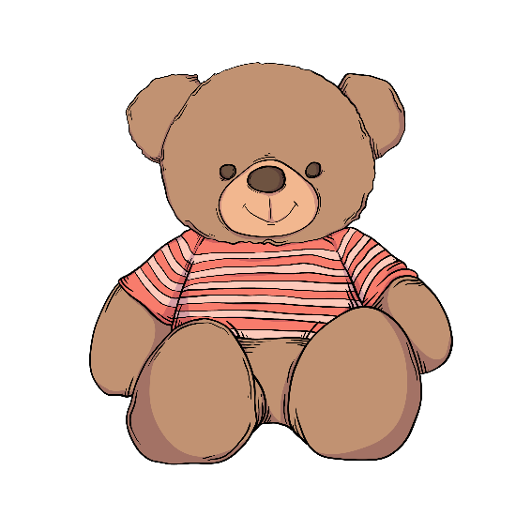

teddy bear
teddy bears
/ˈtedi beə/
/ˈtedi beəz/

Slide 11



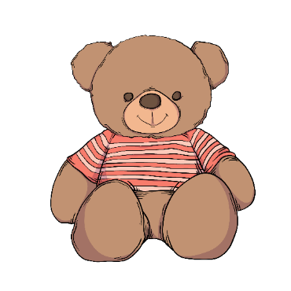
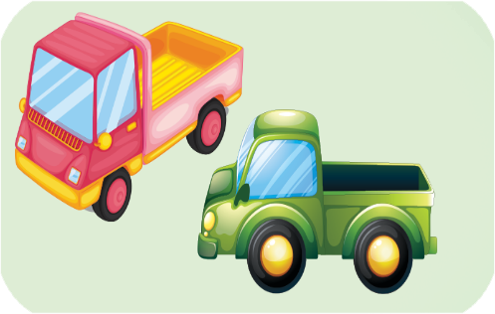
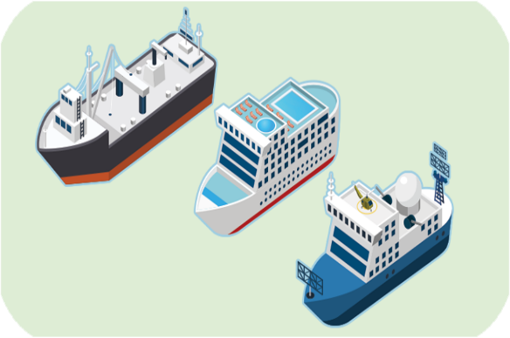
Review
truck
bus
ship
teddy bear
trucks
buses
ships
teddy bears

Slide 12
Checking vocabulary
truck
trucks
xe tải
bus
buses
xe buýt
ship
ships
tàu thủy
teddy bear
teddy bears
con gấu bông

Slide 13
Structures

Slide 14
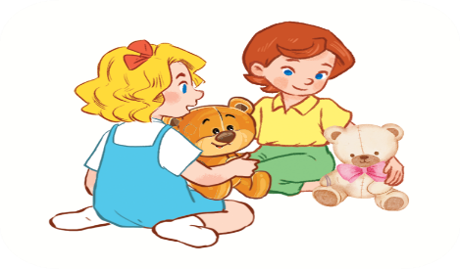
Structures
Cách nói họ có cái gì đó.
They have _______.
Example:
They have two teddy bears.

Slide 15

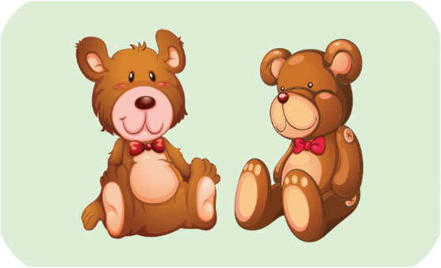
2. Listen, point and say.
a
b
They have ________.
trucks
buses
c
d
ships
teddy bears

Slide 16
They have two trucks

Slide 17
They have three buses

Slide 18
They have three ships

Slide 19
They have two teddy bears

Slide 20
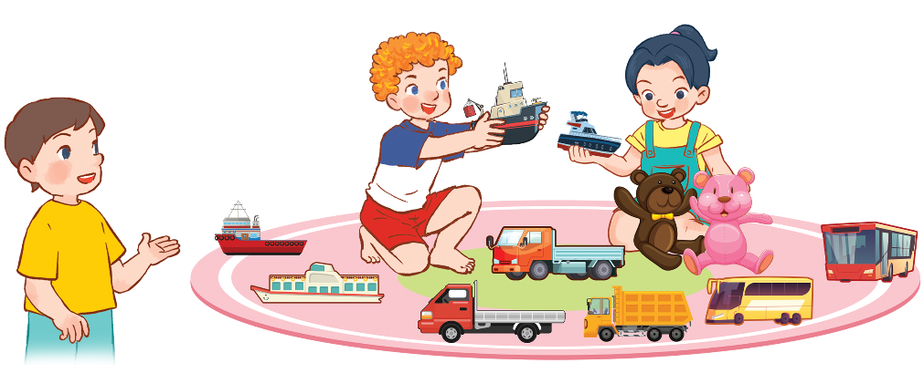
3. Let’s talk
They have _____________.
two teddy bears
three trucks
four ships
two buses
1
4
2
3

Slide 21
Let’s play!

Slide 22








truck
bus
ship

Slide 23

buses
bus
teddy bear

Slide 24
teddy bear
trucks
teddy bears

Slide 25

teddy ________
bear
bears
dolls

Slide 26
trucks
teddy bear
bus

Slide 27

tr_____
acks
uck
ucks

Slide 28
bus
ship
buses

Slide 29

They have ______.
three buses
two trucks
a bus

Slide 30
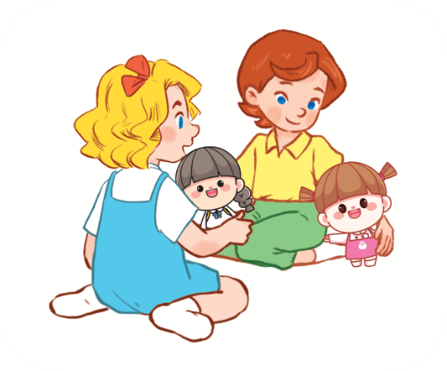
_____ ______ two dolls.
She has
They have
He has

Slide 31
They _____ _____ ships.
have two
has three
have three

Slide 32

Good job!

Slide 33
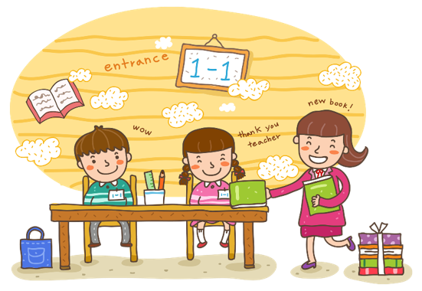
Wrap up

Slide 34
Review
truck
bus
ship
teddy bear
trucks
buses
ships
teddy bears

Slide 35
Structures
Cách nói họ có cái gì đó.
They have _______.
Example:
They have two teddy bears.

Slide 36

Thank you!

