Slide 1


DAI LOC DEPARTMENT OF EDUCATION AND TRAINING
DAI QUANG PRIMARY SCHOOL
WELCOME TO OUR CLASS !
Subject: English 3
Class: 3E
Teacher: Pham Thi My Chau

Slide 2
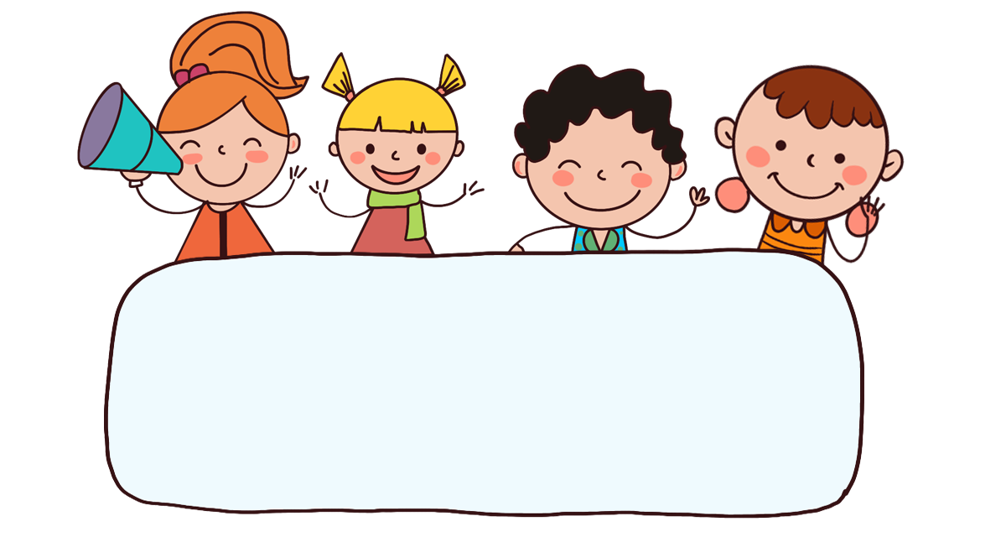
Warm-up

Slide 3
Let’s play!

Slide 4



Minion game

Slide 5


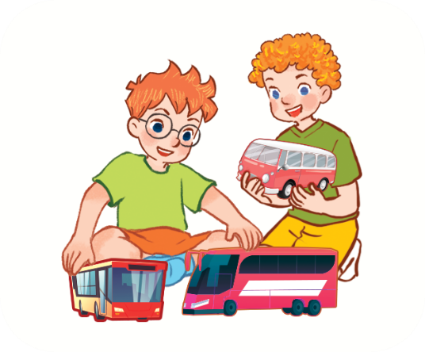


They have three buses.

Slide 6
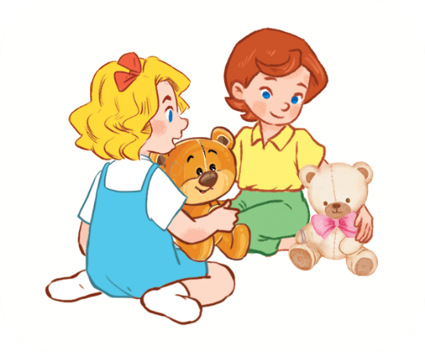
They have two teddy bears.

Slide 7
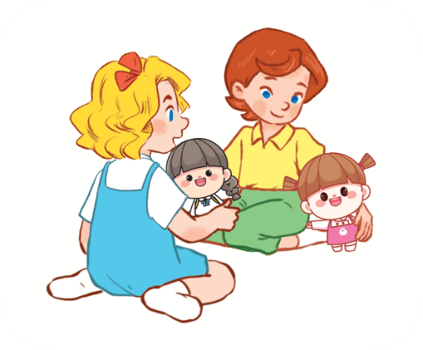
They have two dolls.

Slide 8
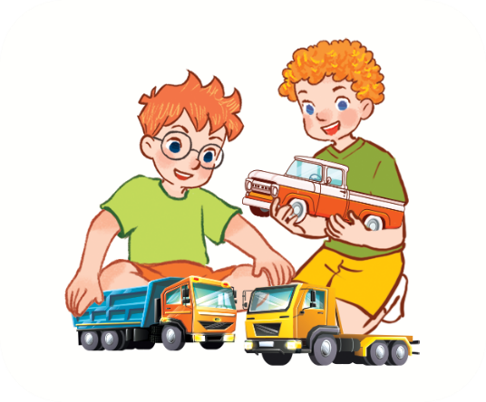
They have three trucks.

Slide 9
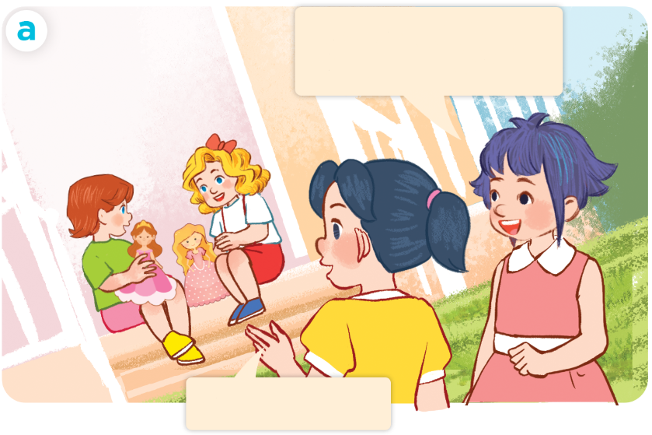
They have two dolls.

Slide 10
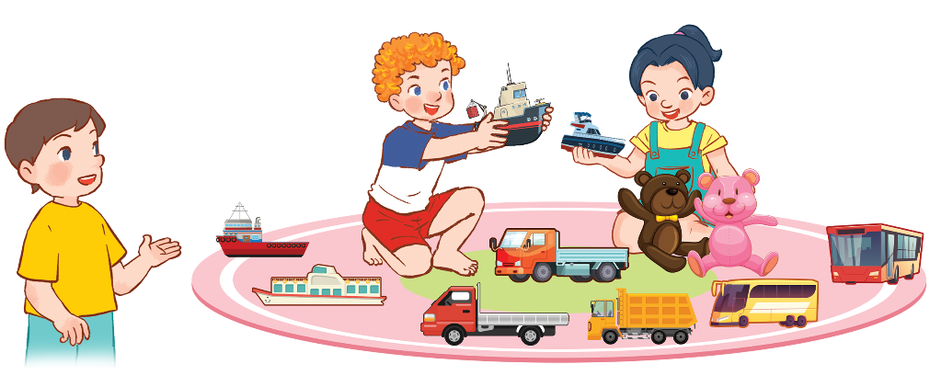
_________trucks.
They have three

Slide 11
_________two teddy bears.
They have

Slide 12
____ have four ships.
They

Slide 13
Well done!

Slide 14


Monday, April 1st , 2024
UNIT 17 : OUR TOYS
*Lesson 2:
Part: 4, 5 & 6

Slide 15


4. Listen and tick.
a
b
1
a
b
2

Slide 16
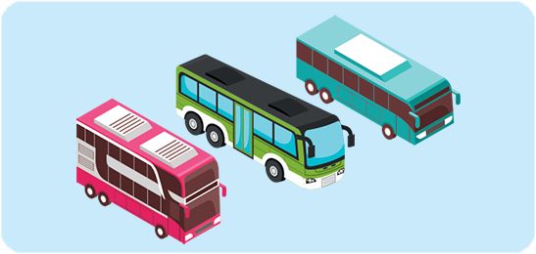

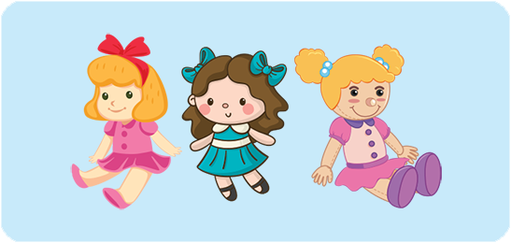

5. Look, complete and read.
buses
1. Ben and Nam have three ___________.
two ships
2. They have ______________.
three dolls
3. Lucy and Mai have ______________.
have two teddy bears
4. They ____________________.

Slide 17
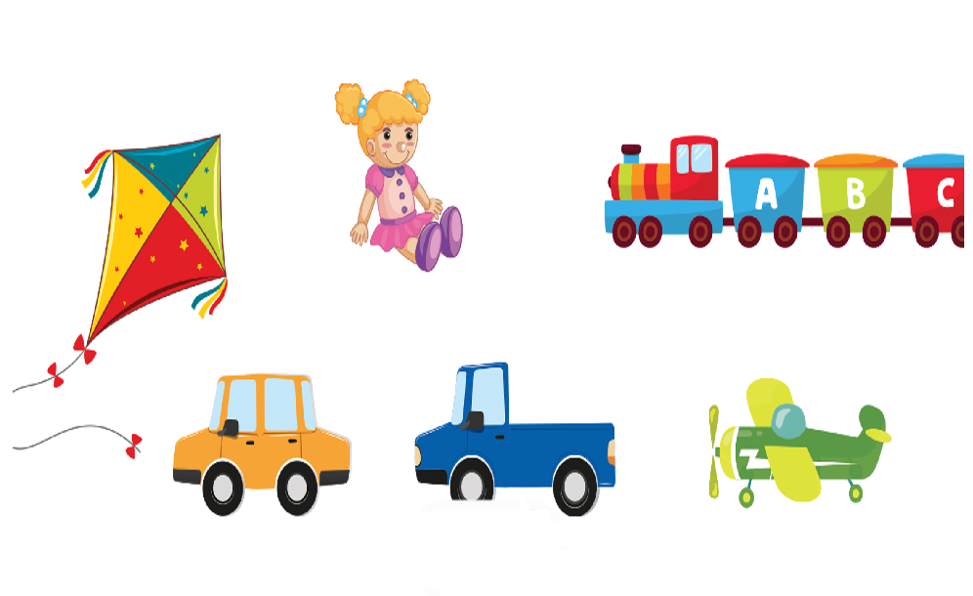
6. Let’s play.
Kim’s game

Slide 18
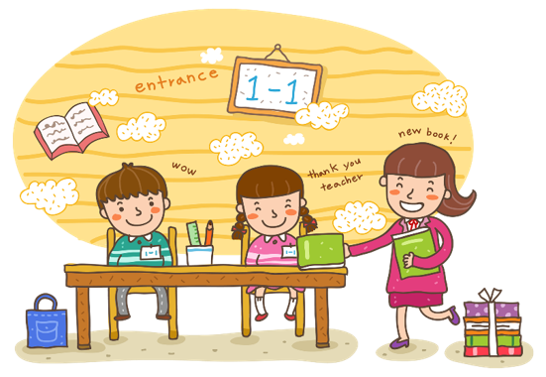
Wrap up

Slide 19


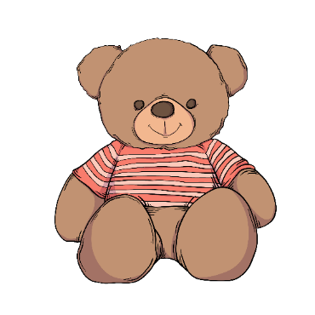
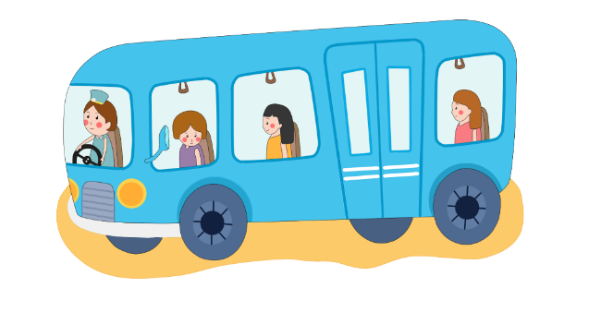
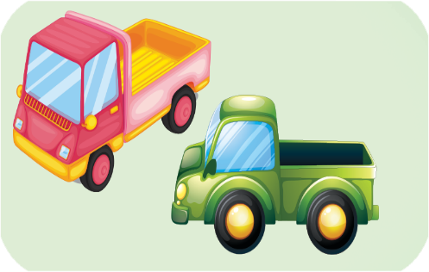
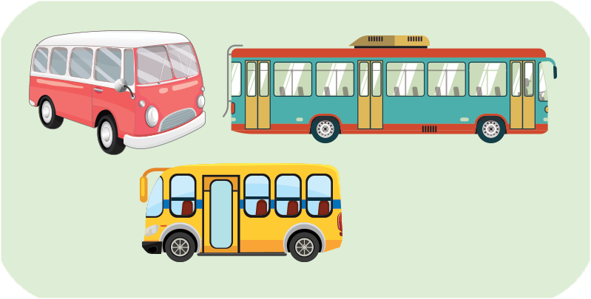
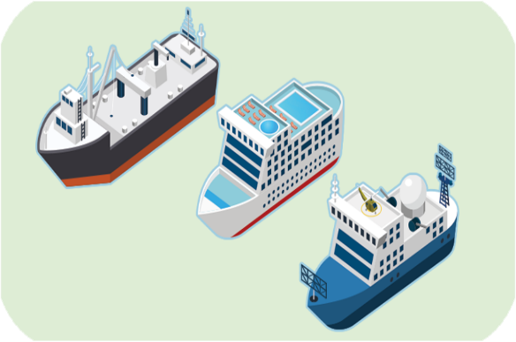

Review
truck
bus
ship
teddy bear
trucks
buses
ships
teddy bears

Slide 20

Structures
Cách nói họ có cái gì đó.
They have _______.
Example:
They have two teddy bears.

Slide 21

Thank you!

