Slide 1


DAI LOC DEPARTMENT OF EDUCATION AND TRAINING
DAI QUANG PRIMARY SCHOOL
WELCOME TO OUR CLASS !
Subject: English 3
Class: 3D
Teacher: Pham Thi My Chau

Slide 2
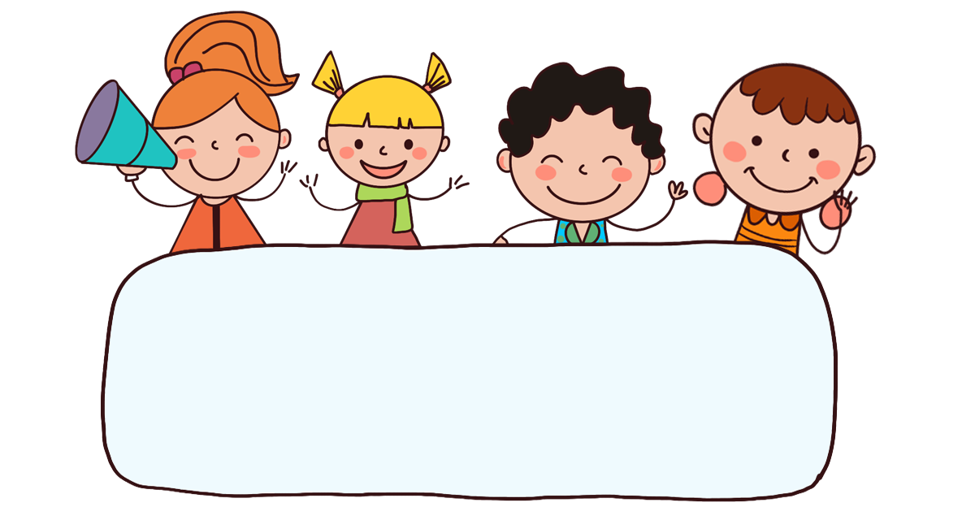
Warm-up

Slide 3

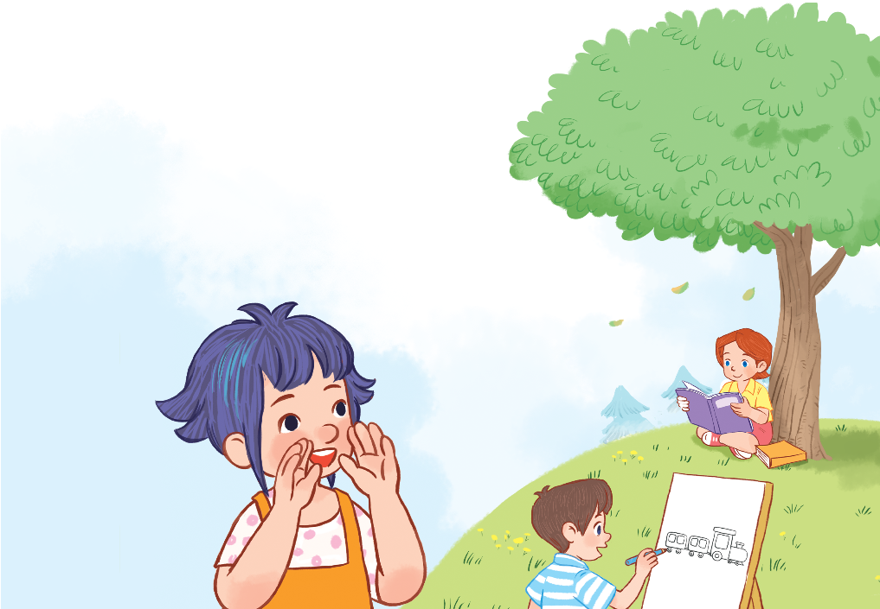
Facebook : Bùi Liễu
0968142780
3. Let’s chant.
Listen, everyone!
Stand up!
Count to ten,
No! No! No!
And sing with me.
I’m reading a book.
No! No! No!
I’m drawing a train.

Slide 4


Thursday, April 18th, 2024
UNIT 19 : OUTDOOR ACTIVITIES
*Lesson 1:
Part: 1, 2 & 3

Slide 5

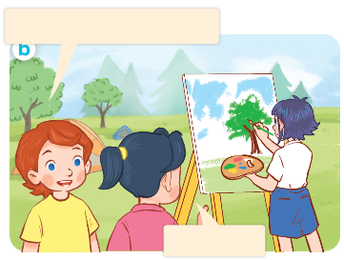
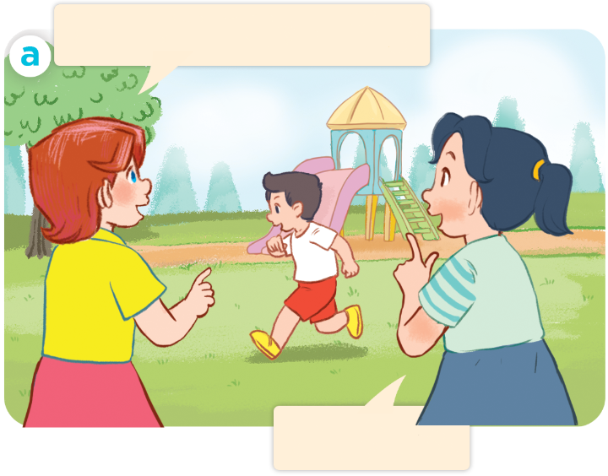
I have two rabbits. How many rabbits do you have?
1. Look, listen and repeat.
Look! Nam is running.
Look! Linh is painting.
Yes, he is.
Yes, she is.
Who are they?
Where are they?
What are they doing?

Slide 6
Vocabulary

Slide 7
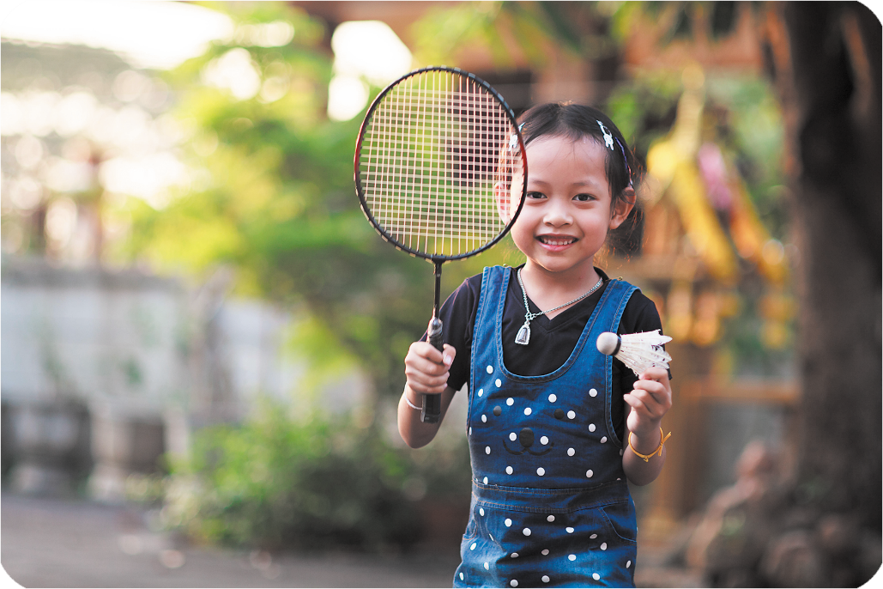
playing badminton
/ˈpleɪɪŋˈbæd.mɪn.tən/
chơi cầu lông

Slide 8
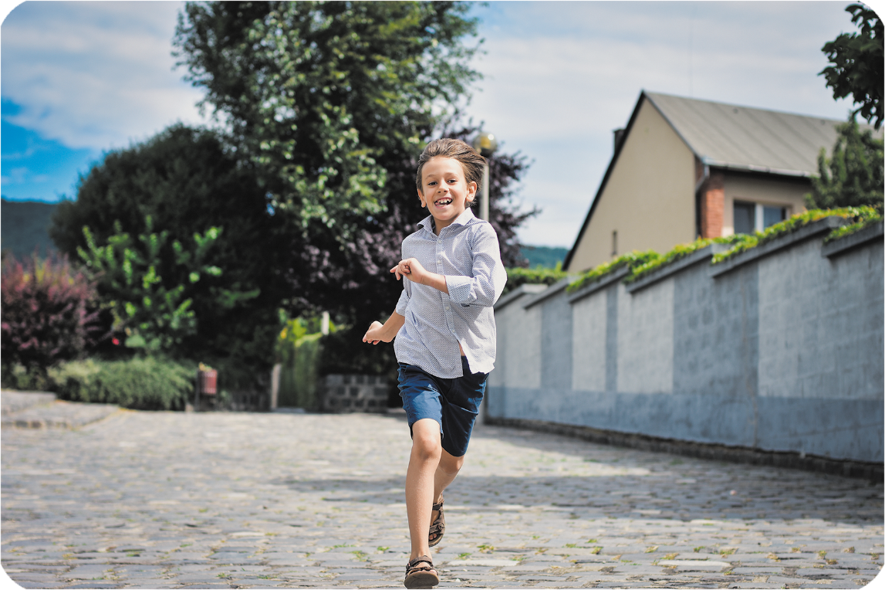
running
/ˈrʌn.ɪŋ/
chạy

Slide 9
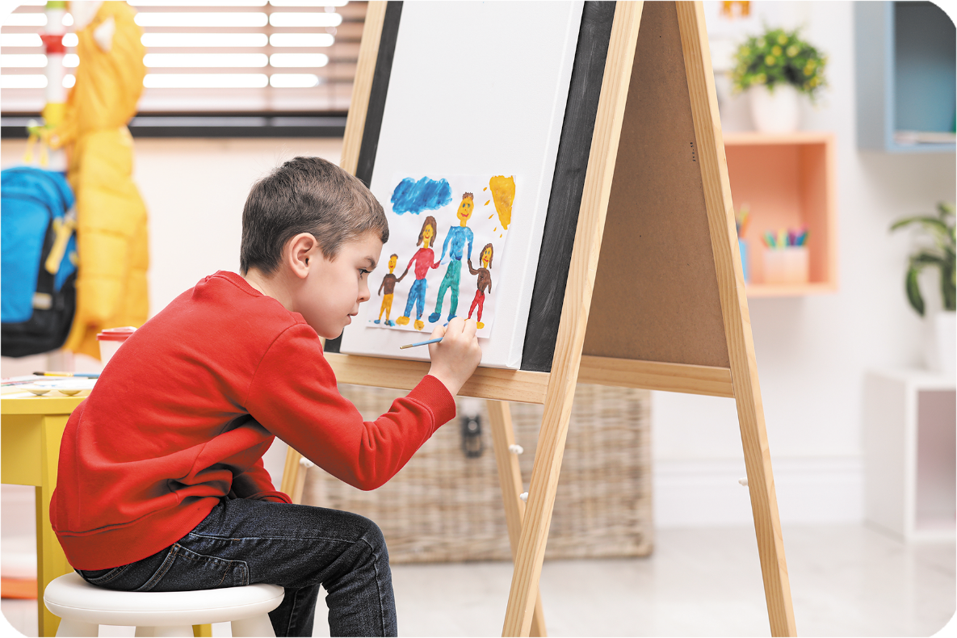
painting
/ˈpeɪn.tɪŋ/
vẽ, sơn màu

Slide 10
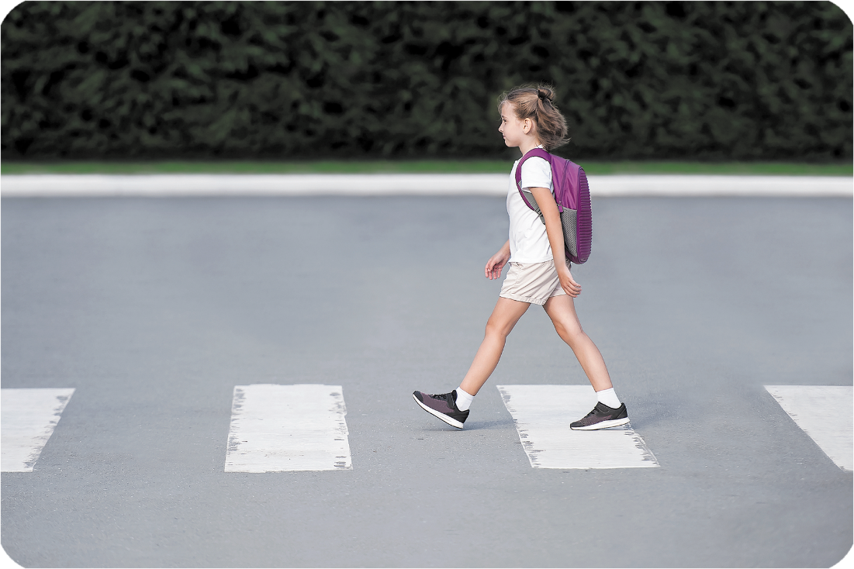
walking
/ˈwɔː.kɪŋ/
đi bộ

Slide 11



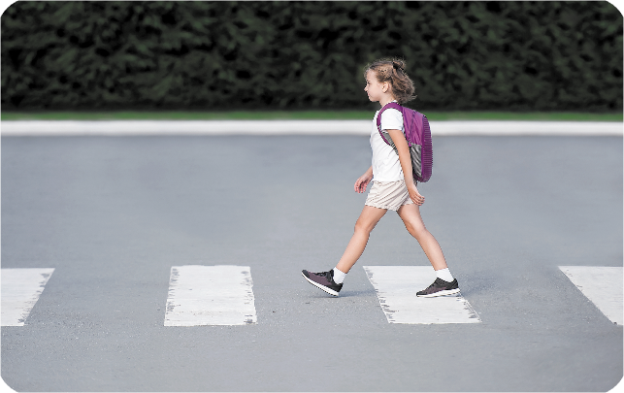
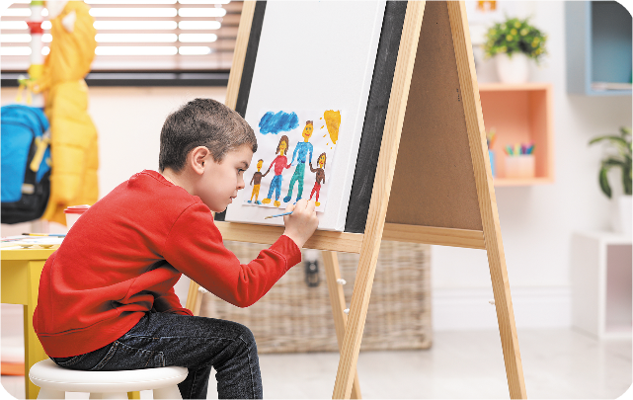
Review
playing badminton
running
painting
walking

Slide 12
Checking vocabulary
playing badminton
chơi cầu lông
running
chạy
walking
đi bộ
painting
vẽ, sơn màu

Slide 13
Structures

Slide 14
Structures
Cách nói cậu ấy / cô ấy đang làm gì.
He’s / She’s _____________.
He’s running.
Yes, he is.

Slide 15


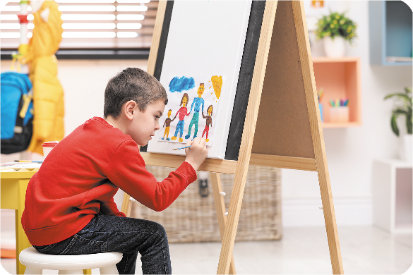

2. Listen, point and say.
a
b
He’s / She’s _______.
playing badminton
running
c
d
painting
walking

Slide 16
playing badminton
She’s playing badminton

Slide 17
running
He’s running.

Slide 18
painting
He’s painting.

Slide 19
walking
She’s walking.

Slide 20


Let’s play!
START

Slide 21


Choose the correct answer.
A. running
B. playing badminton
C. walking
NEXT

Slide 22

Choose the correct answer.
A. running
B. painting
C. walking
NEXT

Slide 23

Choose the correct answer.
A. walking
B. singing
C. painting
NEXT

Slide 24

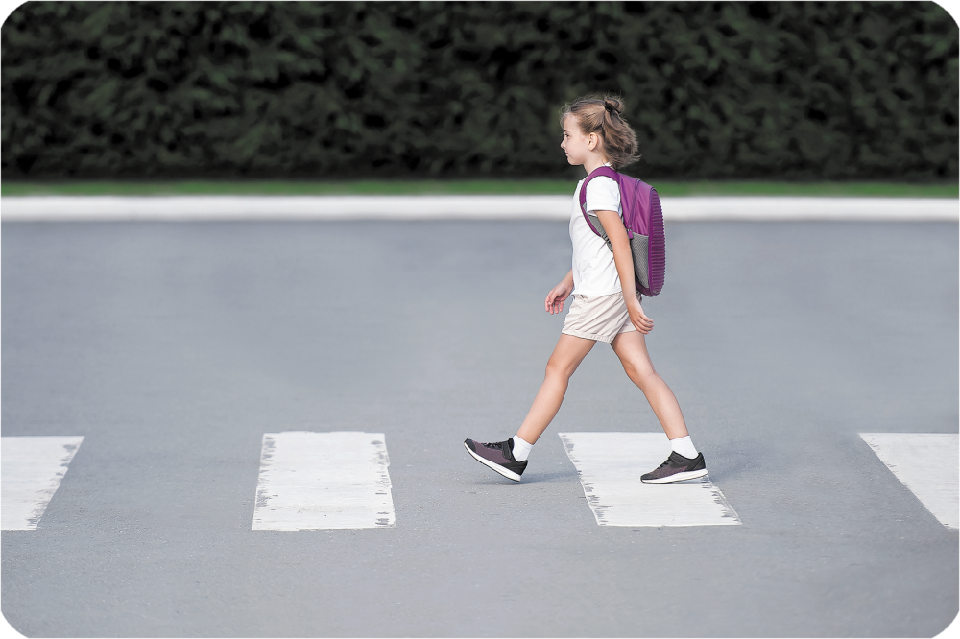
Choose the correct answer.
A. painting
B. walking
C. playing badminton
NEXT

Slide 25

Choose the correct answer.
A. un
r__ning
B. an
C. in
NEXT

Slide 26
Choose the correct answer.
A. at
playing b__minton
B. an
C. ad
NEXT

Slide 27
Choose the correct answer.
A. j
_alking
B. w
C. p
NEXT

Slide 28
Choose the correct answer.
A. ain
p___ting
B. oin
C. ean
NEXT

Slide 29
Choose the correct answer.
Look! Nam is_____.
A. painting
B. walking
C. running
Yes, he is.
NEXT

Slide 30
Choose the correct answer.
Look! Linh is________.
A. running
B. painting
C. walking
Yes, she is.
NEXT

Slide 31
Well done!

Slide 32
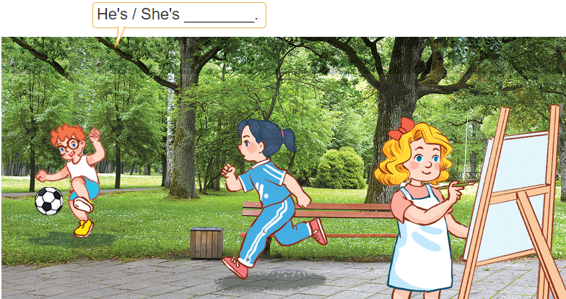
3. Let’s talk.
He’s / She __________.

Slide 33

Wrap up

Slide 34
Review
playing badminton
running
painting
walking

Slide 35
Structures
Cách nói cậu ấy / cô ấy đang làm gì.
He’s / She’s _____________.
He’s running.
Yes, he is.

Slide 36

Thank you!

