Slide 1


Slide 2
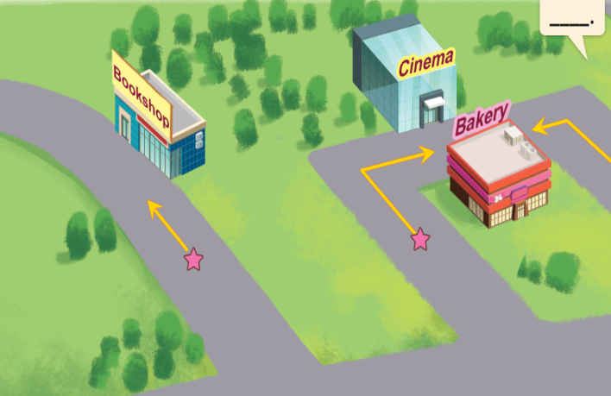
Unit 17
In the city
Lesson 2 (4+5+6)

Slide 3

Warm-up

Slide 4
Let’s play!

Slide 5






- Nhấn vào “spin” để quay, nhấn vào mũi tên đỏ để dừng. Sau đó chọn câu hỏi.
Lucky wheel
30
20
1
2
3
40
10
50
80
4
5
6
60
70
7
8
9
Spin

Slide 6
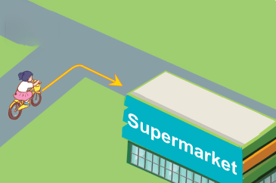






A: How can I get to the supermarket?
B: _______________
A. Turn right.
B. Turn left.
C. Turn round.
D. Go straight.
BACK

Slide 7
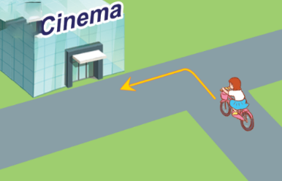



A: How can I get to the cinema?
B: _______________
A. Turn right.
B. Turn left.
C. Go straight.
D. Turn round.
BACK

Slide 8
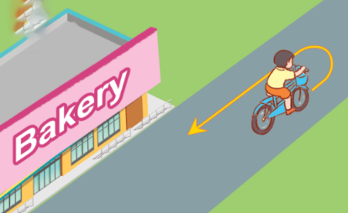


A: How can I get to the bakery?
B: _______________
A. Turn round.
B. Turn right.
C. Turn left.
D. Go straight.
BACK

Slide 9

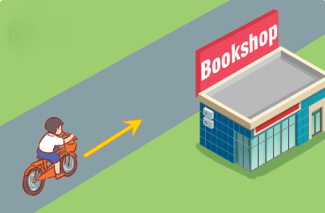


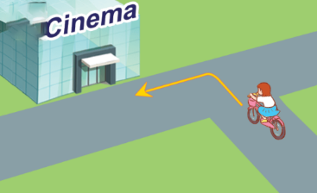


A.
B.
C.
D.
BACK

Slide 10


A.
B.
C.
D.
BACK

Slide 11


_____ can I get to the bookshop?
A. What
B. Why
C. How
D. Where
BACK

Slide 12
Chose the odd one out.
A. right
B. turn round
C. straight
D. left
BACK

Slide 13


→ Turn left.
A. True
B. False
BACK

Slide 14


A. True
B. False
QUAY VỀ

Slide 15
Well done!

Slide 16



Contents
Listen and tick.
Look, complete and read.
Let’s play.

Slide 17


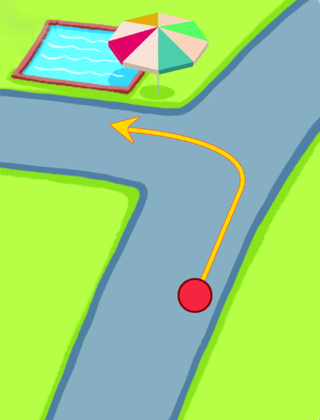
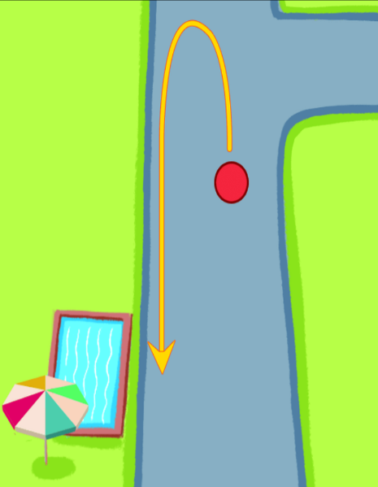
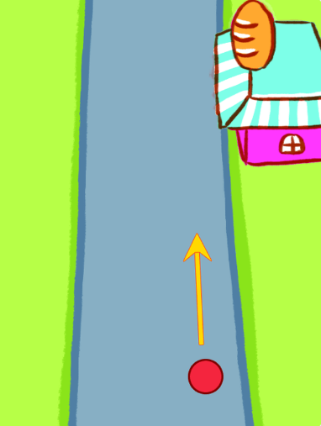
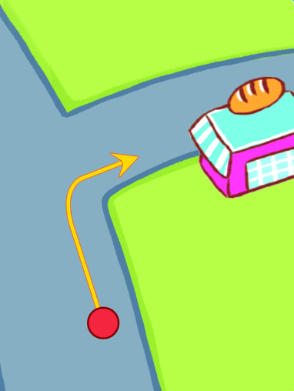

4. Listen and tick.
1.
2.
a
b
a
b
Click on the speaker to listen.

Slide 18
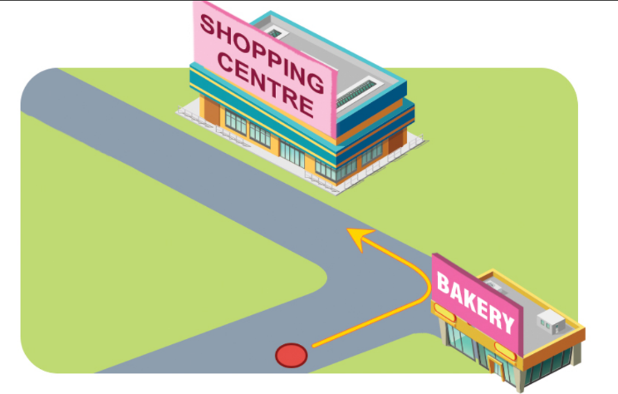
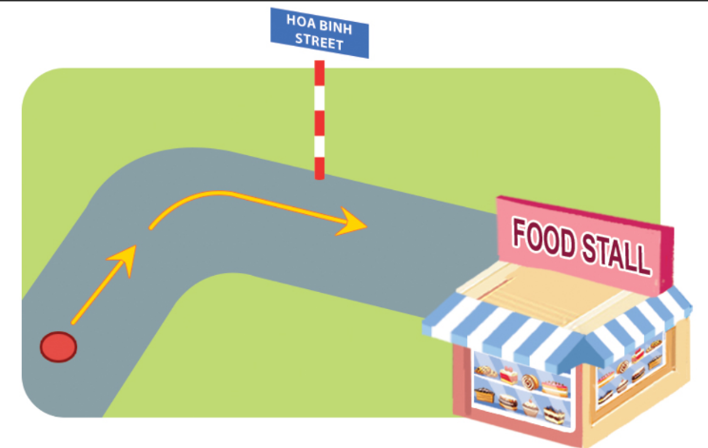
5. Look, complete and read.
1.
A: Excuse me. How can I get to the
shopping centre?
B: The sports centre or the shopping centre?
A: _______________.
B: Turn _______ at the bakery.
A: Thank you very much.
Shopping centre
left
2.
A: Excuse me. Is there a food stall near
here?
B: There’s a food stall on Hoa Binh Street.
A: _______ can I get there?
B: Go straight and turn _______.
A: Thank you very much for your help.
How
right

Slide 19
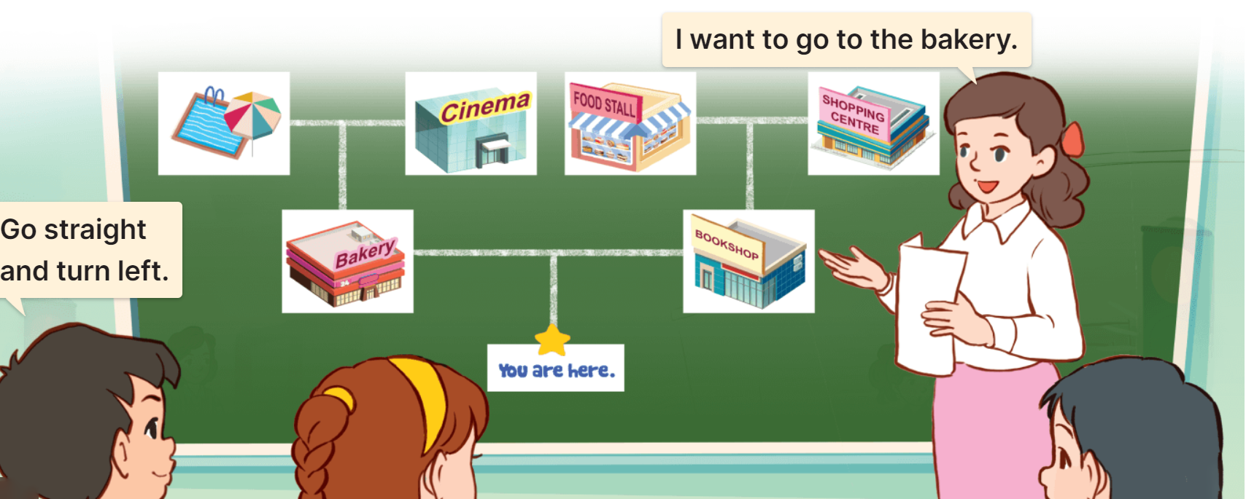
6. Let’s play.
Show me the way

Slide 20
Wrap up

Slide 21


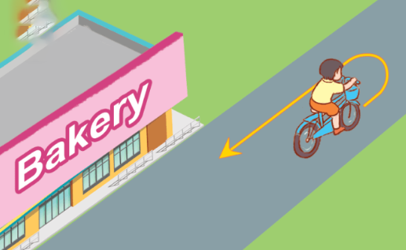

Review
How can I get to the _______?
__________.
go straight
turn round
turn right
turn left

Slide 22
Homework
……………………………………..
……………………………………..

Slide 23

Thank you!

