Slide 1


Slide 2
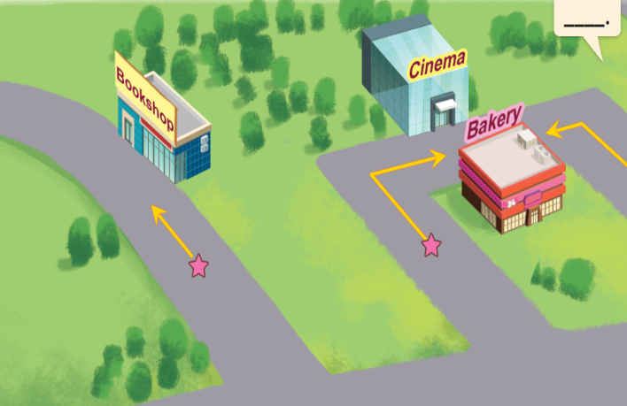
Unit 17
In the city
Lesson 3 (4+5+6)

Slide 3
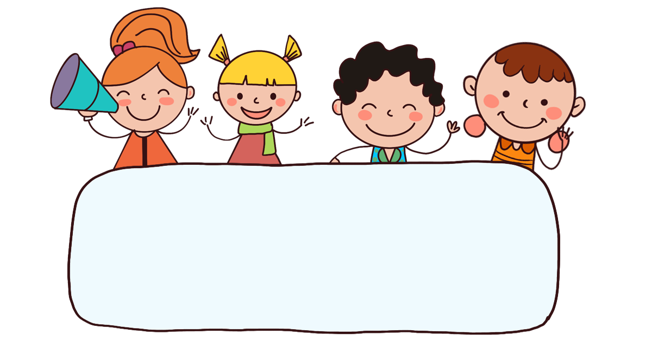
Warm-up

Slide 4









Let’s play

Slide 5









MsPham-0936082789
MsPham-0936082789
MsPham-0936082789
MsPham-0936082789

Slide 6
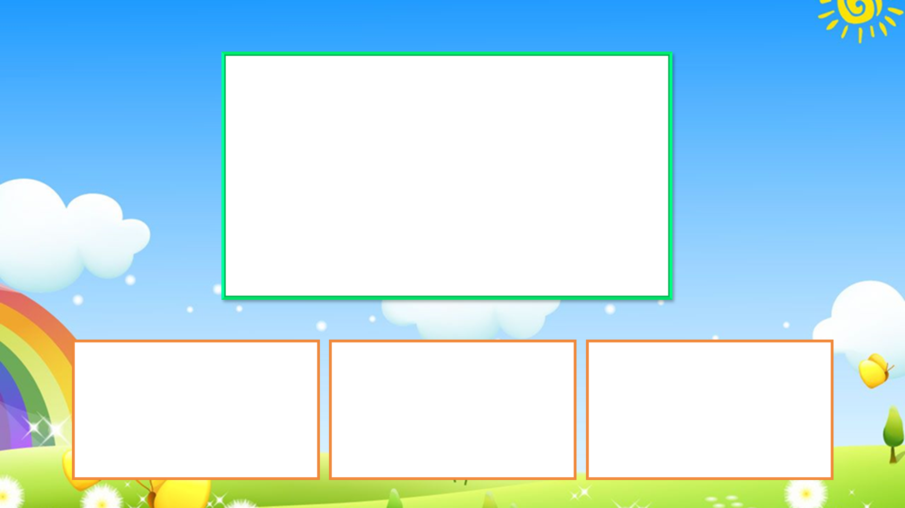





2
turn _____
A. left
B. right
C. round

Slide 7

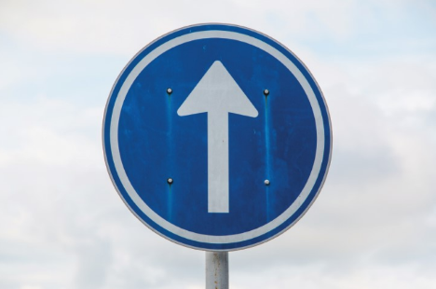
go ______
A. left
B. straight
C. right

Slide 8
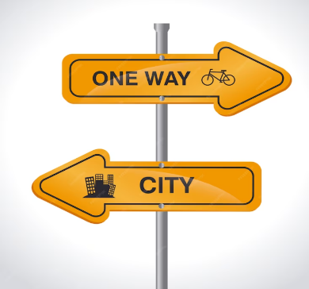
2
A. road sign
B. straight
C. right

Slide 9
A: _____ does it say?
B: It says stop.
A. What
B. When
C. Where

Slide 10
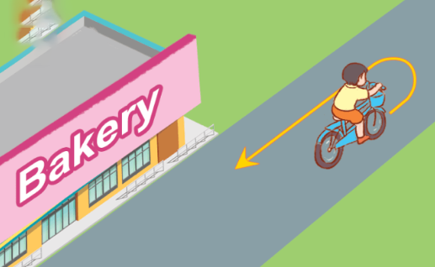
2
turn _____
A. round
B. right
C. straight

Slide 11

A: How can I _____ the
water park?
B: Go straight.
A. get to
B. go straight
C. turn round

Slide 12

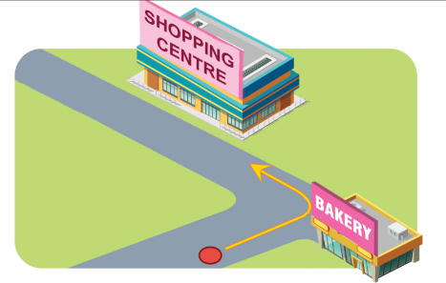
A: How can I get to the shopping centre?
B: _______________.
A. Go straight at the bookshop.
B. Turn round at the bakery.
C. Turn left at the bakery.

Slide 13

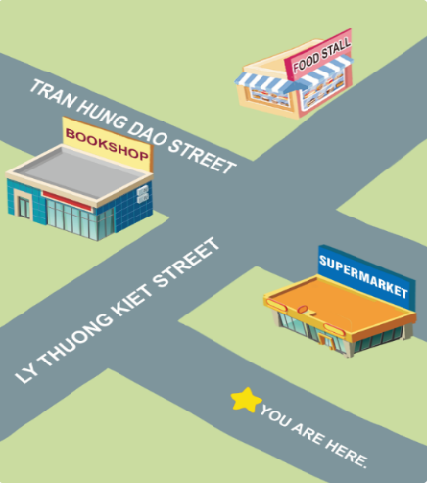
A: How can I get to the food stall?
B: __________.
A. Turn right and go straight.
B. Go straight and turn left.
C. Go straight and turn right.

Slide 14

A: What does it say?
B: It says stop.
A. True
B. False

Slide 15
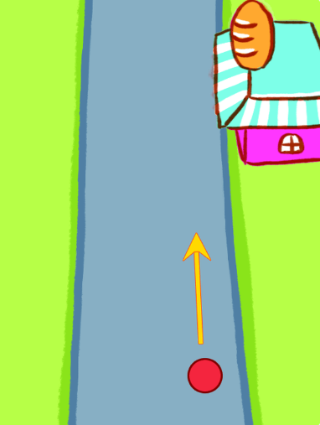

A. True
B. False

Slide 16

Well done!

Slide 17



Contents
Read and tick True or False.
Let’s write.
Project.

Slide 18

4. Read and tick True or False.
1
Mai wants to buy some bread. The bakery is in Nguyen Hue Street. How can she get there? She can go straight and turn right. The bakery is on the right.
Bill wants to buy some books. The bookshop is in Green Street. How can he get there? He can go straight and turn left. The bookshop is on the left.
2
3
4
True | False
1. The bakery is in Nguyen Hue Street.
2. Mai can go straight and turn left to get to the bakery.
3. Bill wants to go to the library.
4. Bill can go straight and turn left to get to the bookshop.

Slide 19

5. Let’s write.
- What do you want to buy at the bookshop?
- Where is it?
- How can you get there?
How can I get there?
Today is Sunday. I want to buy _____________________________________________________________________________________________________________________________.
some books and a pen.
The bookshop is on Tran Hung Dao Street.
I can go straight and
and turn right. Then, I turn left. The bookshop is on the left.

Slide 20
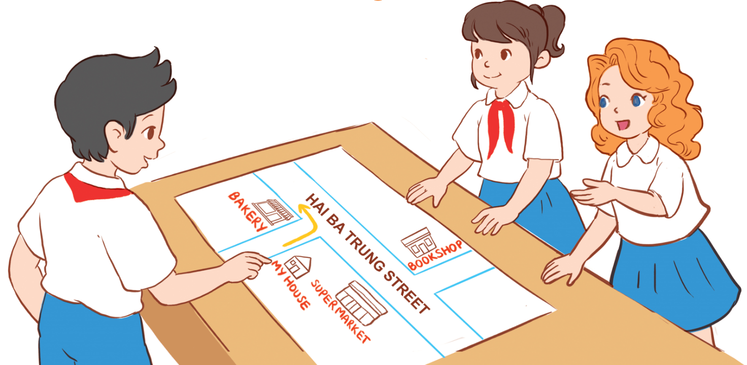
6. Project
How can I get to _________?

Slide 21
Wrap up

Slide 22






Review
Unit 17 Lesson 1
What does it say?
It says ‘_______’.
stop
turn left
go straight
turn right

Slide 23
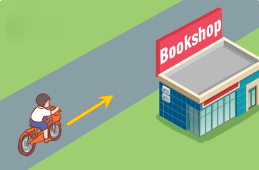
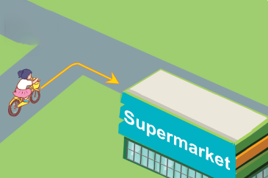
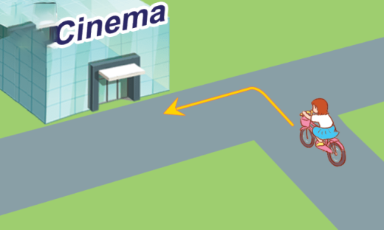
Review
Unit 17 Lesson 2
How can I get to the _______?
__________.
go straight
turn round
turn right
turn left

Slide 24
Homework
……………………………………...
……………………………………....

Slide 25

Thank you!

