Slide 1
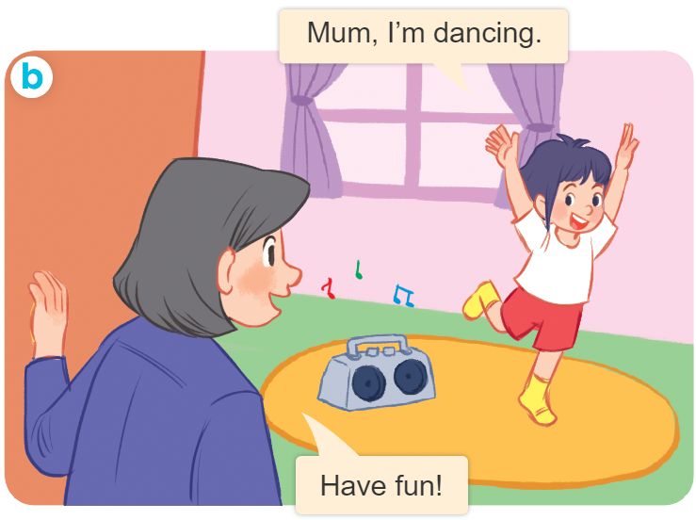
Tuesday April 9th , 2024
Playing and doing
Unit
18
Lesson 1

Slide 2

Warm-up

Slide 3


Let’s chant.
Kite, kite, kite.
Bike, bike, bike.
Toys, toys, toys.
Ben has a kite.
Mary has a bike.
Ben and Mary have toys.
He has a kite.
She has a bike.
They have toys.

Slide 4



Contents
Look, listen and repeat.
Listen, point and say.
Let’s talk.

Slide 5
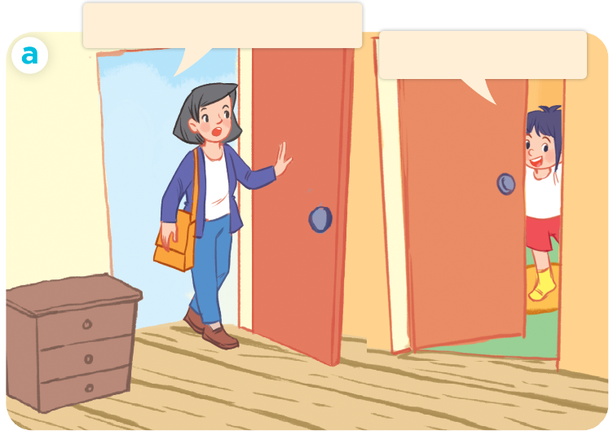
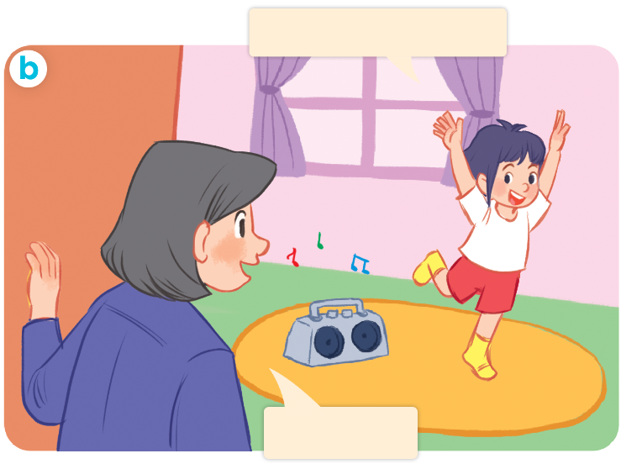
1. Look, listen and repeat.
Where are you, Linh?
Mum, I’m dancing.
I’m in my room.
Have fun!
Who are they?
Where are they?
What are they doing?

Slide 6
Vocabulary

Slide 7

writing
/ˈraɪ.tɪŋ/
viết

Slide 8
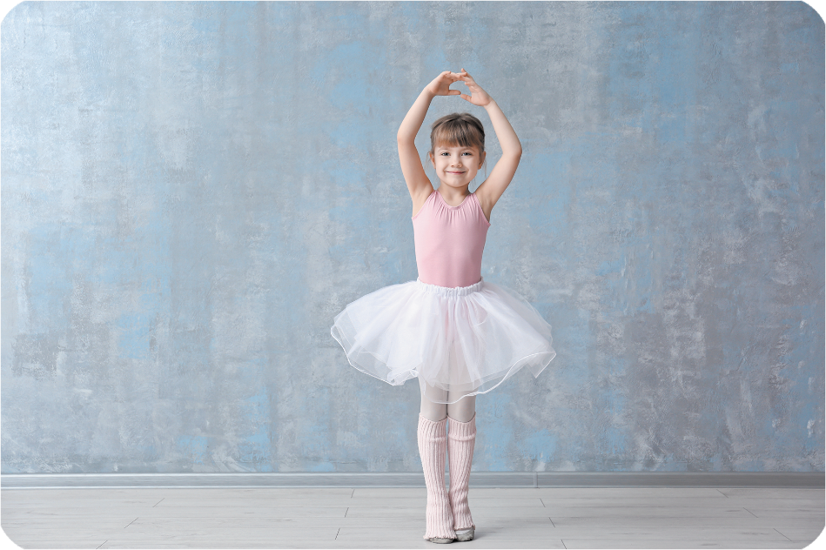
dancing
/dɑːnsɪŋ/
nhảy, múa

Slide 9
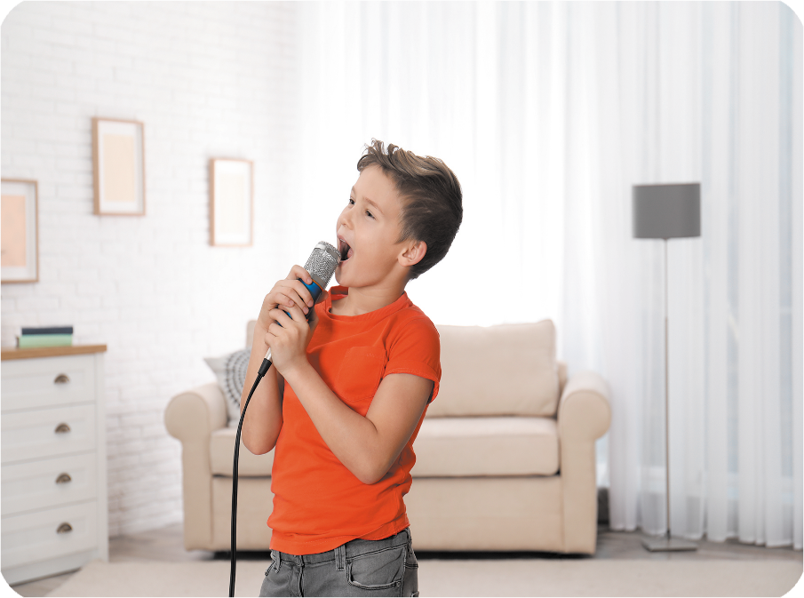
singing
/ˈsɪŋ.ɪŋ/
hát

Slide 10

reading
/ˈriː.dɪŋ/
đọc

Slide 11




Review
writing
dancing
singing
reading

Slide 12
1/ New words:
write
viết
dance
nhảy, múa
sing
hát
read
đọc
Write + ing = writing: đang viết

Slide 13
Structures

Slide 14
2/Model sentences
Cách nói mình đang làm gì.
I’m singing. ( tôi đang hát)
I’m = I am

Slide 15

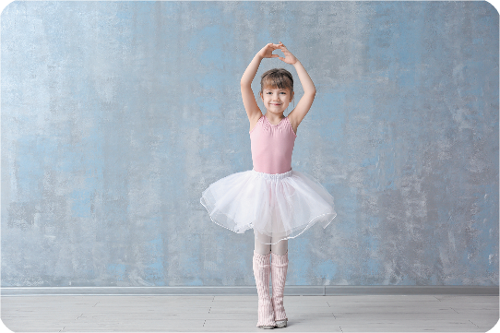
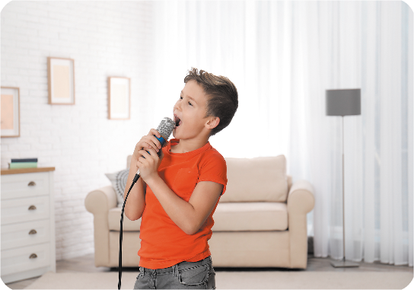

2. Listen, point and say.
a
b
I’m ____________.
writing
dancing
c
d
singing
reading

Slide 16
writing
I’m ____________.
writing

Slide 17
dancing
I’m ____________.
dancing

Slide 18
singing
I’m ____________.
singing

Slide 19
reading
I’m ____________.
reading

Slide 20

3. Let’s talk
I’m ______.

Slide 21

Facebook : Bùi Liễu
0968142780
Let’s play!

Slide 22


















Picking
apples
Notes:
Facebook : Bùi Liễu
Mobile phone: 0968142780

Slide 23
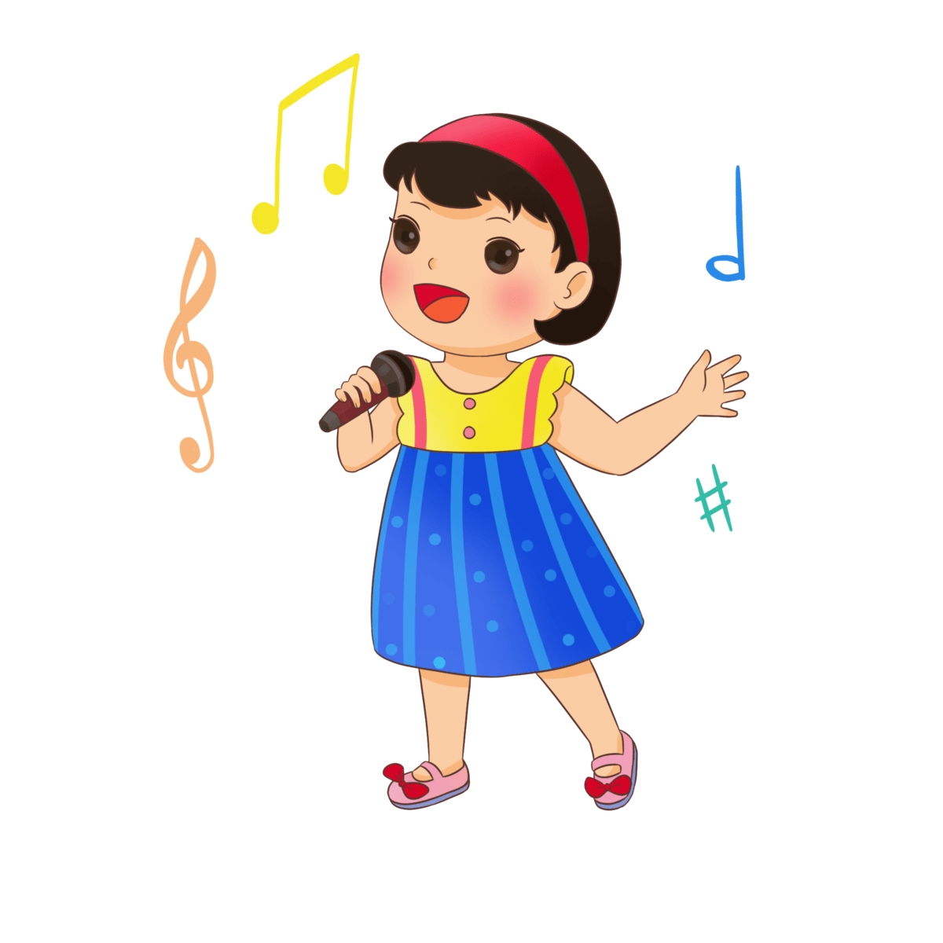

drawing
A
Facebook : Bùi Liễu
Mobile phone: 0968142780
singing
B
dancing
C
Notes:
Facebook : Bùi Liễu
Mobile phone: 0968142780

Slide 24

dancing
A
drawing
B
singing
C
Notes:
Facebook : Bùi Liễu
Mobile phone: 0968142780

Slide 25

dancing
A
Facebook : Bùi Liễu
Mobile phone: 0968142780
singing
B
reading
C
Notes:
Facebook : Bùi Liễu
Mobile phone: 0968142780

Slide 26

writing
A
singing
B
dancing
C
Notes:
Facebook : Bùi Liễu
Mobile phone: 0968142780

Slide 27


A
Facebook : Bùi Liễu
Mobile phone: 0968142780
B
Notes:
Facebook : Bùi Liễu
Mobile phone: 0968142780

Slide 28

A
Facebook : Bùi Liễu
Mobile phone: 0968142780
B
Notes:
Facebook : Bùi Liễu
Mobile phone: 0968142780

Slide 29

I __ dancing.
am
A
is
B
are
C

Slide 30

ia
r _ _ding
A
Facebook : Bùi Liễu
Mobile phone: 0968142780
ea
B
ie
C
Notes:
Facebook : Bùi Liễu
Mobile phone: 0968142780

Slide 31

wri_ _ng
ti
A
ii
B
ei
C
Notes:
Facebook : Bùi Liễu
Mobile phone: 0968142780

Slide 32

Good job!

Slide 33

Wrap up

Slide 34
Review
writing
dancing
singing
reading

Slide 35
Structures
Cách nói tôi/tớ đang làm gì.
I’m _____________.
I’m = I am

Slide 36

Thank you!

