Slide 1
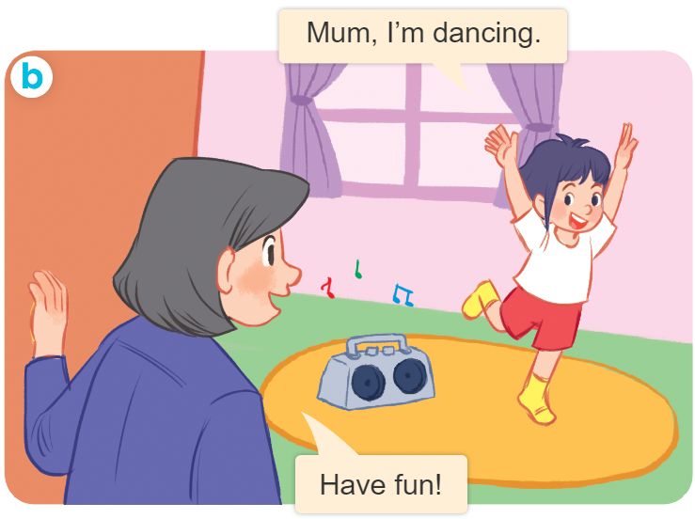
..................................
Playing and doing
Unit
18
Lesson 1 (4+5+6)
Facebook : Bùi Liễu
0968142780

Slide 2

Warm-up

Slide 3


Facebook : Bùi Liễu
0968142780
Let’s play!

Slide 4




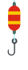

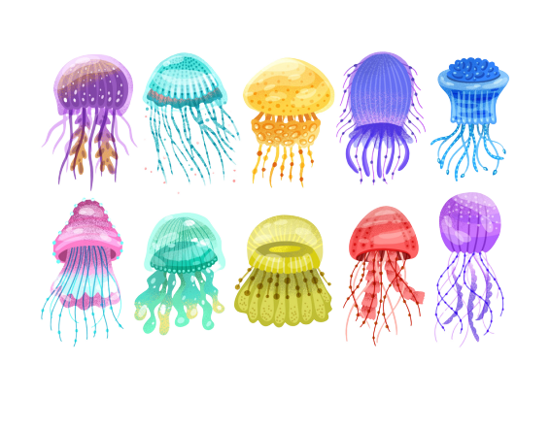




GO FISHING
Game
PLAY

Slide 5












EXIT
7
6
9
4
10
2
8
1
5
3
13
Click vào con cá có số để chuyển tới câu hỏi
12
11
14
15

Slide 6




trả lời xong thì nhấn click mũi tên để quay lại chọn con cá
A
dancing
B
reading
C
singing
D
STOVE

Slide 7

A
singing
B
reading
C
writing
D
Climb

Slide 8

A
singing
B
reading
C
dancing
D
May

Slide 9

A
reading
B
writing
C
dancing
D
Watch

Slide 10

A
din
B
den
C
dan
_ _ _cing
D
Next to

Slide 11
A
in
B
an
s_ _ ging
C
se
D
Next to

Slide 12

A
B
C
D
They likes sport.

Slide 13

A
dancing
B
singing
C
reading
I am _____.
D
She should take some warm water.

Slide 14

A
ing
B
ang
C
I am read _ _ _.
eng
D
She should take some warm water.

Slide 15

A
I am dancing.
B
I are reading.
C
I am writing.
D
They likes sport.

Slide 16
Facebook : Bùi Liễu
0968142780
Thank you!

Slide 17



Contents
Facebook : Bùi Liễu
0968142780
Listen and tick.
Look, complete and read.
Let’s play.

Slide 18





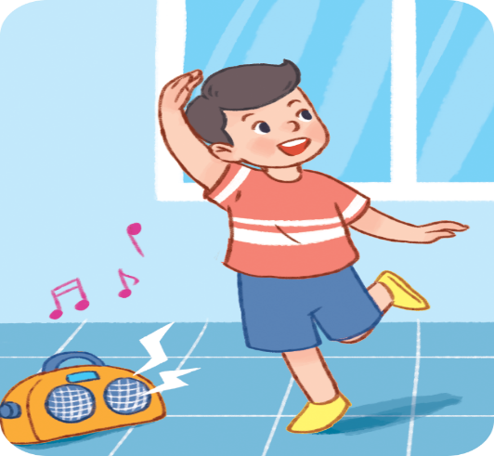
4. Listen and tick.
a
b
1
a
b
2

Slide 19
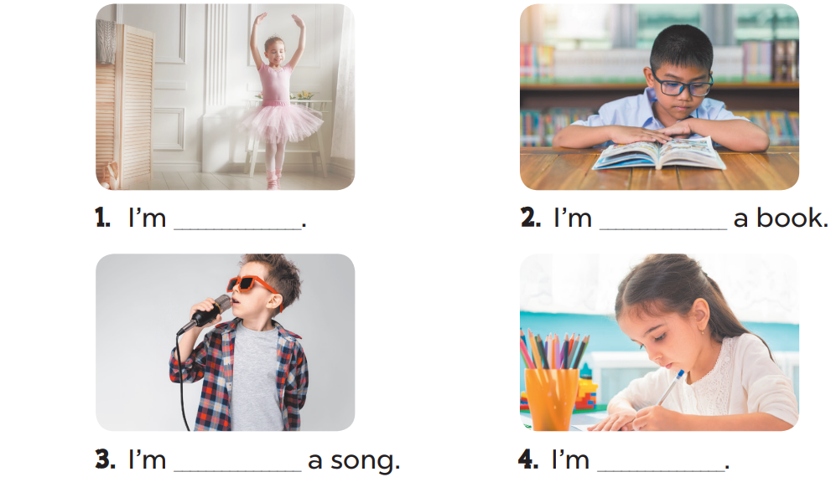
5. Look, complete and read.
dancing
reading
singing
writing

Slide 20
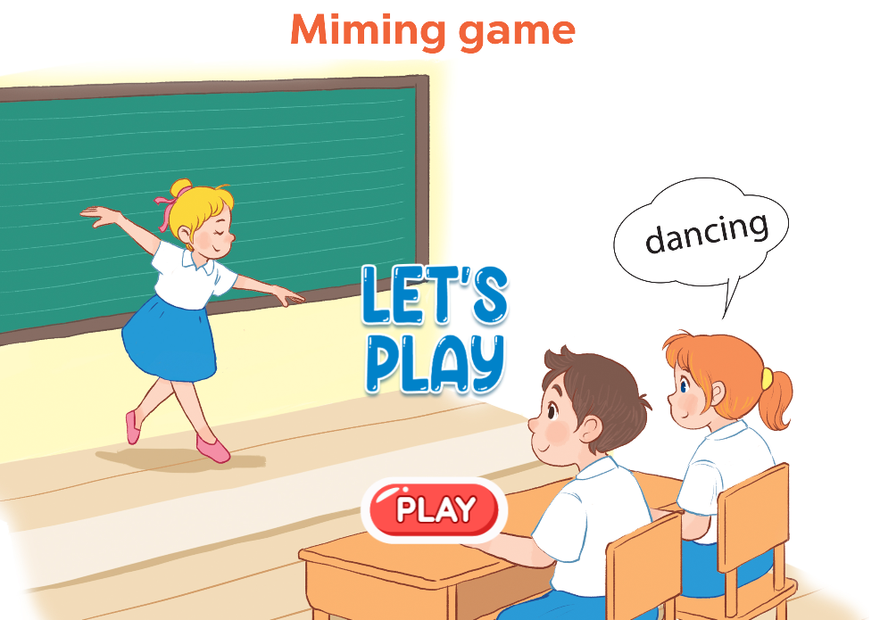
6. Let’s sing.

Slide 21

Wrap up

Slide 22

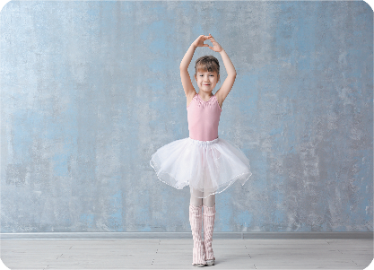


Review
writing
dancing
singing
reading

Slide 23
Structures
Cách nói tôi/tớ đang làm gì.
I’m _____________.
I’m = I am

Slide 24

Facebook : Bùi Liễu
0968142780
Thank you!

