Slide 1
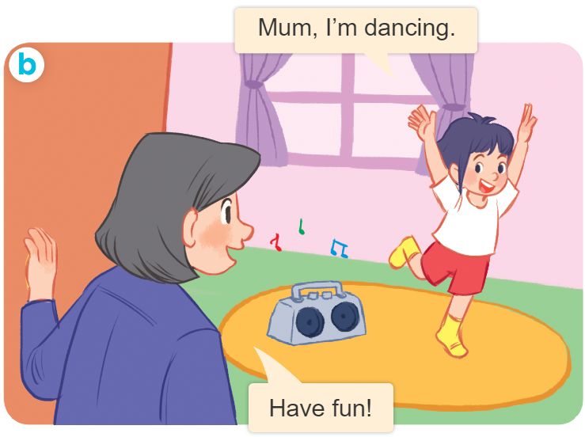
Thursday April 11th , 2024
Playing and doing
Unit
18
Lesson 2
Facebook : Bùi Liễu
0968142780

Slide 2
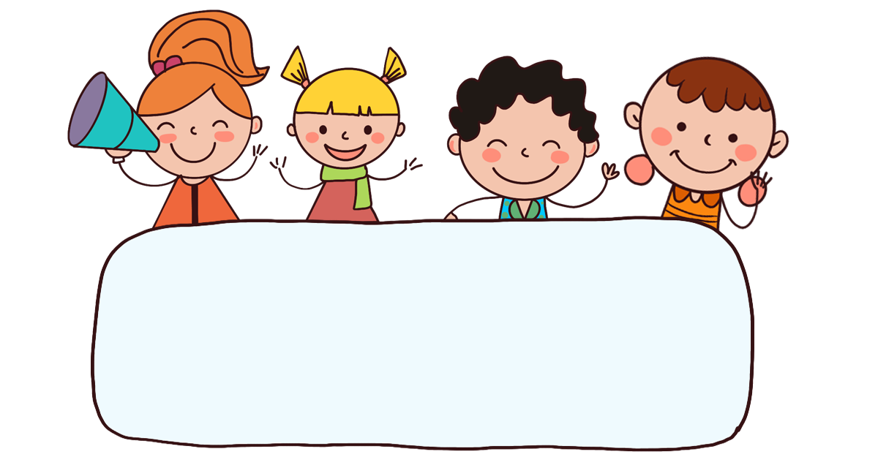
Warm-up

Slide 3

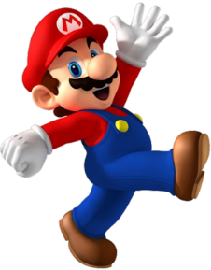
Facebook : Bùi Liễu
0968142780
PLAY

Slide 5




B. writing
A. dancing
C.reading
Facebook : Bùi Liễu
0968142780

Slide 6
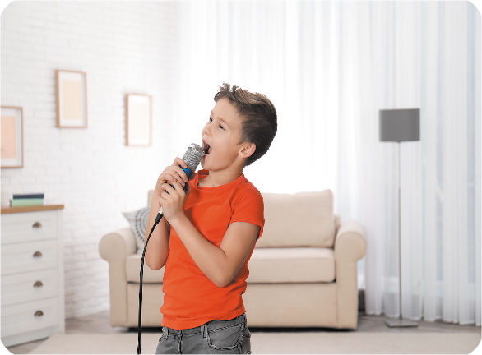
B. reading
A. singing
C.writing
Facebook : Bùi Liễu
0968142780

Slide 7

B. ee
ea
C. oa
Facebook : Bùi Liễu
0968142780
r__ding

Slide 8
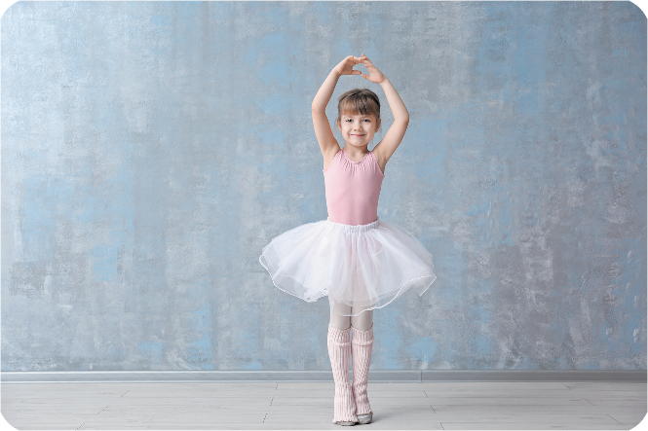
B. on
A. en
C. an
d__cing

Slide 9

B. u
C. i
A. a
Facebook : Bùi Liễu
0968142780
wr_ting

Slide 10

B. reading
A. dancing
C. singing
I’m ______
a book.

Slide 11
B. reading
A. singing
C.writing
Facebook : Bùi Liễu
0968142780
I’m _____
a song.

Slide 12
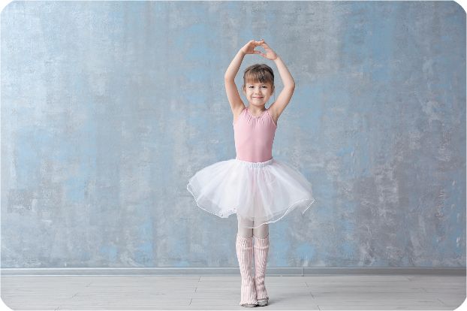
B. reading
dancing
C. writing
Facebook : Bùi Liễu
0968142780

Slide 13





Facebook : Bùi Liễu
0968142780
EXIT

Slide 14



Contents
Facebook : Bùi Liễu
0968142780
Look, listen and repeat.
Listen, point and say.
Let’s talk.

Slide 15

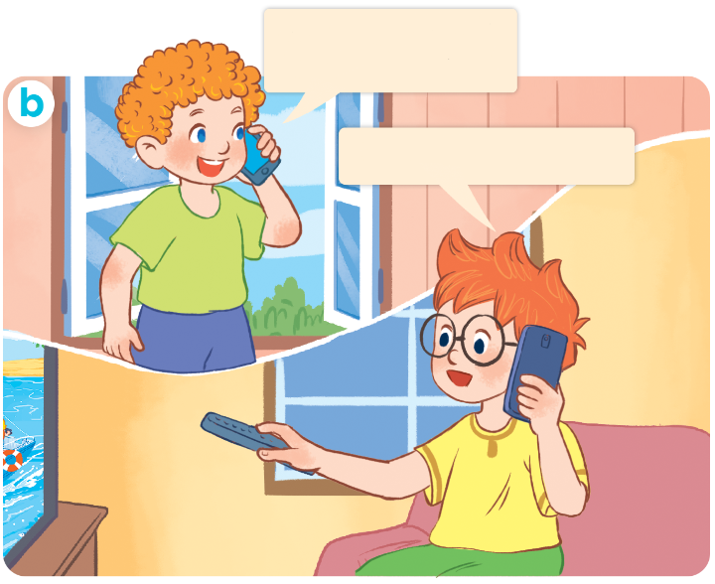
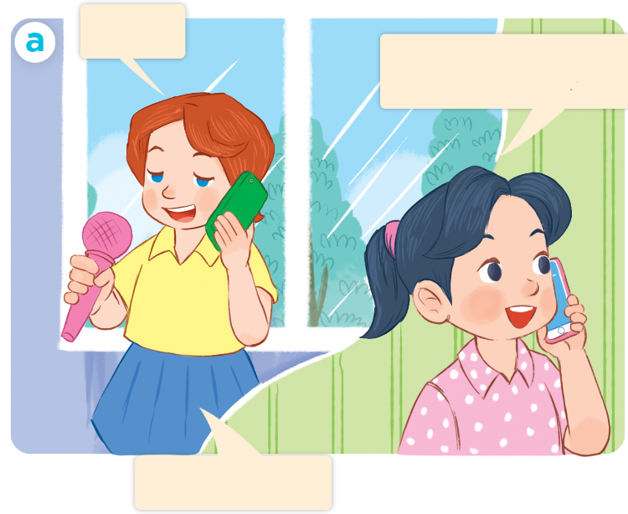
1. Look, listen and repeat.
Hi, Ben. What are
you doing?
Hello.
Hi, Lucy. What are you doing?
I’m watching TV.
I’m singing.
Who are they?
Where are they?
What are they doing?

Slide 16
Vocabulary

Slide 17
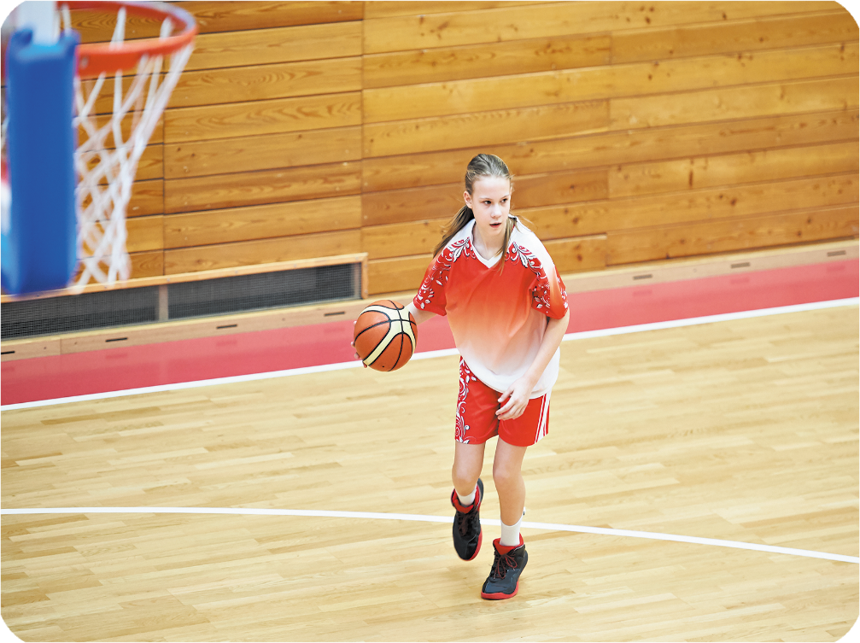

playing basketball
/ˈpleɪɪŋ ˈbɑː.skɪt.bɔːl/
chơi bóng rổ

Slide 18
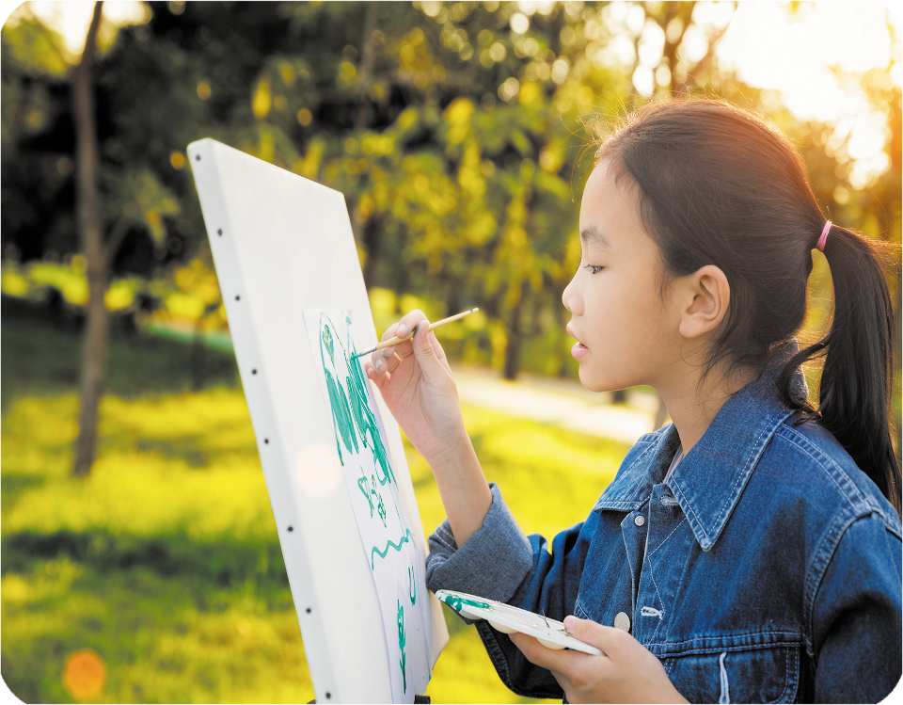
drawing a picture
/ˈdrɔː.ɪŋ əˈpɪk.tʃər/
vẽ tranh

Slide 19
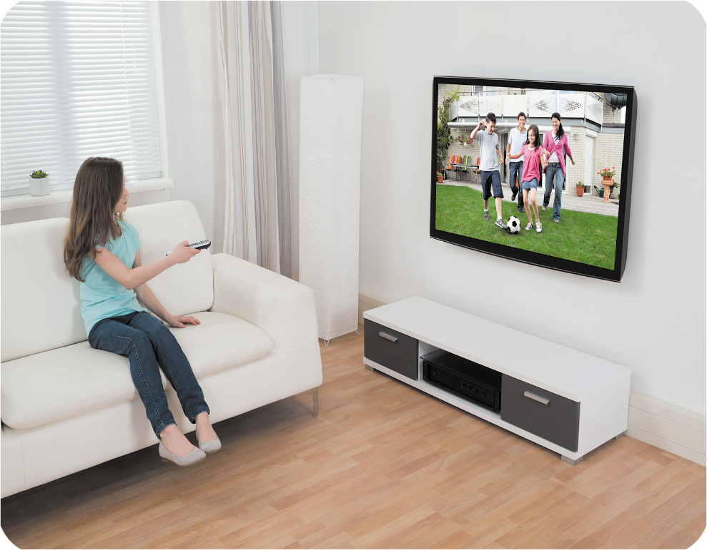
watching TV
/wɒtʃɪŋˌtiːˈviː/
xem TV

Slide 20
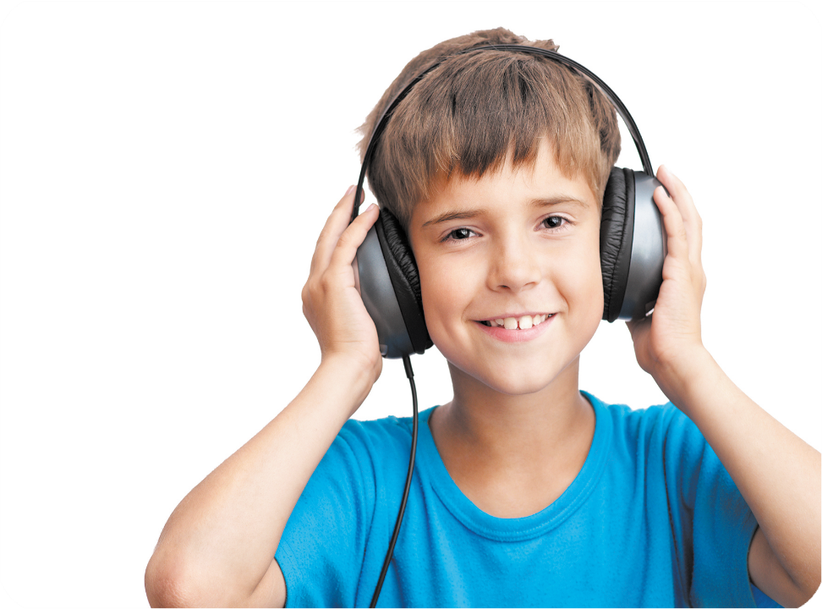
listening to music
/ˈlɪs.ənɪŋ tuːˈmjuː.zɪk/
nghe nhạc

Slide 21




Review
playing basketball
drawing a picture
watching TV
listening to music

Slide 22



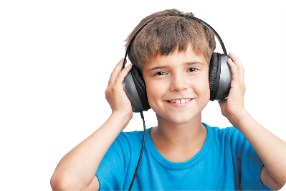
Checking vocabulary
watching TV
1
a
drawing a picture
2
b
playing basketball
3
c
listening to music
4
d

Slide 23
New words :
Watch TV: xem tivi
draw a picture: vẽ tranh
play basketball: chơi bóng rỗ
listen to music: nghe nhạc
Watch + ing = watching: đang xem

Slide 24
Structures

Slide 25
2.Model sentences
hỏi và trả lời ai đó đang làm gì .
What are you doing?
I’m playing basketball.
I’m = I am

Slide 26




2. Listen, point and say.
a
b
What are you doing?
playing basketball
drawing a picture
I’m ___________.
c
d
watching TV
listening to music

Slide 27
What are you doing?
playing basketball
I’m ___________.
playing basketball

Slide 28
What are you doing?
drawing a picture
I’m ___________.
drawing a picture

Slide 29
What are you doing?
watching TV
watching TV
I’m ___________.

Slide 30
What are you doing?
listening to music
I’m ___________.
listening to music

Slide 31
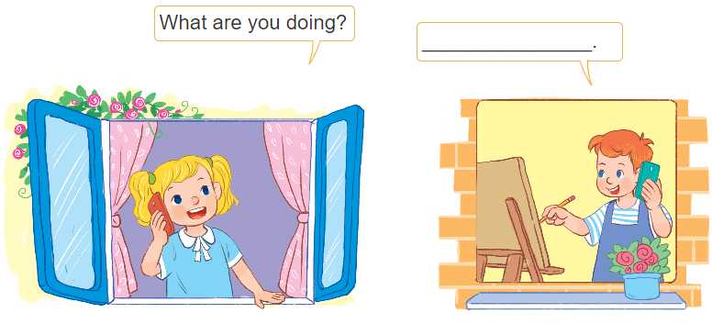
3. Let’s talk.
I’m drawing.

Slide 32
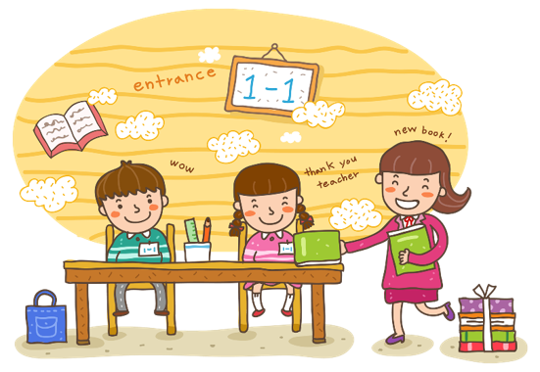
Wrap up

Slide 33
Review
playing basketball
drawing a picture
watching TV
listening to music

Slide 34
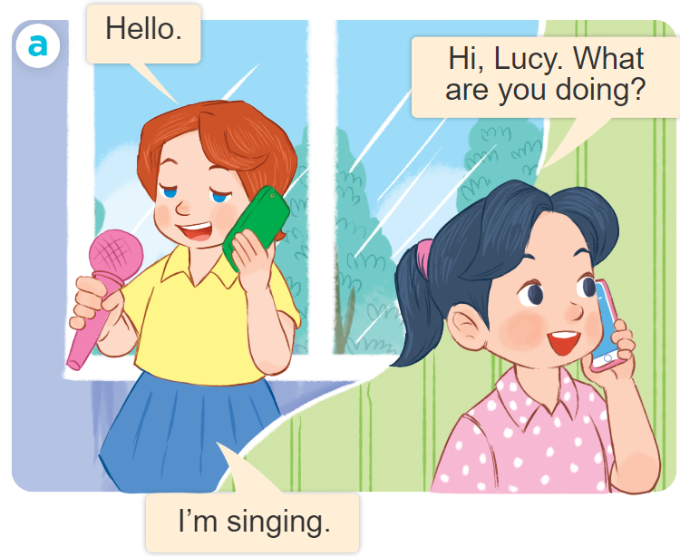
Structures
Để hỏi và trả lời cho câu hỏi: “Bạn đang làm gì vậy”.
What are you doing?
I’m ___________.
I’m = I am

Slide 35

Facebook : Bùi Liễu
0968142780
Thank you!

