Slide 1
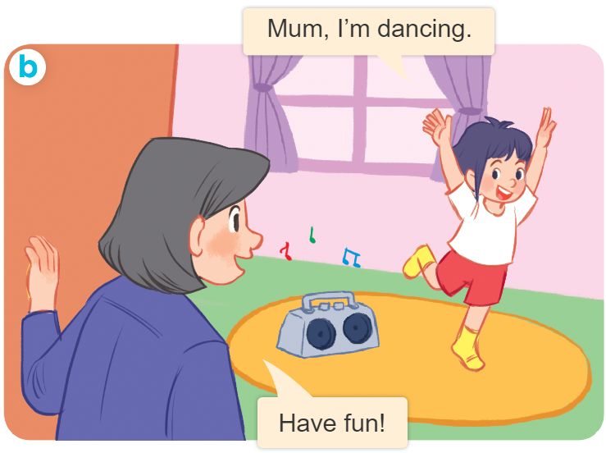
..................................
Playing and doing
Unit
18
Lesson 2 (4+5+6)
Facebook : Bùi Liễu
0968142780

Slide 2
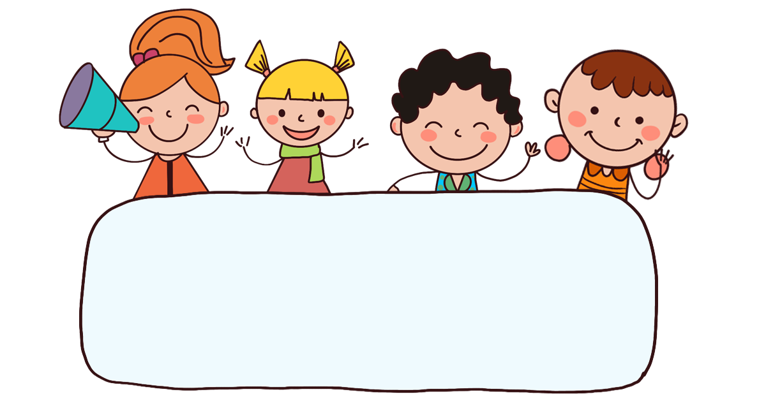
Warm-up

Slide 3

Facebook : Bùi Liễu
0968142780
Let’s play!

Slide 4












Slide 5

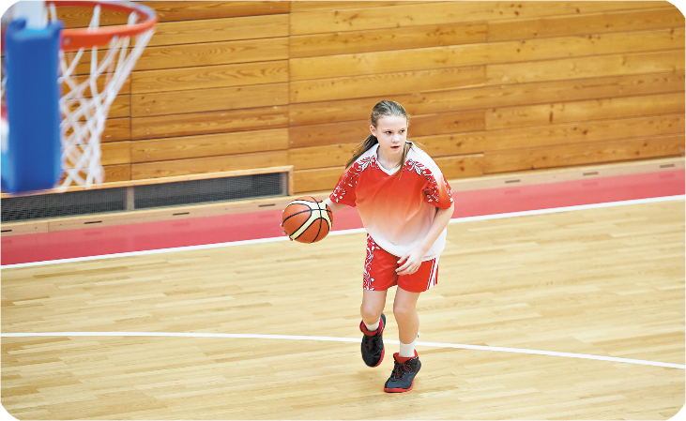





What are you doing?
I’m ____________.
Next
watching TV
playing basketball
drawing a picture
listening to music

Slide 6

Next
watching TV
playing basketball
drawing a picture
listening to music

Slide 7
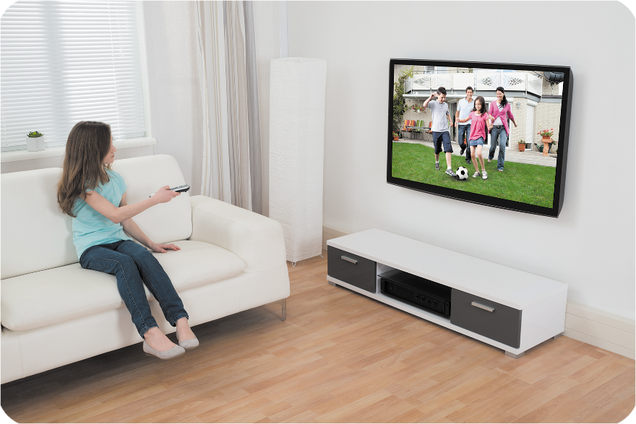
Next
watching TV
listening to music
playing basketball
drawing a picture

Slide 8
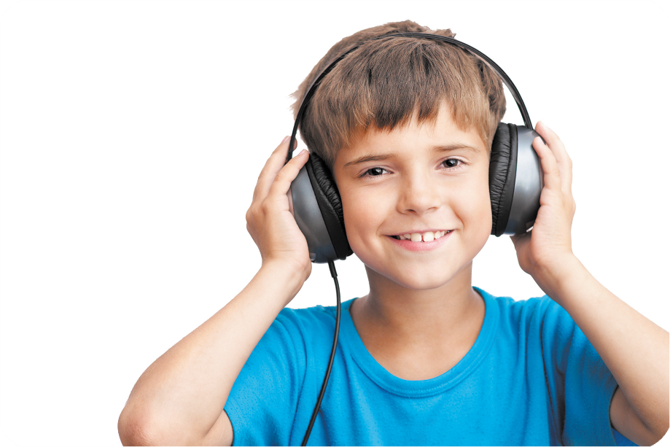
Next
listening to music
drawing a picture
playing basketball
watching TV

Slide 9


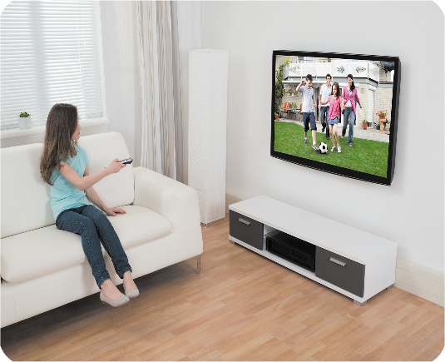
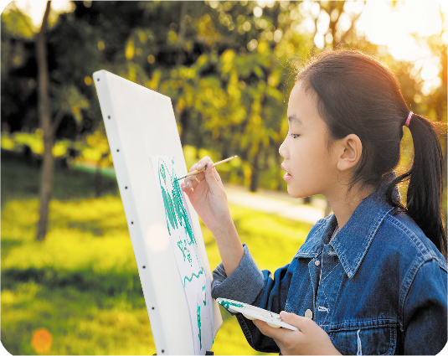

Next

Slide 10

dr__ing a picture
Next
au
ar
aw
at

Slide 11

w__ching TV
Next
as
it
er
at

Slide 12




Next

Slide 13




Next

Slide 14
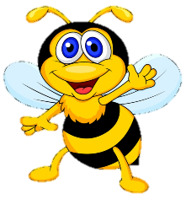








Slide 15



Contents
Facebook : Bùi Liễu
0968142780
Listen and number.
Look, complete and read.
Let’s sing.

Slide 16
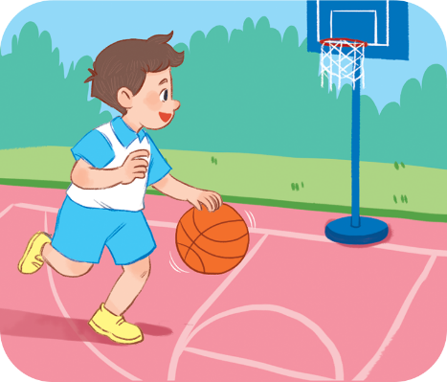
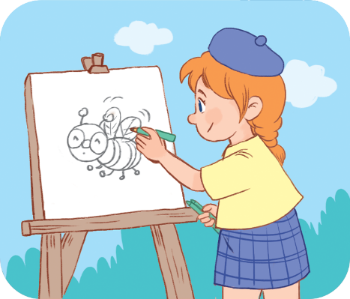
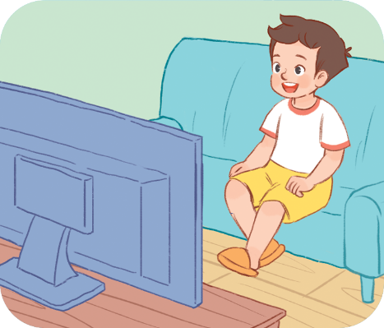
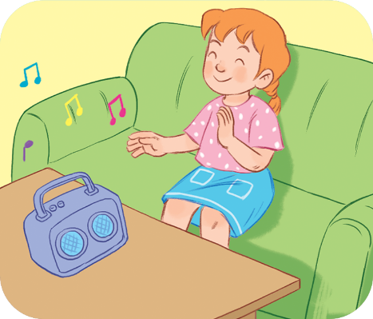





4. Listen and number.
a
b
c
d
3
2
1
4

Slide 17
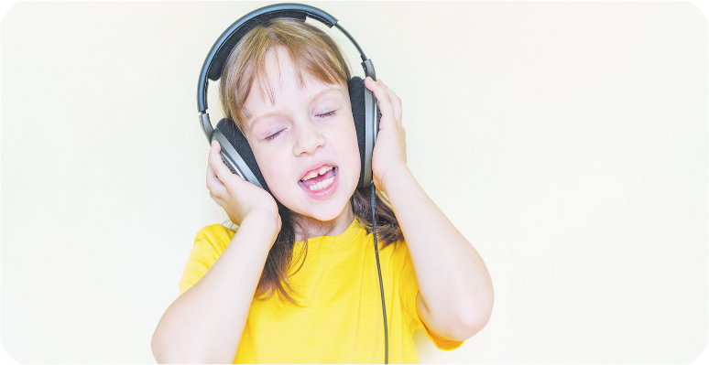
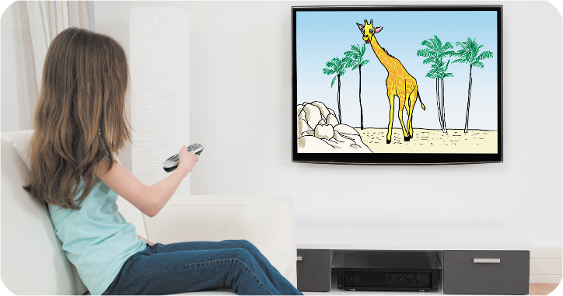
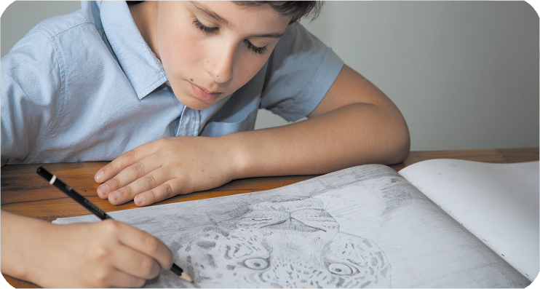
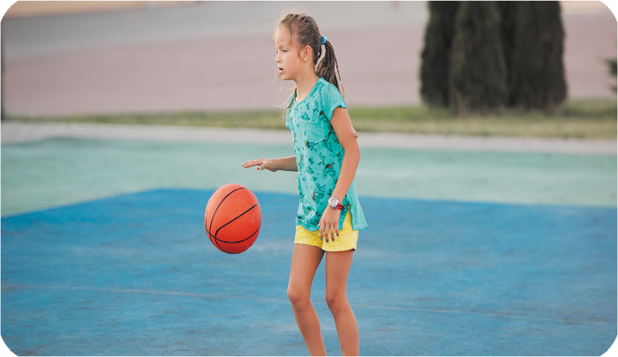
5. Look, complete and read.
A: What are you doing ?
B: I’m _______ to music.
2. A: What are you doing ?
B: I’m ________ TV.
watching
listening
doing
3. A: What are you _______ ?
B: I’m _______a picture.
are
4. A: What _____ you doing ?
B: I’m _______ basketball.
drawing
playing

Slide 18
5. Complete
are / you/ what/ doing?
singing/ a song/ I am.
have/ They/ two / ships.
a car/ she / has
cats/ How/ do/ many/ you/ have?
.

Slide 19

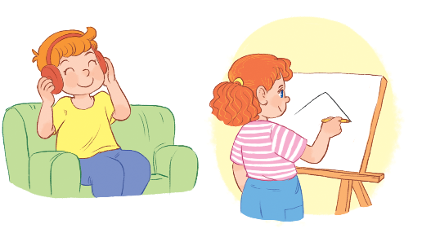
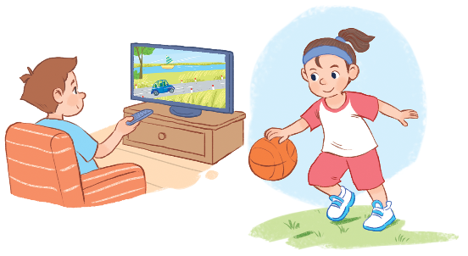
6. Let’s sing.
What are you doing?
What are you doing?
I’m listening. I’m listening to music.
What are you doing?
I’m drawing. I’m drawing a picture.
What are you doing?
I’m watching. I’m watching TV.
What are you doing?
I’m playing. I’m playing basketball.

Slide 20

6. Let’s sing.
What are you doing?
What are you doing?
I’m listening. I’m listening to music.
What are you doing?
I’m drawing. I’m drawing a picture.
What are you doing?
I’m watching. I’m watching TV.
What are you doing?
I’m playing. I’m playing basketball.

Slide 21

Wrap up

Slide 22





Review
playing basketball
drawing a picture
watching TV
listening to music

Slide 23
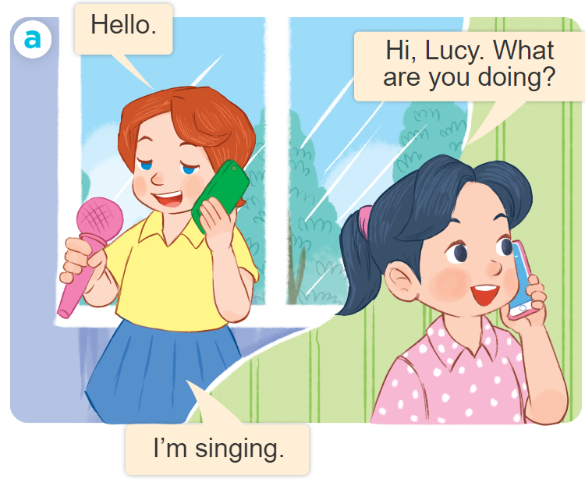
Structures
Để hỏi và trả lời cho câu hỏi: “Bạn đang làm gì vậy”.
What are you doing?
I’m ___________.
I’m = I am

Slide 24

Facebook : Bùi Liễu
0968142780
Thank you!

