Slide 1
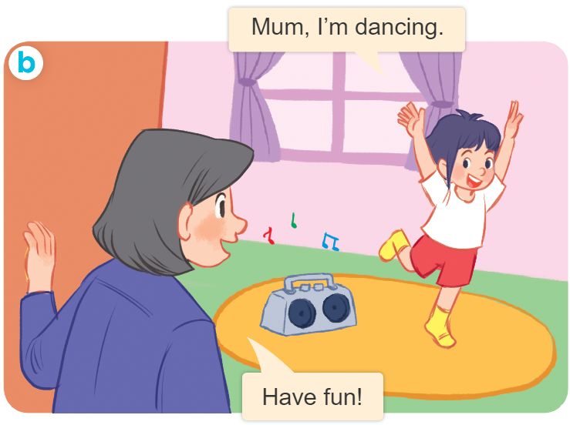
Tuesday April 16th, 2024
Playing and doing
Unit
18
Lesson 3
Facebook : Bùi Liễu
0968142780

Slide 2
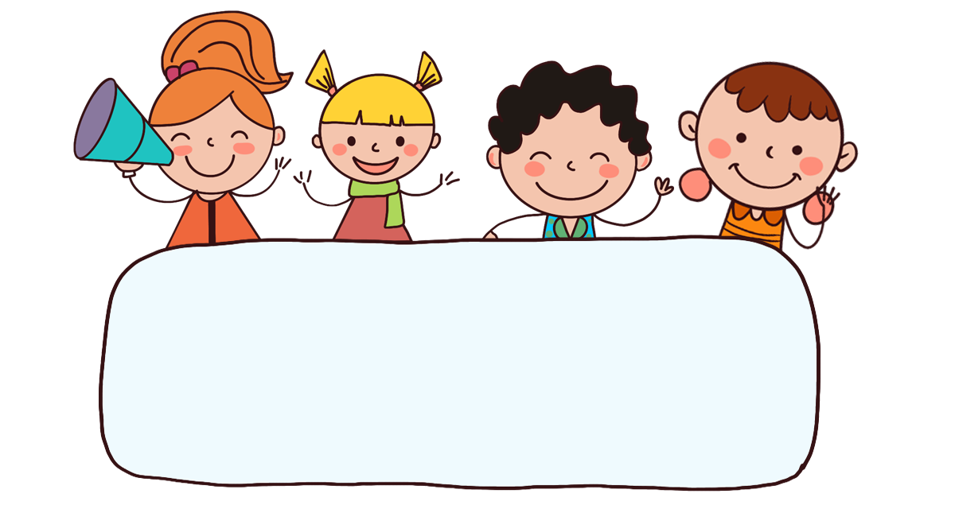
Warm-up

Slide 3
Let’s play!

Slide 4







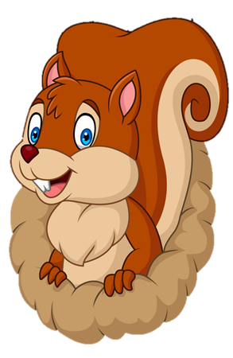
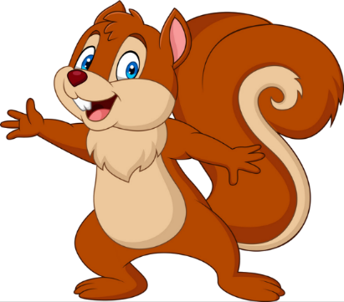
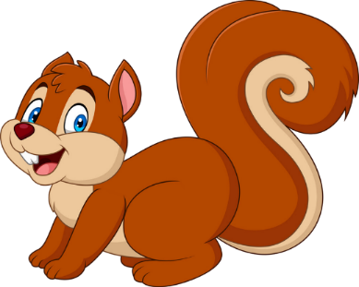

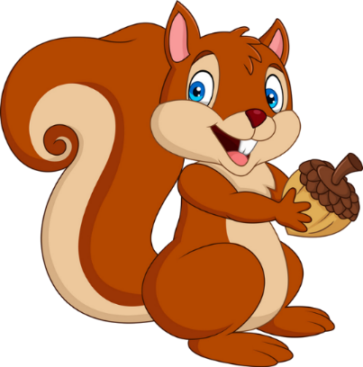
Notes:
Facebook : Bùi Liễu
Mobile phone: 0968142780

Slide 5

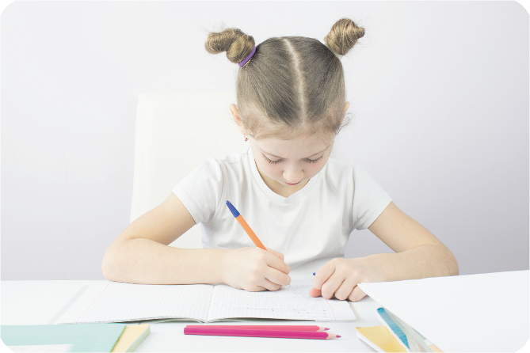


A. writing
B. reading
Notes:
Facebook : Bùi Liễu
Mobile phone: 0968142780

Slide 6
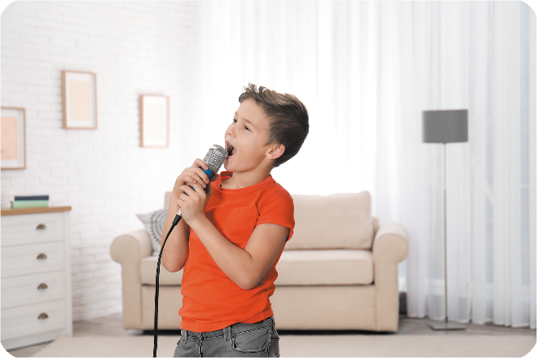
A. reading
B. singing
Notes:
Facebook : Bùi Liễu
Mobile phone: 0968142780

Slide 7
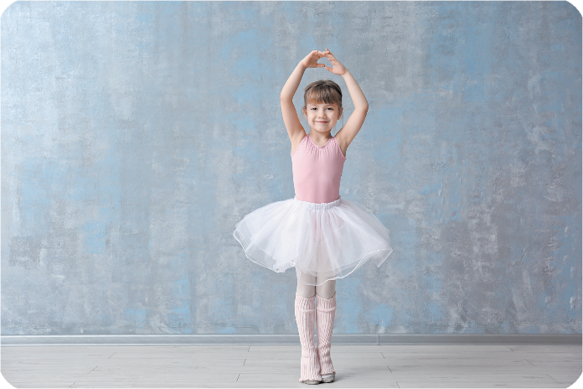
A. dancing
B. writing
Notes:
Facebook : Bùi Liễu
Mobile phone: 0968142780

Slide 8

A. reading
B. singing
Notes:
Facebook : Bùi Liễu
Mobile phone: 0968142780

Slide 9

What are you doing?
I’m ________.
A. listening to music
B. drawing a picture
C. watching TV
Notes:
Facebook : Bùi Liễu
Mobile phone: 0968142780

Slide 10
s__ging
A. an
B. ou
C. in
Notes:
Facebook : Bùi Liễu
Mobile phone: 0968142780

Slide 11
d___ing
A. anc
B. unc
C. uni
Notes:
Facebook : Bùi Liễu
Mobile phone: 0968142780

Slide 12
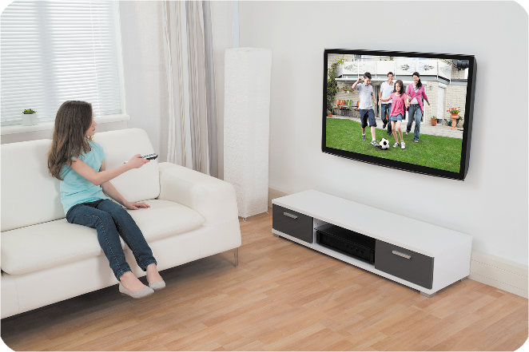
A. dancing
B. writing
C. Watching TV
Notes:
Facebook : Bùi Liễu
Mobile phone: 0968142780

Slide 13
What are you doing?
I’m ________.
A. reading book
B. listenning to music
Notes:
Facebook : Bùi Liễu
Mobile phone: 0968142780

Slide 14
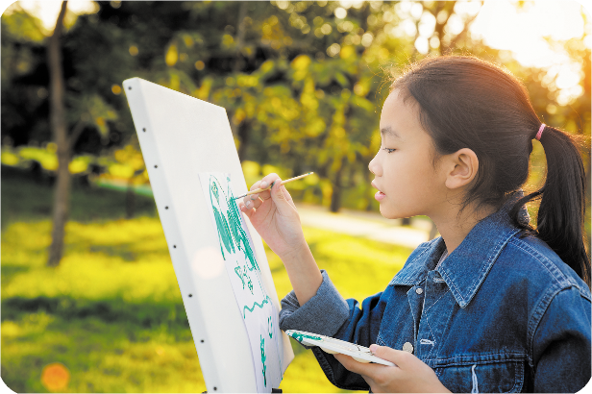
What are you doing?
A. I’m drawing a picture.
B. I’m watching TV.
Notes:
Facebook : Bùi Liễu
Mobile phone: 0968142780

Slide 15
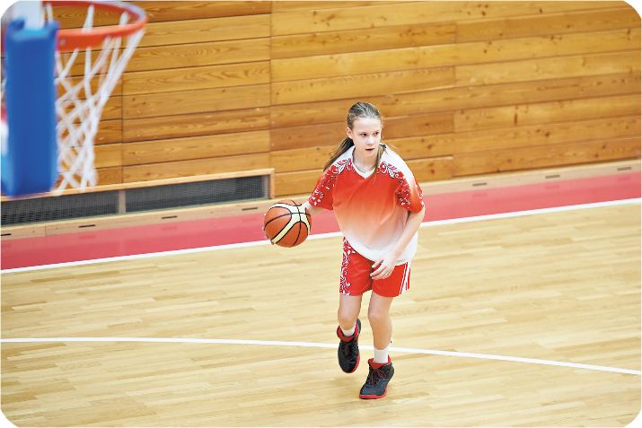
A. playing basketball
B. listening to music
Notes:
Facebook : Bùi Liễu
Mobile phone: 0968142780

Slide 16
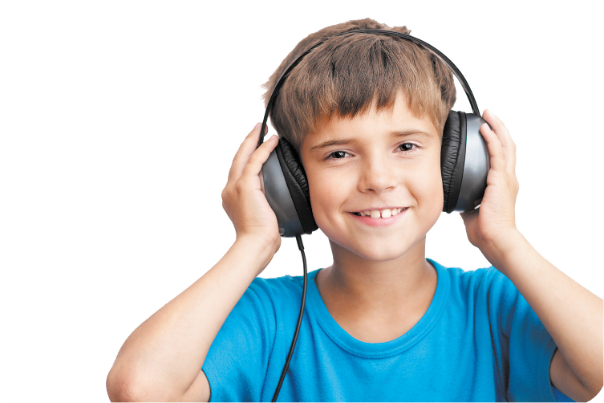
A. playing basketball
B. listening to music
Notes:
Facebook : Bùi Liễu
Mobile phone: 0968142780

Slide 17


EXIT
Notes:
Facebook : Bùi Liễu
Mobile phone: 0968142780

Slide 18



Contents
Facebook : Bùi Liễu
0968142780
Look, listen and repeat.
Listen and circle.
Let’s chant.

Slide 19
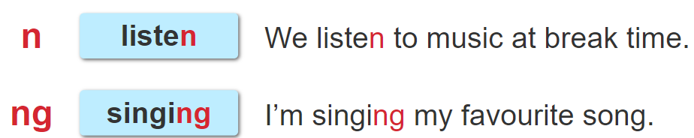
1. Look, listen and repeat.

Slide 20
2. Listen and tick.
1. I __________ at break time.
a. listen to music b. sing a song
2. I’m __________ a song.
a. singing b. listening to

Slide 21

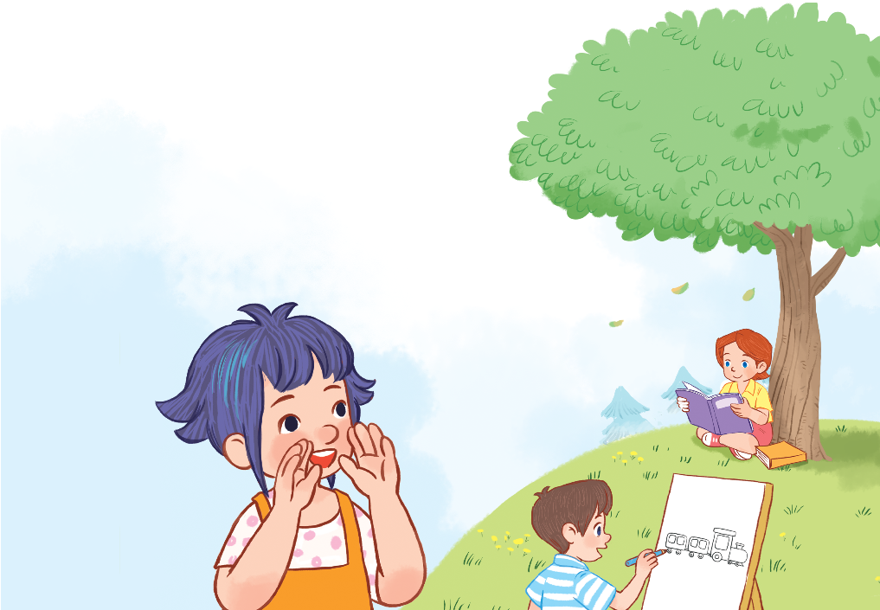
Facebook : Bùi Liễu
0968142780
3. Let’s chant.
Listen, everyone!
Stand up!
Count to ten,
No! No! No!
And sing with me.
I’m reading a book.
No! No! No!
I’m drawing a train.

Slide 22

Facebook : Bùi Liễu
0968142780
3. Let’s chant.
Listen, everyone!
Stand up!
Count to ten,
No! No! No!
And sing with me.
I’m reading a book.
No! No! No!
I’m drawing a train.

Slide 23
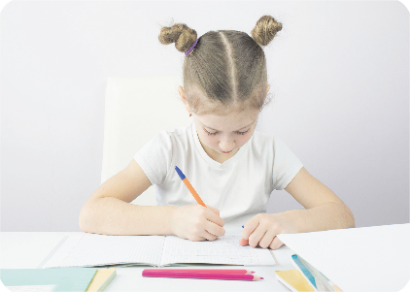



Review
writing
dancing
singing
reading

Slide 24




Review
playing basketball
drawing a picture
watching TV
listening to music

Slide 25
Structures
Cách nói tôi/tớ đang làm gì.
I’m _____________.
I’m = I am

Slide 26
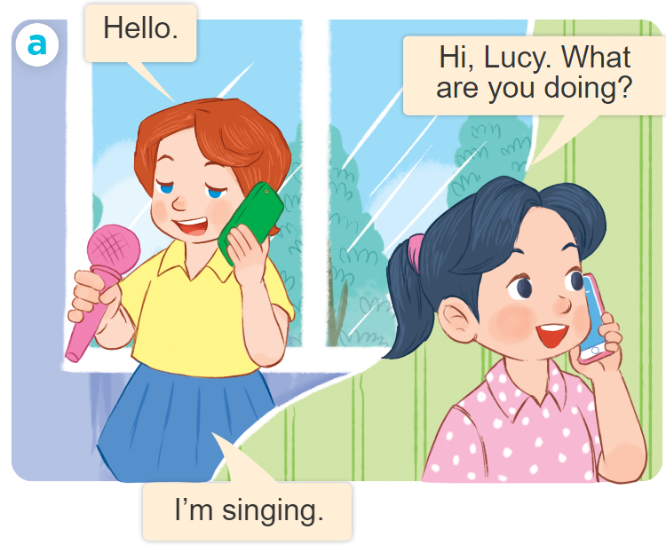
Structures
Để hỏi và trả lời cho câu hỏi: “Bạn đang làm gì vậy”.
What are you doing?
I’m ______________.
I’m = I am

Slide 27

Facebook : Bùi Liễu
0968142780
Thank you!

