Slide 1
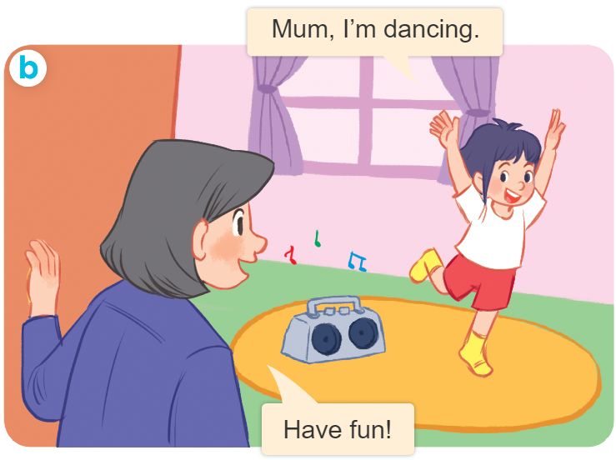
..................................
Playing and doing
Unit
18
Lesson 3 (4+5+6)
Facebook : Bùi Liễu
0968142780

Slide 2

Warm-up

Slide 3
Let’s play!

Slide 4

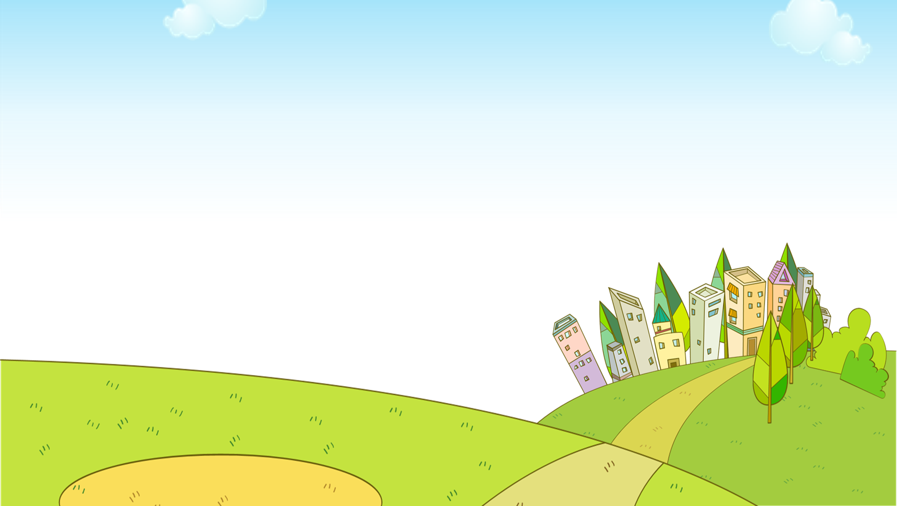


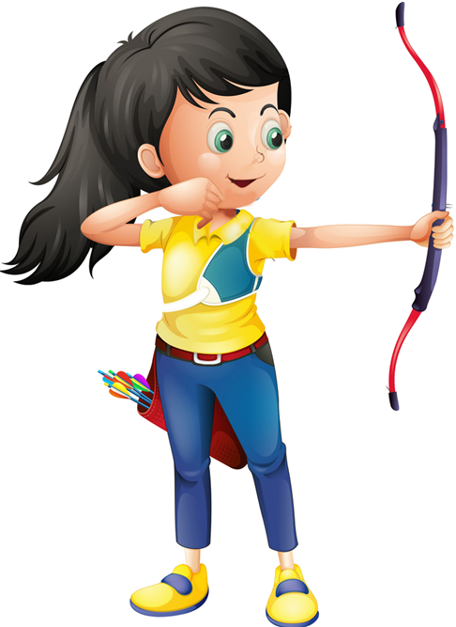




Ms Huyền Phạm
0936.082.789

Slide 5


A. it
wr__ing
B. ir
Ms Huyền Phạm
0936.082.789
Notes:
Facebook : Bùi Liễu
Mobile phone: 0968142780

Slide 6
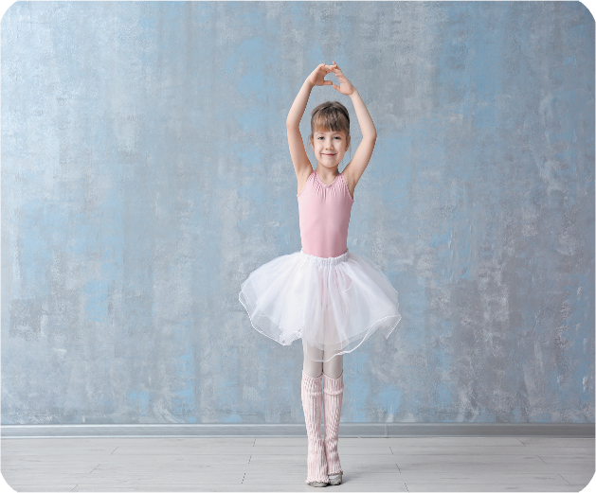
A. an
d__cing
B. en
Ms Huyền Phạm
0936.082.789

Slide 7
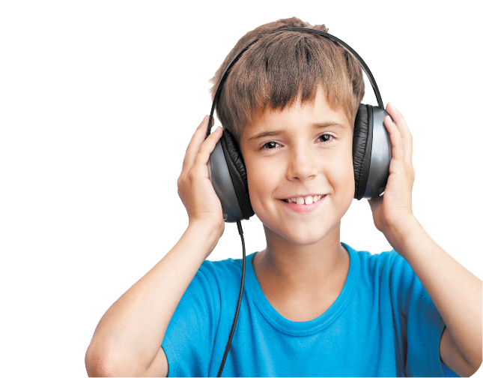
A. reading
______ to music
B. listening
Ms Huyền Phạm
0936.082.789

Slide 8
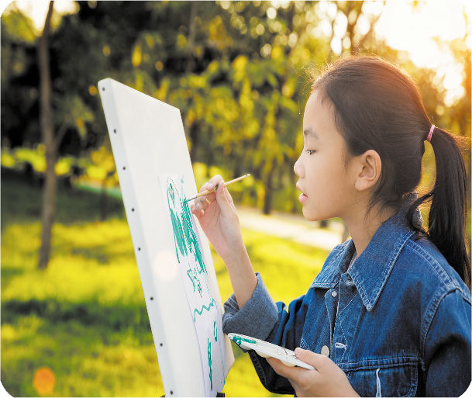
A. watching
________ a picture
B. drawing
Ms Huyền Phạm
0936.082.789

Slide 9
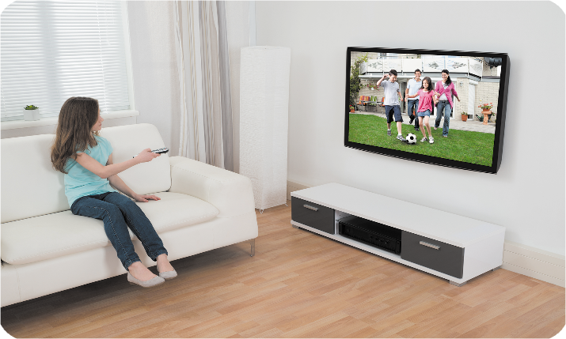
What are you doing?
I’m_________.
A. playing basketball
B. watching TV
Ms Huyền Phạm
0936.082.789

Slide 10
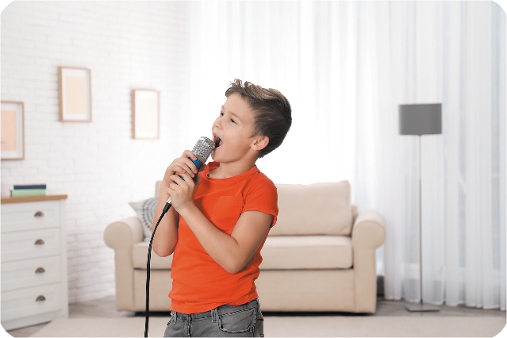
I’m ______ a song.
A. writing
B. singing
Ms Huyền Phạm
0936.082.789

Slide 11

I’m _________ a book.
A. reading
B. listening
Ms Huyền Phạm
0936.082.789
Notes:
Facebook : Bùi Liễu
Mobile phone: 0968142780

Slide 12

I’m ________.
A. singing
B. dancing
Ms Huyền Phạm
0936.082.789

Slide 13
What ____ you doing?
I’m _______ basketball.
A. are / playing
B. is / playing
Ms Huyền Phạm
0936.082.789

Slide 14
What are you _____?
I’m drawing a picture.
A. doing
B. do
Ms Huyền Phạm
0936.082.789
Notes:
Facebook : Bùi Liễu
Mobile phone: 0968142780

Slide 15

Good job!
Ms Huyền Phạm
0936.082.789

Slide 16



Contents
Facebook : Bùi Liễu
0968142780
Read and match.
Let’s write.
Project.

Slide 17



4. Read and match.
1. My name’s Linh. I’m in the library. I’m reading a book.
a
2. My name’s Minh. I’m in the music room. I’m listening to music.
b
3. My name’s Lucy. I’m in the art room. I’m drawing a goldfish.
c

Slide 18
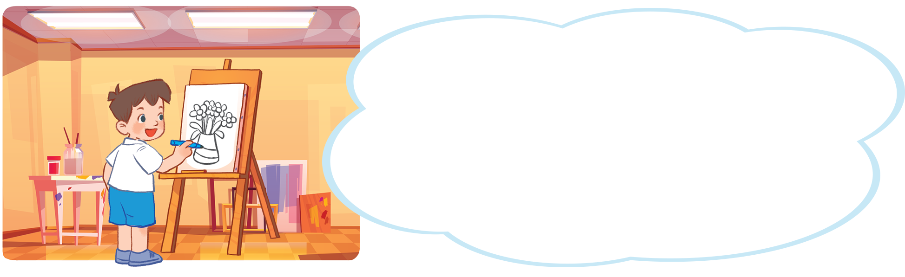
5. Let’s write.
My name is_____. I’m in the ________. I’m ____________________. I like _____________. What about you?
My name is Lieu. I’m in the art room. I’m drawing a vase with many flowers. I like drawing. What about you?
vase:lọ hoa
flower:hoa

Slide 19
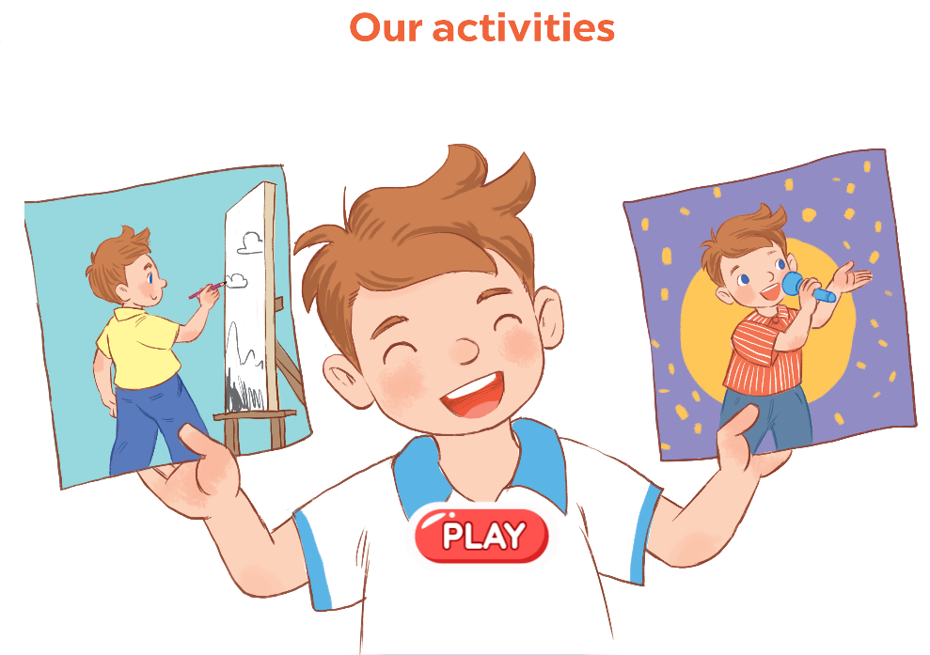
6. Project.

Slide 20

Wrap up

Slide 21





Review
writing
dancing
singing
reading

Slide 22
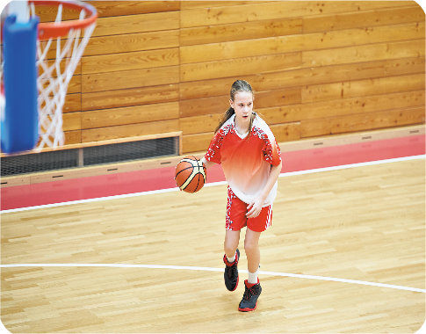




Review
playing basketball
drawing a picture
watching TV
listening to music

Slide 23
Structures
Cách nói tôi/tớ đang làm gì.
I’m _____________.
I’m = I am

Slide 24
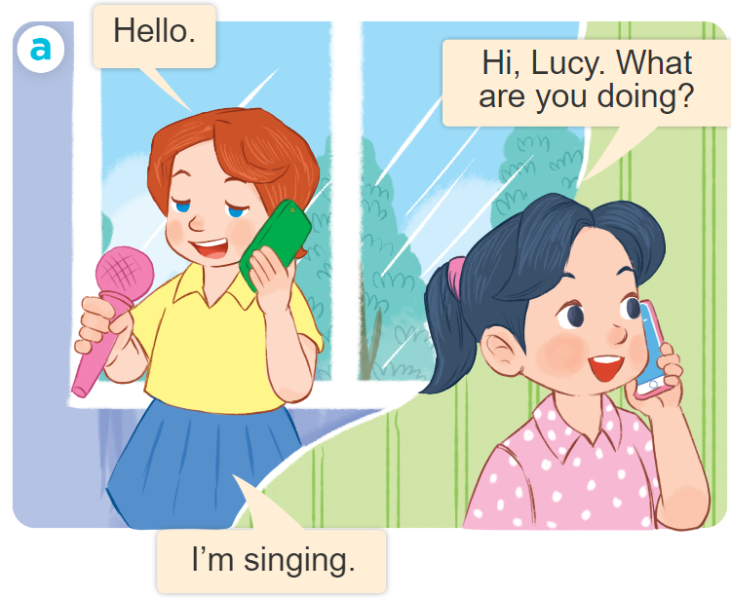
Structures
Để hỏi và trả lời cho câu hỏi: “Bạn đang làm gì vậy”.
What are you doing?
I’m ______________.
I’m = I am

Slide 25

Facebook : Bùi Liễu
0968142780
Thank you!

