Slide 1


DAI LOC DEPARTMENT OF EDUCATION AND TRAINING
DAI QUANG PRIMARY SCHOOL
WELCOME TO OUR CLASS !
Subject: English 3
Class: 3D
Teacher: Pham Thi My Chau

Slide 2
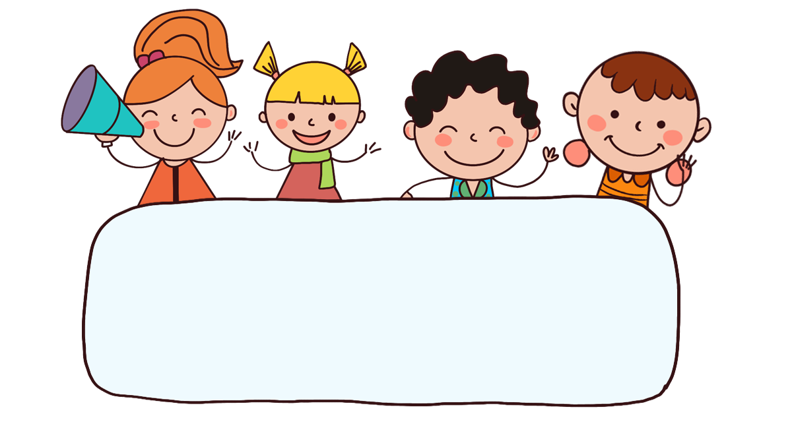
Warm-up

Slide 3

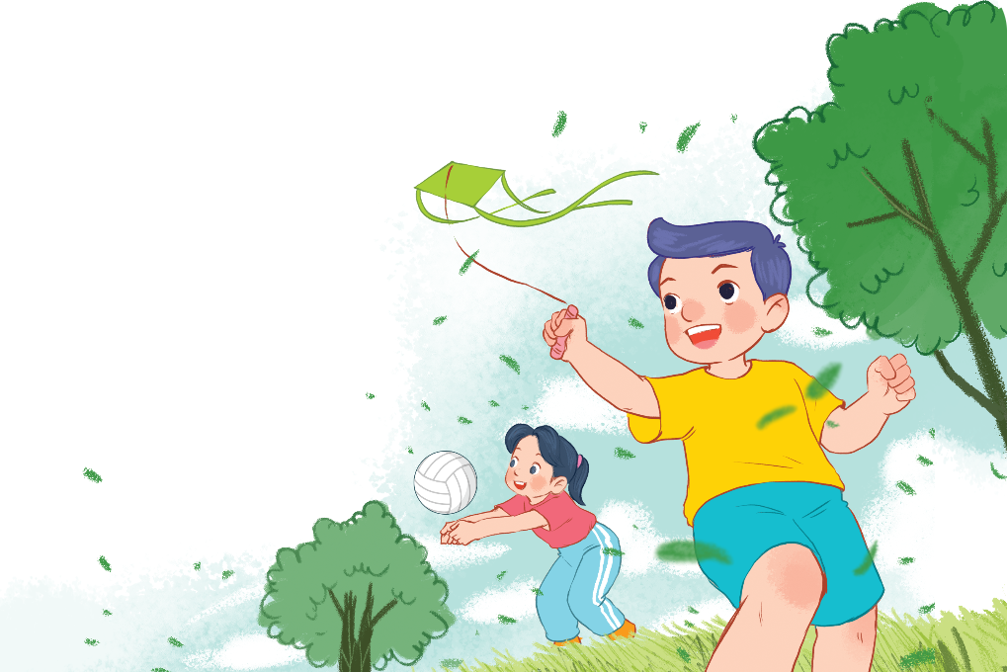
Let’s chant.
Playing, playing, playing.
What's she doing?
She's playing volleyball.
She's playing volleyball.
Flying, flying, flying.
What's he doing?
He's flying a kite.
He's flying a kite.

Slide 4


UNIT 19 : OUTDOOR ACTIVITIES
*Lesson 3:
Part: 4, 5 & 6

Slide 5
4. Read and answer.
Mai and her friends are in the park. They like sports and games. Mai's cycling. Linh's playing badminton. Nam's flying a kite. Ben's playing football with Minh. They have a lot of fun in the park.
1. Where are Mai and her friends?
3. What's Nam doing?
They are in the park.
Nam's flying a kite.
2. What's Mai doing?
4. What's Ben doing?
Mai's cycling.
Ben's playing football with Minh.

Slide 6

5. Let’s write.
Lucy and Nam are my friends. They like sports and games. Lucy is playing volleyball. Nam is playing football. I like skipping. I'm skipping. What are you doing?
Lucy and Nam are my friends. They like ________________. Lucy is _______________. Nam is __________________. I like _________.I'm ________. What are you doing?

Slide 7
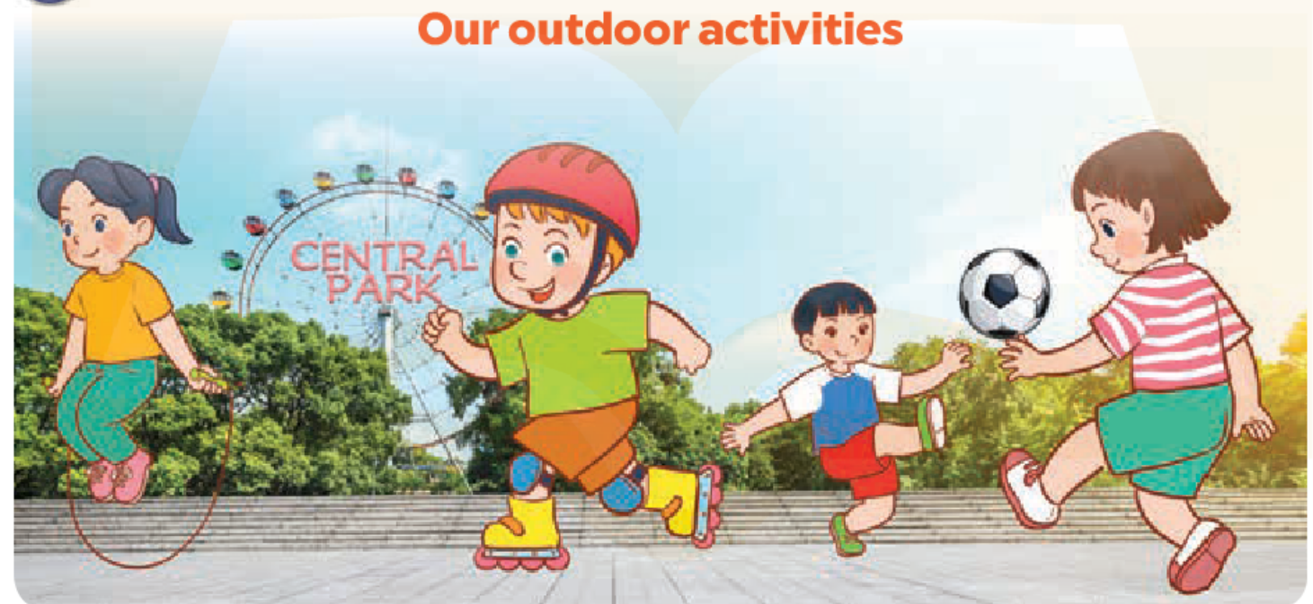
6. Project.

Slide 8
Let’s play!

Slide 9
Arrange me!
1. playing / She’s / badminton / . /
5. is / He / painting/./
2. / is / he / . / running /
6. /is / He / kite / a / . / flying /
3. She’s _________.
7. A: What / she / is / doing?
B: She is cycling.
4. A: / she / what’s / ? / doing /
B: She’s skipping.
8. A: he / What’s / doing / ? /
B: He’s skating.

Slide 10


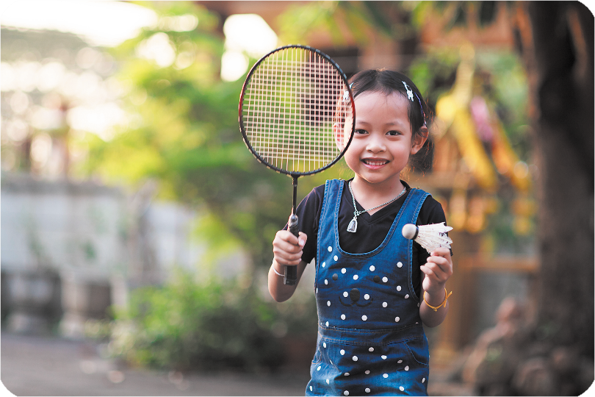
Arrange me!
10
Time’s up
1. playing / She’s / badminton / . /
She’s playing badminton.

Slide 11
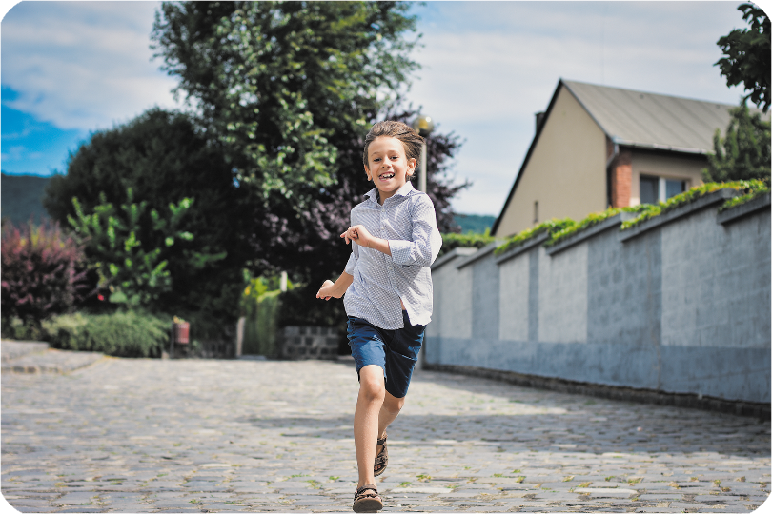
Arrange me!
10
Time’s up
2. / is / he / . / running /
He is running.

Slide 12
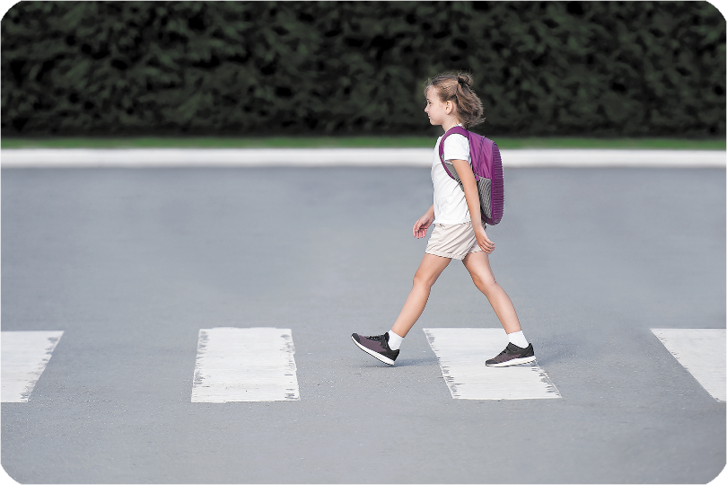
Arrange me!
10
Time’s up
3. She’s _________.
walking

Slide 13
Arrange me!
10
Time’s up
4. A: / she / what’s / ? / doing /
B: She’s skipping.
What’s she doing?

Slide 14
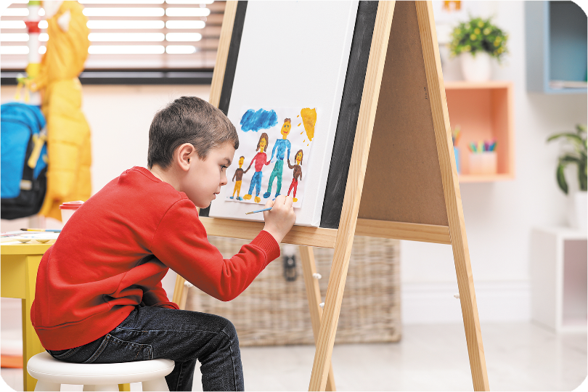
Arrange me!
10
Time’s up
5. is / He / painting/./
He is painting.

Slide 15
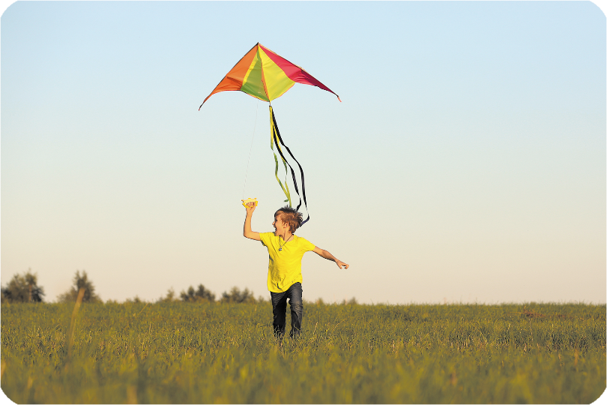
Arrange me!
10
Time’s up
6. /is / He / kite / a / . / flying /
He is flying a kite. flying

Slide 16
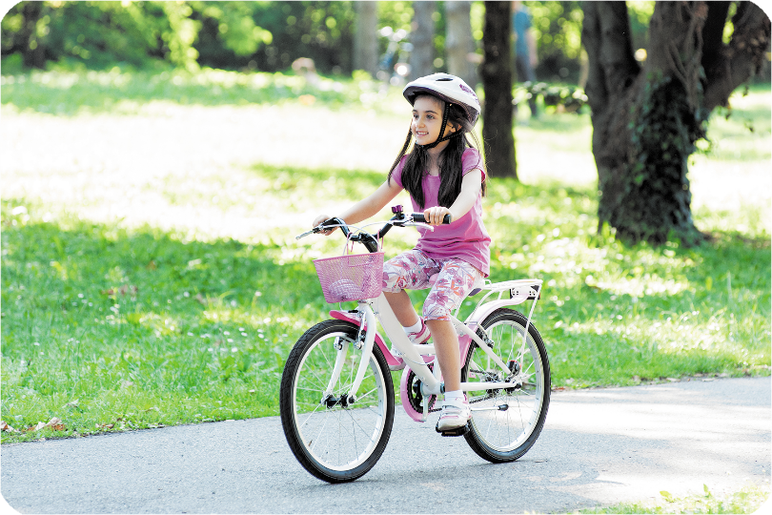
Arrange me!
10
Time’s up
7. A: What / she / is / doing / ? /
B: She is cycling.
What is she doing?

Slide 17
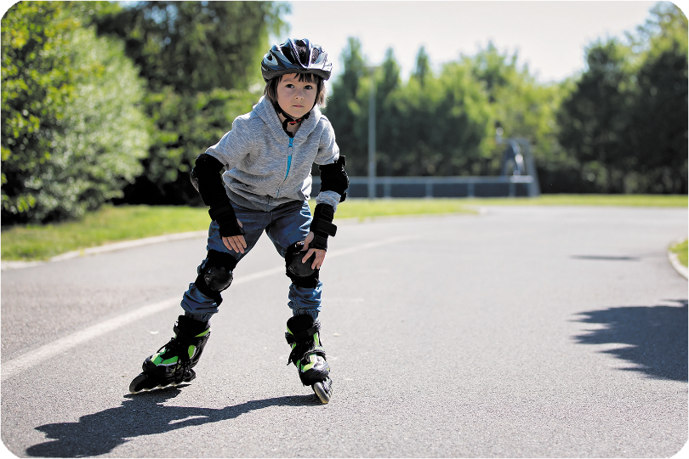
Arrange me!
10
Time’s up
8. A: he / What’s / doing / ? /
B: He’s skating.
What’s he doing?

Slide 18
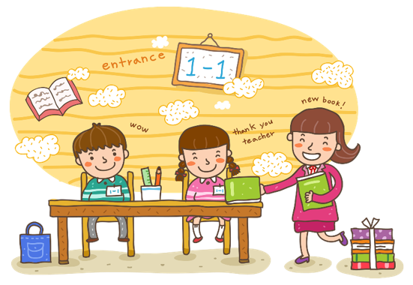
Wrap up

Slide 19
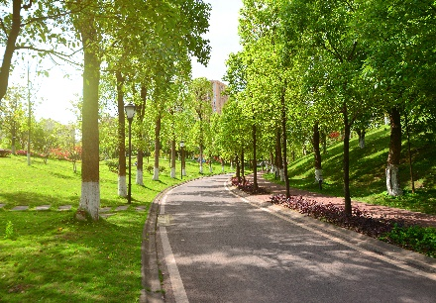




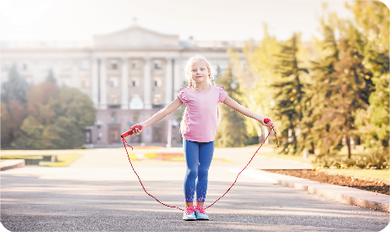
Vocabulary
park
skating
cycling
flying a kite
skipping

Slide 20




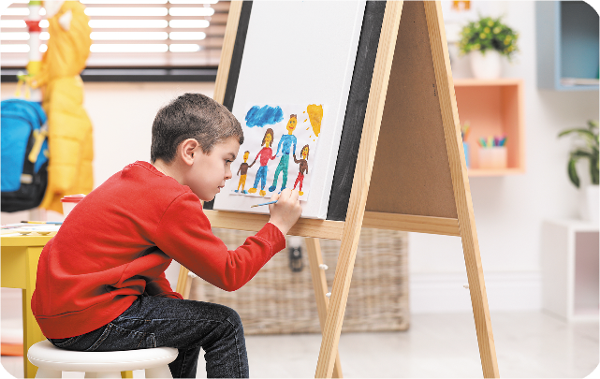
Vocabulary
playing badminton
running
painting
walking

Slide 21

Thank you!

