Slide 1
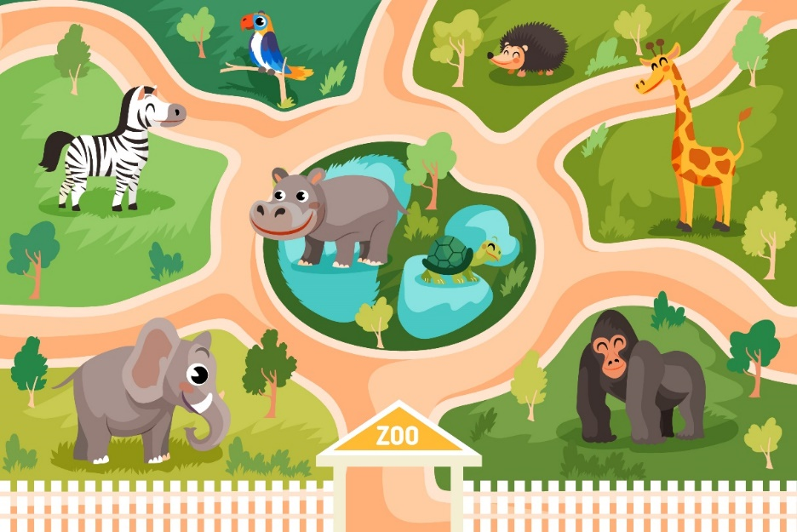
Bùi Liễu 0968142780
..................................
Unit
20
At the zoo
Lesson 1 (4+5+6)
Bùi Liễu 0968142780

Slide 2

Warm-up

Slide 3
Let’s play!

Slide 4
Choose the right answer.
✓
A: ______ can you see?
B: I can see a peacock.
A
B
C
Where
What
Who

Slide 5
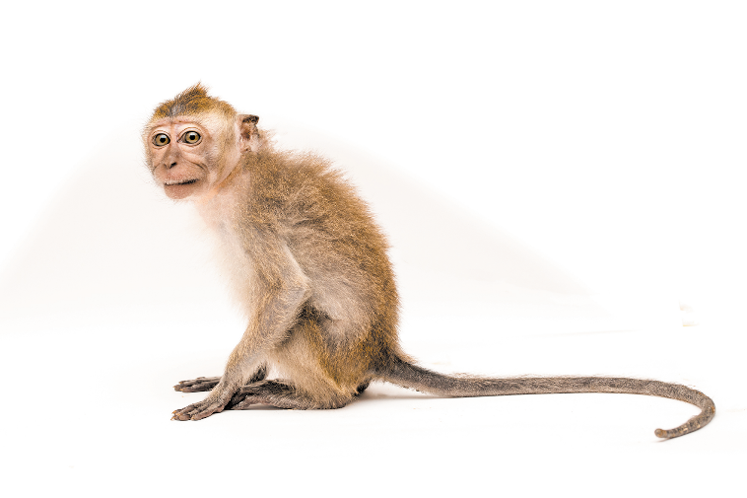
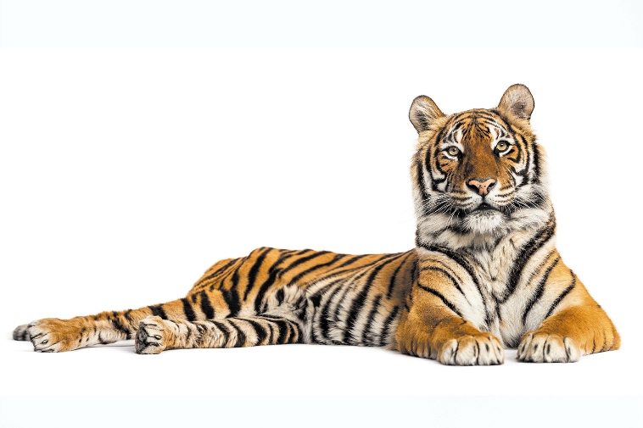
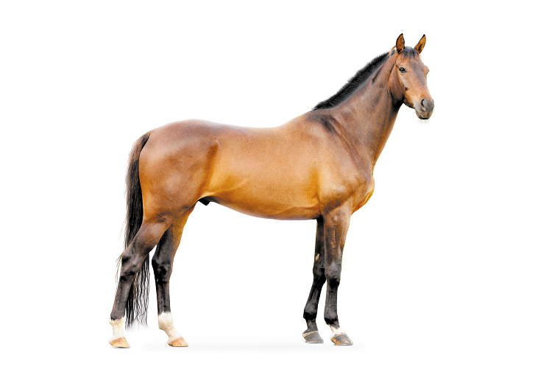
Choose the right answer.
✓
A: What can you see?
B: I can see a monkey.
A
B
C

Slide 6
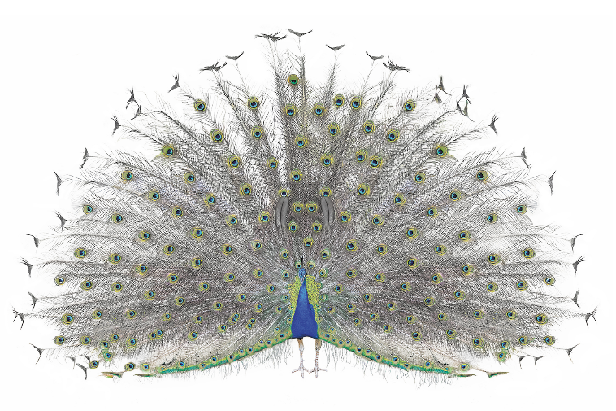
Choose the right answer.
✓
A: What can you see?
B: I can see a peacock.
A
B
C

Slide 7
Choose the right answer.
✓
A: What can you see?
B: I can see a tiger.
A
B
C

Slide 8

✓
Choose the right answer.
A
B
C

Slide 9
✓
Choose the right answer.
A
B
C

Slide 10

Choose the right answer.
✓
A: What can you see?
B: I can see a horse.
A
B
C

Slide 11

✓
Choose the right answer.
A
B
C

Slide 12
✓
Choose the right answer.
A
B
C

Slide 13
✓
Choose the right answer.
A: What can you see?
B: _______ see a peacock.
A
B
C
He can
I can
She can

Slide 14

Facebook : Bùi Liễu
0968142780
WELL DONE!

Slide 15
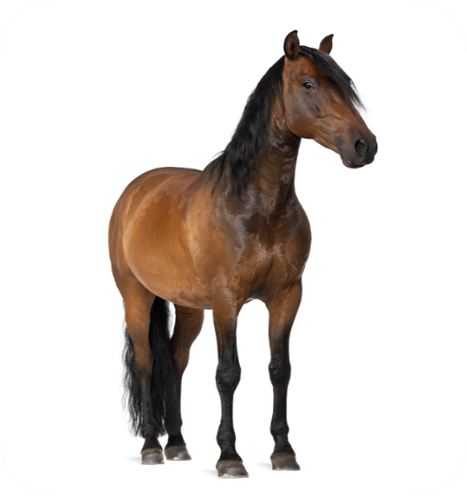
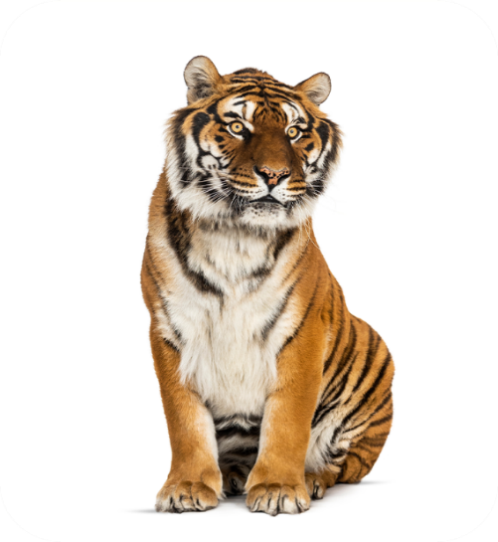
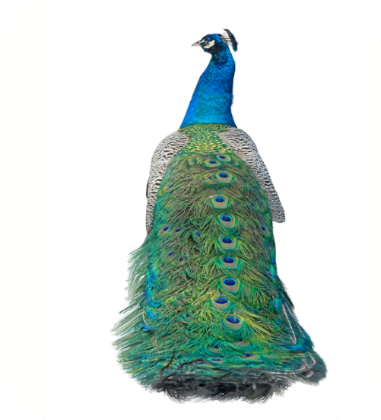
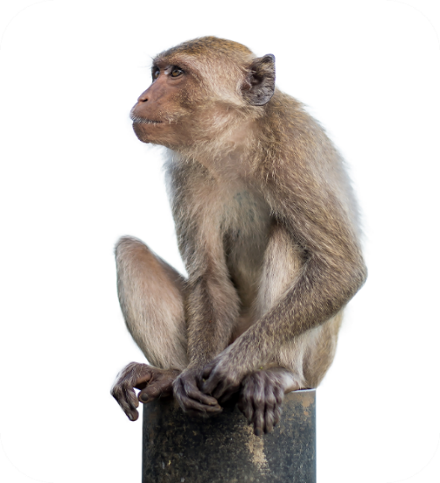




4. Listen and number.
a
b
c
d
2
3
4
1

Slide 16
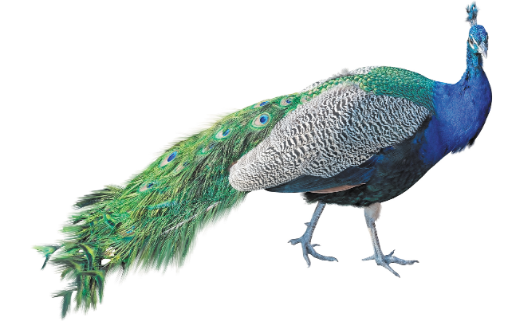
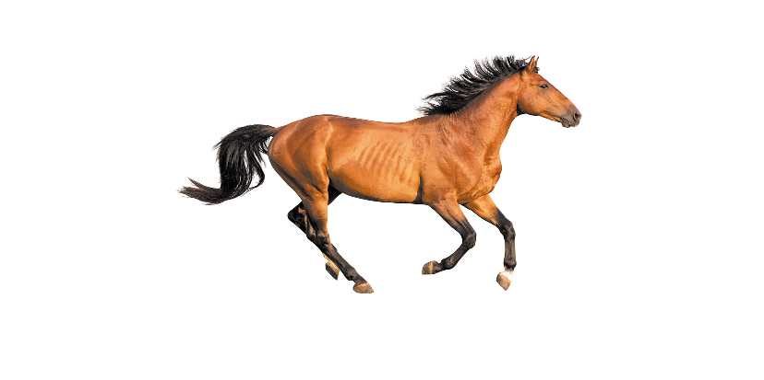
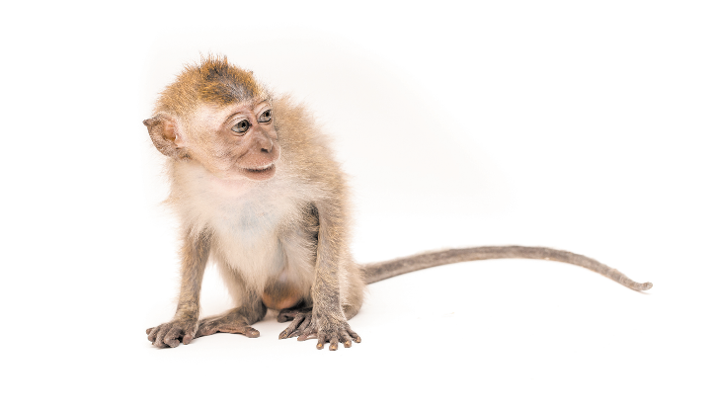
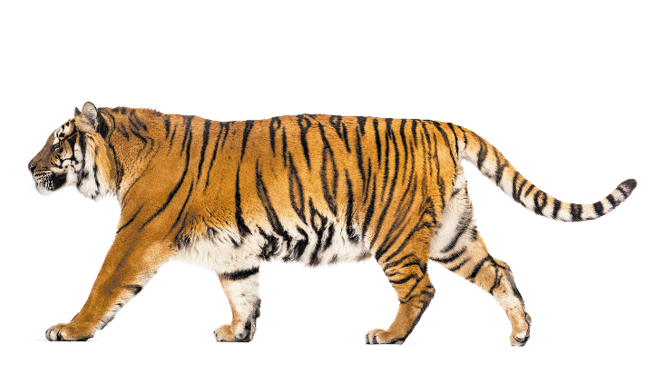
5. Look, complete and read.
1. A: What can you see?
B: I can see a __________.
2. A: What can you see?
B: I can see a ________.
peacock
horse
see
4. A: What _______________?
B: I can see a _____.
3. A: What can you _____?
B: I can see a ________.
can you see
monkey
tiger

Slide 17
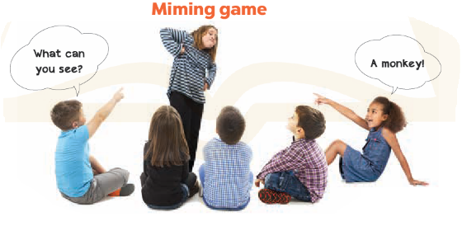
6. Let’s play.

Slide 18

Wrap up

Slide 19

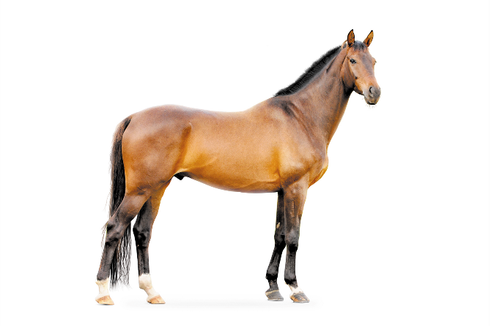

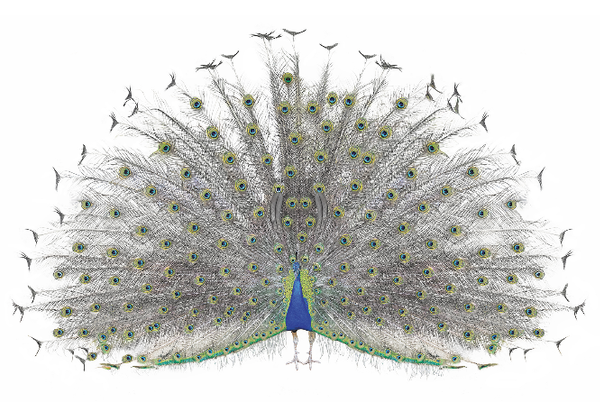
Bùi Liễu 0968142780
Review
tiger
horse
Bùi Liễu 0968142780
monkey
peacock

Slide 20
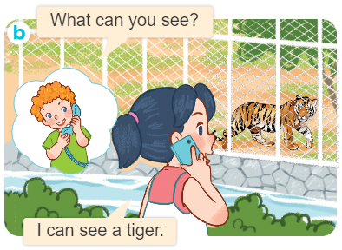
Structures
Cách hỏi và trả lời bạn nhìn thấy gì.
What can you see?
I can see_________.

Slide 21

Thank you!

