Slide 1


DAI LOC DEPARTMENT OF EDUCATION AND TRAINING
DAI QUANG PRIMARY SCHOOL
WELCOME TO OUR CLASS !
Subject: English 3
Class: 3E
Teacher: Pham Thi My Chau

Slide 2
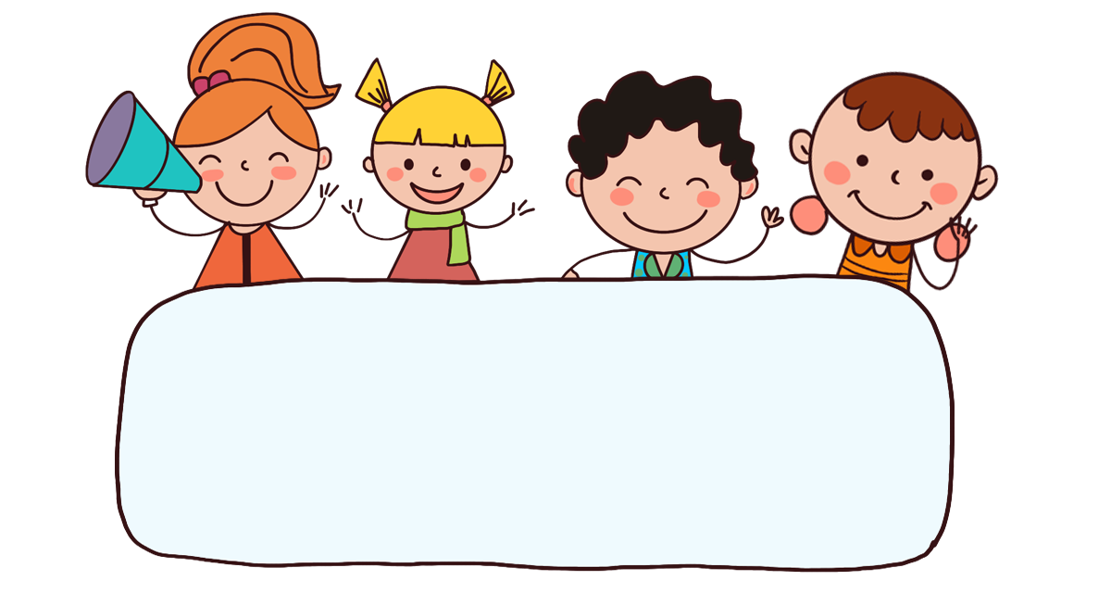
Warm-up

Slide 3

Let’s play!

Slide 4









Sun flower

Slide 5



h__se
A
B
C
D
or
ow
er
on

Slide 6
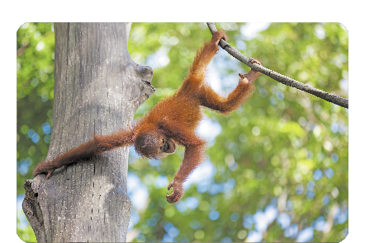
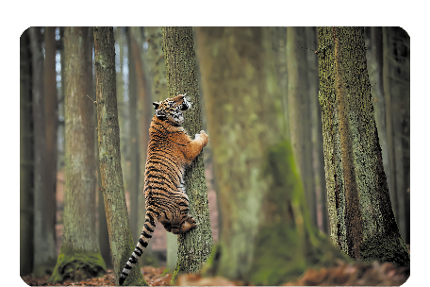
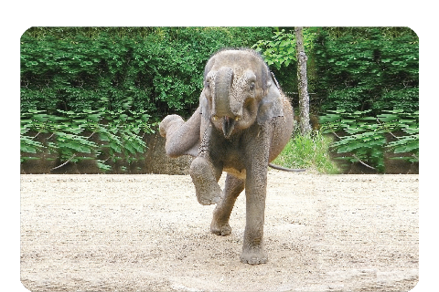
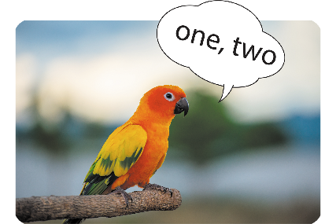
A
B
C
D
Sai
Đúng
Sai
Sai

Slide 7
mon____
A
B
C
D
kay
key
kit
ney

Slide 8
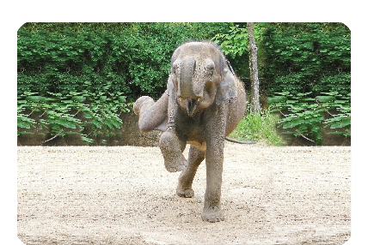
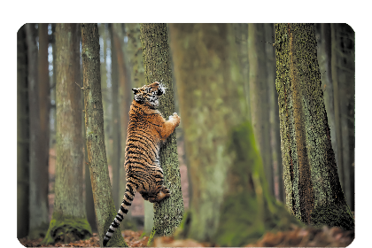

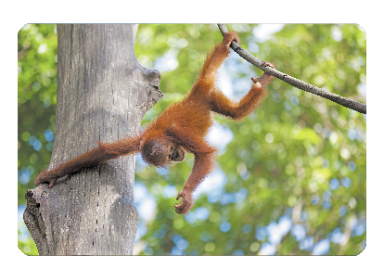
A
B
C
D
Sai
Sai
Sai
Đúng

Slide 9
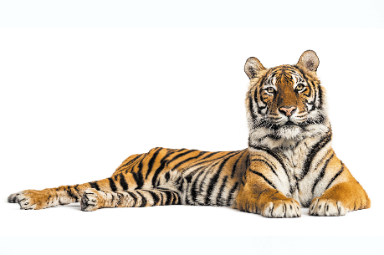
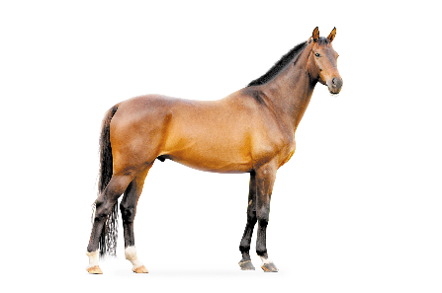

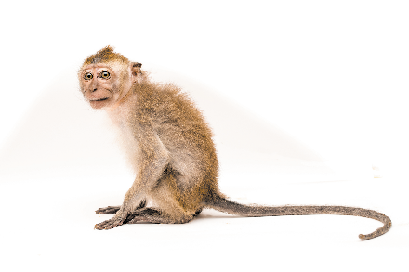
What can you see?
I can see a elephant.
A
B
C
D
Sai
Sai
Đúng
Sai

Slide 10
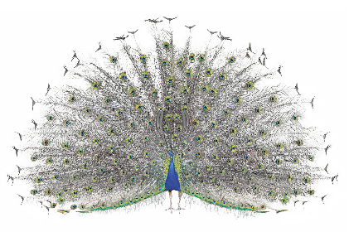


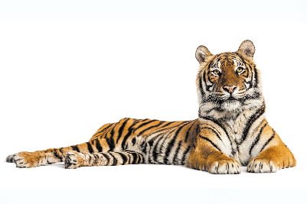
What can you see?
I can see a peacock.
Click on the flower to show the right answer.
A
B
C
D

Slide 11
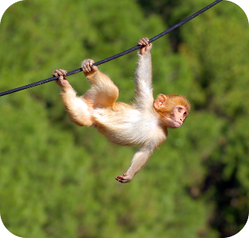
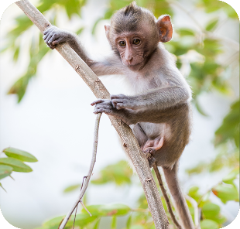
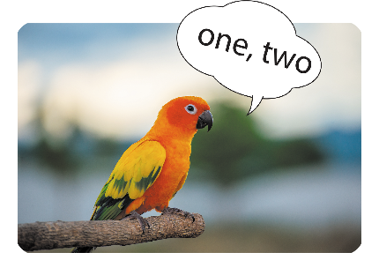
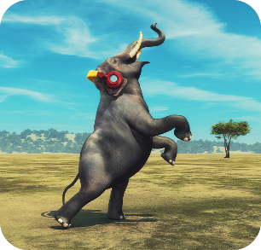
What’s the parrot doing?
It’s counting.
A
B
C
D
Sai
Sai
Đúng
Sai

Slide 12
What’s the _____ doing?
It’s climbing.
A
B
C
D
monkey
elephant
parrot
tiger

Slide 13
What’s the monkey doing?
It’s __________.
A
B
C
D
climbing
dancing
counting
swinging

Slide 14
_______ the elephant doing?
It’s dancing.
A
B
C
D
Where’re
What’re
What’s
When

Slide 15


Slide 16


UNIT 20 : AT THE ZOO
*Lesson 3:
Part: 4, 5 & 6

Slide 17

I have two rabbits. How many rabbits do you have?
4. Read and tick True or False.
Linh and her mother are at the zoo. They can see many animals. A monkey is swinging. A tiger is climbing a tree. An elephant is drawing. A peacock is dancing. Linh and her mother like the animals at the zoo.
 | True | False
1. Linh and her mother are at the zoo.
2. They can see a monkey, a tiger and many peacocks.
3. A tiger is climbing a tree.
4. A peacock is dancing.

Slide 18
5. Let’s write.
My friends and I are at the zoo. We can see many the animals. A monkey is swinging. A peacock is dancing. We like atanimals the zoo.
My friends and I are at the zoo. We can see many __________. A monkey is ________. A ________ is dancing. We ________ the animals at the zoo.

Slide 19
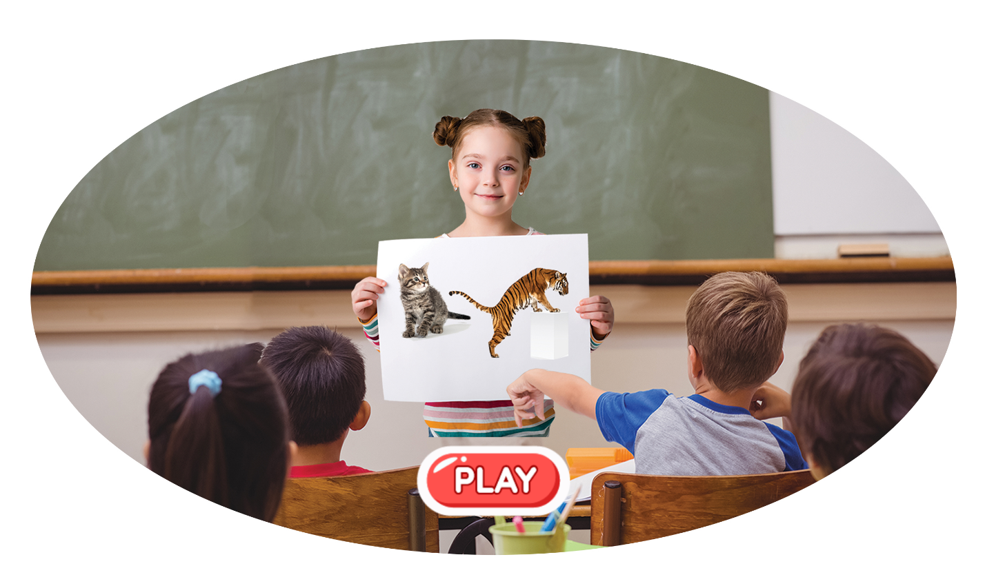
6. Project.
My favourite animals

Slide 20
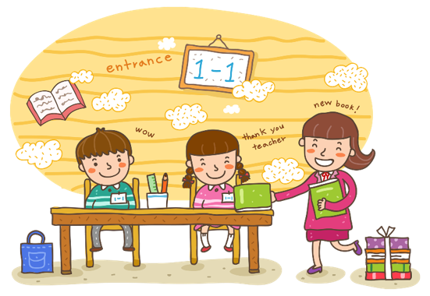
Wrap up

Slide 21
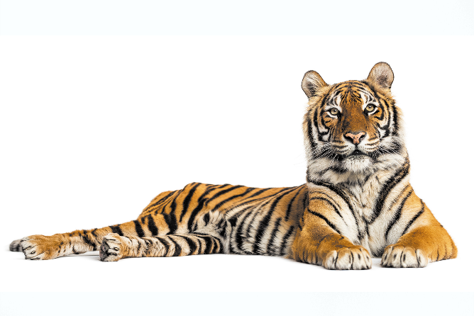
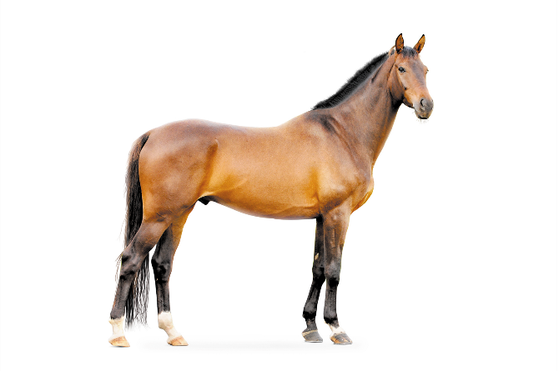

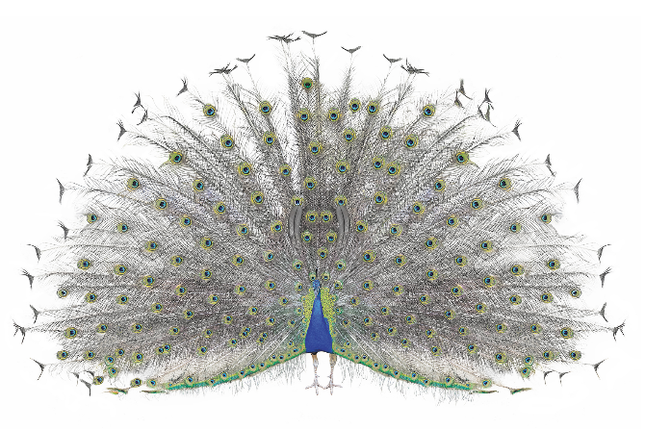
Vocabulary
tiger
horse
monkey
peacock

Slide 22
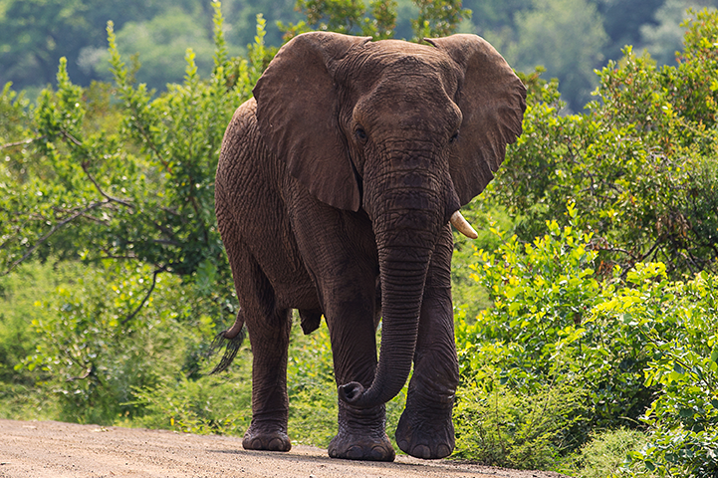


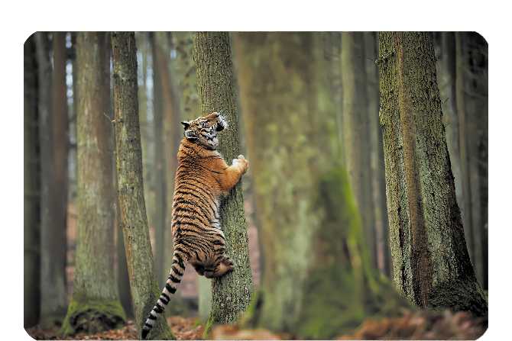
Vocabulary
elephant
counting
swinging
climbing

Slide 23
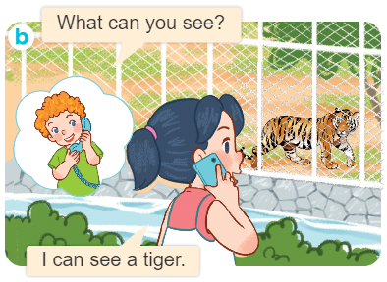
Structures
Cách hỏi và trả lời bạn xem gì.
What can you see?
I can see_________.

Slide 24
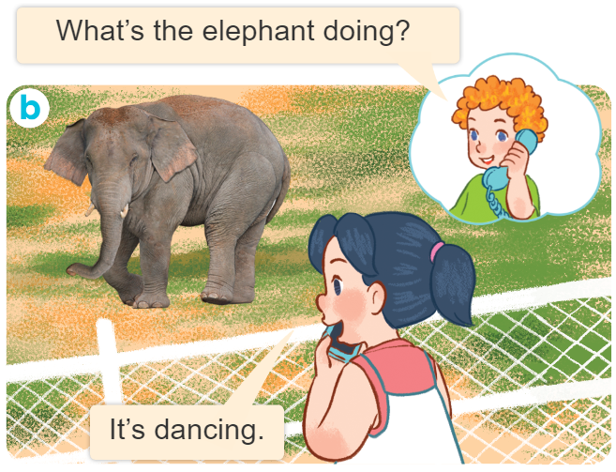
Structures
Cách hỏi và trả lời ai đang làm gì.
What’s the _______doing?
It’s _________.

Slide 25

Thank you!

