Slide 1
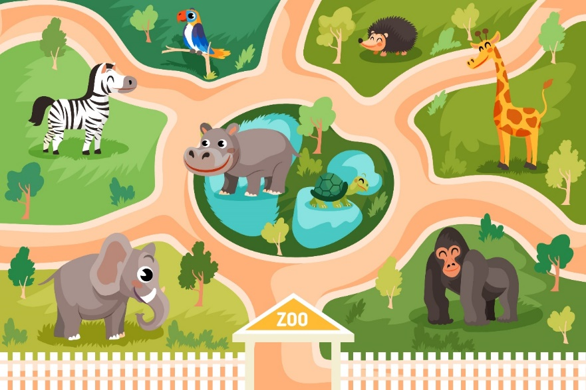
Bùi Liễu 0968142780
..................................
Unit
20
At the zoo
Lesson 1
Facebook : Bùi Liễu
0968142780
Bùi Liễu 0968142780

Slide 2

Warm-up

Slide 3

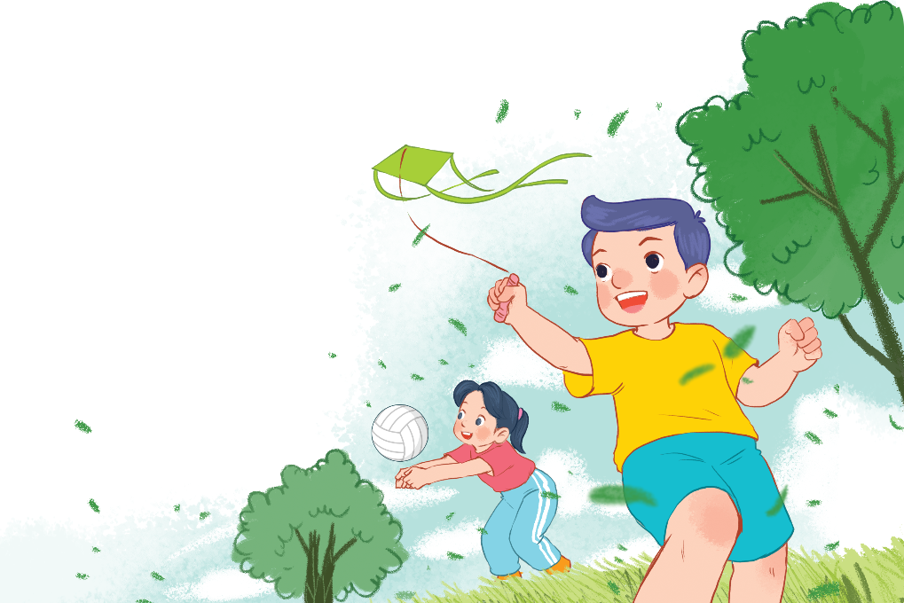
Bùi Liễu 0968142780
Let’s chant.
Playing, playing, playing.
What's she doing?
She's playing volleyball.
She's playing volleyball.
Flying, flying, flying.
Bùi Liễu 0968142780
What's he doing?
He's flying a kite.
He's flying a kite.

Slide 4






Contents
Facebook : Bùi Liễu
0968142780
Look, listen and repeat.
Listen, point and say.
Let’s talk.
Listen and number.
Look, complete and read.
Let’s play.

Slide 5

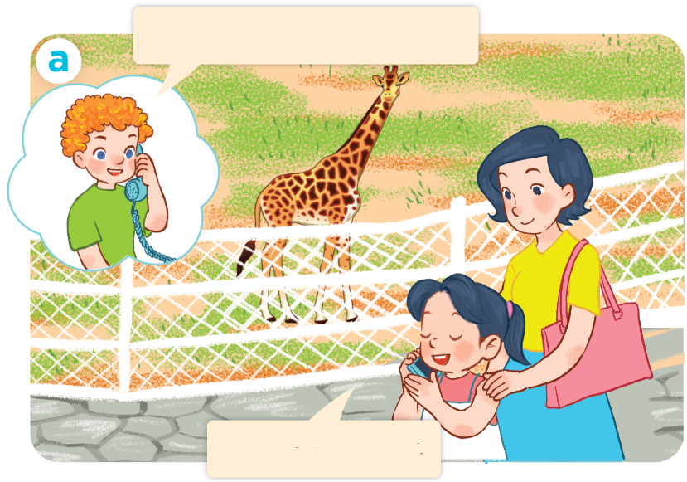
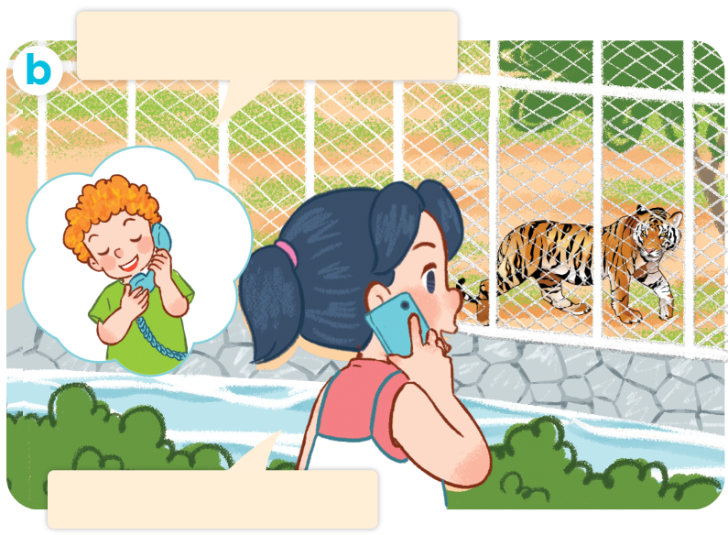
I have two rabbits. How many rabbits do you have?
1. Look, listen and repeat.
Where are you, Mai?
What can you see?
I’m at the zoo.
I can see a tiger.
Who are they?
What are they doing?
Where are they?

Slide 6
VOCABULARY

Slide 7
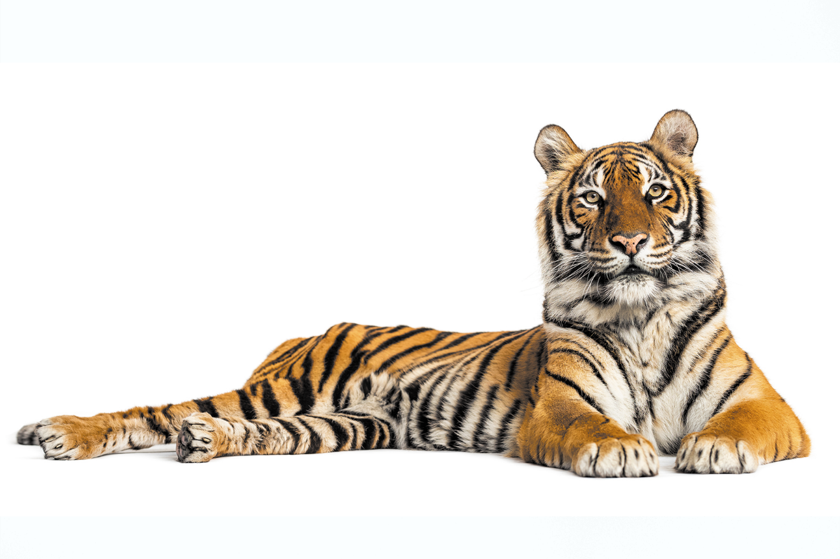
tiger
/ˈtaɪ.ɡər/
con hổ

Slide 8
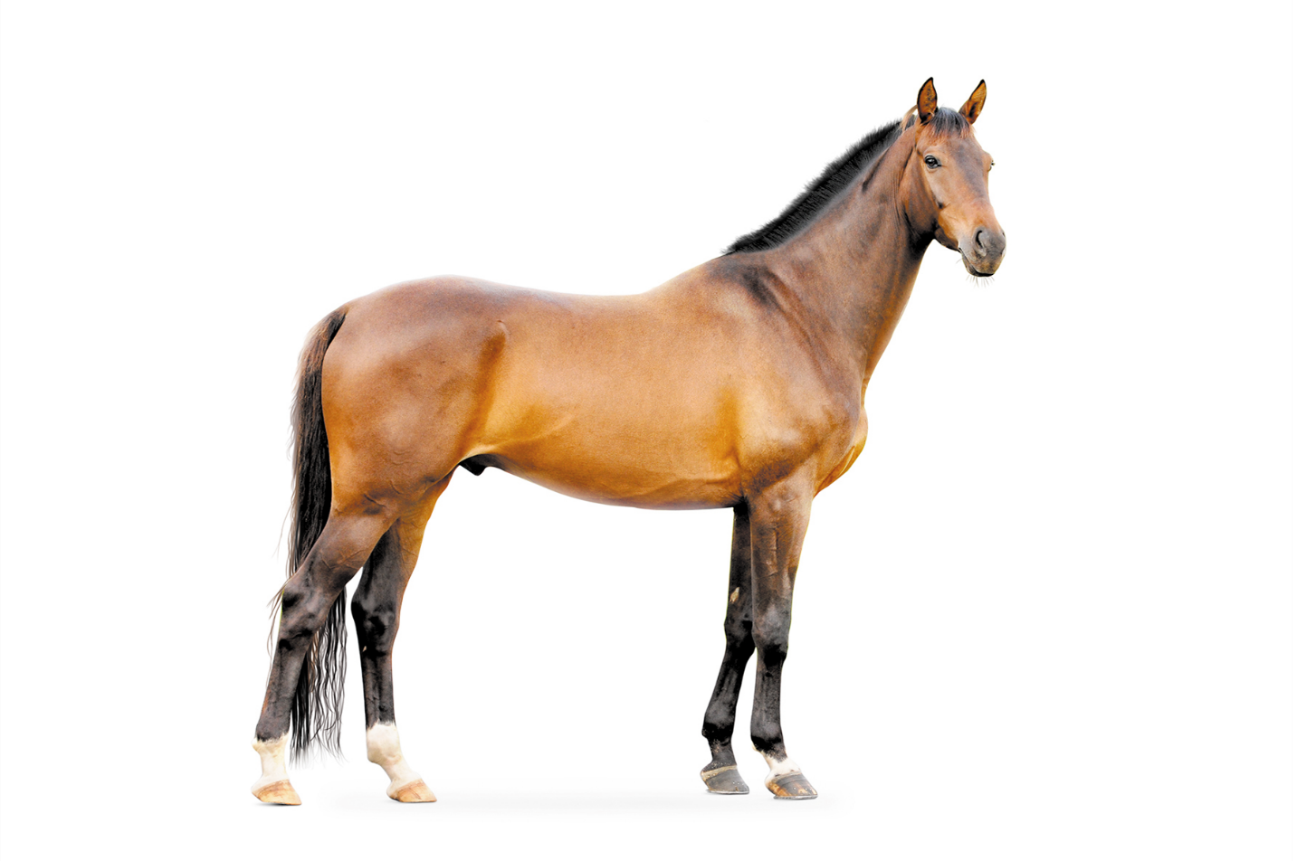
horse
/hɔːs/
con ngựa

Slide 9
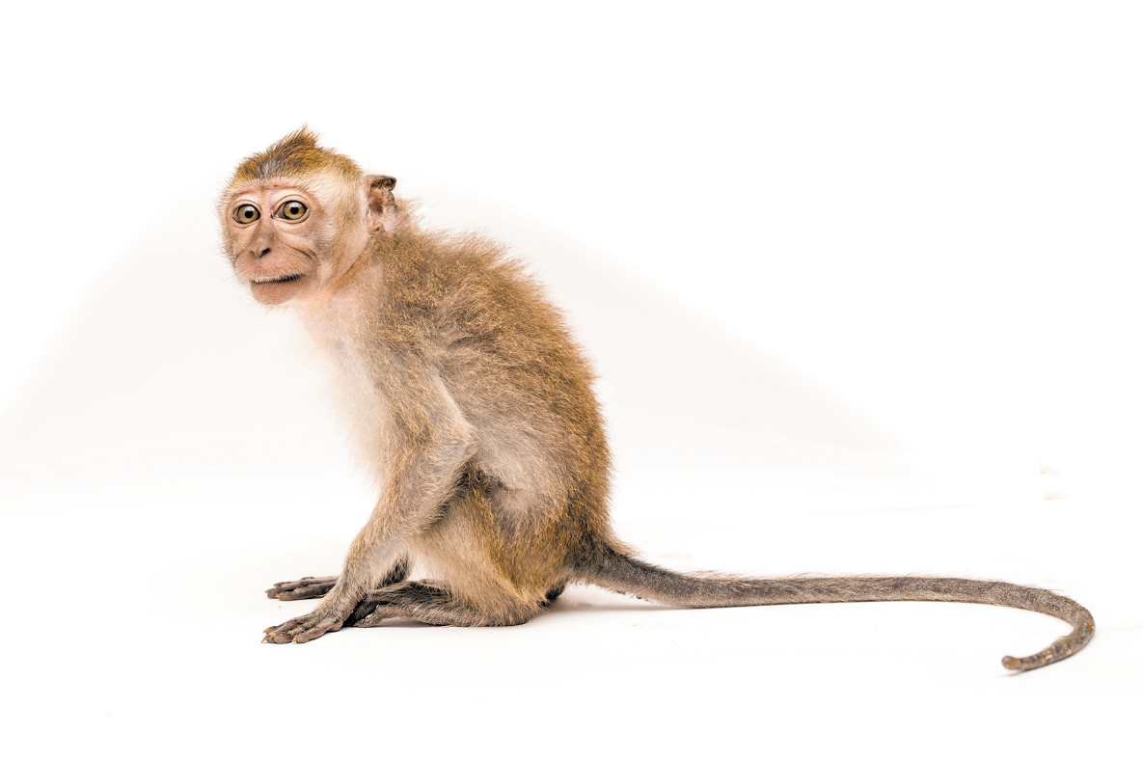
monkey
/ˈmʌŋ.ki/
con khỉ

Slide 10
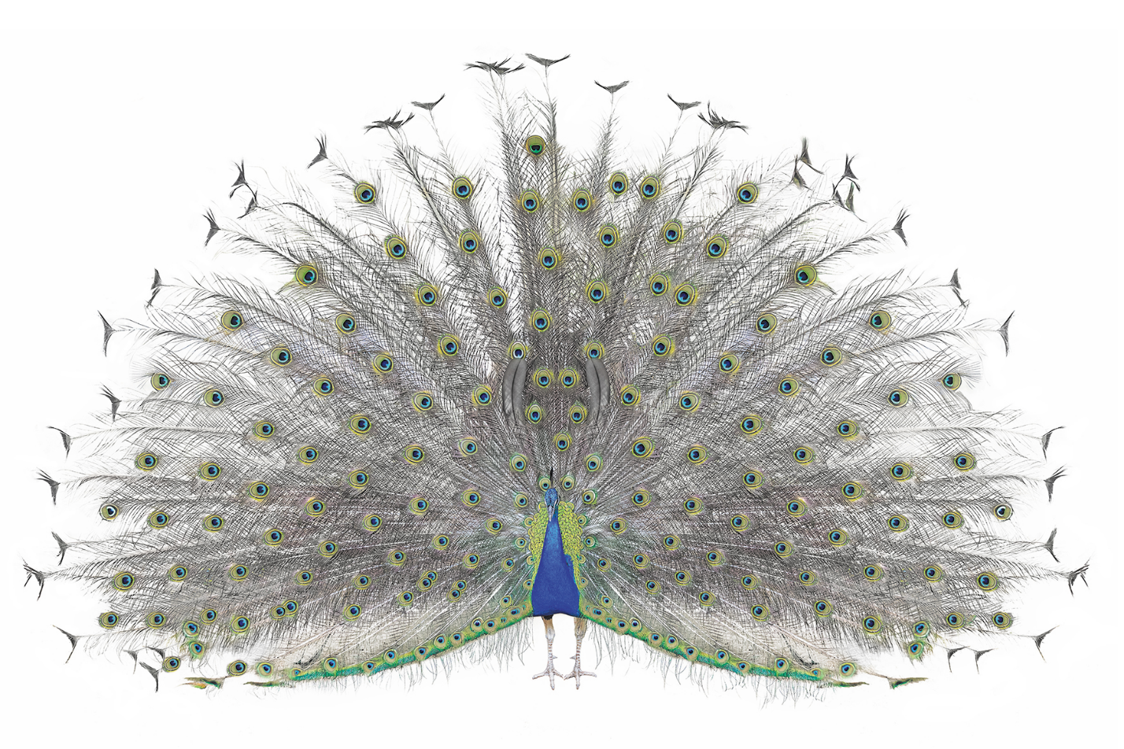
peacock
/ˈpiː.kɒk/
con công

Slide 11

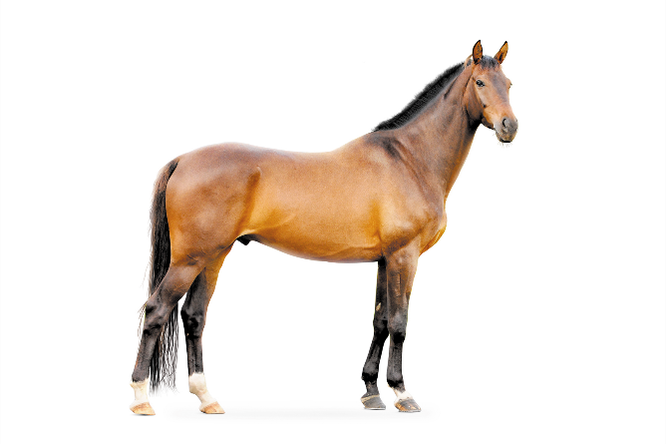


Review
tiger
horse
monkey
peacock

Slide 12

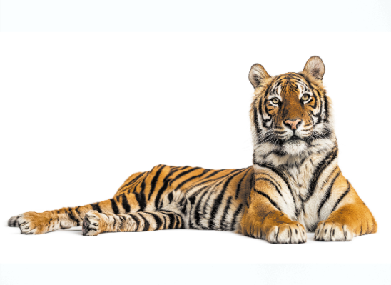


Matching
Facebook : Bùi Liễu
Mobile phone: 0968142780
1
2
3
4
horse
monkey
peacock
____
_____
tiger
_____
_____
a
tiger
c
peacock
b
horse
d
monkey

Slide 13
STRUCTURES

Slide 14
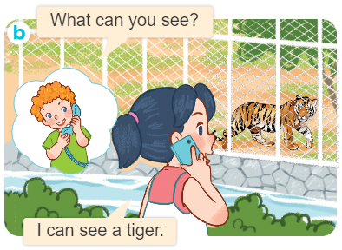
Structures
Cách hỏi và trả lời “bạn có thể nhìn thấy gì”.
What can you see?
I can see _________.

Slide 15
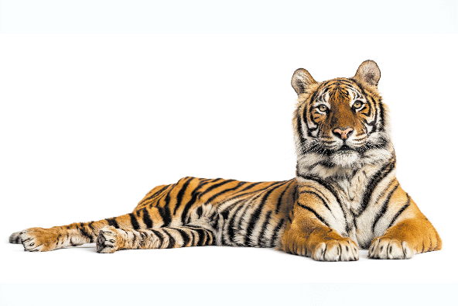



2. Listen, point and say.
a
b
What can you see?
a tiger
a horse
c
d
I can see _________.
a monkey
a peacock

Slide 16

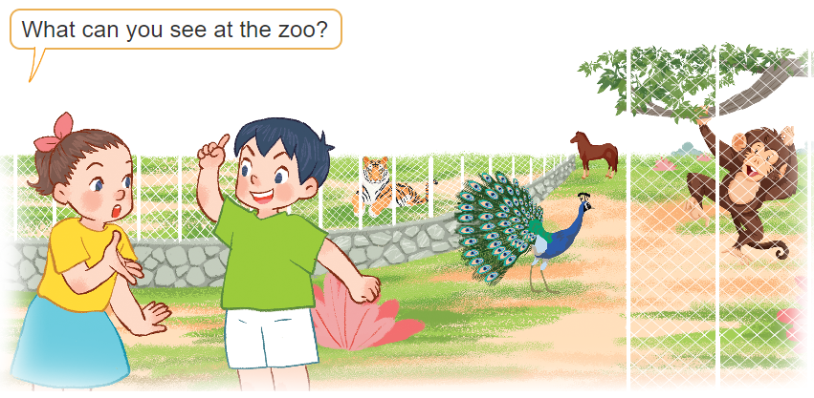
3. Let’s talk.
I can see a monkey.
I can see a peacock.
I can see a horse.
I can see a tiger.
3
1
4
2

Slide 17
Let’s play!

Slide 18



Choose the right answer.
A. peacock
B. tiger

Slide 19
A. horse
B. monkey

Slide 20
A. tiger
B. peacock

Slide 21
A. monkey
B. horse

Slide 22

Bùi Liễu 0968142780
A.
B.
Bùi Liễu 0968142780

Slide 23

A.
B.

Slide 24

Bùi Liễu 0968142780
A.
B.
Bùi Liễu 0968142780

Slide 25


A.
B.

Slide 26
p__cock
A. oa
B. ea

Slide 27
h__se
A. or
B. er

Slide 28

Facebook : Bùi Liễu
0968142780
WELL DONE!

Slide 29
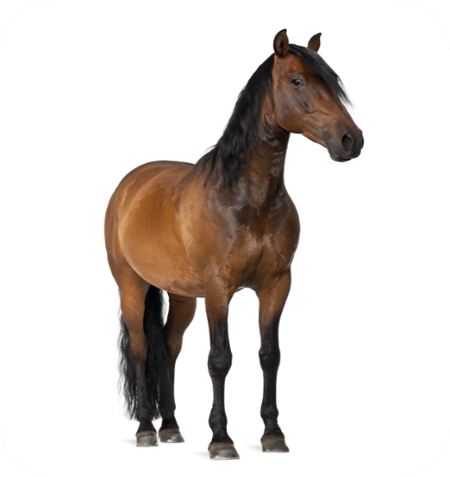
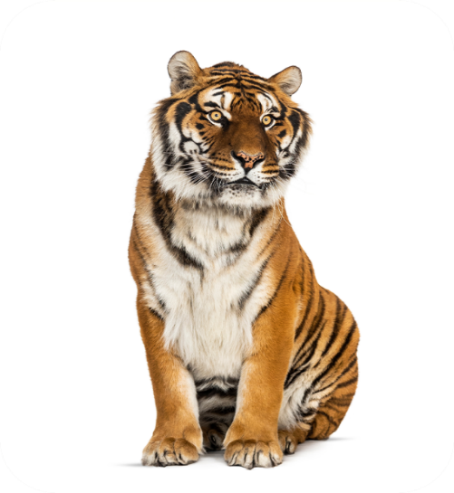
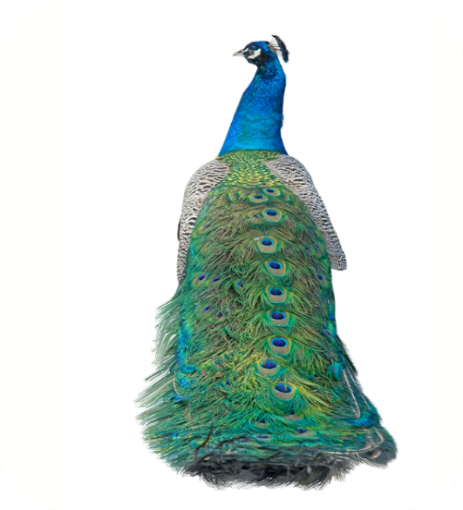
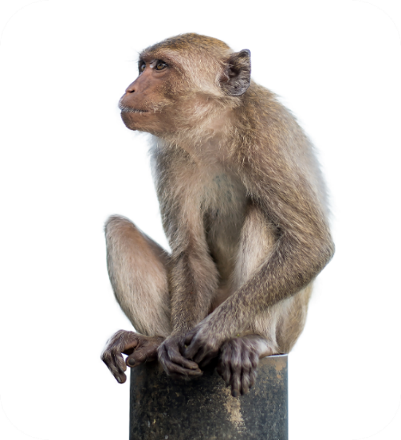




4. Listen and number.
a
b
c
d
2
3
4
1

Slide 30
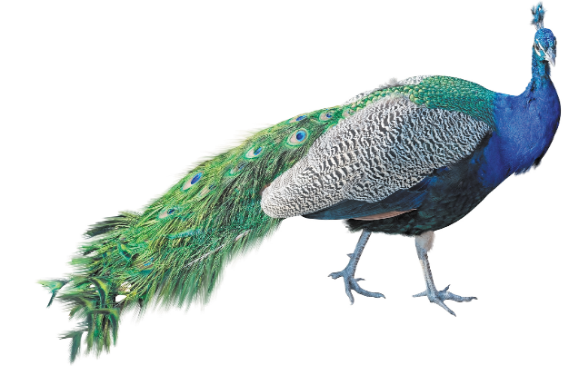
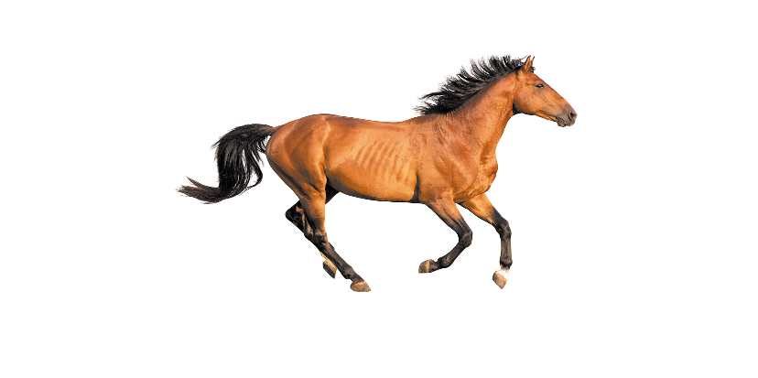
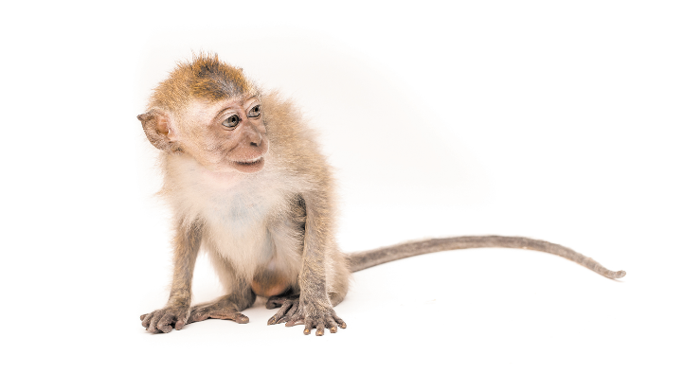
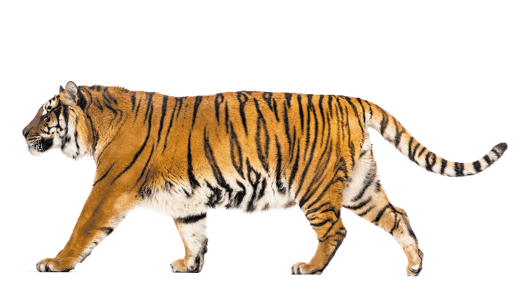
5. Look, complete and read.
1. A: What can you see?
B: I can see a __________.
2. A: What can you see?
B: I can see a ________.
peacock
horse
see
4. A: What ____________?
B: I can see a _____.
3. A: What can you _____?
B: I can see a _______.
can you see
monkey
tiger

Slide 31
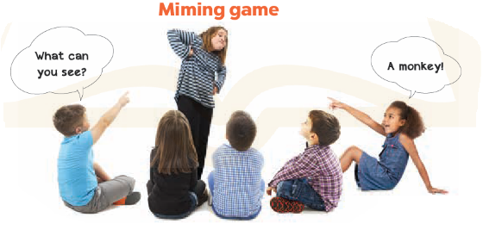
6. Let’s play.
6. Let’s play.

Slide 32
Let’s play!

Slide 33
Choose the right answer.
✓
A: ______ can you see?
B: I can see a peacock.
A
B
C
Where
What
Who

Slide 34



Choose the right answer.
✓
A: What can you see?
B: I can see a monkey.
A
B
C

Slide 35
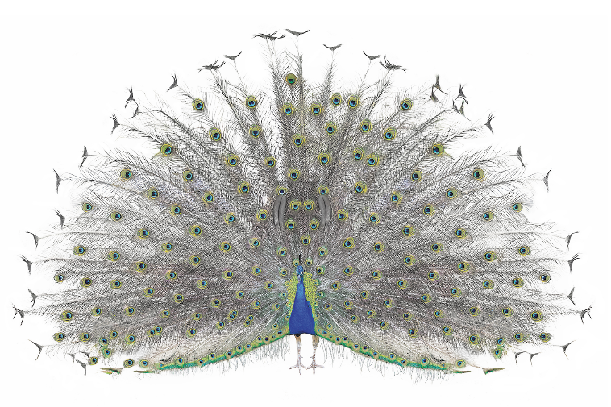
Choose the right answer.
✓
A: What can you see?
B: I can see a peacock.
A
B
C

Slide 36
Choose the right answer.
✓
A: What can you see?
B: I can see a tiger.
A
B
C

Slide 37
✓
Choose the right answer.
A
B
C

Slide 38
✓
Choose the right answer.
A
B
C

Slide 39

Choose the right answer.
✓
A: What can you see?
B: I can see a horse.
A
B
C

Slide 40

✓
Choose the right answer.
A
B
C

Slide 41
✓
Choose the right answer.
A
B
C

Slide 42
✓
Choose the right answer.
A: What can you see?
B: _______ see a peacock.
A
B
C
He can
I can
She can

Slide 43
Facebook : Bùi Liễu
0968142780
WELL DONE!

Slide 44
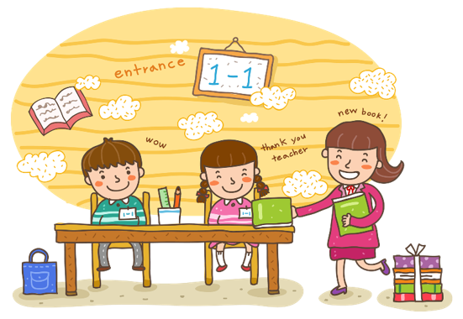
Wrap up

Slide 45
Review
a
b
What can you see?
a tiger
a horse
c
d
I can see _________.
a monkey
a peacock

Slide 46
Homework
Learn by heart all the new words.
Read again the dialogue in part 1.

Slide 47

Facebook : Bùi Liễu
0968142780
Thank you!

