Slide 1
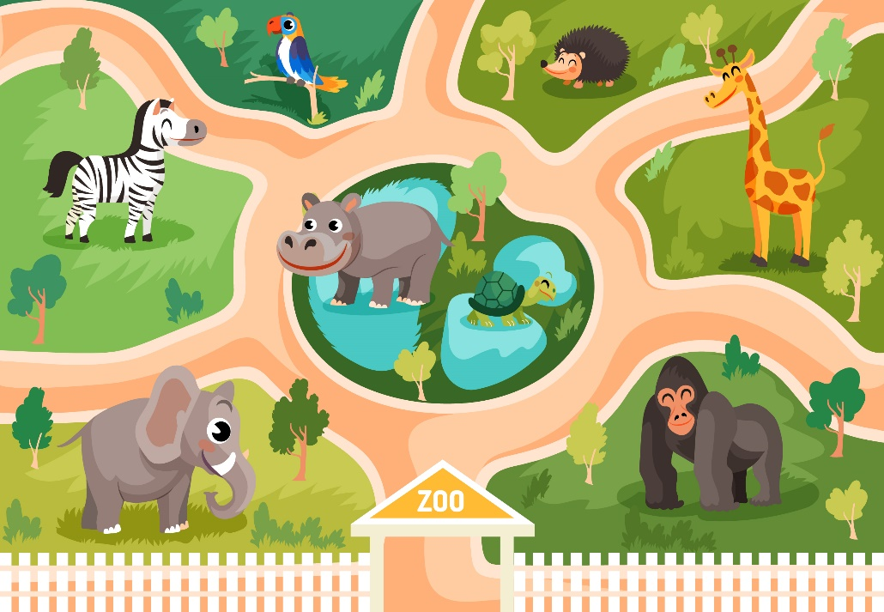
..................................
Unit
20
At the zoo
Lesson 3
Facebook : Bùi Liễu
0968142780

Slide 2

Warm-up

Slide 3

Facebook : Bùi Liễu
0968142780
Let’s play!
Notes:
Facebook : Bùi Liễu Mobile phone: 0968142780

Slide 4
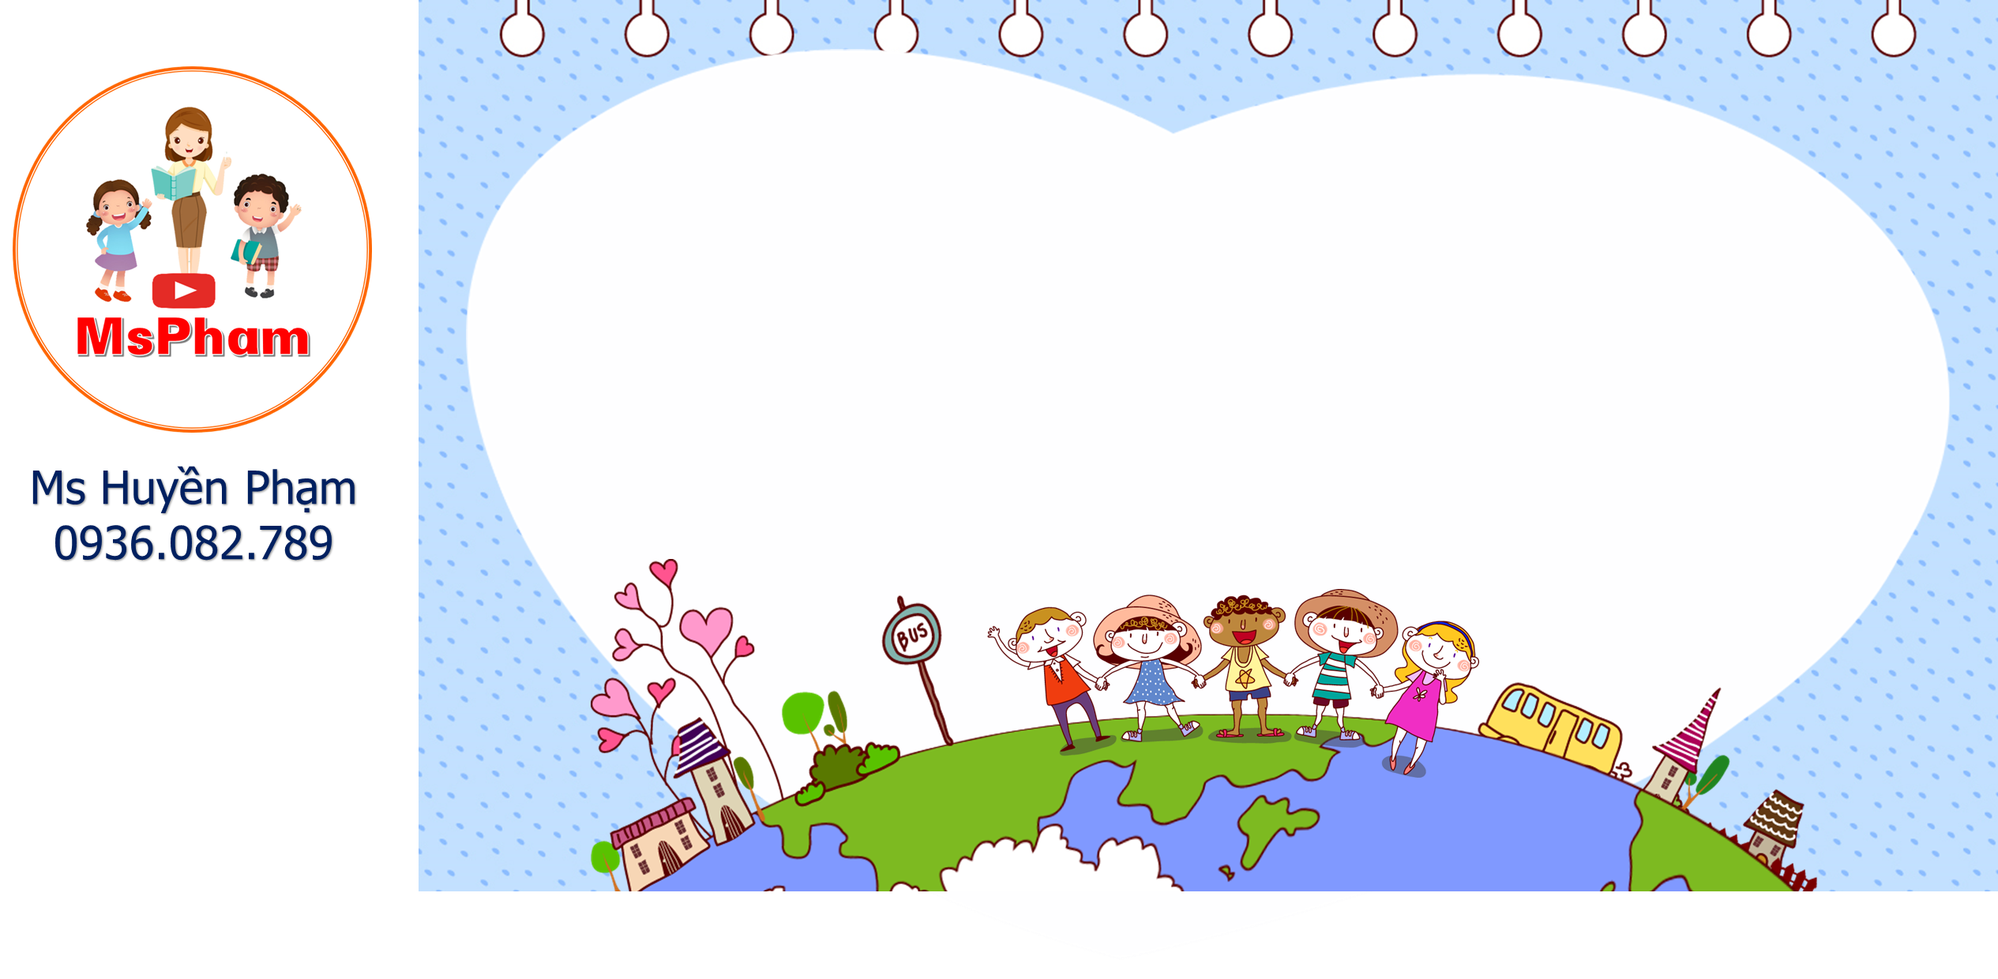

Green planet
PLAY
Notes:
Facebook : Bùi Liễu 0968142780

Slide 5
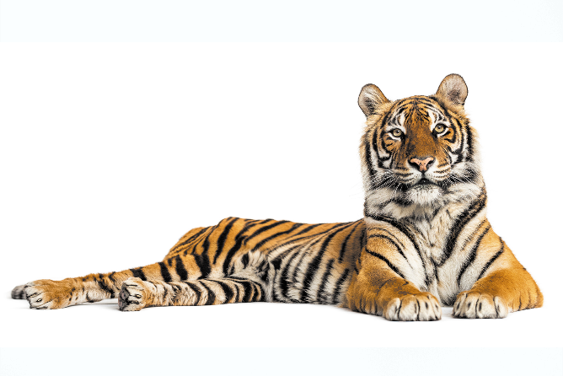







A. tiger
B. peacock
C. monkey
Notes:
Facebook : Bùi Liễu 0968142780

Slide 6
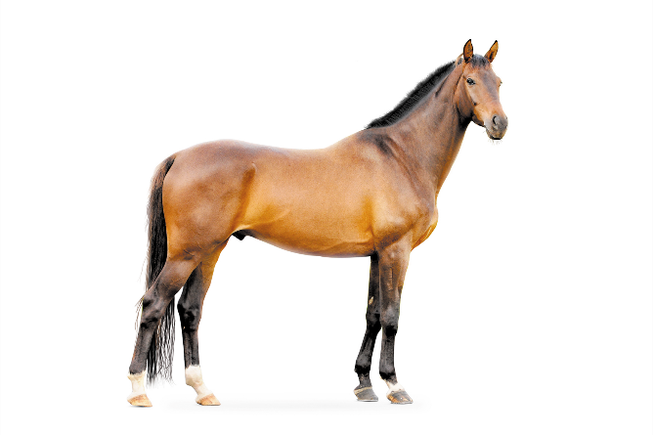
Facebook : Bùi Liễu
0968142780
A. horse
B. tiger
C. peacock
Notes:
Facebook : Bùi Liễu 0968142780

Slide 7
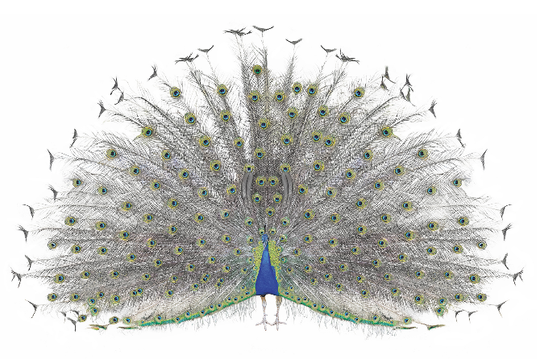




Facebook : Bùi Liễu
0968142780
A. tiger
B. monkey
C. peacock
Notes:
Facebook : Bùi Liễu 0968142780

Slide 8
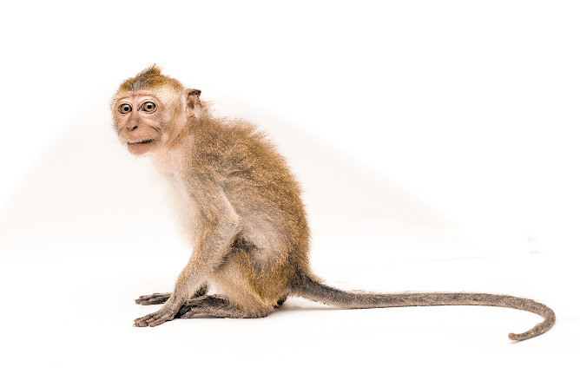


A. peacock
B. monkey
C. horse
Notes:
Facebook : Bùi Liễu 0968142780

Slide 9

tig__
A.or
B. er
C. ea
Notes:
Facebook : Bùi Liễu 0968142780

Slide 10
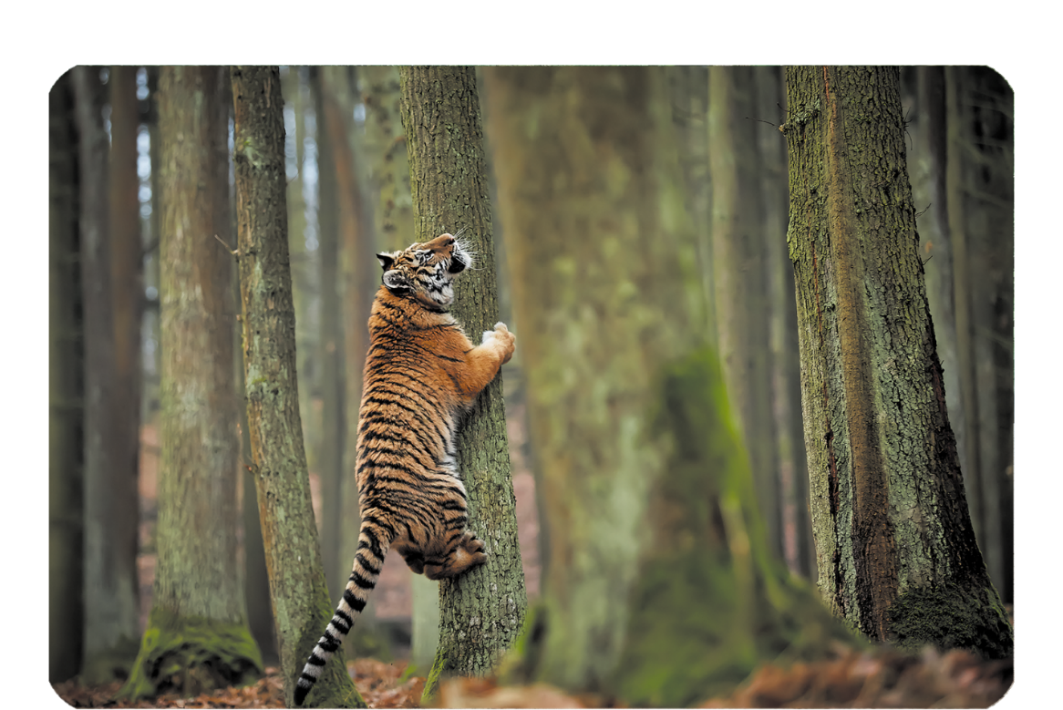
A. counting
B. climbing
Notes:
Facebook : Bùi Liễu 0968142780

Slide 11
Facebook : Bùi Liễu
0968142780
mon___
A. key
B. ney
C. kay
Notes:
Facebook : Bùi Liễu 0968142780

Slide 12
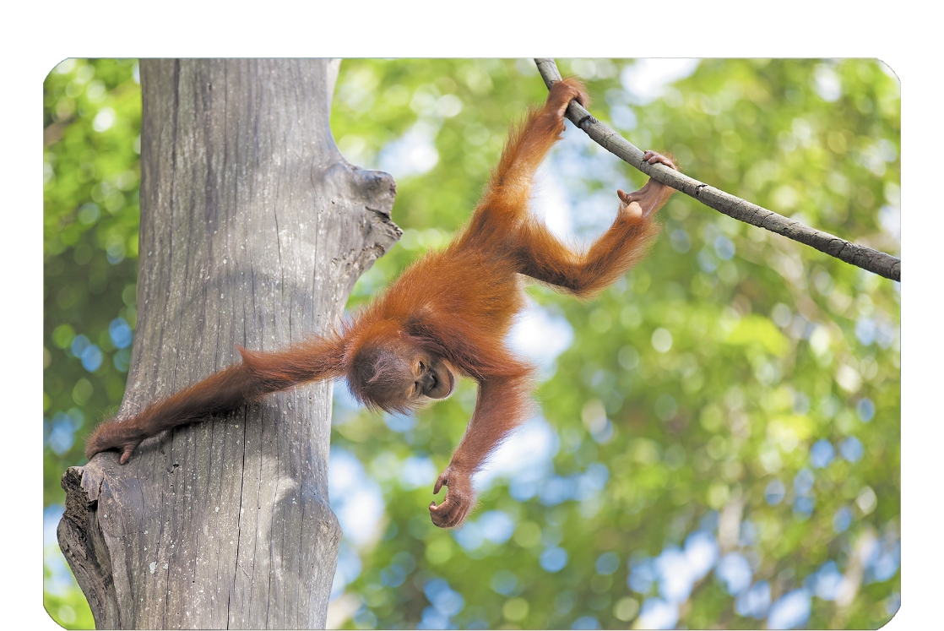
A. swinging
B. climbing
Notes:
Facebook : Bùi Liễu 0968142780

Slide 13
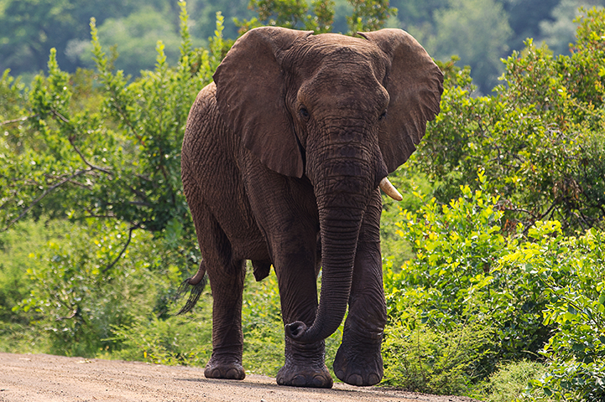
A.tiger
B. elephant
C. peacock
Notes:
Facebook : Bùi Liễu 0968142780

Slide 14
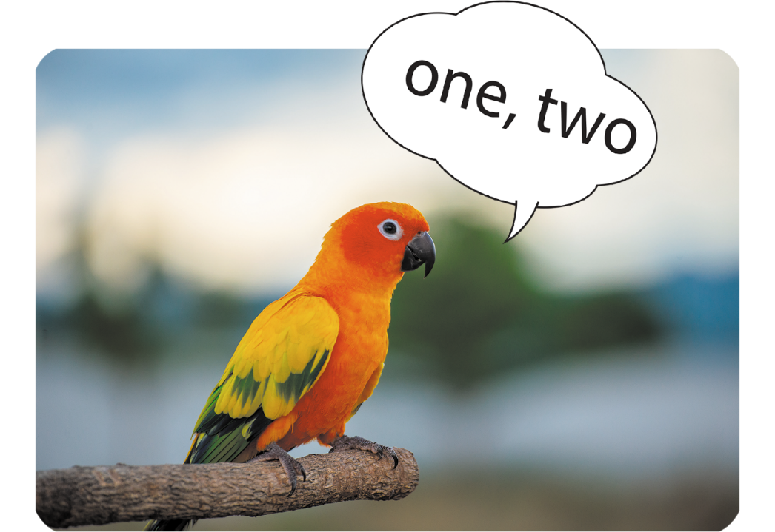
Facebook : Bùi Liễu
0968142780
A. counting
B. swinging
C.climbing
Notes:
Facebook : Bùi Liễu 0968142780

Slide 15


Facebook : Bùi Liễu
0968142780
Notes:
Facebook : Bùi Liễu 0968142780

Slide 16






Contents
Facebook : Bùi Liễu
0968142780
Listen and repeat.
Listen and circle.
Let’s chant.
Read and tick True or False.
Let’s write.
Project.

Slide 17

I have two rabbits. How many rabbits do you have?
1. Listen and repeat.
a parrot I can see a parrot.
a dancing The peacock is dancing.

Slide 18
2. Listen and circle.
1. I can see a __________.
2. The monkey is __________.
a. cat
a. dancing
b. rabbit
b. skating
c. parrot
c. drawing

Slide 19
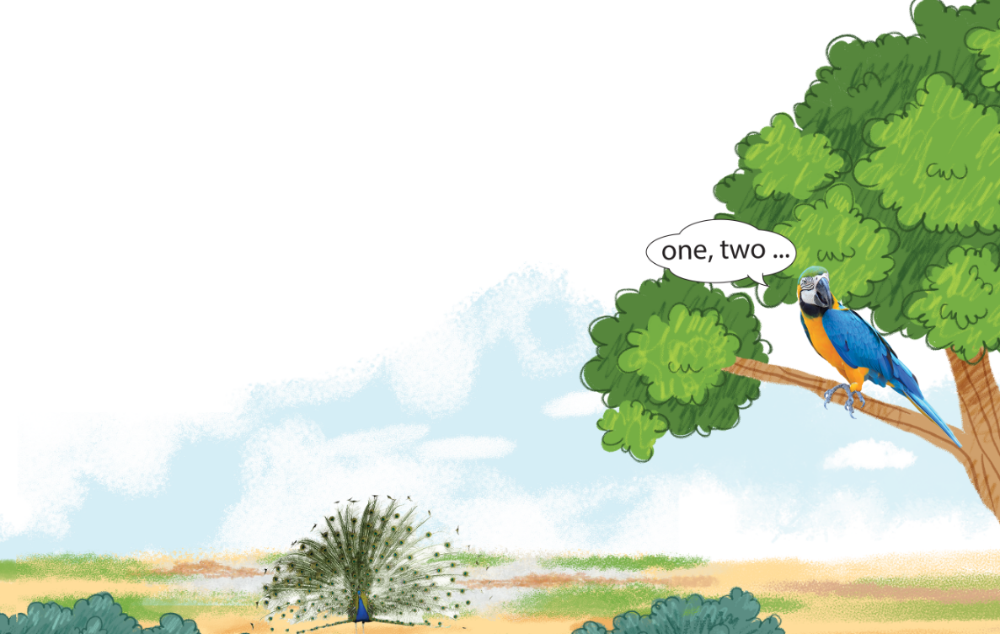
3. Let’s chant.
We can see a parrot.
The parrot is counting.
We can see a parrot.
The parrot is counting.
They can see a peacock.
The peacock is dancing.
They can see a peacock.
The peacock is dancing.

Slide 20

3. Let’s chant.
We can see a parrot.
The parrot is counting.
We can see a parrot.
The parrot is counting.
They can see a peacock.
The peacock is dancing.
They can see a peacock.
The peacock is dancing.

Slide 21


Facebook : Bùi Liễu
0968142780
Let’s play!

Slide 22








Sun flower

Slide 23


h__se
A
B
C
D
or
ow
er
on

Slide 24
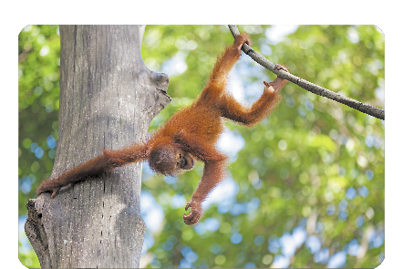
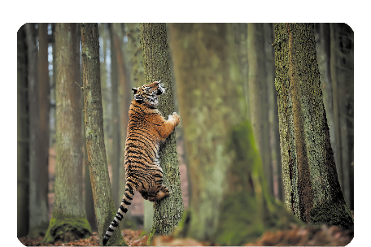
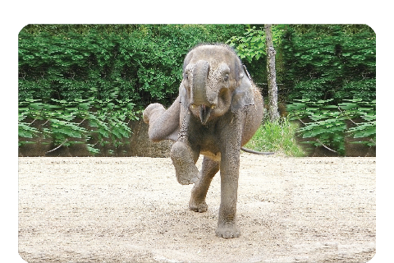
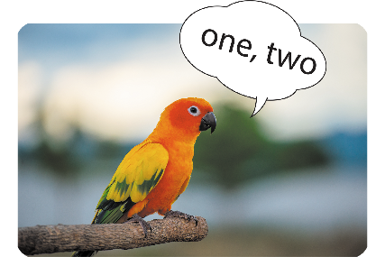
A
B
C
D
Sai
Đúng
Sai
Sai

Slide 25
mon____
A
B
C
D
kay
key
kit
ney

Slide 26
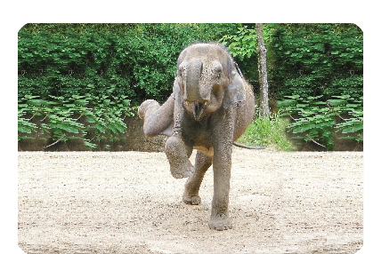
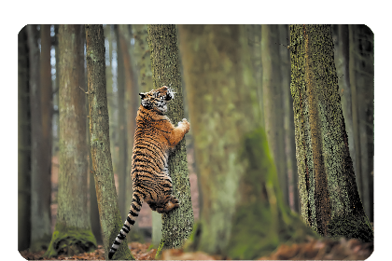

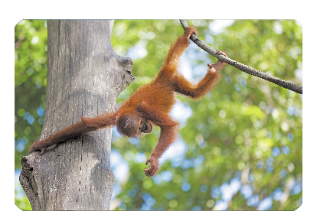
A
B
C
D
Sai
Sai
Sai
Đúng

Slide 27
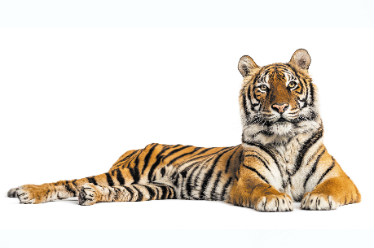
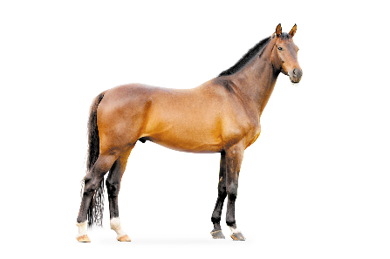


What can you see?
I can see a elephant.
A
B
C
D
Sai
Sai
Đúng
Sai

Slide 28
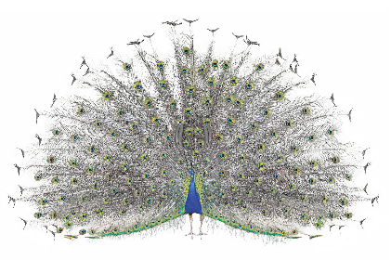


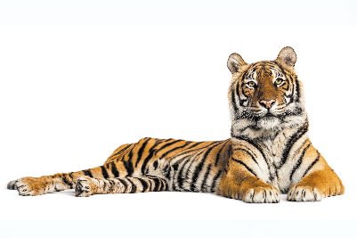
What can you see?
I can see a peacock.
Click on the flower to show the right answer.
A
B
C
D

Slide 29
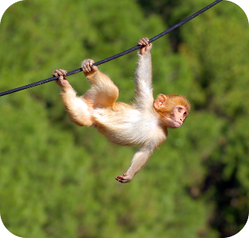
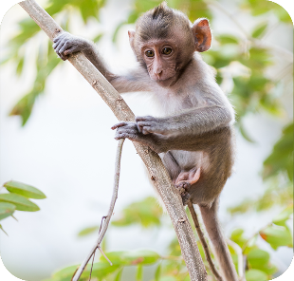

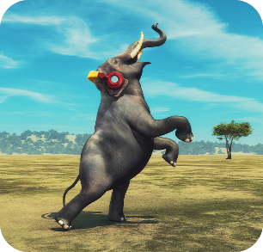
What’s the parrot doing?
It’s counting.
A
B
C
D
Sai
Sai
Đúng
Sai

Slide 30
What’s the _____ doing?
It’s climbing.
A
B
C
D
monkey
elephant
parrot
tiger

Slide 31
What’s the monkey doing?
It’s __________.
A
B
C
D
climbing
dancing
counting
swinging

Slide 32
_______ the elephant doing?
It’s dancing.
A
B
C
D
Where’re
What’re
What’s
When

Slide 33


Slide 34

I have two rabbits. How many rabbits do you have?
4. Read and tick True or False.
Linh and her mother are at the zoo. They can see many animals. A monkey is swinging. A tiger is climbing a tree. An elephant is drawing. A peacock is dancing. Linh and her mother like the animals at the zoo.
 | True | False
1. Linh and her mother are at the zoo.
2. They can see a monkey, a tiger and many peacocks.
3. A tiger is climbing a tree.
4. A peacock is dancing.

Slide 35
5. Let’s write.
My friends and I are at the zoo. We can see many the animals. A monkey is swinging. A peacock is dancing. We like atanimals the zoo.
My friends and I are at the zoo. We can see many __________. A monkey is ________. A ________ is dancing. We ________ the animals at the zoo.

Slide 36
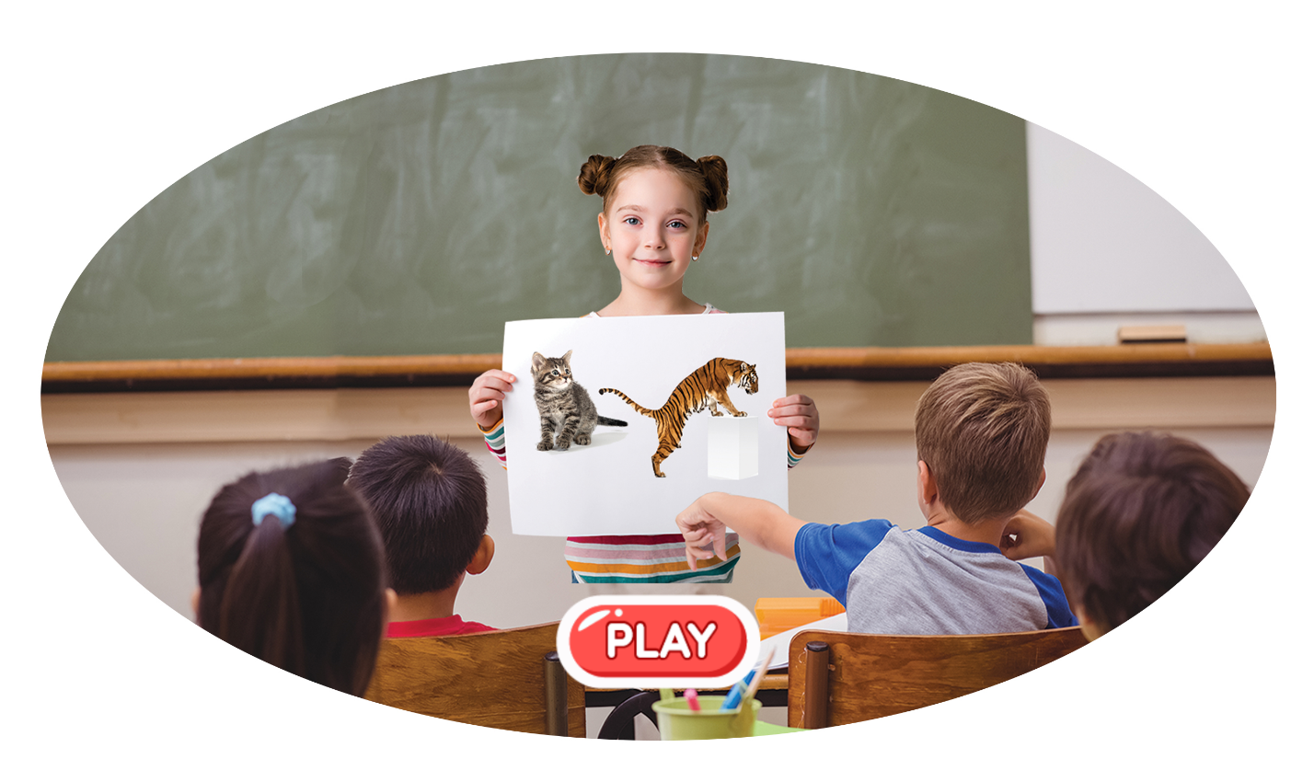
6. Project.
My favourite animals

Slide 37
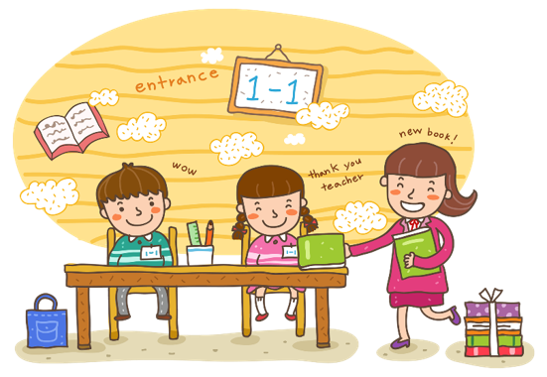
Wrap up

Slide 38




Review
a
b
What can you see?
a tiger
a horse
c
d
I can see _________.
a monkey
a peacock

Slide 39
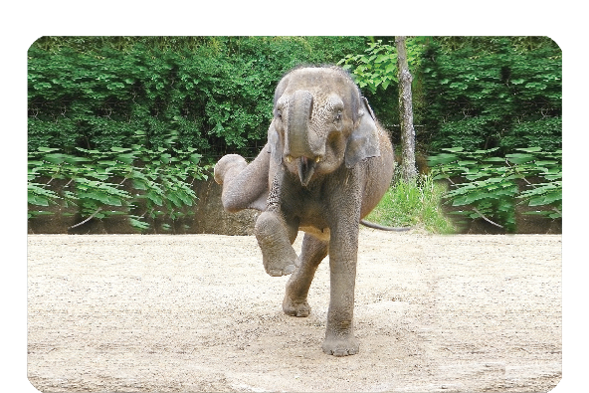



Review
a
b
What’s the ____ doing?
dancing
counting
c
d
It’s _________.
swinging
climbing

Slide 40
Homework
Learn by heart all the new words.
Read again the dialogue in part 1.

Slide 41

Facebook : Bùi Liễu
0968142780
Thank you!

