Slide 1


DAI LOC DEPARTMENT OF EDUCATION AND TRAINING
DAI QUANG PRIMARY SCHOOL
WELCOME TO OUR CLASS !
Subject: English 3
Class: 3G
Teacher: Pham Thi My Chau

Slide 2
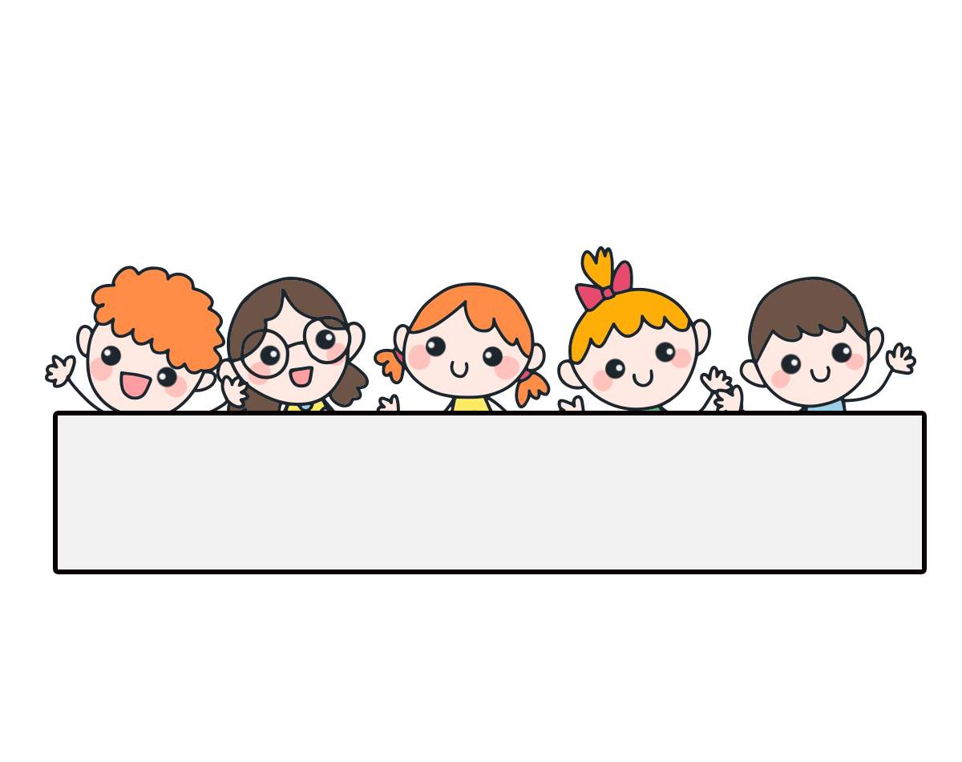
Warm-up

Slide 3

Let’s sing.

Slide 4


Tuesday, September 17th , 2024
UNIT 1 : HELLO
*Lesson 1:
Part: 4, 5 & 6

Slide 5
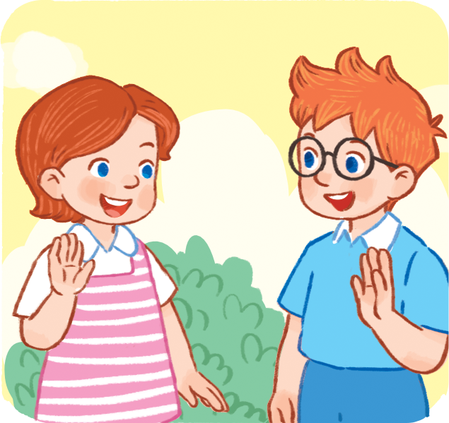
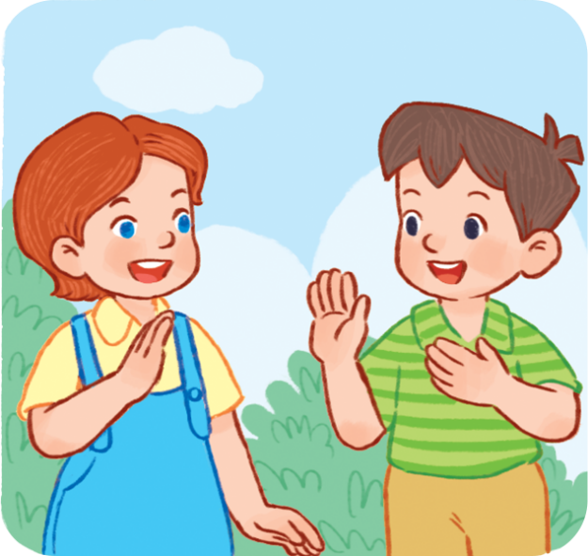
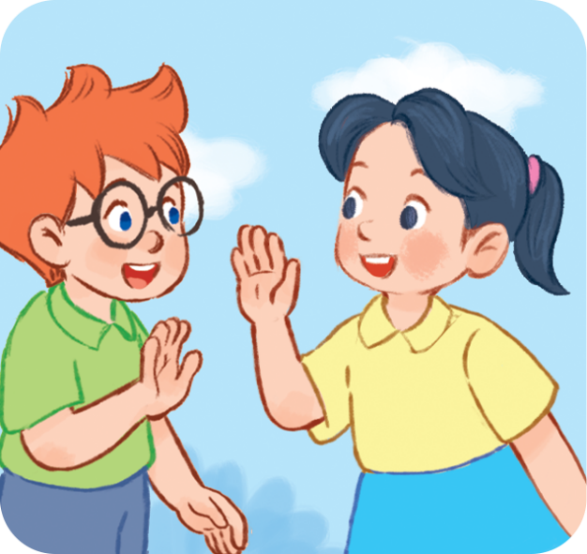
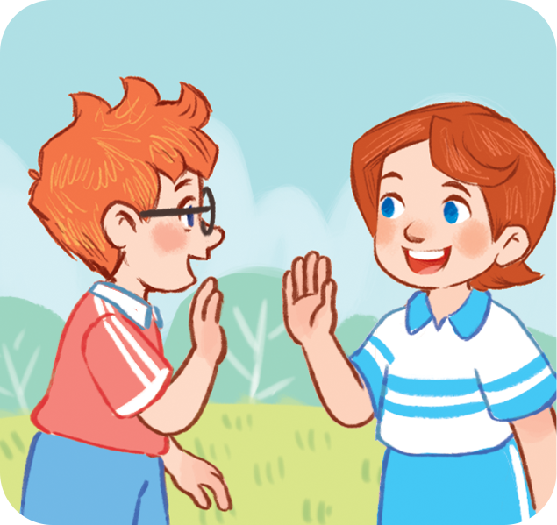
4. Listen and circle.
a
b
1
a
b
2

Slide 6

4. Listen and circle.
a
b
1

Slide 7
4. Listen and tick.
a
b
2

Slide 8
Lucy: Hello. I’m Lucy.
Minh: Hello, Lucy. I’m Minh
Ben: Hi. I’m Ben.
Mai: Hi, Ben. I’m Mai.

Slide 9
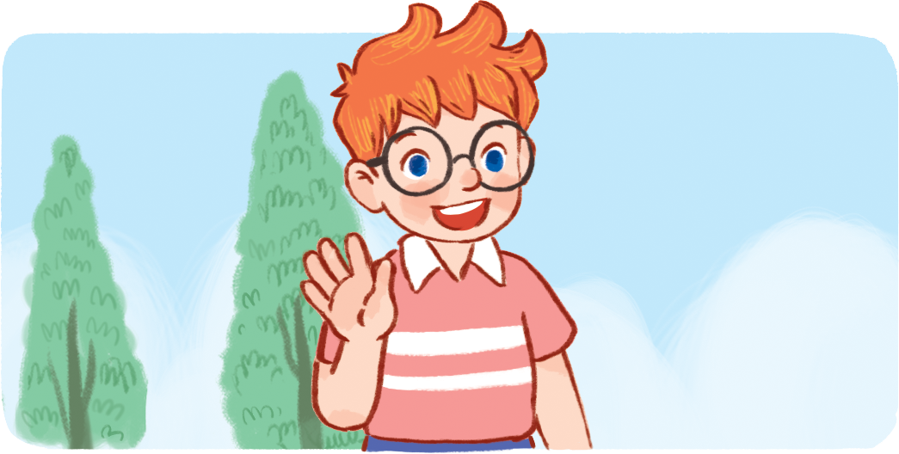

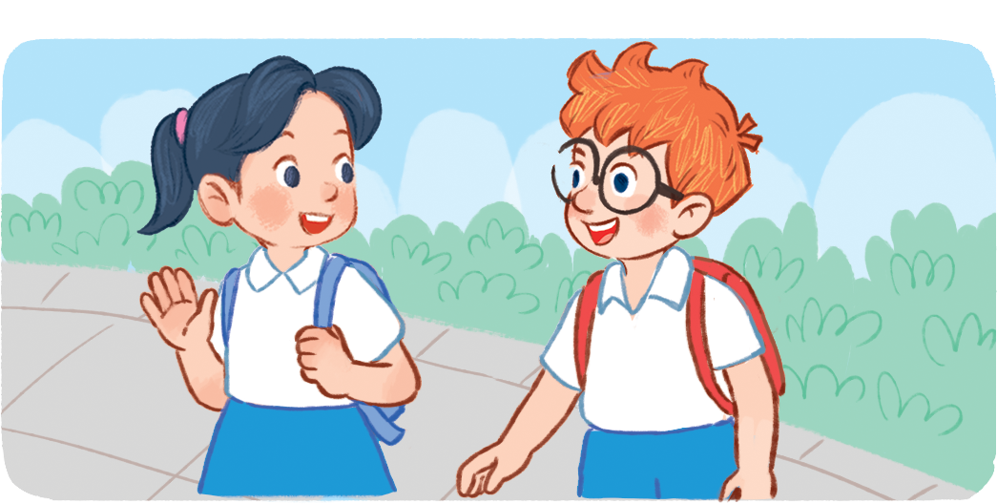
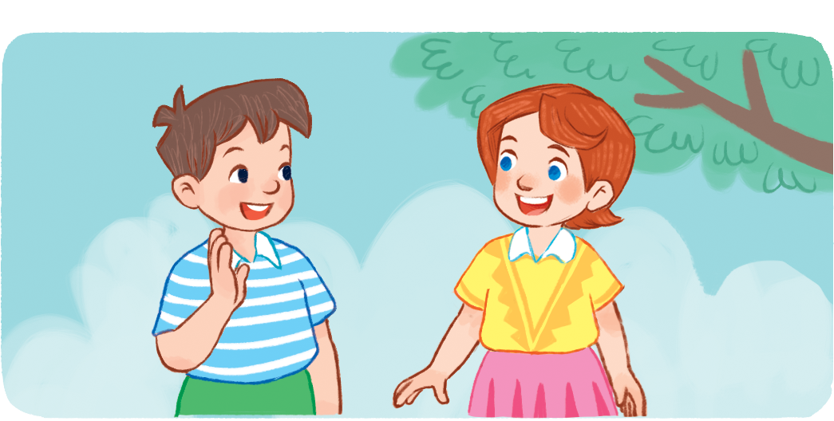
Hello
5. Look, complete and read.
Hi
1. ____. I’m Ben.
2. ____. I’m Lucy.
I’m
Hello
I’m
3. Hi, Ben. ____Mai.
4. _____, Lucy. ____ Minh.

Slide 10
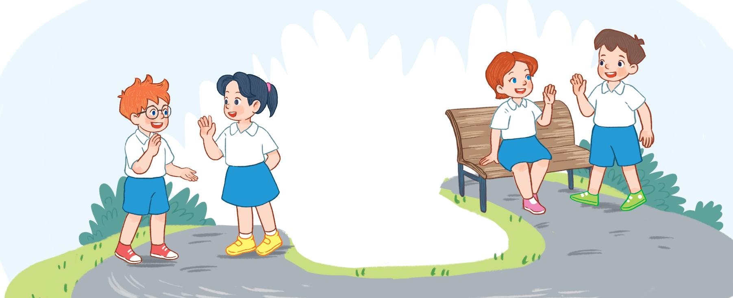
6. Let’s sing.
Hello
Hello.
Hello.
I’m Ben.
Hi, Ben.
Hi, Ben.
I’m Mai.
Hello.
Hello.
I’m Minh.
Hi, Minh.
Hi, Minh.
I’m Lucy.

Slide 11
Wrap up

Slide 12
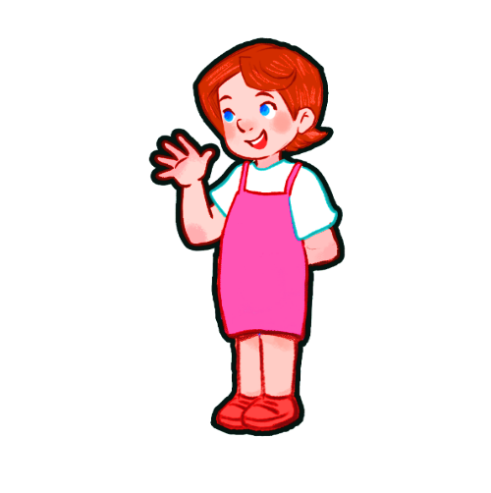
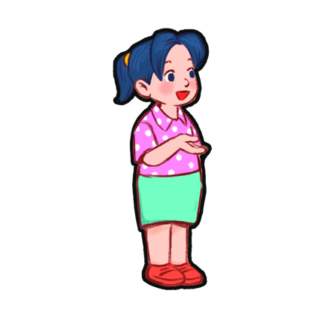

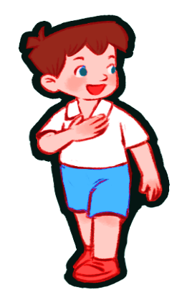
Vocabulary
Facebook : Bùi Liễu
0968142780
Ben
Lucy
Mai
Minh

Slide 13
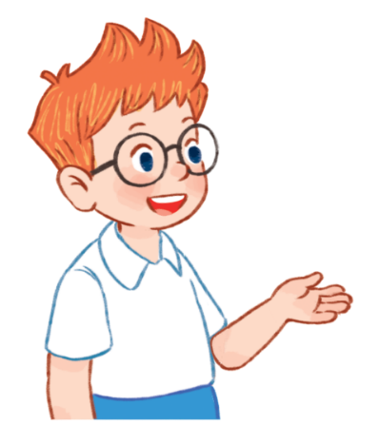



Vocabulary
Hello
Hi
hello
= hi
/heˈləʊ/
/haɪ/
xin chào
I
/aɪ/
tôi, tớ

Slide 14
Grammar
1. Chào khi gặp nhau.
Hello/Hi
2. Giới thiệu tên mình.
I’m + name
(I am = I’m)
Ví dụ:
I'm Mai. (Mình tên là Mai.)
Hi, I'm Mai. (Xin chào, mình tên là Mai.)

Slide 15
Homework
Learn by heart all the new words.
Read again the dialogue in part 1.

Slide 16

Thank you!

