Slide 1


DAI LOC DEPARTMENT OF EDUCATION AND TRAINING
DAI QUANG PRIMARY SCHOOL
WELCOME TO OUR CLASS !
Subject: English 3
Class: 3G
Teacher: Pham Thi My Chau

Slide 2

Warm-up

Slide 3

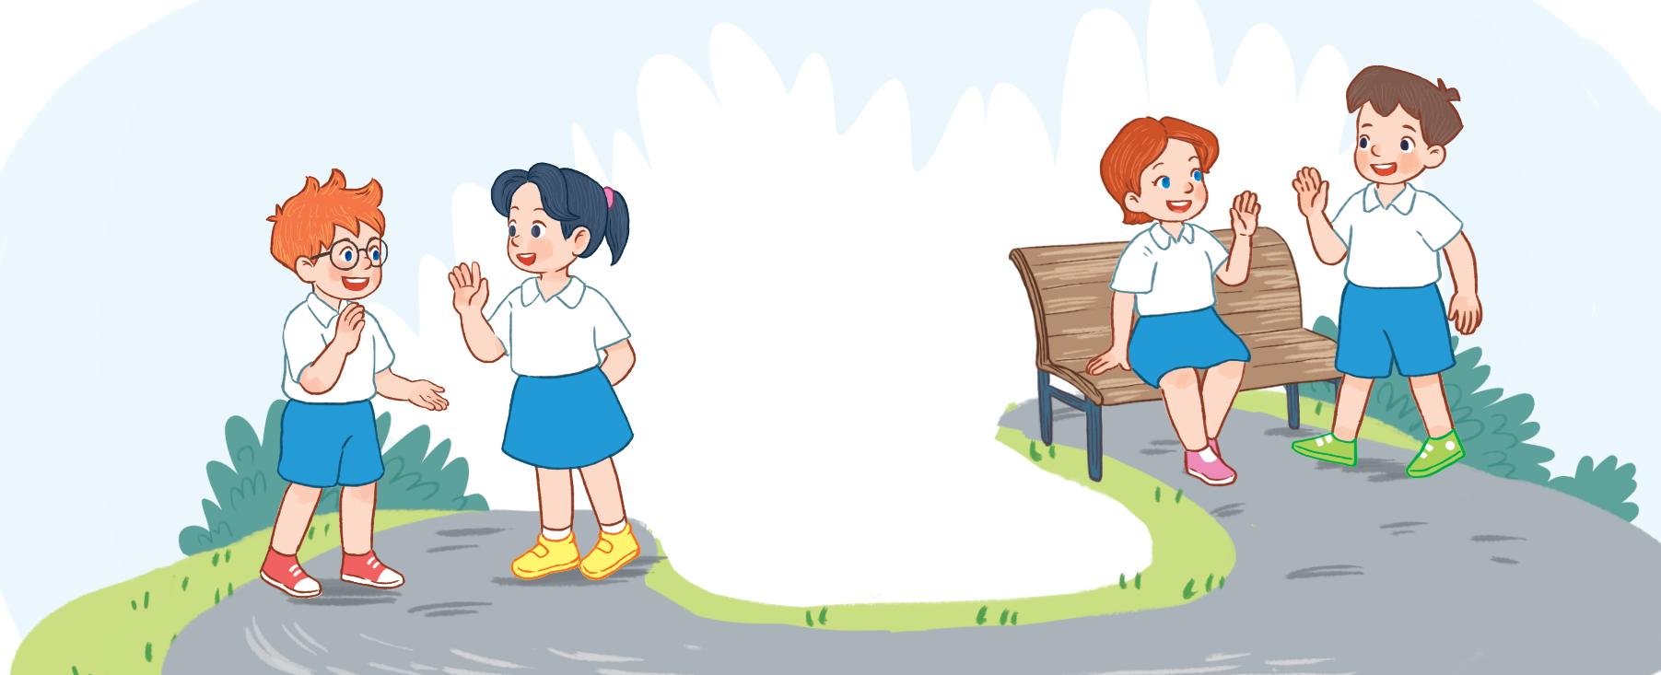
Let’s sing.
Hello
Hello.
Hello.
I’m Ben.
Hi, Ben.
Hi, Ben.
I’m Mai.
Hello.
Hello.
I’m Minh.
Hi, Minh.
Hi, Minh.
I’m Lucy.
Notes:
Facebook : Bùi Liễu
Mobile phone: 0968142780

Slide 4


Thursday, September 19th , 2024
UNIT 1 : HELLO
*Lesson 2:
Part: 1, 2 & 3

Slide 5
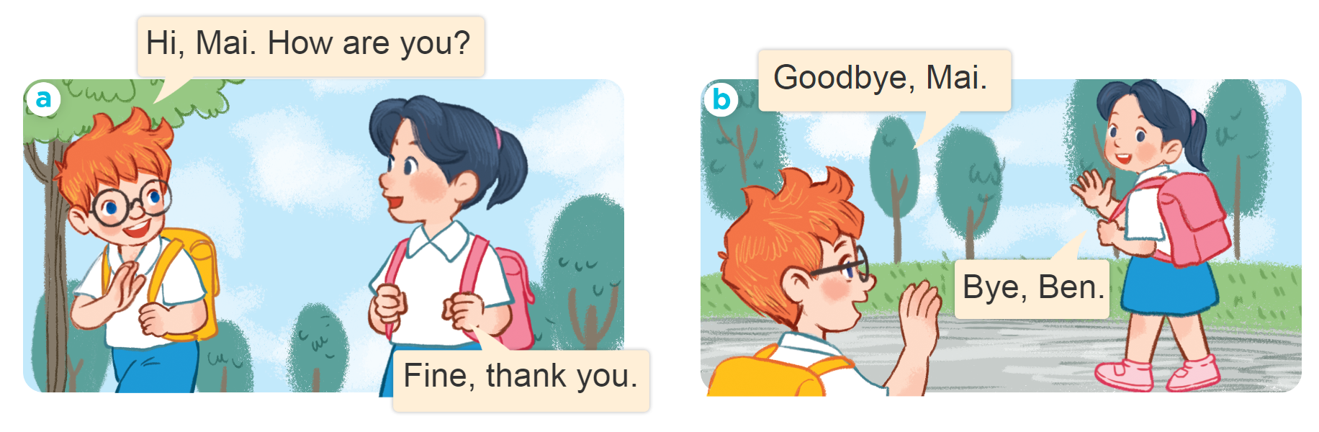
1. Look, listen and repeat.
Notes:
Facebook : Bùi Liễu
Mobile phone: 0968142780

Slide 6






1. Look, listen and repeat.
Goodbye, Mai.
Hi, Mai. How are you?
Bye, Ben.
Fine, thank you.
Notes:
Facebook : Bùi Liễu
Mobile phone: 0968142780

Slide 7
Vocabulary

Slide 8
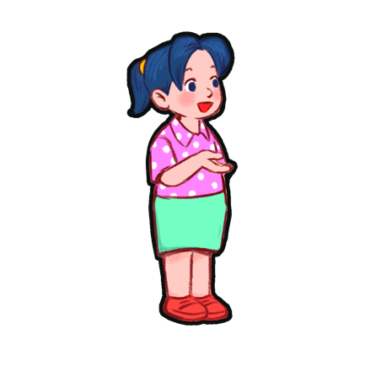

Vocabulary
you
you
/juː/
bạn

Slide 9
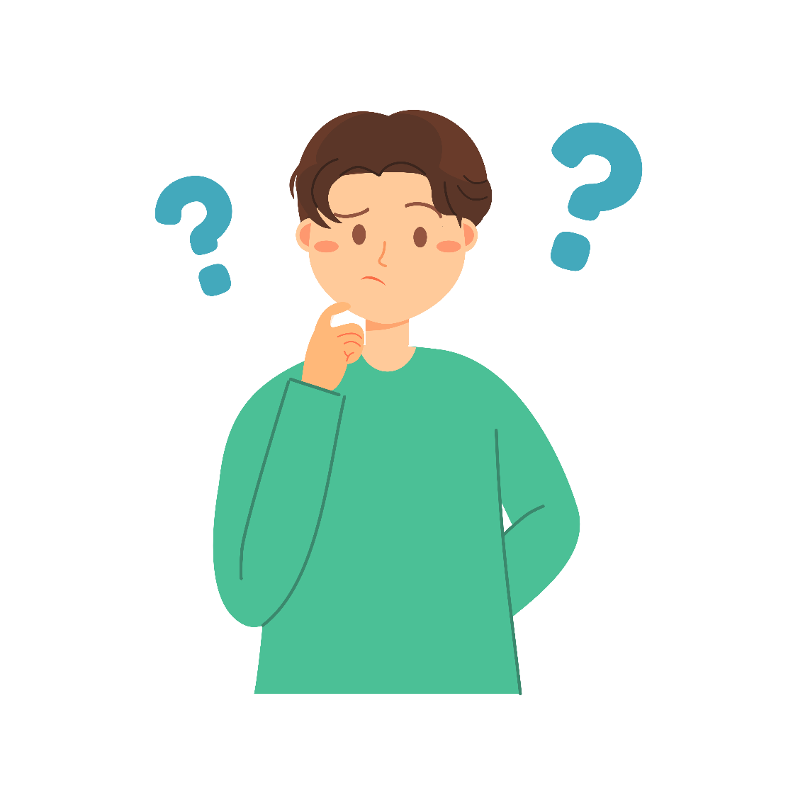
Vocabulary
How
/ haʊ /
như thế nào

Slide 10

Vocabulary
How are you?
/haʊ ɑː juː/
Bạn có khỏe không?

Slide 11

Vocabulary
fine
/faɪn/
khỏe, tốt

Slide 12
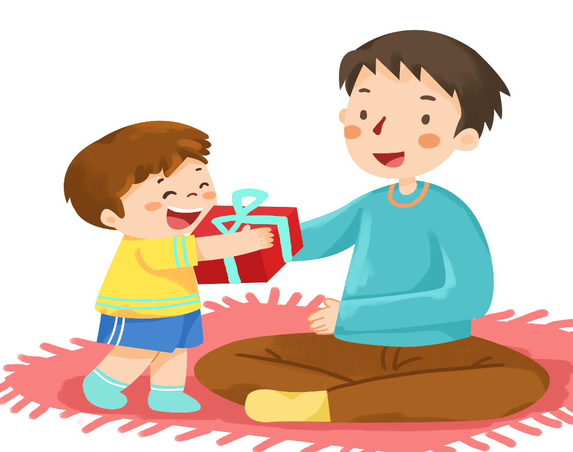

Vocabulary
Thank you
= Thanks
/ θæŋk juː /
/ θæŋks/
Cảm ơn bạn
Cảm ơn

Slide 13
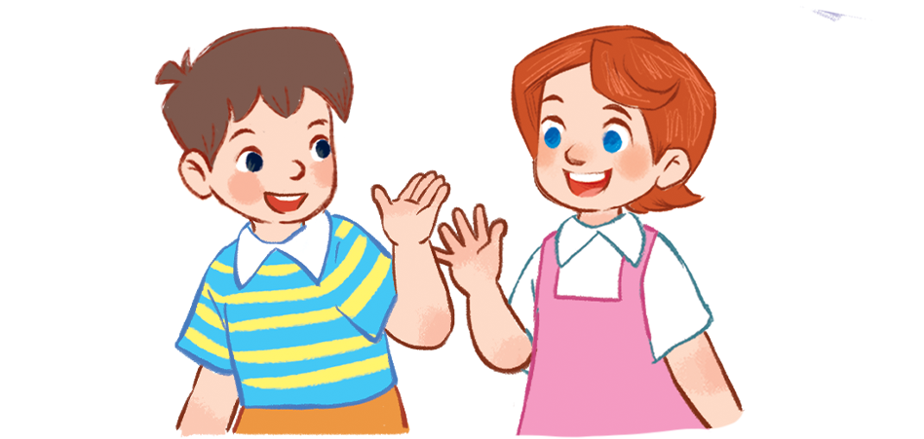
Vocabulary
Goodbye
= Bye
/ˌɡʊdˈbaɪ/
/baɪ/
Tạm biệt
Tạm biệt

Slide 14
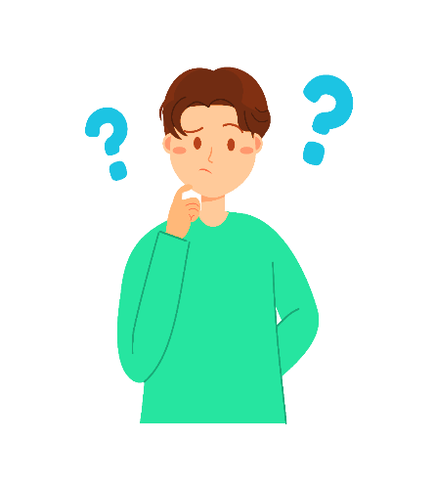



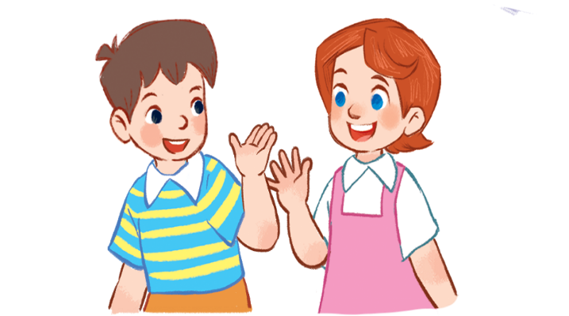
Review
you
you
how
How are you
fine
Thank you= thanks
Goodbye = bye

Slide 15
Thursday, September 5th , 2024
Unit 1: Lesson 2- P 1, 2, 3
I/ New words
you : bạn
how : như thế nào
How are you ? : Bạn có khoẻ không
Fine : tốt, khoẻ
Thank you : cảm ơn bạn
Thanks : cảm ơn
Goodbye/ bye : tạm biệt

Slide 16



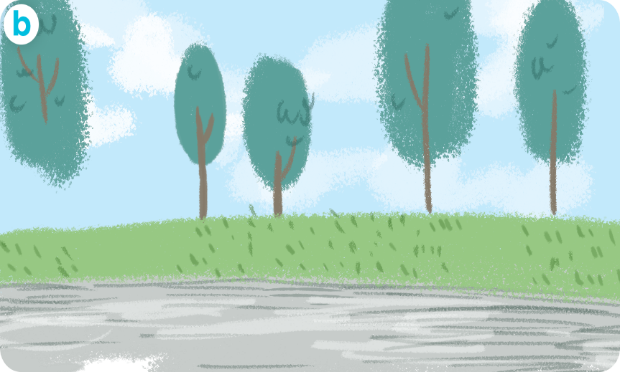


II/ Model sentence
Chào và hỏi sức khỏe.
Hi, Mai. How are you ?
Fine, Thank you.
Chào tạm biệt.
Goodbye/ bye

Slide 17
2. Listen, point and say.
Hi. How are you?
Good bye.
______, _________.
_________.
a
b
Fine, thank you
Goodbye/ Bye

Slide 18
2. Listen, point and say.
Hi. How are you?
_____, __________.
Fine thank you
a

Slide 19
2. Listen, point and say.
Good bye.
Bye
____.
b

Slide 20



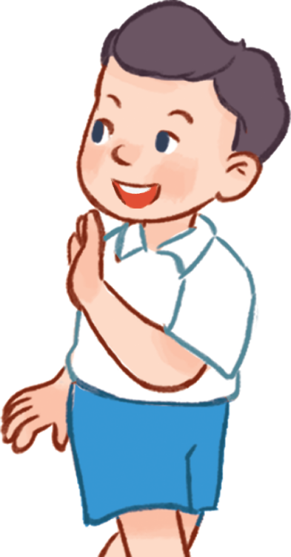
3. Let’s talk.
Hi. How are you?
Good bye / bye.
______, _________.
_________.
a
b

Slide 21
3. Let’s talk.
Hi. How are you?
_____, __________.
Fine thank you
a

Slide 22

3. Let’s talk.
Good bye / bye.
_____________.
Goodbye / Bye
b

Slide 23
Let’s play!
Notes:
Facebook : Bùi Liễu
Mobile phone: 0968142780

Slide 24
Can you guess?
Notes:
Facebook : Bùi Liễu
Mobile phone: 0968142780

Slide 25

1
2
3
4
5
6
7
8
9
next
neb
Ben

Slide 26
1
2
3
4
5
6
7
8
9
next
Mai
ima

Slide 27
1
2
3
4
5
6
7
8
9
next
inhm
Minh

Slide 28

1
2
3
4
5
6
7
8
9
next
cylu
Lucy

Slide 29
1
2
3
4
5
6
7
8
9
next
beydgoo
goodbye

Slide 30
1
2
3
you
4
5
6
Facebook : Bùi Liễu
0968142780
7
8
9
next
you
uyo

Slide 31
1
2
3
4
5
6
7
8
9
next
hwo aer ouy
How are you?

Slide 32
1
2
3
4
5
6
7
8
9
next
how
hwo

Slide 33
1
2
3
4
5
6
7
8
9
Facebook : Bùi Liễu
0968142780
next
oodg bey
Goodbye

Slide 34
1
2
3
Facebook : Bùi Liễu
0968142780
4
5
6
7
8
9
end
fine
ifne

Slide 35
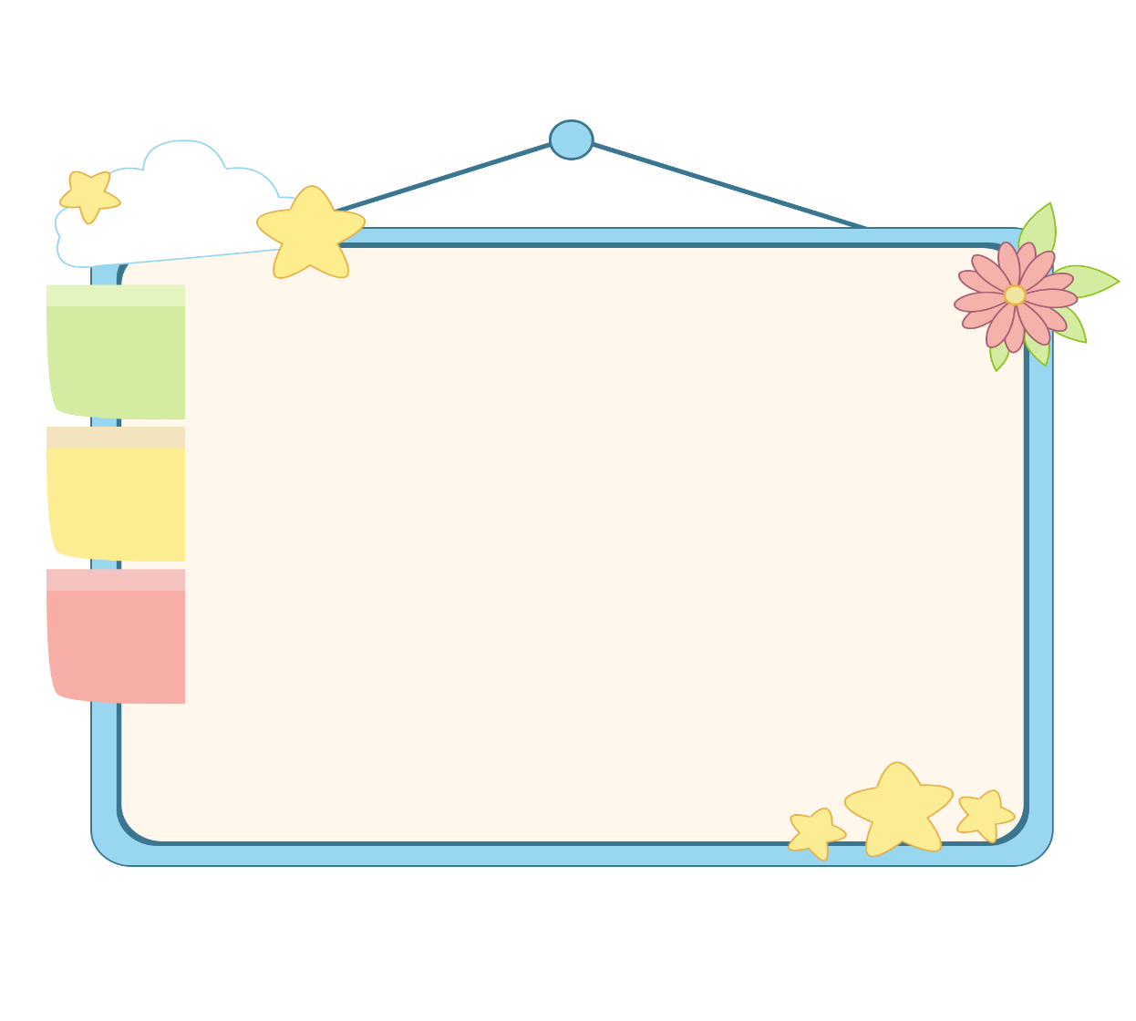
WELL DONE!

Slide 36
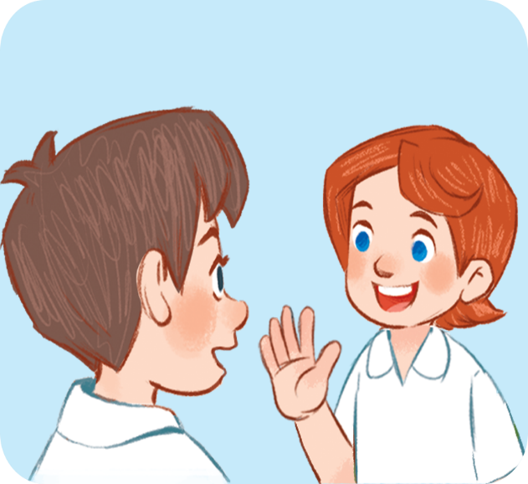

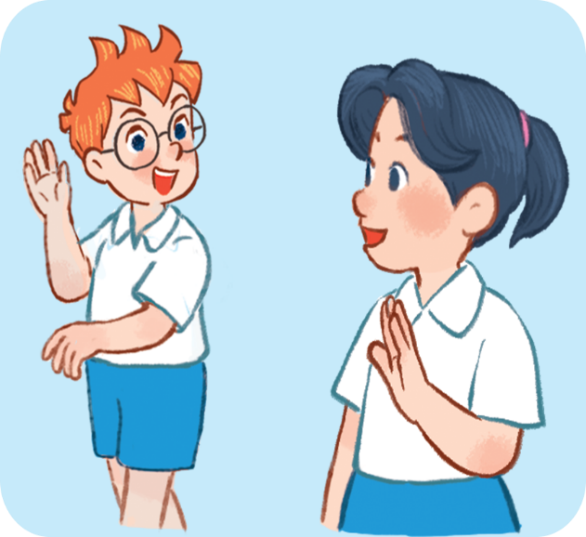
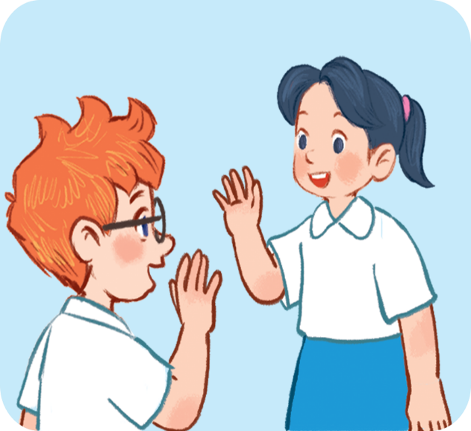




4. Listen and number.
a
b
c
d
3
4
2
1

Slide 37
Wrap up

Slide 38
Wrap up
you
you
how
How are you
fine
Thank you= thanks
Goodbye = bye

Slide 39
Grammar
Facebook : Bùi Liễu
0968142780
1. Chào và hỏi sức khỏe.
Question: Hello/Hi. How are you?
(Xin chào. Bạn có khỏe không?)
Answer: Fine. Thank you.
(Mình khỏe. Mình cảm ơn.)
2. Chào tạm biệt.
Goodbye / bye.
(Tạm biệt.)

Slide 40
Homework
Learn by heart all the new words.
Read again the dialogue in part 1.

Slide 41

Thank you!
Notes:
Facebook : Bùi Liễu
0968142780

