Slide 1

Welcome to our class!

Slide 2

Warm-up
& review

Slide 3

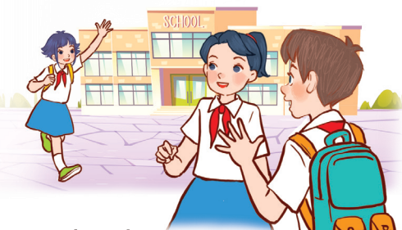
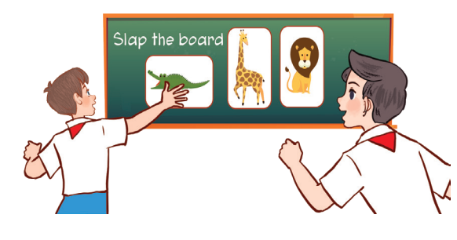
Let’s sing.
Back to school
Back to school.
Happy to see my friends!
Back to school.
Learning and playing are really cool!
Back to school.
Happy to see my teachers!
Back to school.
Learning and playing are really cool!
Click on the speaker to listen.

Slide 4

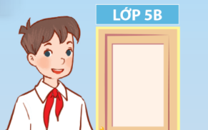
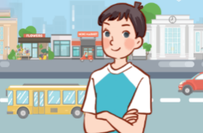
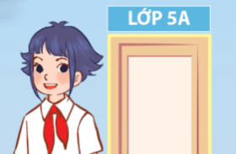
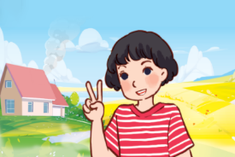
Unit 1
All about me!
Lesson 1 (1+2+3)

Slide 5



Contents
Look, listen and repeat.
Listen, point and say.
Let’s talk.

Slide 6


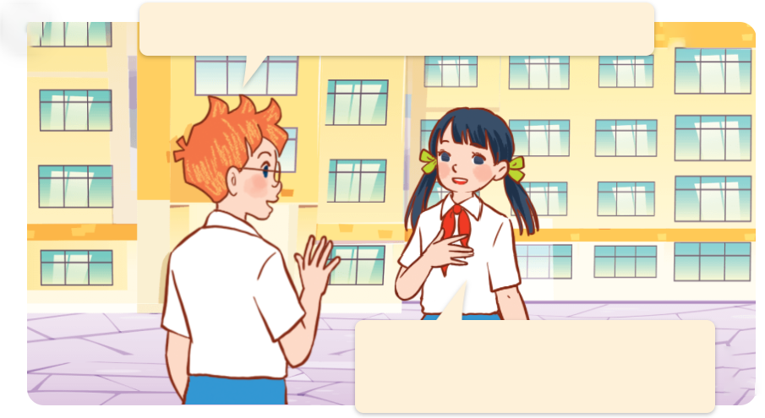
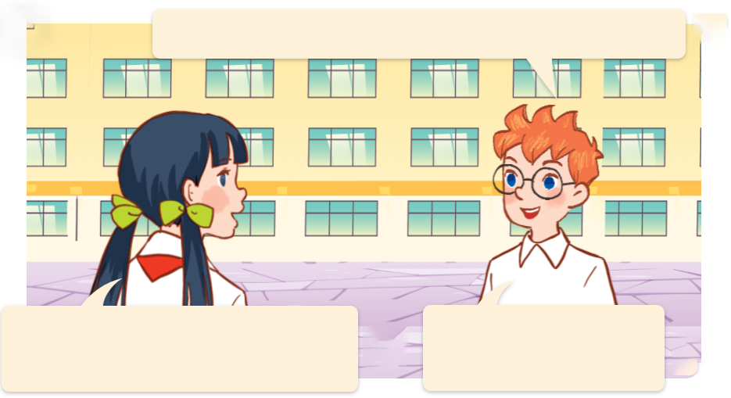
1. Look, listen and repeat.
Can you tell me about yourself, Lan?
Hello, I’m Ben.
Nice to meet you.
a
b
Hello, Ben.
I’m Lan.
Well, I’m in Class 5C.
I’m in Class 5B.
Nice to meet you, too.
I live in the
countryside.
I live in the city.
They are talking about themselves.
Where are they?
They’re at school.
Who are they?
They are Ben and Lan.
What are they talking about?
Nhấn vào loa để chạy chữ và nghe toàn bài.
Nhấn vào từng câu để nghe lại, muốn nghe lại bao nhiêu lần thì ấn vào câu đó bấy nhiêu lần.

Slide 7
Vocabulary

Slide 8
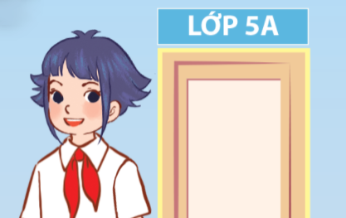
Class 5A
/klɑːs faɪv eɪ/
Lớp 5A
Click on the English word to listen again.

Slide 9

Class 5B
/klɑːs faɪv bɪː/
Lớp 5B

Slide 10
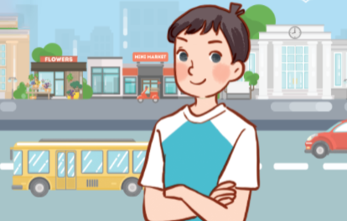
city
/ˈsɪt.ɪ/
thành phố

Slide 11

countryside
/ˈkʌn.trɪ.saɪd/
nông thôn

Slide 12
Review
Class 5A
Class 5B
city
countryside
Click on the English word to listen again.

Slide 13



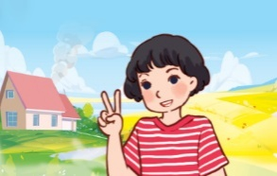
Vocabulary
1. Class 5A
: Lớp 5A
2. Class 5B
: Lớp 5B
3. city
: thành phố
4. countryside
: nông thôn
Click on the English word to listen again.

Slide 14

Checking vocabulary!

Slide 15

LOOK AND CHOOSE!

Slide 16




Look and choose.
a
b
countryside

Slide 17
Look and choose.
a
b
Class 5A

Slide 18
Look and choose.
a
b
city

Slide 19
Look and choose.
a
b
Class 5B

Slide 20
Well done!

Slide 21
Structures

Slide 22




Hỏi và giới thiệu bản thân:
Can you tell me about yourself?
I’m in _____.
I live in the ____.
Example:
Can you tell me about yourself?
I live in the city.

Slide 23


Unit 1 lesson 1 (1+2+3)
Can you tell me about yourself?
I’m in _______.
I live in the ____.
Class 5A
countryside
Class 5B
city

Slide 24
2. Listen, point and say.
a
b
Can you tell me about yourself?
Class 5A
Class 5B
I’m in ______.
c
d
I live in the ______.
city
countryside
Click on the phrases to listen again.

Slide 25


2. Listen, point and say.
a
Class 5A
Can you tell me about yourself?
I’m in Class 5A.
Click on the sentences to listen.

Slide 26


2. Listen, point and say.
b
Class 5B
Can you tell me about yourself?
I’m in Class 5B.

Slide 27

2. Listen, point and say.
c
city
Can you tell me about yourself?
I live in the city.

Slide 28


2. Listen, point and say.
d
countryside
Can you tell me about yourself?
I live in the countryside.

Slide 29
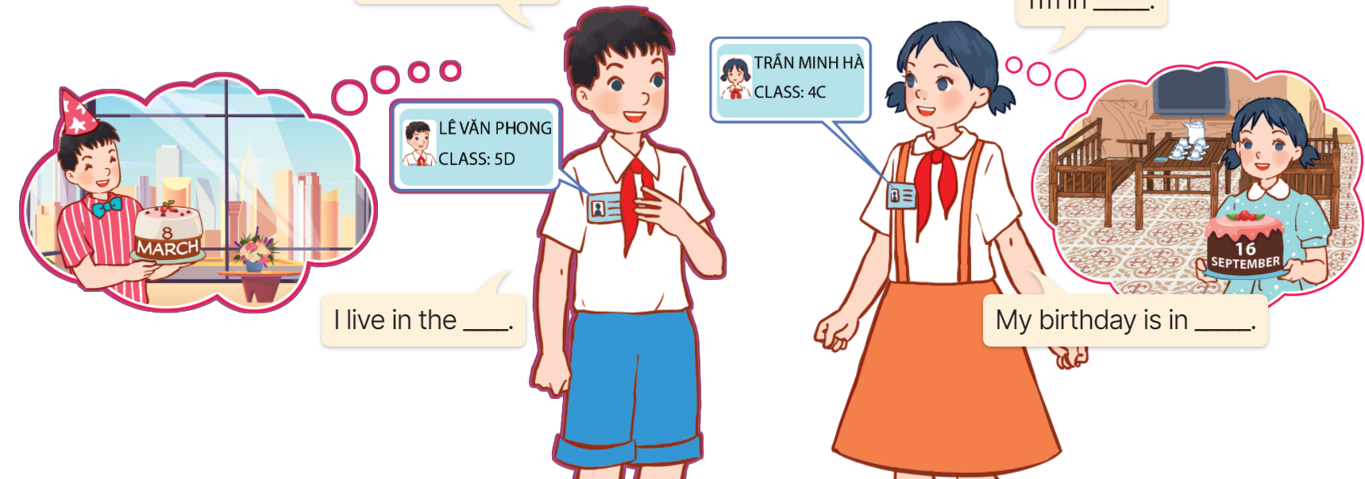
3. Let’s talk.
Can you tell me about yourself?
My name’s ____.
I’m in ______.
I live in the ____.
My birthday is in ____

Slide 30
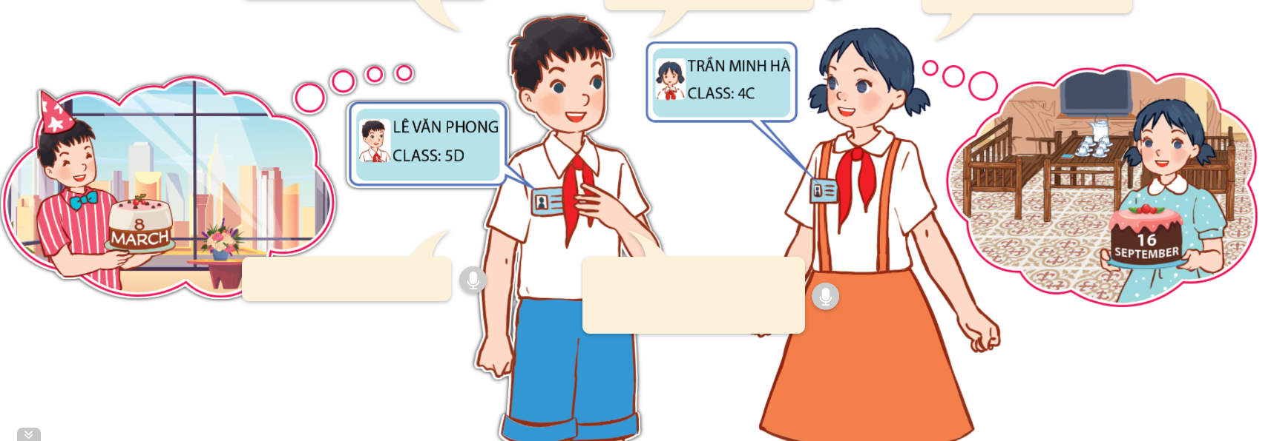
3. Let’s talk.
My name’s ______.
Phong
I’m in ________.
Can you tell me about yourself?
Class 5D
city
I live in the ____.
My birthday is in ______.
March

Slide 31
3. Let’s talk.
My name’s ____.
Ha
Can you tell me about yourself?
I’m in ________.
Class 4C
I live in the __________.
countryside
My birthday is in _________.
September

Slide 32
Fun corner
& wrap-up

Slide 33

DORAEMON

Slide 34


1/10
A. city
B. Class 5B
C. countryside
D. Class 5A

Slide 35
2/10
A. city
B. Class 5B
C. Class 5A
D. countryside

Slide 36


3/10
Choose the odd one out.
A. city
B. roar
C. sing
D. run

Slide 37
A: Can you tell me about yourself?
B: I live in the ____.
4/10
A. town
B. mountains
C. countryside
D. city

Slide 38
5/10
A: Can you tell me about yourself?
B: I’m in ____.
A. Class 5B
B. village
C. Class 5A
D. city

Slide 39
6/10
A: Can you tell me about yourself?
B: I live in the countryside.
A. True
B. False

Slide 40

7/10
Listen and choose.
A. True
B. False

Slide 41


Listen and choose.
8/10
A.
B.
C.
D.

Slide 42
Listen and choose.
9/10
A.
B.
D.
C.

Slide 43

10/10
Listen and choose.
A.
B.
C.
D.

Slide 44

Good job!

Slide 45
Unit 1 lesson 1 (1+2+3)
Can you tell me about yourself?
I’m in _______.
I live in the ____.
Class 5A
countryside
Class 5B
city

Slide 46
Homework
Learn by heart all the new words and the model sentences.
Read again the dialogue in part 1.
Prepare for lesson 1 (4+5+6).

Slide 47

Goodbye!

