Slide 1

Welcome to
our class!

Slide 2
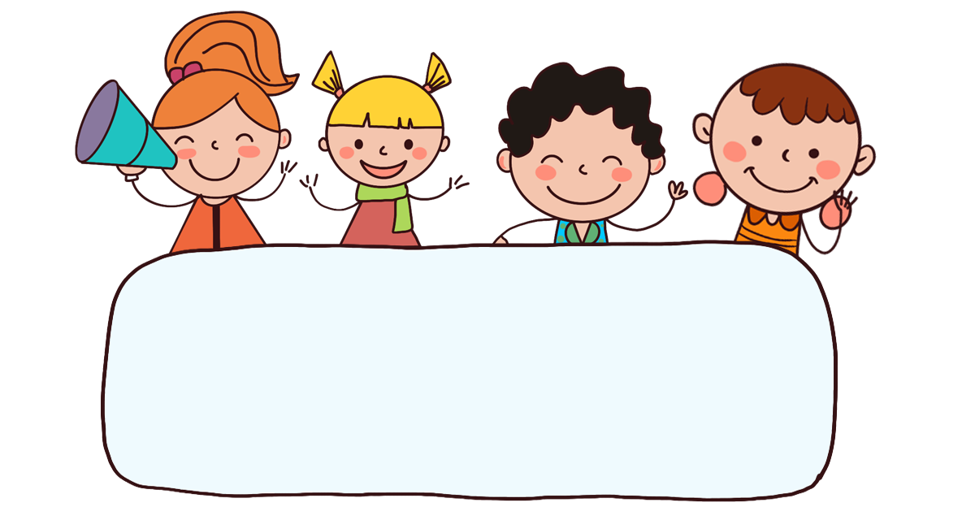
Warm-up
& review

Slide 3

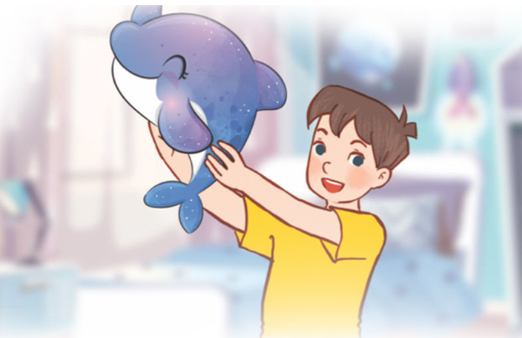
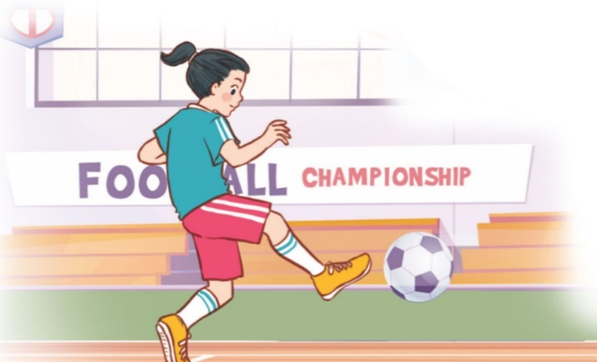
Let’s chant.
What’s your favourite animal?
Do you like pandas?
No, I don’t.
I don’t like pandas.
I like dolphins.
What’s your favourite sport?
Do you like tennis?
No, I don’t.
I don’t like tennis.
I like football.

Slide 4

PASS THE BALL
Notes:
Pass the balls. When the music stops, whoever has a ball must stand up then ask and answer the question on the PowerPoint.

Slide 5
PASS THE BALL!
STOP!

Slide 6
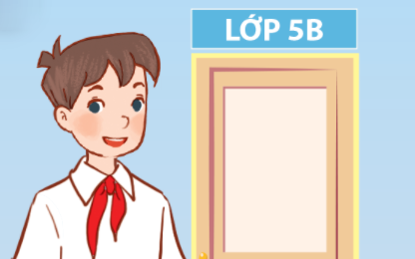
1/4
A: Can you tell me about yourself?
B: I’m in Class 5B.

Slide 7
PASS THE BALL!
STOP!

Slide 8
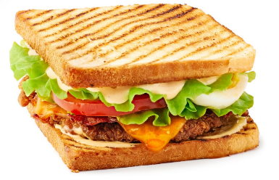
2/4
A: What’s your favourite food?
B: It’s a sandwich.

Slide 9
PASS THE BALL!
STOP!

Slide 10
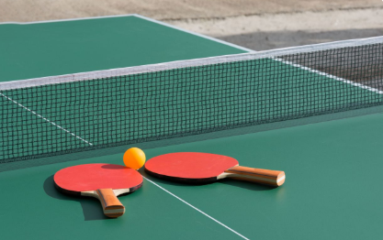
3/4
A: What’s your favourite sport?
B: It’s table tennis.

Slide 11
PASS THE BALL!
STOP!

Slide 12
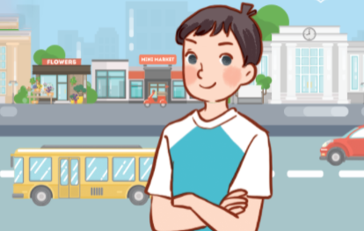

4/4
A: Can you tell me about yourself?
B: I live in the city.

Slide 13
Good job!

Slide 14

Monday, July 15th 2024
Unit 1
All about me!
Lesson 3 (4+5+6)

Slide 15



Contents
Read and circle.
Let’s write.
Project.

Slide 16
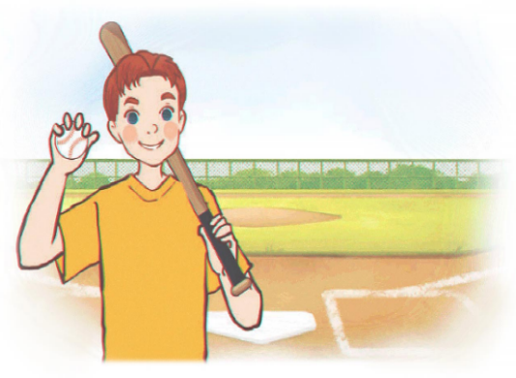
4. Read and circle.
Hi, all. Let me tell you a little bit about myself. My name’s Tom. I’m in Grade 5. I live in a big city. My favourite subject is maths. My favourite food is fish and chips. I’m a big fan of baseball. It’s really fun.
1
2
1. Tom lives in ________.
a. a big village
b. a big city
c. a big town
2. He likes ________
a. fish and rice
b. chicken and chips
c. fish and chips

Slide 17
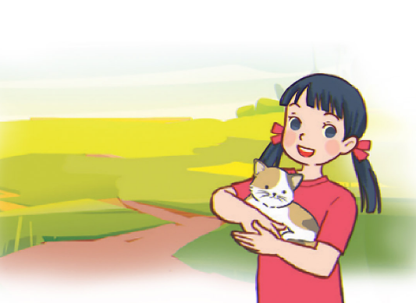
4. Read and circle.
Hello, everyone. Let me introduce myself. My full name’s Le Mai Lan. You can call me Lan. I’m in Class 5C. I live in the countryside. I love pets. I have two kittens and a rabbit. My favourite colour is pink. My favourite food is chicken pho. Yum!
3
4
3. Lan is in ________.
a. Class 4C
b. Class 5C
c. Class 3C
4. Her favourite colour is _______.
a. pink
b. green
c. blue

Slide 18
5. Let’s write.
My name is ______. I live in the ______________. I am in Class _____. My favourite sport is _______. My favourite food is ________. My favourite colour is ______. My favourite animal is _______. What about you? What are your favourite things?
countryside
Nam
5A
football
chicken
yellow
dog

Slide 19
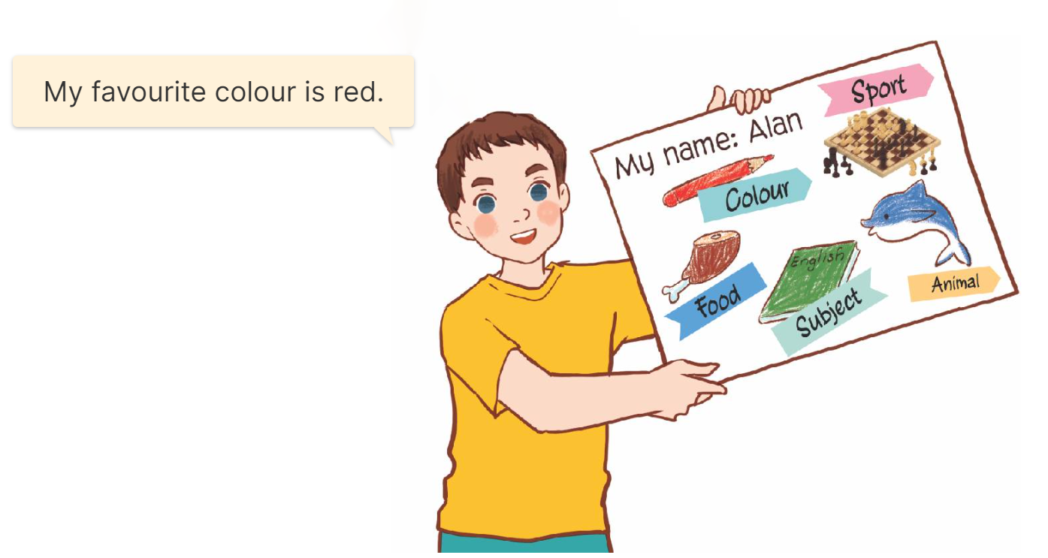
6. Project.
My favourite things

Slide 20
Fun corner
& wrap-up

Slide 21

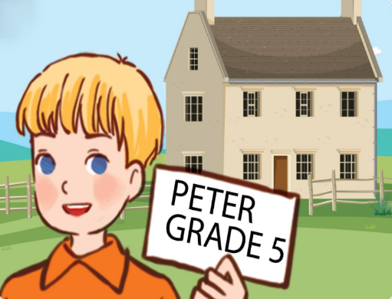
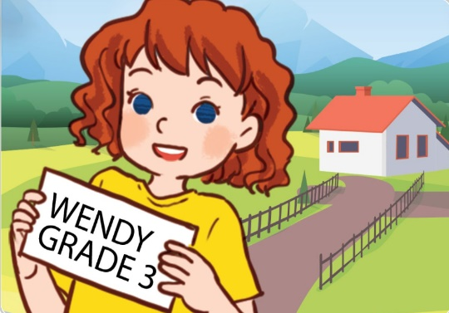
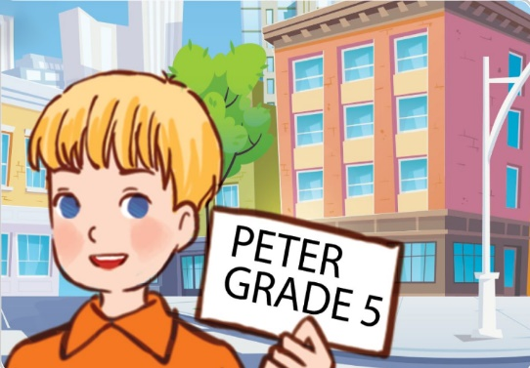


1/8
Listen and choose.
A B C

Slide 22
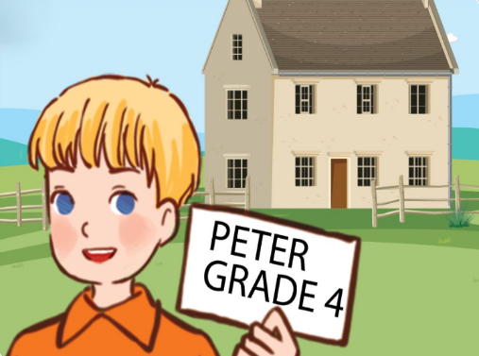
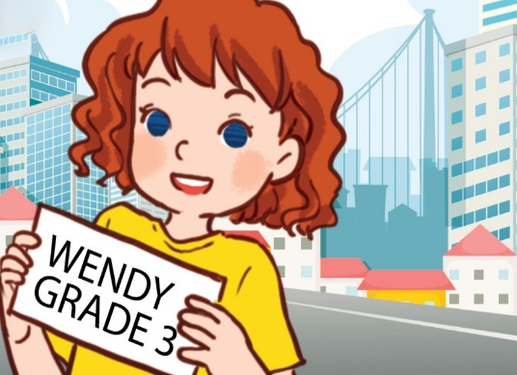
2/8
A B C

Slide 23
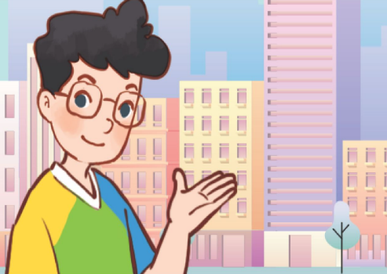
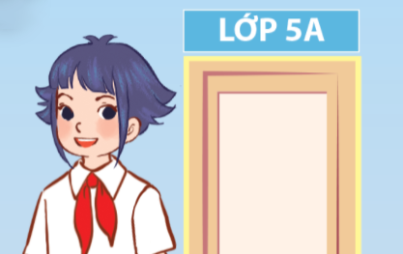
3/8
A B C

Slide 24

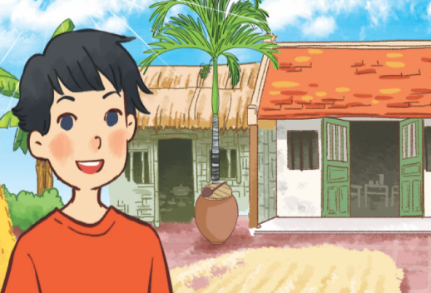
4/8
A B C

Slide 25
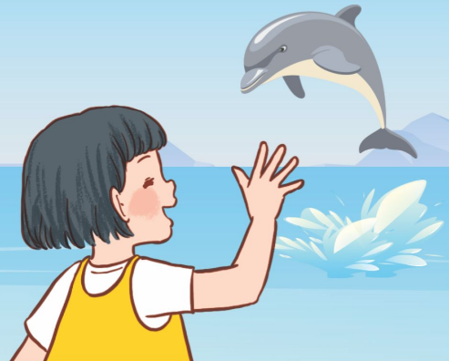

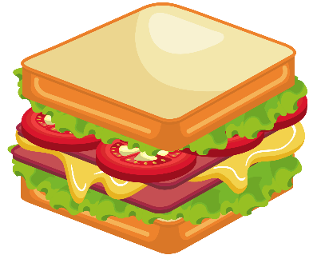
5/8
A B C

Slide 26
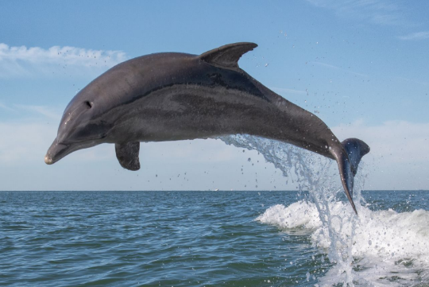
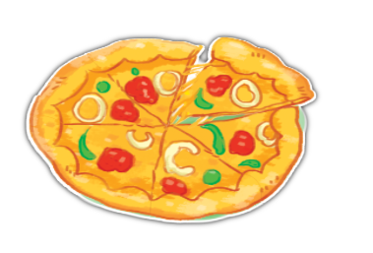
6/8
A B C

Slide 27
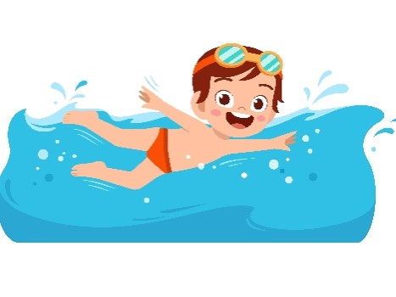


7/8
A B C

Slide 28
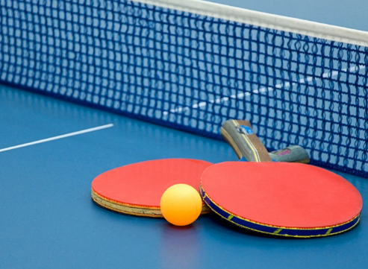
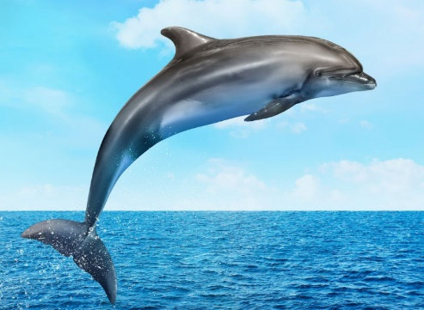

8/8
A B C

Slide 29
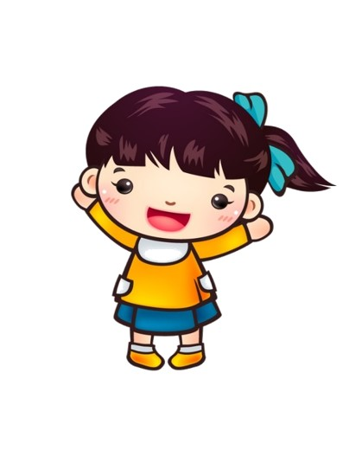
Thank you!

Slide 30


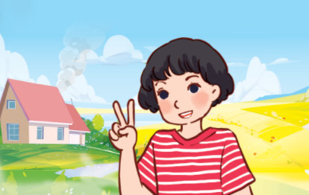
Unit 1 lesson 1
Can you tell me about yourself?
I’m in _______.
I live in the ____.
Class 5A
countryside
Class 5B
city

Slide 31




Unit 1 lesson 2
What’s your favourite _____?
It’s _______.
sport / table tennis
food / a sandwich
colour / pink
animal / a dolphin

Slide 32
Homework
……………………………………….
……………………………………….

Slide 33

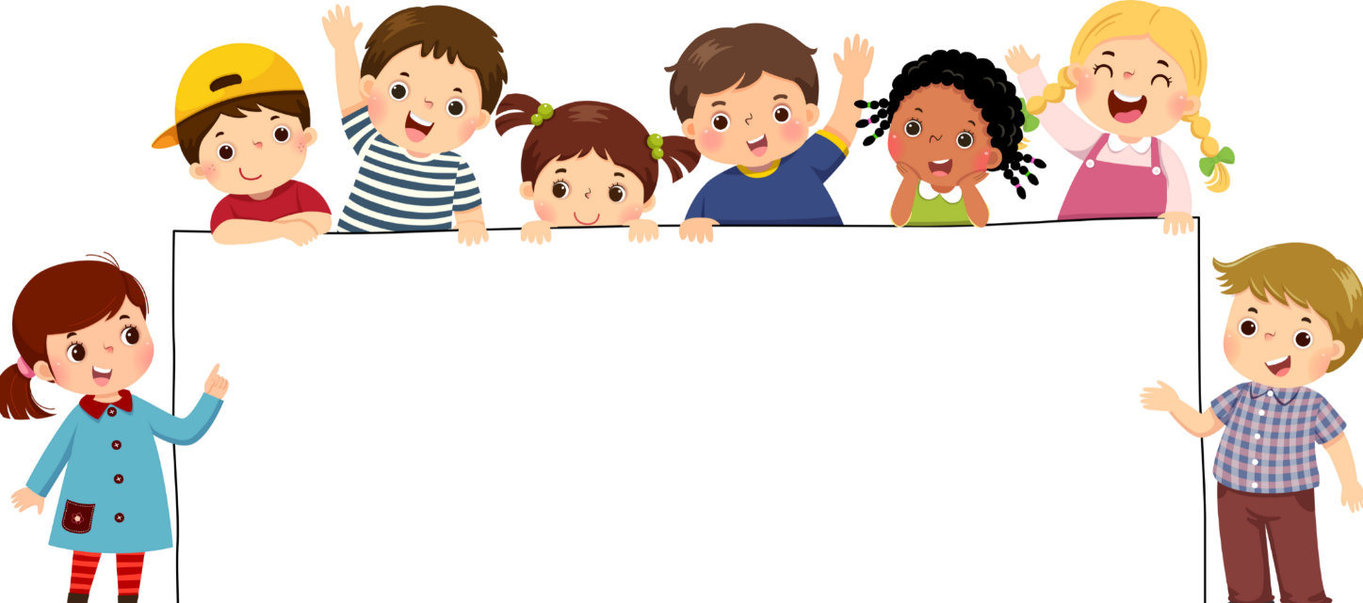
Goodbye!

