Slide 1
MsPham
0936082789
Unit 1
All about me
MsPham
0936082789
Lesson 1 – Part 1, 2, 3

Slide 2
Table of contents
01
Warm-up and review
02
Look, listen and repeat.
MsPham
0936082789
03
Listen, point and say.
04
Let’s talk.
05
Fun corner and wrap-up
https://www.facebook.com/msphampowerpoint

Slide 3
MsPham
0936082789
1.
MsPham
0936082789
Warm-up
https://www.facebook.com/msphampowerpoint

Slide 4
Let’s chant.

Slide 5
MsPham
0936082789
2.
Look listen and repeat
MsPham
0936082789
https://www.facebook.com/msphampowerpoint

Slide 6
Look and listen
MsPham
0936082789
MsPham
0936082789
https://www.facebook.com/msphampowerpoint

Slide 7
Listen and repeat
MsPham
0936082789
MsPham
0936082789
https://www.facebook.com/msphampowerpoint

Slide 8
Listen and repeat
MsPham
0936082789
https://www.facebook.com/msphampowerpoint

Slide 9
Structure
Can you tell me about yourself?
MsPham
0936082789
I’m in Class _____.
I live in the ______.

Slide 10
Can you tell me
about yourself?
city
town
countryside
I’m in Class
_____.
5B
mountains
5A
I live in the
______.

Slide 11
MsPham
0936082789
3.
Look, listen and say
MsPham
0936082789
https://www.facebook.com/msphampowerpoint

Slide 12
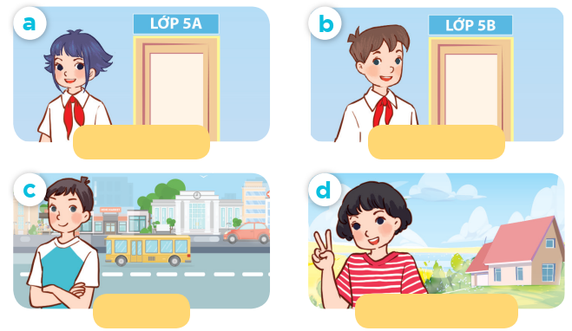
Listen, point and say.
Can you tell me about yourself?
MsPham
0936082789
MsPham
0936082789
I’m in ____.
MsPham
0936082789
Class 5A
Class 5B
I live in the __.
city
countryside
https://www.facebook.com/msphampowerpoint

Slide 13
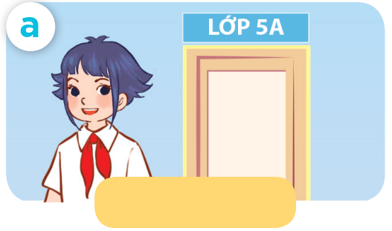
Listen, point and say.
MsPham
0936082789
MsPham
0936082789
Can you tell me about yourself?
MsPham
0936082789
I’m in class 5A.
Class 5A
https://www.facebook.com/msphampowerpoint

Slide 14
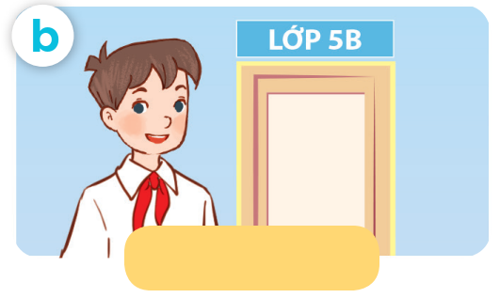
Listen, point and say.
MsPham
0936082789
MsPham
0936082789
Can you tell me about yourself?
MsPham
0936082789
I’m in class 5B.
Class 5B
https://www.facebook.com/msphampowerpoint

Slide 15
Listen, point and say.
MsPham
0936082789
MsPham
0936082789
Can you tell me about yourself?
MsPham
0936082789
I live in the city.
city
https://www.facebook.com/msphampowerpoint

Slide 16
Listen, point and say.
MsPham
0936082789
MsPham
0936082789
Can you tell me about yourself?
MsPham
0936082789
I live in the countryside.
countryside
https://www.facebook.com/msphampowerpoint

Slide 17
Listen, point and say.
Can you tell me about yourself?
MsPham
0936082789
MsPham
0936082789
I’m in ____.
MsPham
0936082789
Class 5A
Class 5B
I live in the __.
city
countryside
https://www.facebook.com/msphampowerpoint

Slide 18
MsPham
0936082789
4.
MsPham
0936082789
Let’s talk!
https://www.facebook.com/msphampowerpoint

Slide 19
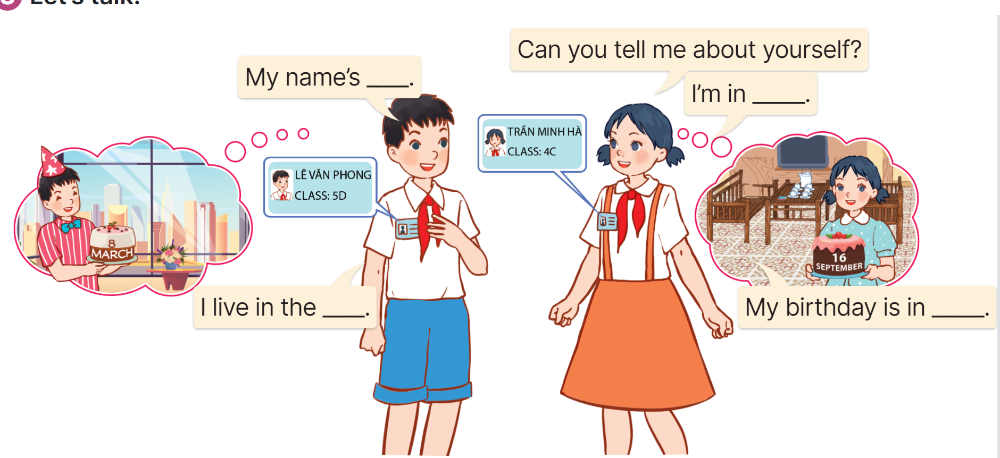
Let’s talk
MsPham
0936082789
https://www.facebook.com/msphampowerpoint

Slide 20
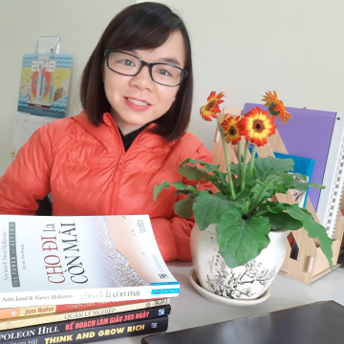
Let’s talk
My birthday
Ms.
HuyenPham
My name’s
_______.
is in _____.
I’m _______.
years old.
I live in
the _______.
I’m in
Class _____.

Slide 21
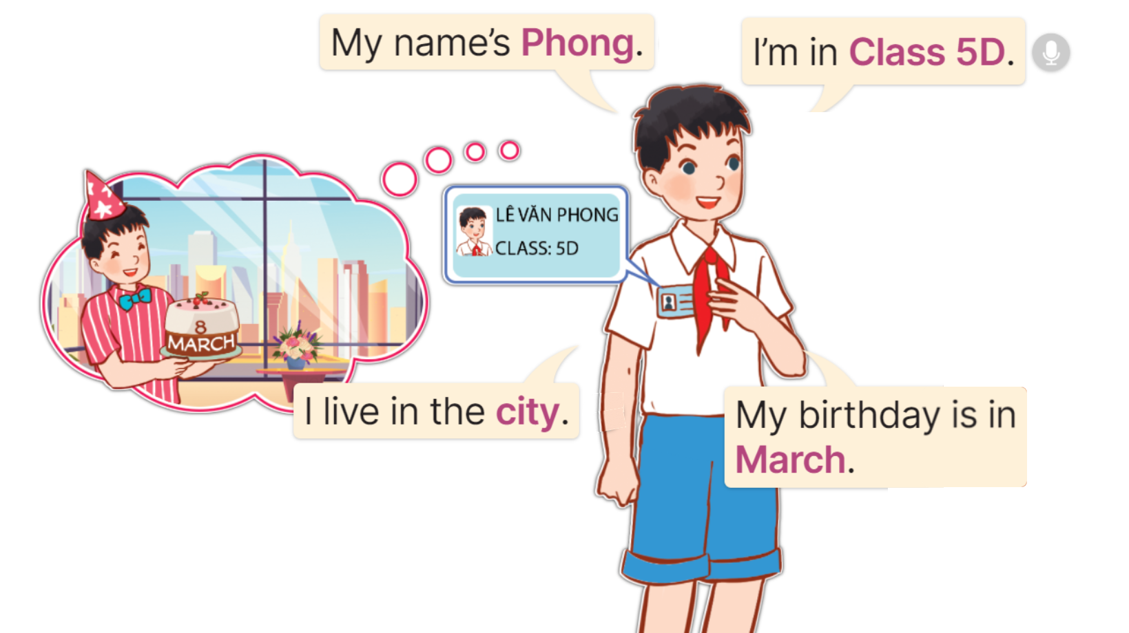
Example
_____
________
MsPham
0936082789
___
_____.
https://www.facebook.com/msphampowerpoint

Slide 22
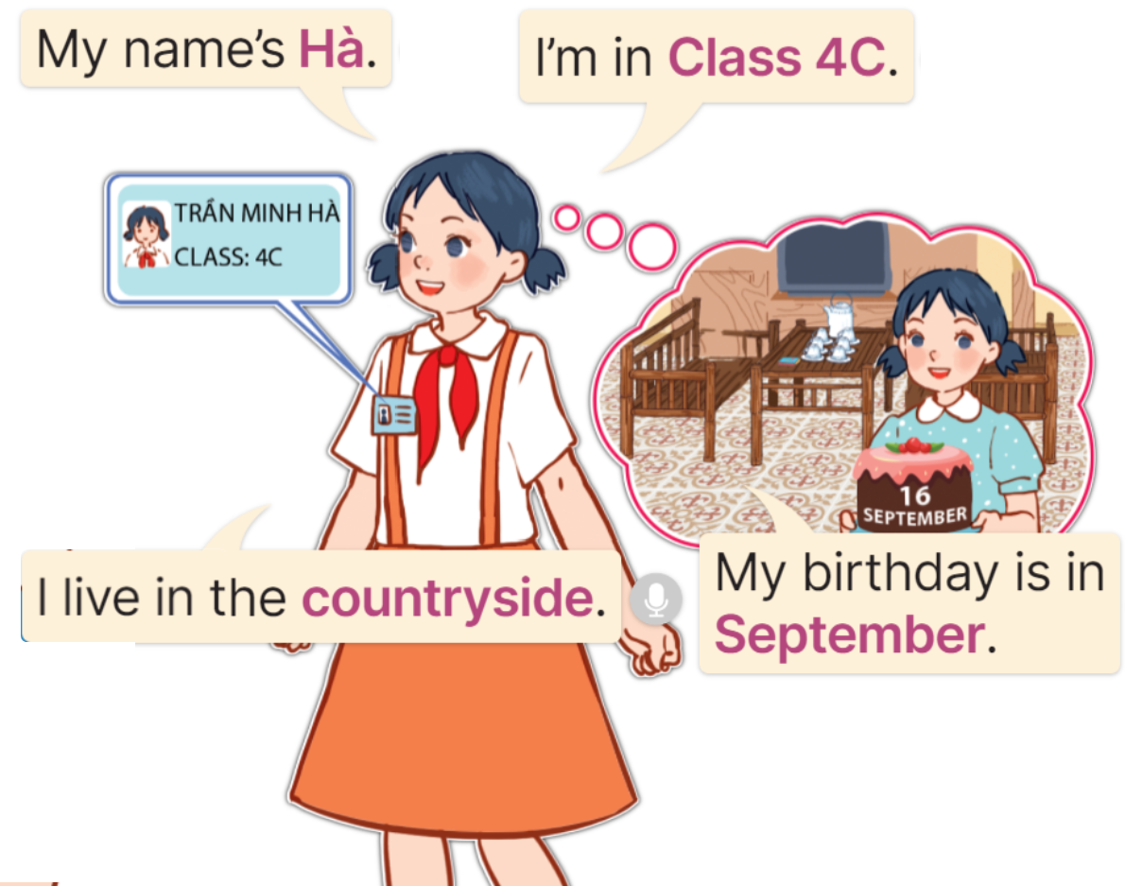
Example
__.
________.
MsPham
0936082789
__________.
__________.
https://www.facebook.com/msphampowerpoint

Slide 23
Work in pair
My birthday
My name’s
Ms.
HuyenPham
is in _____.
_______.
I’m _______.
years old.
I live in
the _______.
I’m in
Class _____.
Giáo viên ghép cặp nhóm 2 học sinh, các con thực hành nói với nhau trong 5-7 phút

Slide 24
Let’s talk
My birthday
Ms.
HuyenPham
My name’s
_______.
is in _____.
I’m _______.
years old.
I live in
the _______.
I’m in
Class _____.
Giáo viên gọi 3-5 bạn lên nói trước lớp.

Slide 25
MsPham
0936082789
5.
Fun corner &
Wrap - up
MsPham
0936082789
https://www.facebook.com/msphampowerpoint

Slide 26
MsPham-0936082789
MsPham-0936082789
MsPham-0936082789
MsPham-0936082789
MsPham-0936082789

Slide 27
MsPham-0936082789
How old are you?
MsPham-0936082789
MsPham-0936082789
MsPham-0936082789
I’m eight years old.
Hello. I’m Lisa.
MsPham-0936082789

Slide 28
MsPham-0936082789
When is your birthday?
MsPham-0936082789
MsPham-0936082789
MsPham-0936082789
My favourite subject is June.
My birthday is in June.
MsPham-0936082789

Slide 29
MsPham-0936082789
Where do you live?
MsPham-0936082789
MsPham-0936082789
MsPham-0936082789
I live in the mountains.
I am in Class 5C.
MsPham-0936082789

Slide 30
MsPham-0936082789
What class are you in?
MsPham-0936082789
MsPham-0936082789
MsPham-0936082789
I go to Đông Hải Primary school.
I’m in Class 5A.
MsPham-0936082789

Slide 31
MsPham-0936082789
What’s your name?
MsPham-0936082789
MsPham-0936082789
MsPham-0936082789
I’m a teacher.
My name’s Lisa.
MsPham-0936082789

Slide 32
MsPham-0936082789
Can you tell me
about yourself?
MsPham-0936082789
MsPham-0936082789
MsPham-0936082789
Lan is in class 5G.
I’m in class 5G.
MsPham-0936082789

Slide 33
MsPham-0936082789
Can you tell me
about yourself?
MsPham-0936082789
MsPham-0936082789
MsPham-0936082789
I live in the city.
You live in the city.
MsPham-0936082789

Slide 34
MsPham-0936082789
Can you tell me
about yourself?
MsPham-0936082789
MsPham-0936082789
MsPham-0936082789
I’m in class 5G.
I live in the city.
I am in class 5G.
She lives in the city.
MsPham-0936082789

Slide 35
MsPham-0936082789
MsPham-0936082789
MsPham-0936082789
MsPham-0936082789
MsPham-0936082789

Slide 36
MsPham
0936082789
Thank you!
MsPham
0936082789
For joining!

