Slide 1
MsPham
0936082789
Unit 1
All about me
MsPham
0936082789
Lesson 1 - Part 3,4,5

Slide 2
Table of contents
01
Warm-up and review
02
Listen and tick.
MsPham
0936082789
03
Read and complete.
04
Let’s sing.
05
Fun corner and wrap-up
https://www.facebook.com/msphampowerpoint

Slide 3
MsPham
0936082789
1.
MsPham
0936082789
Warm-up
https://www.facebook.com/msphampowerpoint

Slide 4
Let’s talk
My birthday
Ms.
HuyenPham
My name’s
_______.
is in _____.
I’m _______.
years old.
I live in
the _______.
I’m in
Class _____.
Giáo viên gọi 3-5 bạn lên nói trước lớp.

Slide 5
Review
Can you tell me about yourself?
MsPham
0936082789
I’m in Class _____.
I live in the ______.

Slide 6
MsPham
0936082789
2.
Listen
and tick
MsPham
0936082789
https://www.facebook.com/msphampowerpoint

Slide 7
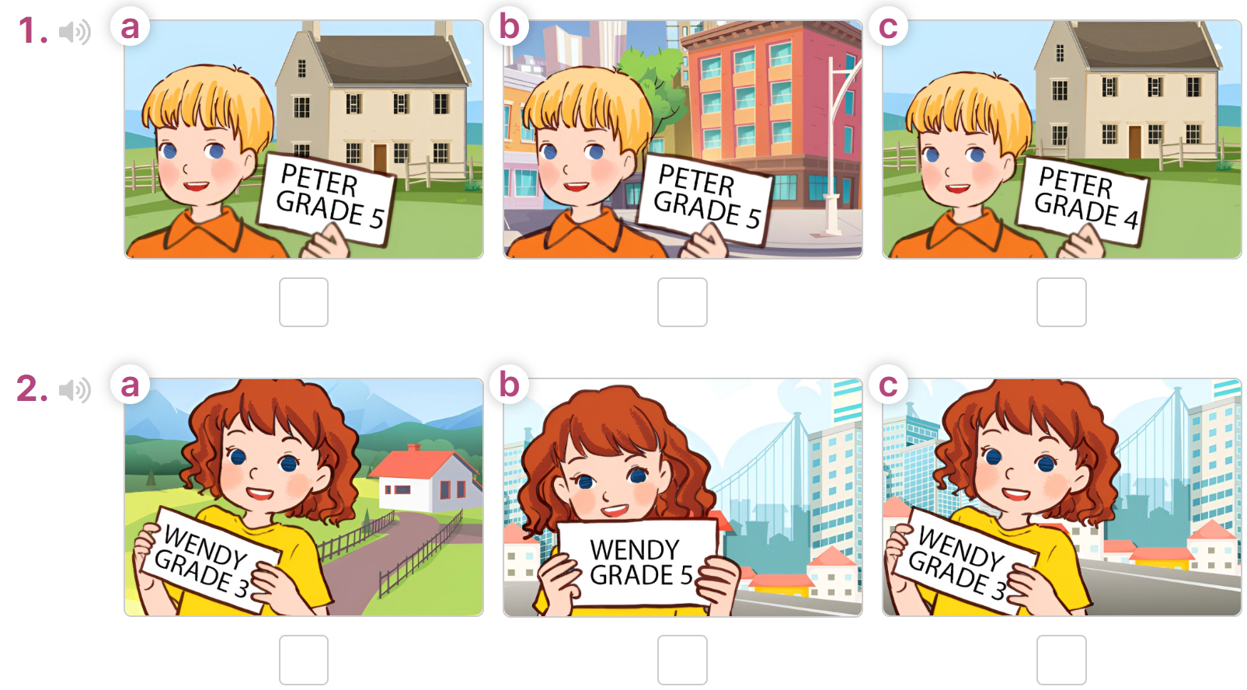
Listen and tick
1. A: Hi. I'm Peter.
B: Hi. I'm Mai. Can you tell me about yourself?
A: Well, I'm in Grade 5. I live in the countryside.
1
MsPham
0936082789
2. A: Hi. I'm Bill. Are you a new pupil?
B: Yes, I am.
A: Can you tell me about yourself?
B: I'm Wendy. I'm in Grade 3. I live in the city.
2
https://www.facebook.com/msphampowerpoint

Slide 8
MsPham
0936082789
3.
Read and complete.
MsPham
0936082789
https://www.facebook.com/msphampowerpoint

Slide 9
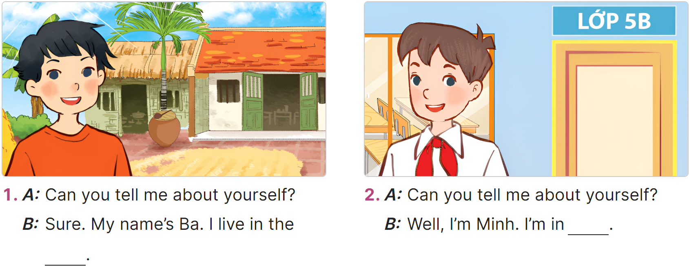
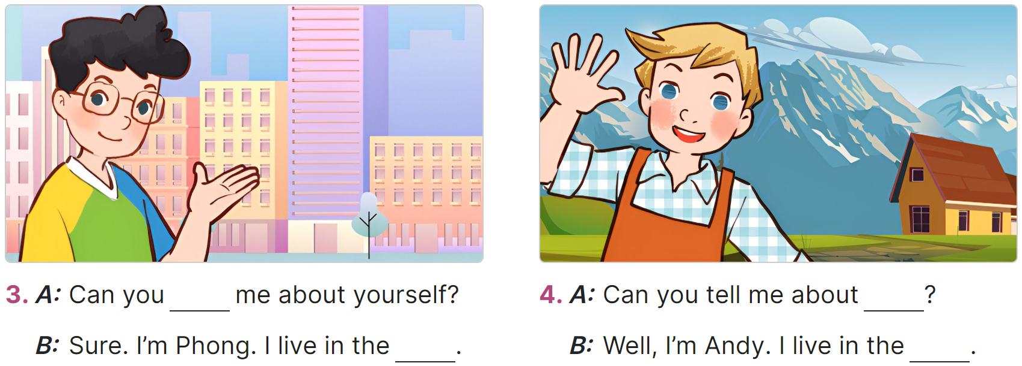
Read and complete.
MsPham
0936082789
https://www.facebook.com/msphampowerpoint

Slide 10
Read and complete.
MsPham
0936082789
______________.
https://www.facebook.com/msphampowerpoint

Slide 11
Read and complete.
MsPham
0936082789
______________.
https://www.facebook.com/msphampowerpoint

Slide 12
Read and complete.
MsPham
0936082789
_____________
_________________.
https://www.facebook.com/msphampowerpoint

Slide 13
Read and complete.
MsPham
0936082789
_____________?
_________________.
https://www.facebook.com/msphampowerpoint

Slide 14
Read and complete.
MsPham
0936082789
https://www.facebook.com/msphampowerpoint

Slide 15
MsPham
0936082789
4.
MsPham
0936082789
Let’s sing!
https://www.facebook.com/msphampowerpoint

Slide 16
All about me!
MsPham
0936082789
https://www.facebook.com/msphampowerpoint

Slide 17
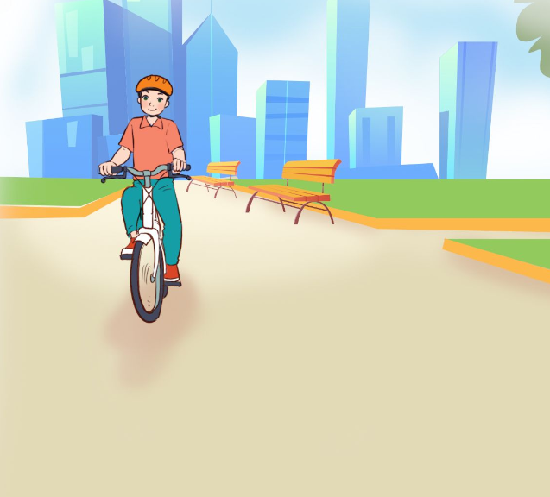
All about me!
I’m Lisa.
I’m in Grade 3.
I live in the countryside.
Where do you live?
I’m Lisa.
I’m in Grade 3.
I live in the countryside.
Where do you live?
MsPham
0936082789
I’m Alan.
I’m in Grade 5.
I live in the city.
Where do you live?
I’m Alan.
I’m in Grade 5.
I live in the city.
Where do you live?
https://www.facebook.com/msphampowerpoint

Slide 18
All about me!
MsPham
0936082789
https://www.facebook.com/msphampowerpoint

Slide 19
MsPham
0936082789
5.
Fun corner &
Wrap - up
MsPham
0936082789
https://www.facebook.com/msphampowerpoint

Slide 20
The bee &
the bear
MsPham
0936092789
MsPham
0936092789
Play

Slide 21
Reoder the words:
you / Can / tell / yourself / me?/ about
MsPham
0936092789
Can you tell me about yourself?
Answer
Next

Slide 22
Reoder the words:
in / I / countryside. / the / live
MsPham
0936092789
I live in the countryside.
Answer
Next

Slide 23
Reoder the words:
My / HaLan. / is / name
MsPham
0936092789
My name is HaLan.
Answer
Next

Slide 24
Reoder the words:
in / My / is / birthday / August.
MsPham
0936092789
My birthday is in August.
Answer
Next

Slide 25
Reoder the words:
Class / I / in / 5A / am.
MsPham
0936092789
I am in Class 5A.
Answer
Next

Slide 26
Reoder the words:
the / live / in / city. / I
MsPham
0936092789
I live in the city.
Answer
Next

Slide 27
Welldone!
MsPham
0936092789
MsPham
0936092789
Next

Slide 28
MsPham
0936082789
Thank you!
MsPham
0936082789
For joining!

