Slide 1
MsPham
0936082789
Unit 1
All about me
MsPham
0936082789
Lesson 2 - Part 1,2,3

Slide 2
Table of contents
01
Warm-up and review
02
Look, listen and repeat.
MsPham
0936082789
03
Listen, point and say.
04
Let’s talk.
05
Fun corner and wrap-up
https://www.facebook.com/msphampowerpoint

Slide 3
MsPham
0936082789
1.
MsPham
0936082789
Warm-up
https://www.facebook.com/msphampowerpoint

Slide 4
All about me!
MsPham
0936082789
https://www.facebook.com/msphampowerpoint

Slide 5
MsPham
0936082789
2.
Look listen and repeat
MsPham
0936082789
https://www.facebook.com/msphampowerpoint

Slide 6
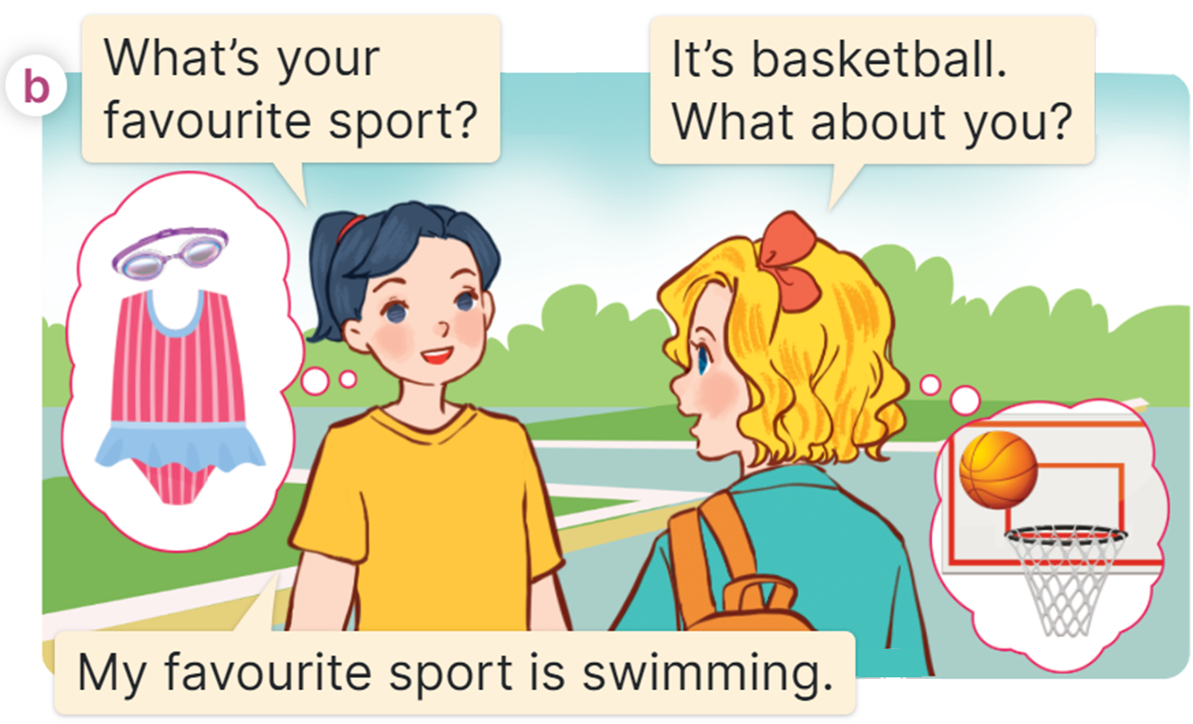
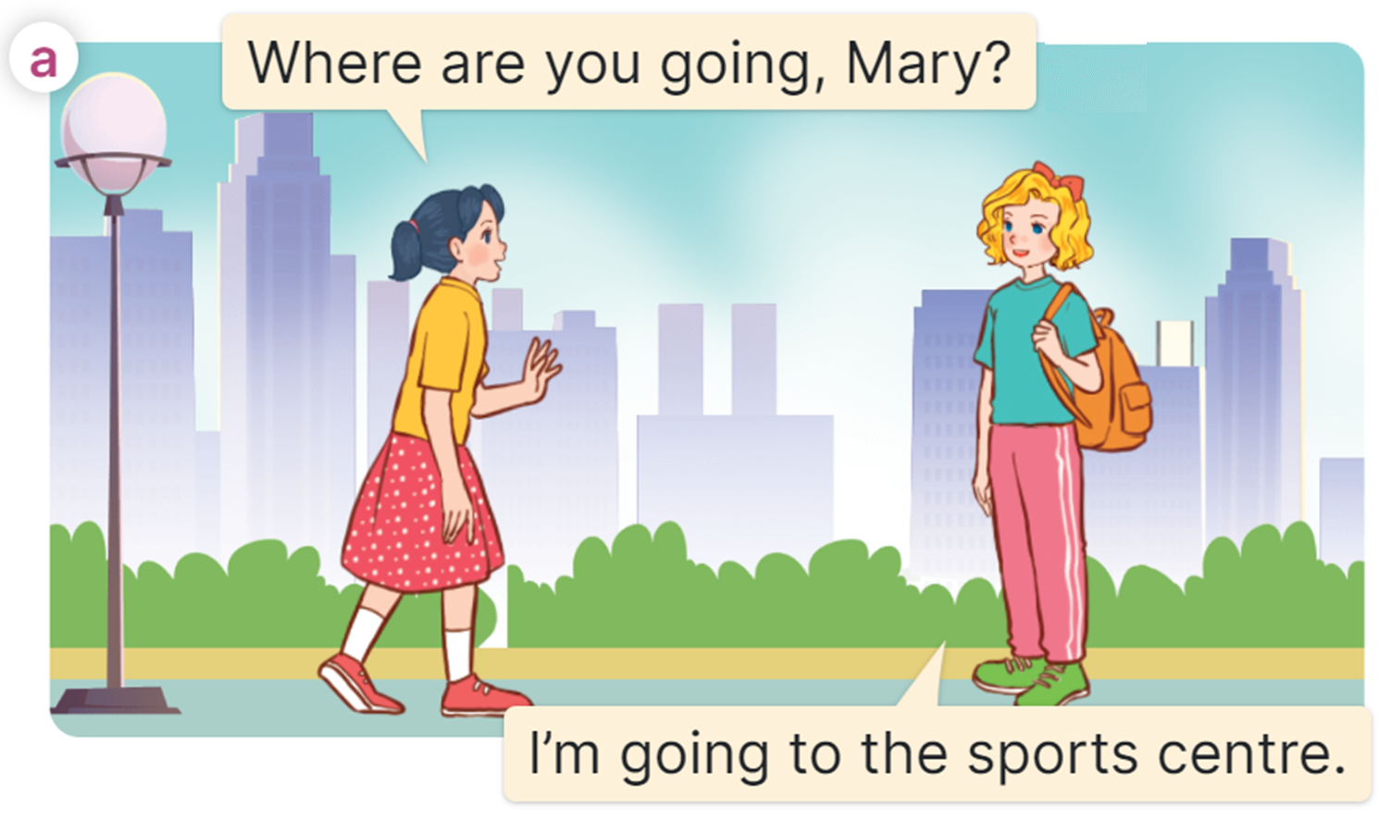
Look and listen
MsPham
0936082789
https://www.facebook.com/msphampowerpoint

Slide 7
Listen and repeat
MsPham
0936082789
MsPham
0936082789
https://www.facebook.com/msphampowerpoint

Slide 8
Listen and repeat
MsPham
0936082789
MsPham
0936082789
https://www.facebook.com/msphampowerpoint

Slide 9
Structure
What’s your favourite ______?
MsPham
0936082789
It’s _________.

Slide 10
MsPham
0936082789
3.
Look listen and say
MsPham
0936082789
https://www.facebook.com/msphampowerpoint

Slide 11
Vocabulary
MsPham
0936082789
MsPham
0936082789
sport
/spɔːt/
MsPham
0936082789
Môn thể thao
https://www.facebook.com/msphampowerpoint

Slide 12
Vocabulary
MsPham
0936082789
MsPham
0936082789
colour
/ˈkʌlər/
MsPham
0936082789
Màu sắc
https://www.facebook.com/msphampowerpoint

Slide 13
Vocabulary
MsPham
0936082789
MsPham
0936082789
animal
/ˈænɪml/
MsPham
0936082789
Con vật
https://www.facebook.com/msphampowerpoint

Slide 14
Vocabulary
MsPham
0936082789
MsPham
0936082789
food
/fuːd/
MsPham
0936082789
Đồ ăn
https://www.facebook.com/msphampowerpoint

Slide 15
Vocabulary
MsPham
0936082789
MsPham
0936082789
a dolphin
/ ə ˈdɒlfɪn/
MsPham
0936082789
Cá heo
https://www.facebook.com/msphampowerpoint

Slide 16
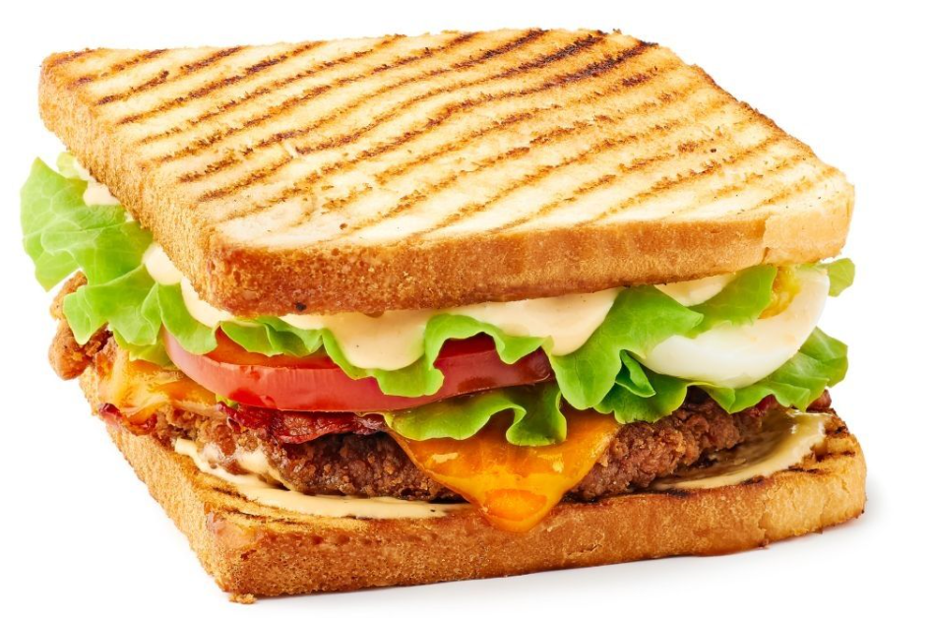
Vocabulary
MsPham
0936082789
MsPham
0936082789
a sandwich
/ ə ˈsænwɪtʃ/
MsPham
0936082789
Bánh mì sandwich
https://www.facebook.com/msphampowerpoint

Slide 17
Vocabulary
sport
: Môn thể thao
MsPham
0936082789
MsPham
0936082789
animal
: Con vật
MsPham
0936082789
colour
: Màu sắc
food
: Đồ ăn
a dolphin
: Cá heo
a sandwich
: Bánh mì sandwich
https://www.facebook.com/msphampowerpoint

Slide 18
Listen, point and say.
What’s your favourite ______?
MsPham
0936082789
MsPham
0936082789
MsPham
0936082789
It’s____.
Class 5A
Class 5B
city
countryside
https://www.facebook.com/msphampowerpoint

Slide 19
Listen, point and say.
MsPham
0936082789
MsPham
0936082789
MsPham
0936082789
What’s your favourite ______?
What’s your favourite sport?
It’s ______.
It’s table tennis.
https://www.facebook.com/msphampowerpoint

Slide 20
Listen, point and say.
MsPham
0936082789
MsPham
0936082789
MsPham
0936082789
What’s your favourite ______?
What’s your favourite colour?
It’s ______.
It’s pink.
https://www.facebook.com/msphampowerpoint

Slide 21
Listen, point and say.
MsPham
0936082789
MsPham
0936082789
MsPham
0936082789
What’s your favourite ______?
What’s your favourite animal?
It’s ______.
It’s a dolphin.
https://www.facebook.com/msphampowerpoint

Slide 22
Listen, point and say.
MsPham
0936082789
MsPham
0936082789
MsPham
0936082789
What’s your favourite ______?
What’s your favourite food?
It’s ______.
It’s sandwich.
https://www.facebook.com/msphampowerpoint

Slide 23
Listen, point and say.
What’s your favourite ______?
MsPham
0936082789
MsPham
0936082789
MsPham
0936082789
It’s____.
Class 5A
Class 5B
city
countryside
https://www.facebook.com/msphampowerpoint

Slide 24
MsPham
0936082789
4.
MsPham
0936082789
Let’s talk!
https://www.facebook.com/msphampowerpoint

Slide 25
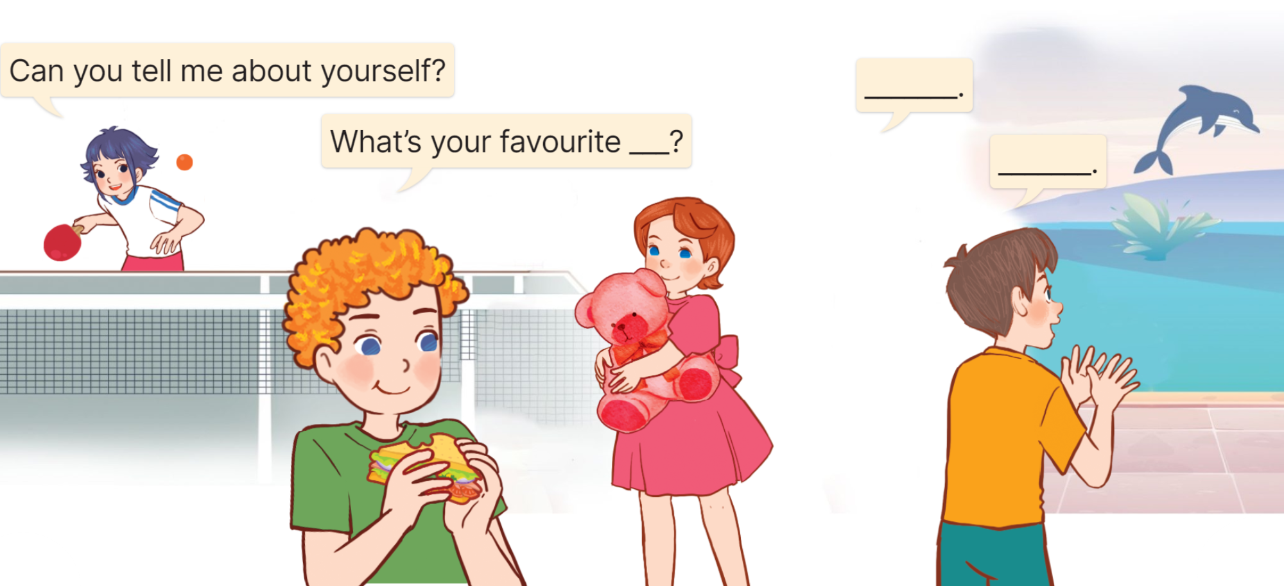
Let’s talk
MsPham
0936082789
https://www.facebook.com/msphampowerpoint

Slide 26
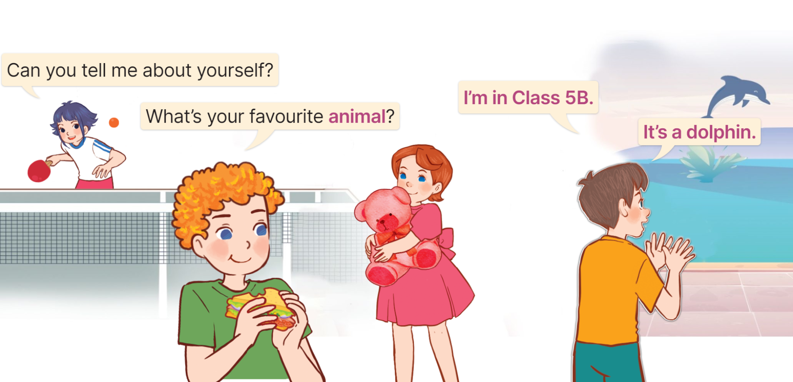
Let’s talk
MsPham
0936082789
https://www.facebook.com/msphampowerpoint

Slide 27
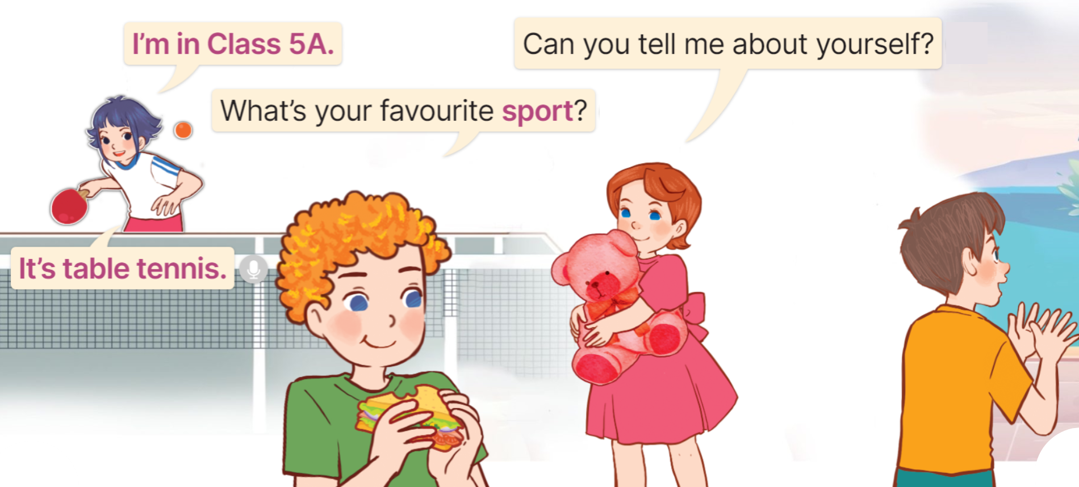
Let’s talk
MsPham
0936082789
https://www.facebook.com/msphampowerpoint

Slide 28
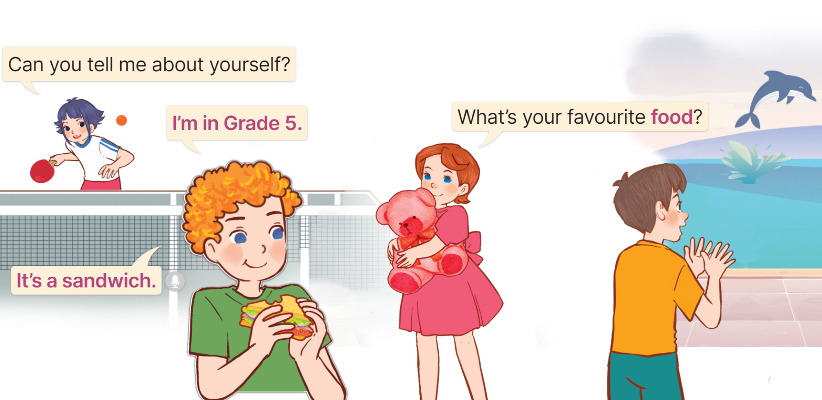
Let’s talk
MsPham
0936082789
https://www.facebook.com/msphampowerpoint

Slide 29
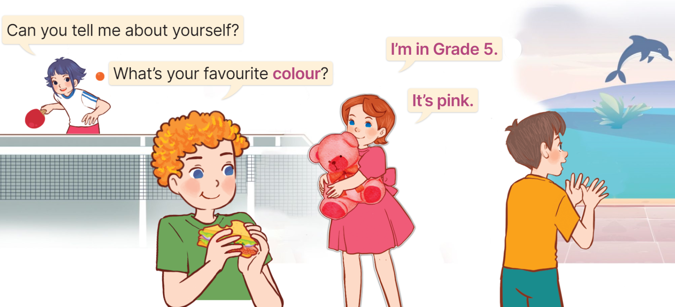
Let’s talk
MsPham
0936082789
https://www.facebook.com/msphampowerpoint

Slide 30
Work in pair
Can you tell me about yourself?
MsPham
0936082789
I’m in Class ____.
What’s your favourite ______?
It’s _________.

Slide 31
Let’s talk
I’m in Class ____.
It’s _________.
MsPham
0936082789
Can you tell me about yourself?
What’s your favourite ______?
Giáo viên gọi 3-5 bạn lên nói trước lớp.

Slide 32
MsPham
0936082789
5.
Fun corner &
Wrap - up
MsPham
0936082789
https://www.facebook.com/msphampowerpoint

Slide 33
Notes:
Ms Huyền Phạm - 0936.082.789 – YOUTUBE: MsPham. Facebook: Dạy và học cùng công nghệ.

Slide 34
colour
MsPham
0936082789
+5
What’s your favourite ______?
It’s pink.
animal
-1
sport
-1
Notes:
Ms Huyền Phạm - 0936.082.789 – YOUTUBE: MsPham. Facebook: Dạy và học cùng công nghệ.

Slide 35
sport
MsPham
0936082789
-1
What’s your favourite ______?
It’s a dolphin.
animal
+5
colour
-1
Notes:
Ms Huyền Phạm - 0936.082.789 – YOUTUBE: MsPham. Facebook: Dạy và học cùng công nghệ.

Slide 36
food
MsPham
0936082789
+5
What’s your favourite ______?
It’s a sandwich.
sport
-1
animal
-1
Notes:
Ms Huyền Phạm - 0936.082.789 – YOUTUBE: MsPham. Facebook: Dạy và học cùng công nghệ.

Slide 37
colour
MsPham
0936082789
-1
What’s your favourite ______?
It’s table tennis.
food
-1
sport
+5
Notes:
Ms Huyền Phạm - 0936.082.789 – YOUTUBE: MsPham. Facebook: Dạy và học cùng công nghệ.

Slide 38
a rabbit
MsPham
0936082789
-1
What’s your favourite colour?
It’s _____.
blue
+5
football
-1
Notes:
Ms Huyền Phạm - 0936.082.789 – YOUTUBE: MsPham. Facebook: Dạy và học cùng công nghệ.

Slide 39
a pencil
MsPham
0936082789
-1
What’s your favourite food?
It’s _____.
a dolphin
-1
a sandwich
+5
Notes:
Ms Huyền Phạm - 0936.082.789 – YOUTUBE: MsPham. Facebook: Dạy và học cùng công nghệ.

Slide 40
table tennis
MsPham
0936082789
+5
What’s your favourite sport?
It’s ______.
chicken
-1
pink
-1
Notes:
Ms Huyền Phạm - 0936.082.789 – YOUTUBE: MsPham. Facebook: Dạy và học cùng công nghệ.

Slide 41
MsPham
0936082789
Great job!
Exit
Notes:
Ms Huyền Phạm - 0936.082.789 – YOUTUBE: MsPham. Facebook: Dạy và học cùng công nghệ.

Slide 42
Review
food
animal
What’s your
favourite ______?
It’s ________.
colour
sport
subject

Slide 43
MsPham
0936082789
Thank you!
MsPham
0936082789
For joining!

