Slide 1


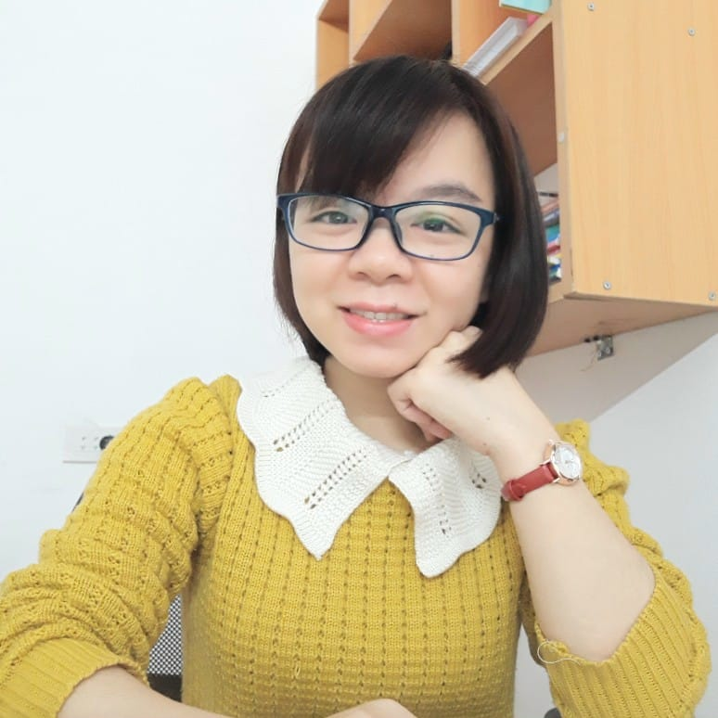







MsPham
0936082789
Unit 1
All about me
MsPham
0936082789
Lesson 2 – Part 4, 5, 6

Slide 2


Table of contents
01
Warm-up and review
02
Listen and match.
MsPham
0936082789
03
Read and complete.
04
Let’s play.
05
Wrap-up
https://www.facebook.com/msphampowerpoint

Slide 3
MsPham
0936082789
1.
MsPham
0936082789
Warm-up
https://www.facebook.com/msphampowerpoint

Slide 4

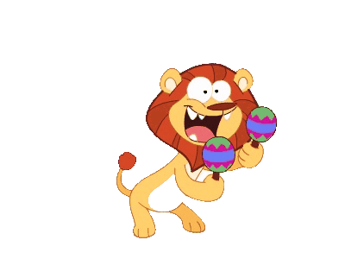
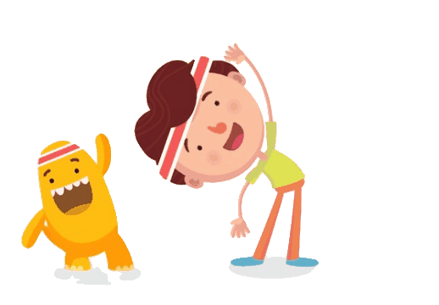
MsPham-0936082789
Flying a plane
MsPham-0936082789
MsPham-0936082789
Play
MsPham-0936082789

Slide 5
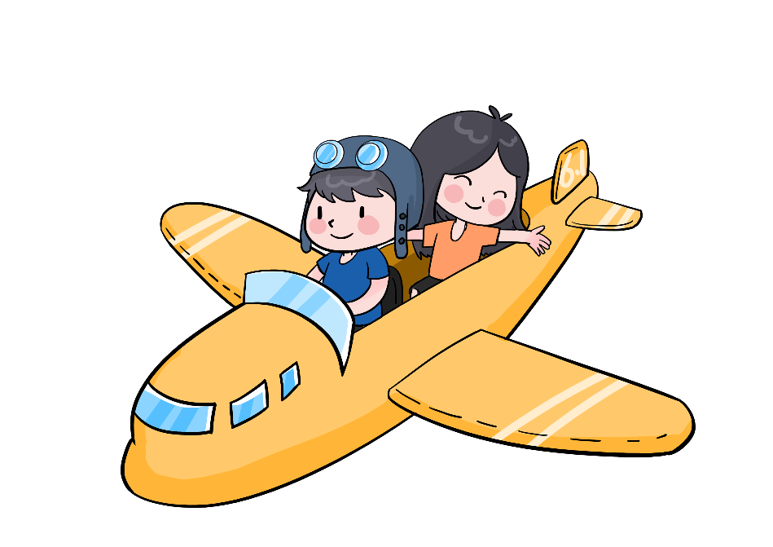
MsPham-0936082789
Order the words
m
ni
+10
al
MsPham-0936082789
a
MsPham-0936082789
Check
animal
Next
MsPham-0936082789

Slide 6
MsPham-0936082789
Order the words
l
a
do
+15
MsPham-0936082789
in
ph
MsPham-0936082789
Check
a dolphin
Next
MsPham-0936082789

Slide 7
MsPham-0936082789
Order the words
sa
ch
wi
+15
MsPham-0936082789
a
nd
MsPham-0936082789
Check
a sandwich
Next
MsPham-0936082789

Slide 8
MsPham-0936082789
Order the words
o
p
+5
t
MsPham-0936082789
r
s
MsPham-0936082789
Check
sport
Next
MsPham-0936082789

Slide 9
MsPham-0936082789
Order the words
d
o
+5
f
MsPham-0936082789
o
MsPham-0936082789
Check
food
Next
MsPham-0936082789

Slide 10
MsPham-0936082789
Order the words
l
o
r
u
+5
MsPham-0936082789
c
o
MsPham-0936082789
Check
colour
Next
MsPham-0936082789

Slide 11
MsPham-0936082789
Order the words
ten
ble
+5
MsPham-0936082789
nis
ta
MsPham-0936082789
Check
table tennis
Next
MsPham-0936082789

Slide 12
MsPham-0936082789
Good job!
MsPham-0936082789
MsPham-0936082789
Exit
MsPham-0936082789

Slide 13










Review
food
animal
What’s your
favourite ______?
It’s ________.
colour
sport
subject

Slide 14
MsPham
0936082789
2.
Listen
and match
MsPham
0936082789
https://www.facebook.com/msphampowerpoint

Slide 15

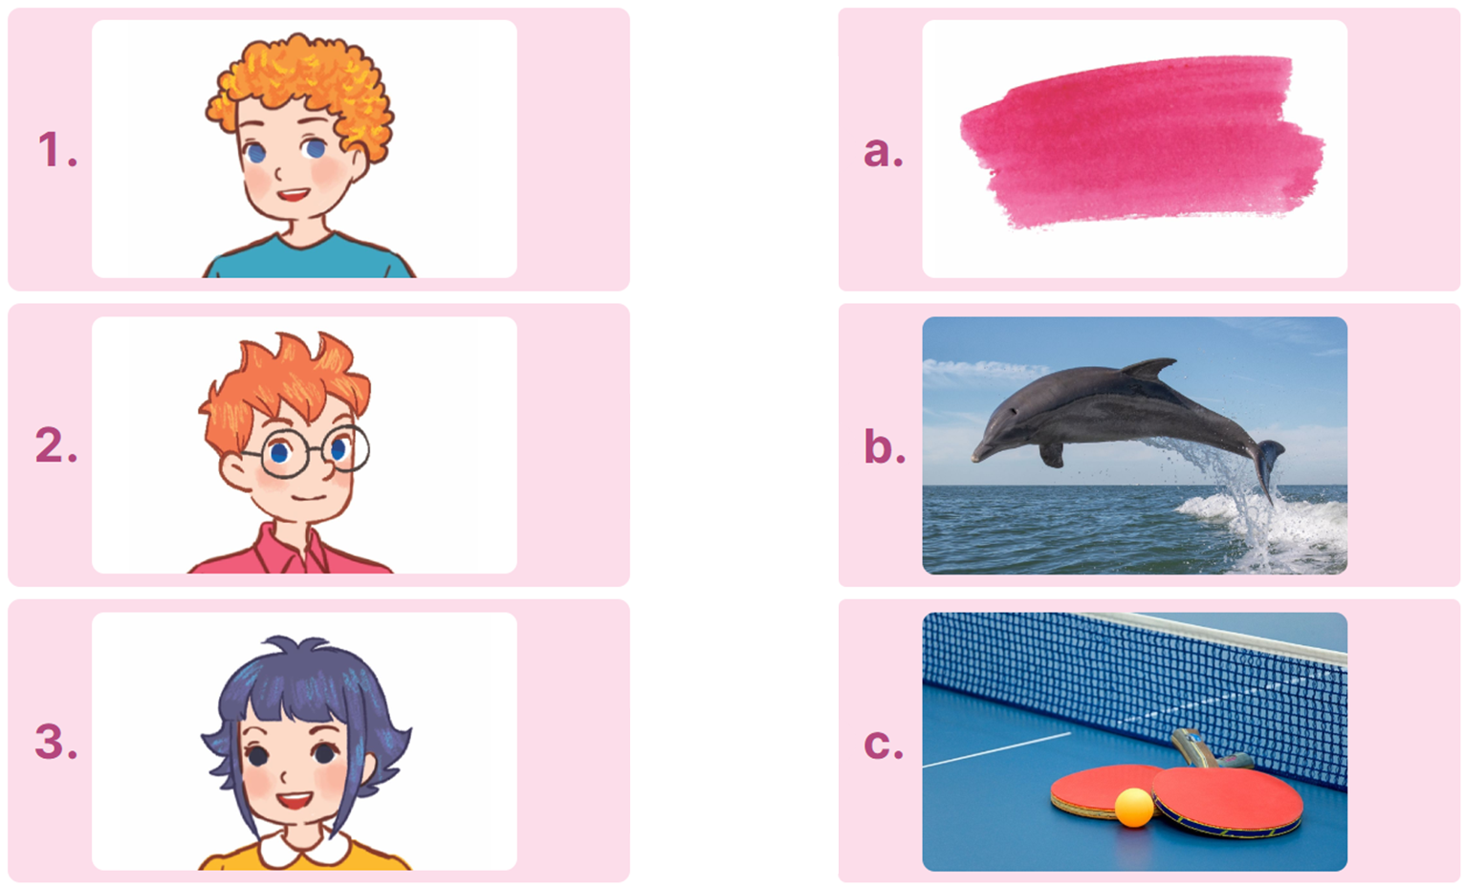

Listen and tick
1. A: What are you doing, Bill?
B: I'm watching a film about animals.
A: What's your favourite animal?
B: It's a dolphin. I love dolphins very much.
2. A: Where were you yesterday, Ben?
B: I was at the sports centre.
A: What's your favourite sport?
B: My favourite sport is table tennis.
MsPham
0936082789
3. A: What's your favourite colour, Minh?
B: It's green. What about you, Linh?
A: Pink. I like pink very much.
https://www.facebook.com/msphampowerpoint

Slide 16
MsPham
0936082789
3.
Read and complete.
MsPham
0936082789
https://www.facebook.com/msphampowerpoint

Slide 17
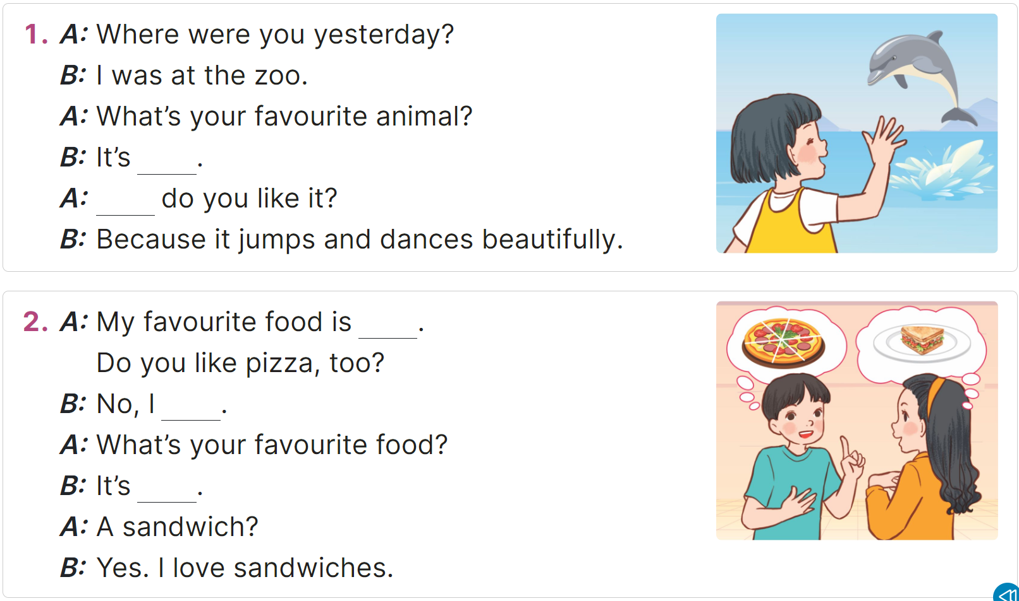
Read and complete.
MsPham
0936082789
https://www.facebook.com/msphampowerpoint

Slide 18
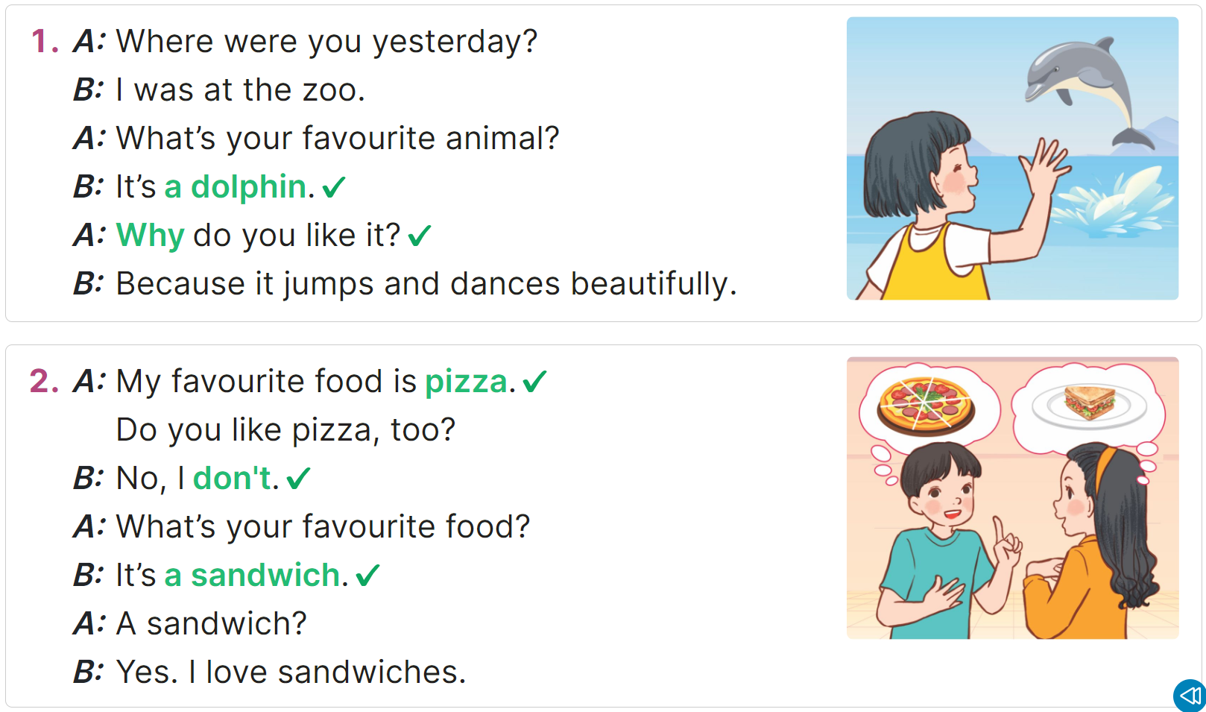
Read and complete.
MsPham
0936082789
______________.
______________
https://www.facebook.com/msphampowerpoint

Slide 19
Read and complete.
______________.
______________.
MsPham
0936082789
______________.
https://www.facebook.com/msphampowerpoint

Slide 20

Read and complete.
MsPham
0936082789
https://www.facebook.com/msphampowerpoint

Slide 21
MsPham
0936082789
4.
MsPham
0936082789
Let’s play!
https://www.facebook.com/msphampowerpoint

Slide 22
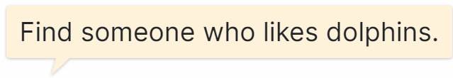
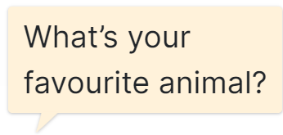
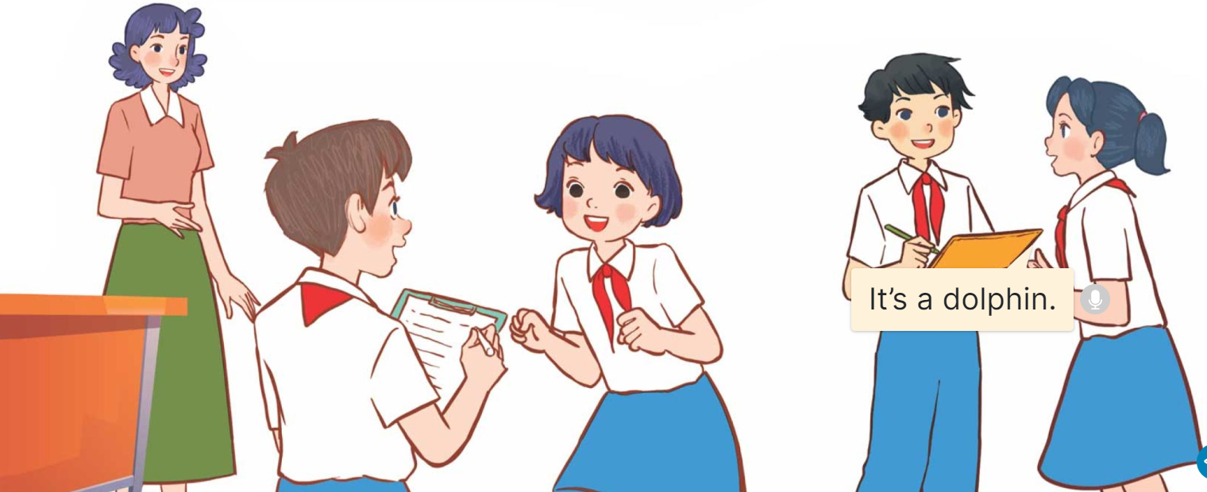
Find someone who…
MsPham
0936082789
https://www.facebook.com/msphampowerpoint

Slide 23
Find someone who…
table tennis.
______
sport?
_____?
_________.
MsPham
0936082789
https://www.facebook.com/msphampowerpoint

Slide 24
Find someone who…
table tennis.
______
sport?
_____?
_________.
MsPham
0936082789
https://www.facebook.com/msphampowerpoint

Slide 25
Find someone who…
pink
______
colour?
_____?
_________.
MsPham
0936082789
https://www.facebook.com/msphampowerpoint

Slide 26
Find someone who…
a sandwich.
______
food?
_____?
_________.
MsPham
0936082789
https://www.facebook.com/msphampowerpoint

Slide 27
MsPham
0936082789
5.
MsPham
0936082789
Wrap - up
https://www.facebook.com/msphampowerpoint

Slide 28
Review
food
animal
What’s your
favourite ______?
It’s ________.
colour
sport
subject

Slide 29
MsPham
0936082789
Thank you!
MsPham
0936082789
For joining!

