Slide 1
MsPham
0936082789
Unit 1
All about me
MsPham
0936082789
Lesson 3 - Part 1,2,3

Slide 2
Table of contents
01
Warm-up and review
02
Listen and repeat.
MsPham
0936082789
03
Circle, listen and check.
04
Let’s chant.
05
Fun corner and wrap-up
https://www.facebook.com/msphampowerpoint

Slide 3
MsPham
0936082789
1.
MsPham
0936082789
Warm-up
https://www.facebook.com/msphampowerpoint

Slide 4
Who is faster?
Start

Slide 5
Choose a question
1
2
3
4
5
6
Exit

Slide 6
Make question:
____________________?
I am in Clas 5C.
Check
Back
Can you tell me about yourself?

Slide 7
Make question:
____________________?
My favourite food
is a sandwich.
Check
Back
What is your favourite food?

Slide 8
Make question:
____________________?
My favourite animal
is a cat.
Check
Back
What is your favourite animal?

Slide 9
Make question:
____________________?
My favourite sport
is volleyball.
Check
Back
What is your favourite sport?

Slide 10
Make question:
____________________?
My favourite colour
is white.
Check
Back
What is your favourite colour?

Slide 11
Make question:
____________________
I live in the countryside.
Check
Back
Can you tell me about yourself?

Slide 12
MsPham
0936082789
2.
Listen and repeat
MsPham
0936082789
https://www.facebook.com/msphampowerpoint

Slide 13
Listen
'dolphin
I like 'dolphins.
MsPham
0936082789
MsPham
0936082789
'tennis
He plays 'tennis on Sundays.
https://www.facebook.com/msphampowerpoint

Slide 14
One-syllable words
Eg:
like
He
play
MsPham
0936082789
MsPham
0936082789
https://www.facebook.com/msphampowerpoint

Slide 15
Two-syllable words
Eg:
dolphin
tennis
Sunday
MsPham
0936082789
MsPham
0936082789
https://www.facebook.com/msphampowerpoint

Slide 16
Word stress
'dolphin
'tennis
'Sunday
MsPham
0936082789
MsPham
0936082789
Word stress is syllable thay you say it more loudly. And we use the stress mark (') to indicate word stress.
Today, we are going to learn about two-syllable words that the stress is on the first syllable.
https://www.facebook.com/msphampowerpoint

Slide 17
The first syllable stress
'dolphin
'tennis
'Sunday
MsPham
0936082789
MsPham
0936082789
https://www.facebook.com/msphampowerpoint
Cả lớp cùng đọc theo cô, chia nhóm (1/2 lớ, ¼ lớp), nhóm 2 và 1 số bạn lên đọc
Notes:
Cả lớp cùng đọc theo cô, chia nhóm (1/2 lớ, ¼ lớp), nhóm 2 và 1 số bạn lên đọc

Slide 18
Listen and repeat
'dolphin
I like 'dolphins.
MsPham
0936082789
MsPham
0936082789
'tennis
He plays 'tennis on Sundays.
https://www.facebook.com/msphampowerpoint
Click vào mỗi câu/mỗi từ để nghe.
Notes:
Click vào mỗi câu/mỗi từ để nghe.

Slide 19
MsPham
0936082789
3.
Circle, listen and check.
MsPham
0936082789
https://www.facebook.com/msphampowerpoint

Slide 20
Circle, listen and check.
1.
a. dolphin
b. giraffe
c. behind
MsPham
0936082789
MsPham
0936082789
MsPham
0936082789
2.
a. Japan
b. July
c. England
3.
a. tennis
b. hello
c. goodbye
https://www.facebook.com/msphampowerpoint
Click nút loa để nghe cả bài
Click từng từ để nghe lại và hiện trọng âm của từ
Notes:
Click nút loa để nghe hoặc dừng

Slide 21
MsPham
0936082789
4.
MsPham
0936082789
Let’s chant!
https://www.facebook.com/msphampowerpoint

Slide 23
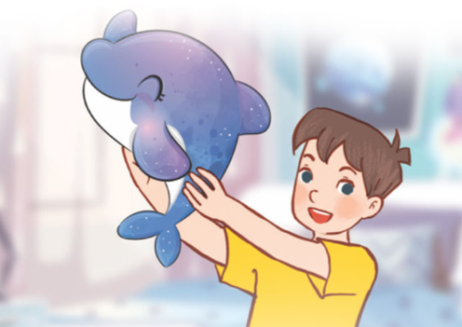
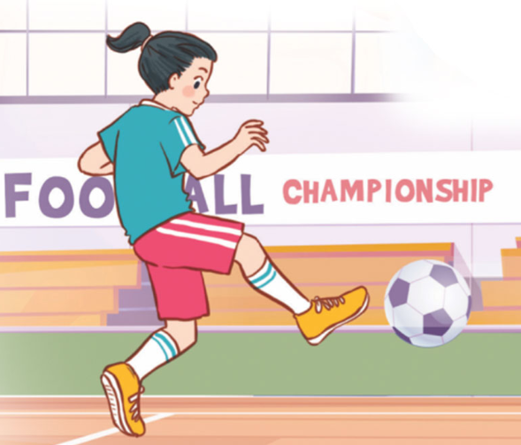
Let’s chant
What’s your favourite animal?
Do you like pandas?
No, I don’t.
I don’t like pandas.
I like dolphins.
What’s your favourite animal?
Do you like pandas?
No, I don’t.
I don’t like pandas.
I like dolphins.
What’s your favourite sport?
Do you like tennis?
No, I don’t.
I don’t like tennis.
I like football.
What’s your favourite sport?
Do you like tennis?
No, I don’t.
I don’t like tennis.
I like football.
MsPham
0936082789
https://www.facebook.com/msphampowerpoint

Slide 25
MsPham
0936082789
5.
Fun corner &
Wrap - up
MsPham
0936082789
https://www.facebook.com/msphampowerpoint

Slide 26
MsPham
0936082789
MsPham
0936082789
https://www.facebook.com/msphampowerpoint
Notes:
Click nút loa để nghe hoặc dừng

Slide 27
How to play
- Divide the class into 2 or 4 groups
Students read aloud words that appear on the screen.
If the word has the stress on the first syllable, the student will jump up.
Otherwise, students stand at their place.
MsPham
0936082789
MsPham
0936082789
https://www.facebook.com/msphampowerpoint
Notes:
Click nút loa để nghe hoặc dừng

Slide 28
Let’s play!
England
MsPham
0936082789
MsPham
0936082789
https://www.facebook.com/msphampowerpoint
Notes:
Click nút loa để nghe hoặc dừng

Slide 29
Let’s play!
Japan
MsPham
0936082789
MsPham
0936082789
https://www.facebook.com/msphampowerpoint
Notes:
Click nút loa để nghe hoặc dừng

Slide 30
Let’s play!
dolphin
MsPham
0936082789
MsPham
0936082789
https://www.facebook.com/msphampowerpoint
Notes:
Click nút loa để nghe hoặc dừng

Slide 31
Let’s play!
behind
MsPham
0936082789
MsPham
0936082789
https://www.facebook.com/msphampowerpoint
Notes:
Click nút loa để nghe hoặc dừng

Slide 32
Let’s play!
giraffe
MsPham
0936082789
MsPham
0936082789
https://www.facebook.com/msphampowerpoint
Notes:
Click nút loa để nghe hoặc dừng

Slide 33
Let’s play!
tennis
MsPham
0936082789
MsPham
0936082789
https://www.facebook.com/msphampowerpoint
Notes:
Click nút loa để nghe hoặc dừng

Slide 34
MsPham
0936082789
Thank you!
MsPham
0936082789
For joining!

