Slide 1
Unit 1
FEELINGS
Lesson 3

Slide 2
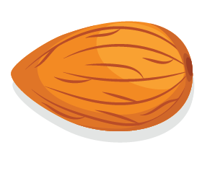
nut
hạt

Slide 3
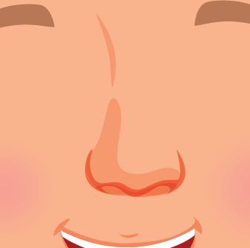
nose
mũi

Slide 4
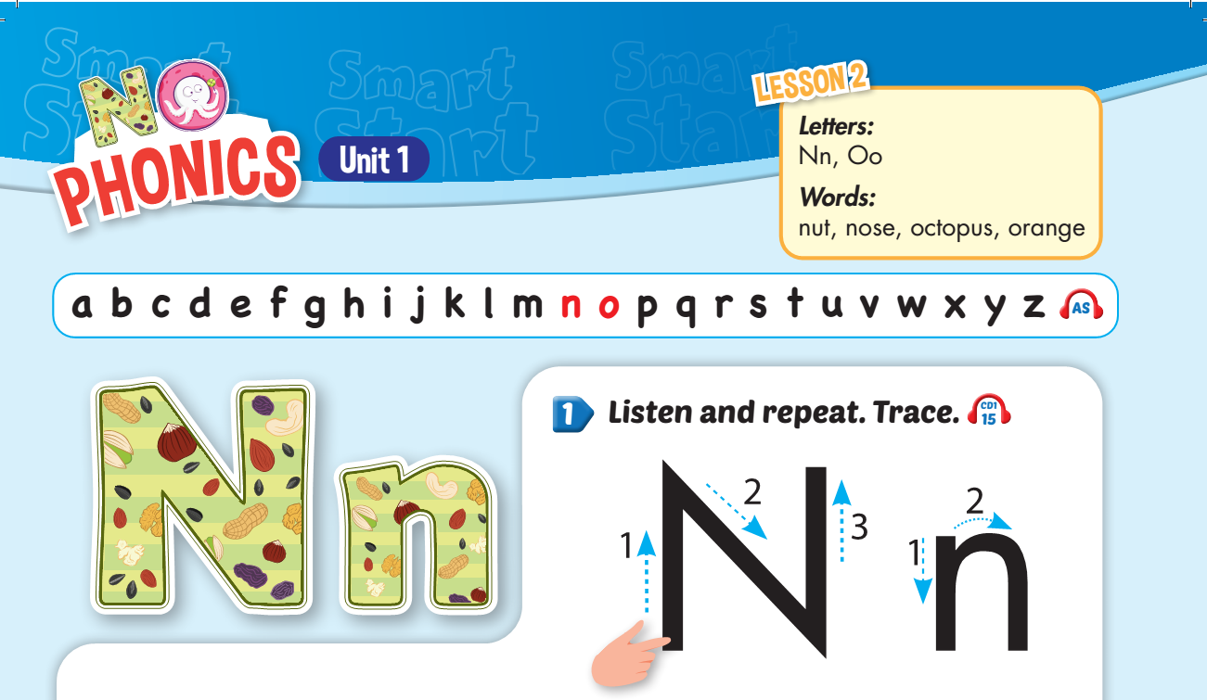



Slide 5
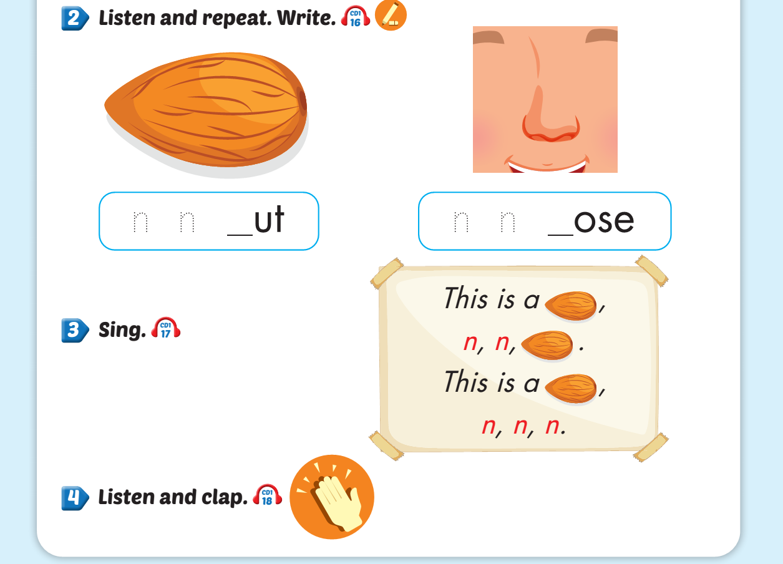
n
n

Slide 6

octopus
bạch tuộc

Slide 7
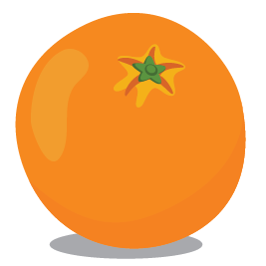
orange
quả cam

Slide 8
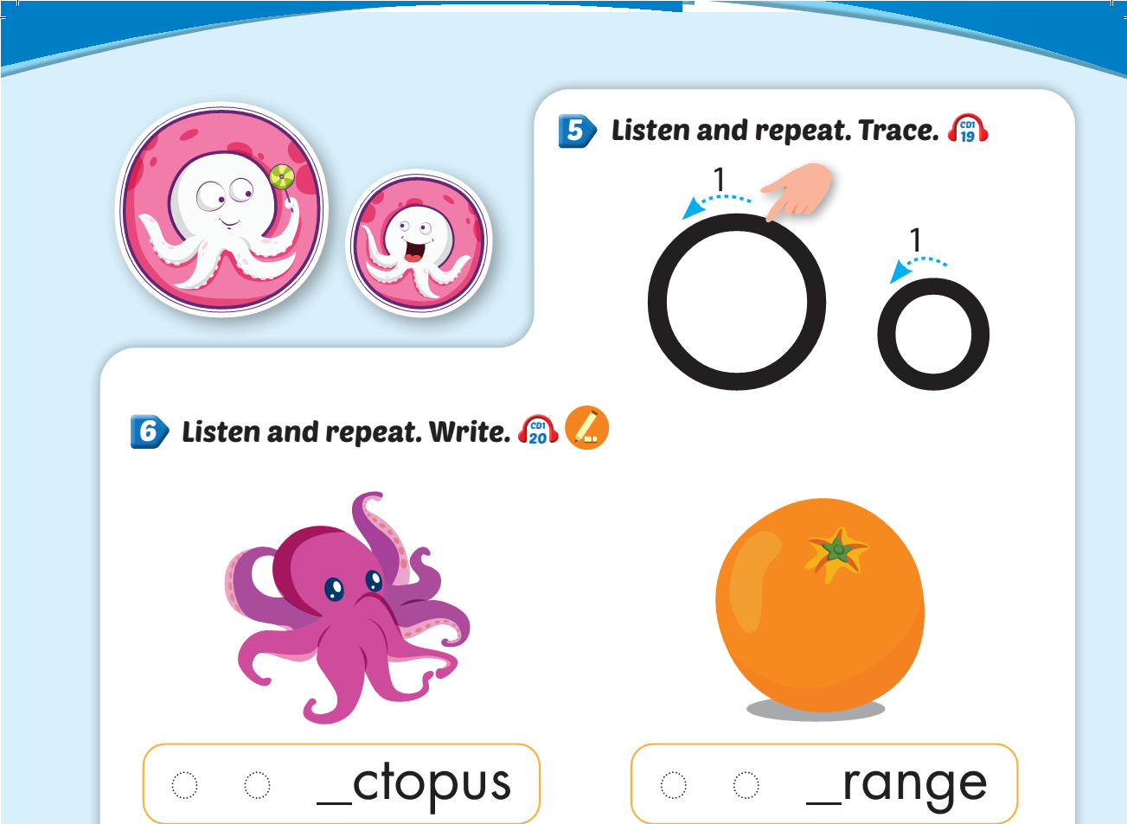
o
o

Slide 9
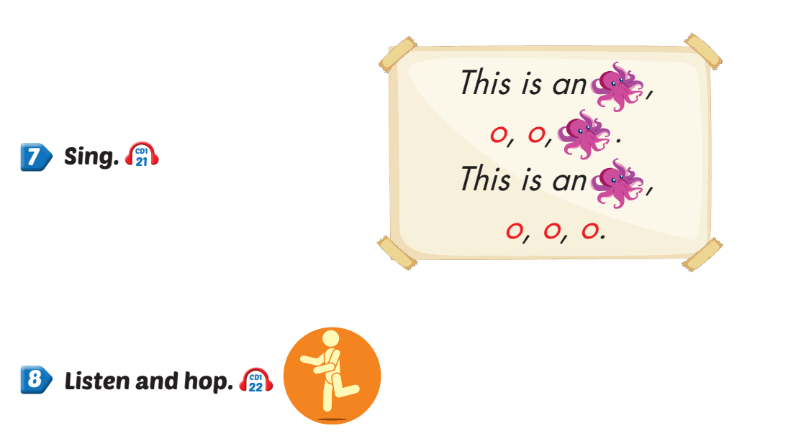

Slide 10
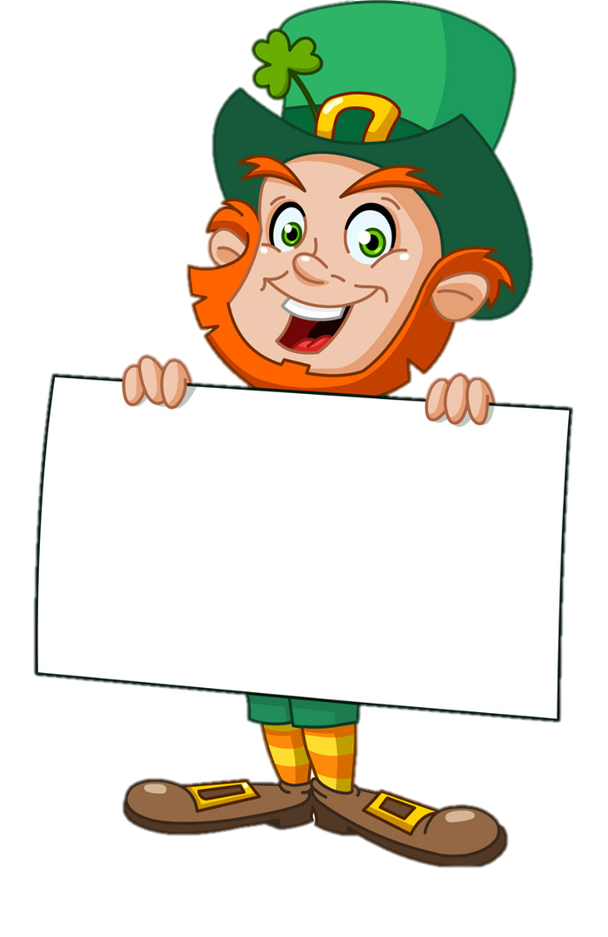

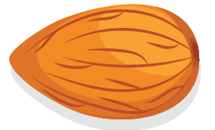

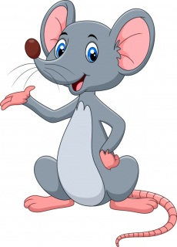

Choose the correct picture
a
b
Oo
c
d
orange

Slide 11
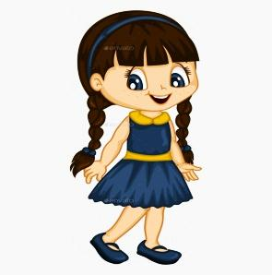

Choose the correct picture
a
b
Nn
c
d
nut

Slide 12



Choose the correct picture
a
b
octopus
Oo
c
d

Slide 13

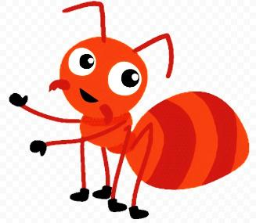
Choose the correct picture
a
b
Nn
c
d
nut

Slide 14
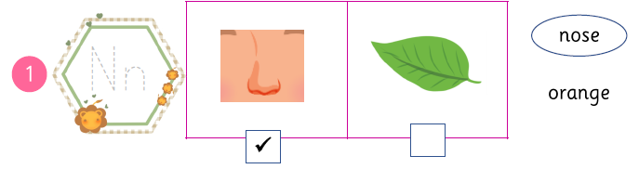
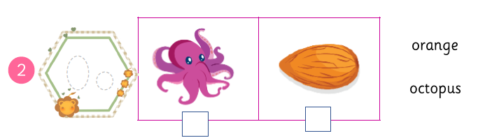
Tick  and circle.
Nn
Oo


Slide 15
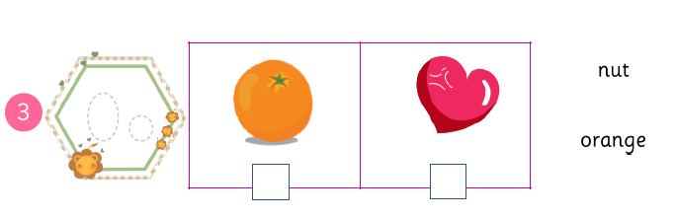
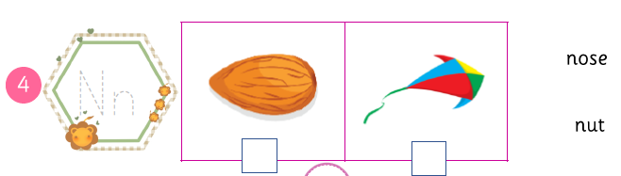
Oo

Nn


Slide 16
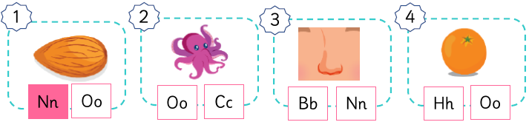
Look and colour.
Oo
Nn
Oo
Nut
Octopus
Nose
Orange

Slide 17
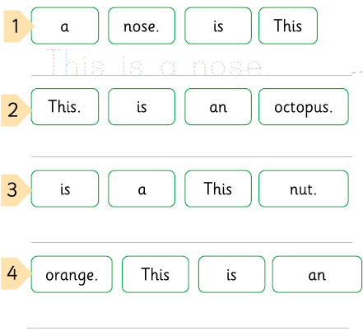



Make a sentence. Match.
This is a nose.
This is an octopus.
This is a nut.
This is an orange.

Slide 18
THANK YOU!

