Slide 1
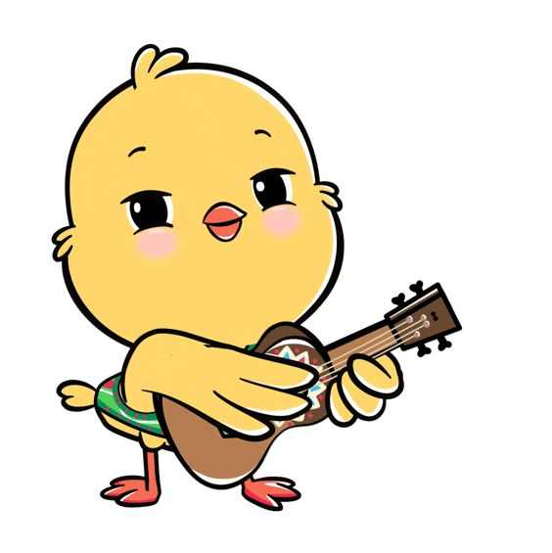
Welcome to our class!

Slide 2
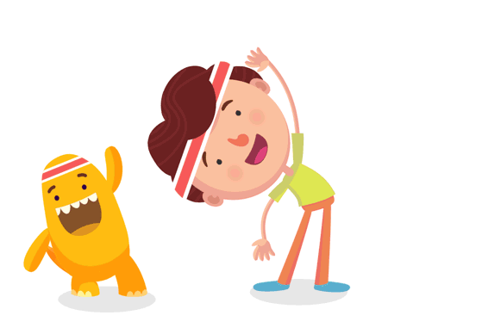
Warm-up

Slide 3



Let’s play!
PLAY

Slide 4


1/8
A: Do you live in that building?
B: ______________
No, I don’t.
Answer
Next

Slide 5
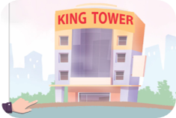

Facebook: Bùi Liễu Powerpoint
0968142780
2/8
A: Do you live in that tower?
B: _________________
Yes, I do.
Answer
Next

Slide 6
3/8
A: ________________?
B: Yes, I do.
Do you live in that tower?
Answer
Next

Slide 7
4/8
A: ___________________?
B: No, I don’t.
Do you live in that building?
Answer
Next

Slide 8
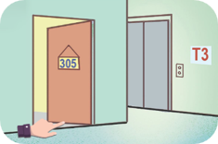
5/8
A: Do you live in this flat?
B: _________________
Yes, I do.
Answer
Next

Slide 9
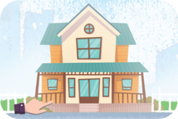
6/8
A: Do you live in this house?
B: ______________
No, I don’t.
Answer
Next

Slide 10
7/8
A: _________________
B: _________________
- Do you live in this flat?
- Yes, I do.
Answer
Next

Slide 11
8/8
A: _________________
B: _________________
- Do you live in this house?
- No, I don’t.
Answer
Next

Slide 12
Great job!
s
EXIT

Slide 13

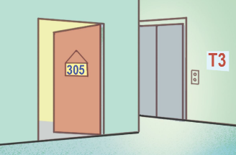
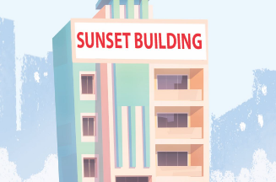
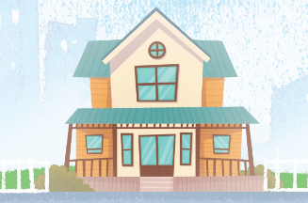
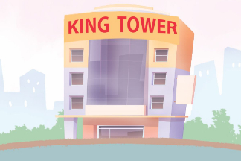
Unit 2
Our homes
Lesson 1 (4+5+6)

Slide 14



Contents
Listen and number.
Read and complete.
Let’s play.

Slide 15

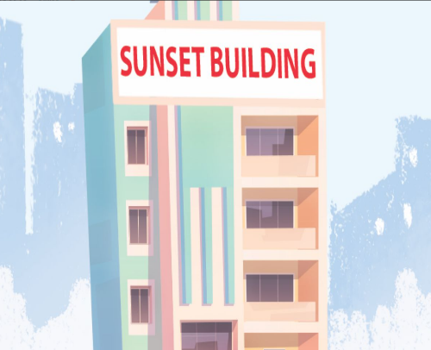
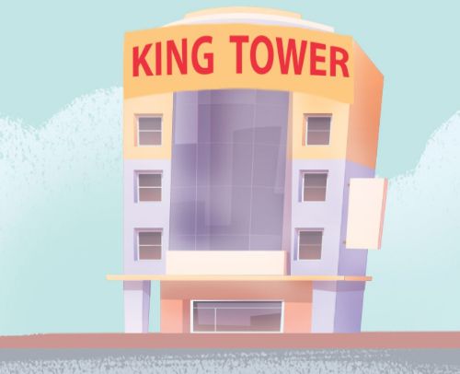
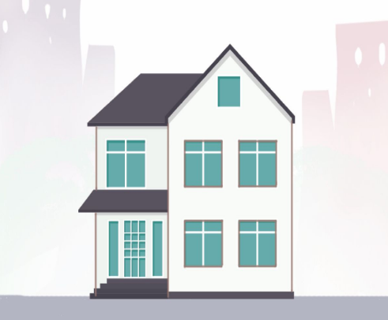
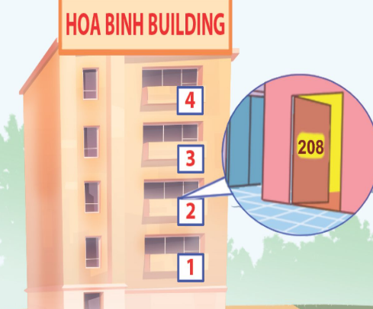




4. Listen and number.
a
b
c
d
4
3
1
2
Click on the speaker to listen.

Slide 16
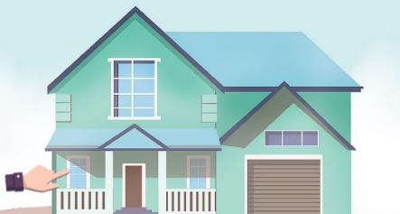
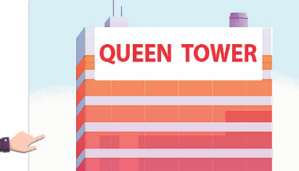
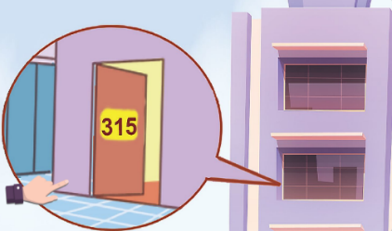
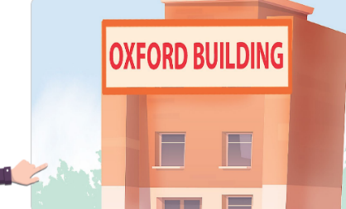
5. Look, complete and read.
this
that
A: Do you live in ____ house?
B: Yes, I do.
1.
2.
A: Do you live in ____ tower ?
B: No, I don’t. I live in Lotus Building.
3.
A: Do you live in this _____?
B: Yes, I do.
flat
building
4.
A: Do you live in that _________?
B: No, I _____. I live in a house
in the countryside.
don’t

Slide 17
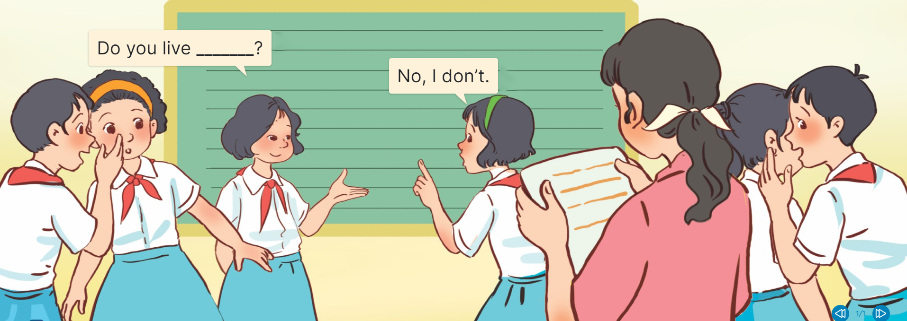
6. Let’s play.
Gussing game

Slide 18
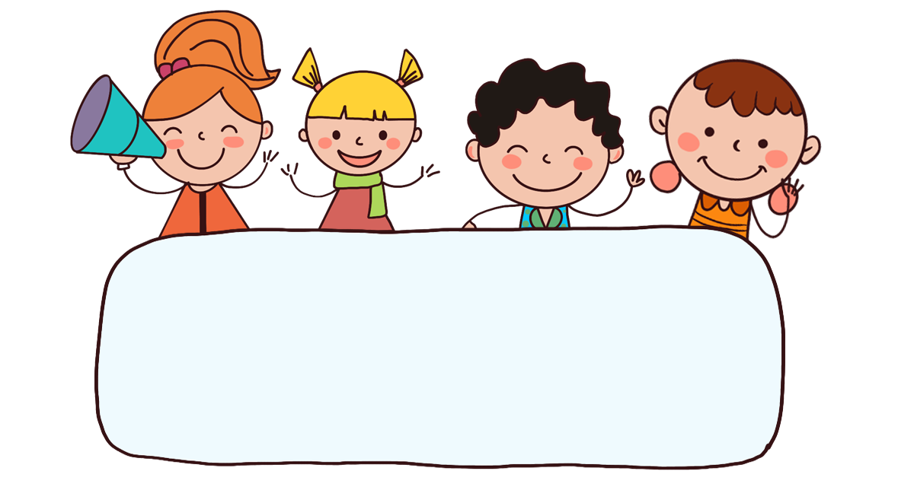
Fun corner
& wrap-up

Slide 19
Let’s play!

Slide 20


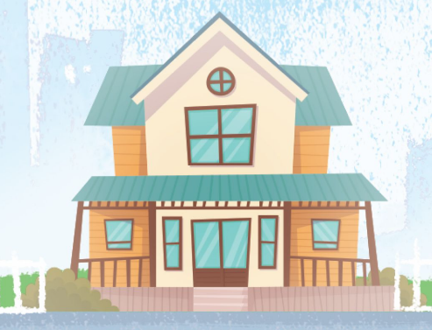



1/8
Listen and choose.
A B C

Slide 21
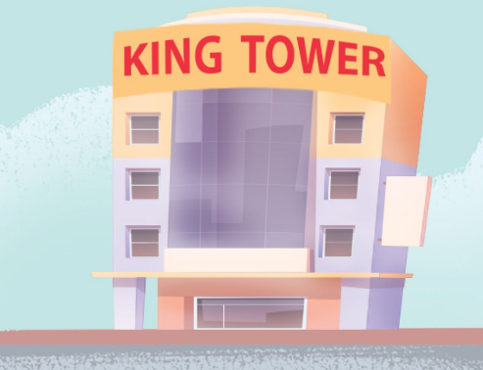

2/8
Listen and choose.
A B C

Slide 22



3/8
Listen and choose.
A B C

Slide 23

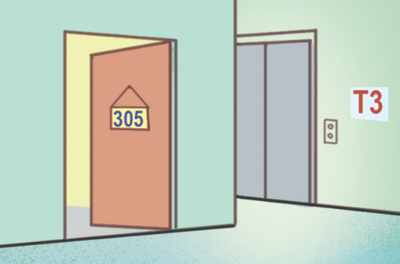

4/8
Listen and choose.
A B C

Slide 24


5/8
A: Do you live in this house?
B: Yes, I do.
A B C

Slide 25

6/8
A: Do you live in that building?
B: No, I don’t.
A B C

Slide 26


7/8
A: Do you live in this flat?
B: Yes, I do.
A B C

Slide 27


8/8
A: Do you live in that tower?
B: No, I don’t.
A B C

Slide 28
Well done!

Slide 29


Unit 2 lesson 1
Do you live in this / that _____?
Yes, I do.
No, I don’t.
house / yes
tower / no
flat / no
building / yes

Slide 30
Homework
Learn by heart all the new words and the model sentences of lesson 1.
Read again the dialogue in part 1.
Prepare for the lesson 2 (1+2+3).

Slide 31

Goodbye!

