Slide 1
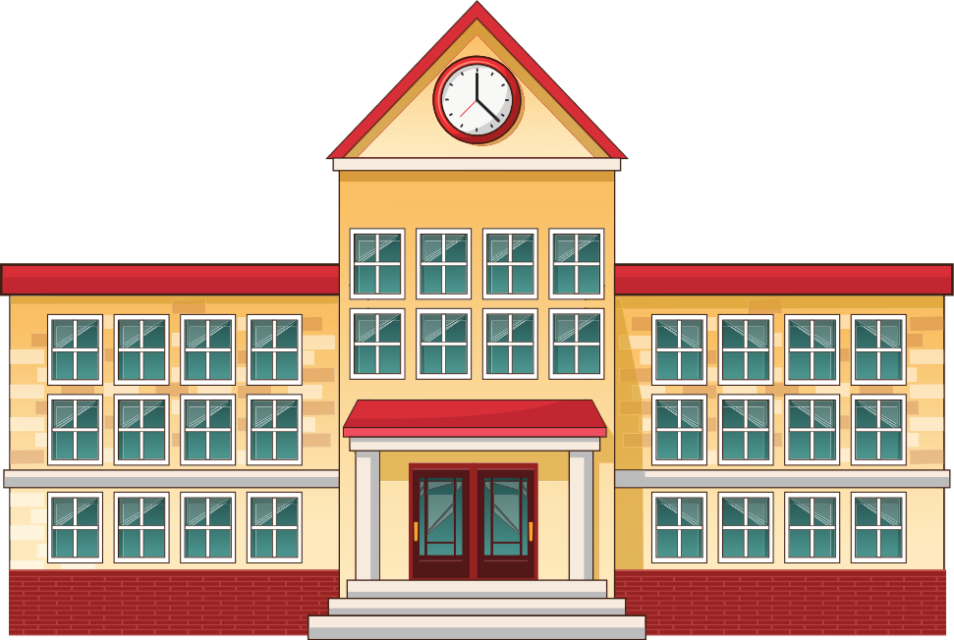
Unit 6
Our school
rooms
Lesson 3
Part: 4, 5, 6
https://www.facebook.com/msphampowerpoint

Slide 2
Table of contents
01.
Warm-up and review
MsPham
0936082789
02.
Read and tick True or False.
03.
Let’s write.
04.
Project.
05.
Fun corner and wrap-up

Slide 3
2
Warm-up and review
MsPham
0936082789

Slide 4
Let’s chant
MsPham
0936082789

Slide 5
LET'S PLAY!
KNOCKOUT
Parts of Speech Game Presentation

Slide 6
HOW TO PLAY
Group the students into two equal groups. Have them stand in two single-file lines facing the board.
Start the game!
Have the two players at the front of each line try to be the first one to call out the correct part of speech.
The first player to call out the part of speech stays in the game and goes to the back of their team's line.
The player that did not call out the part of speech first is eliminated.
The last team to have people standing is the winning team!

Slide 7
ARE YOU READY?
LET'S START THE GAME!

Slide 8
TEAM 1
TEAM 2
Second floor
Third floor

Slide 9
TEAM 1
TEAM 2
First floor
Ground floor

Slide 10
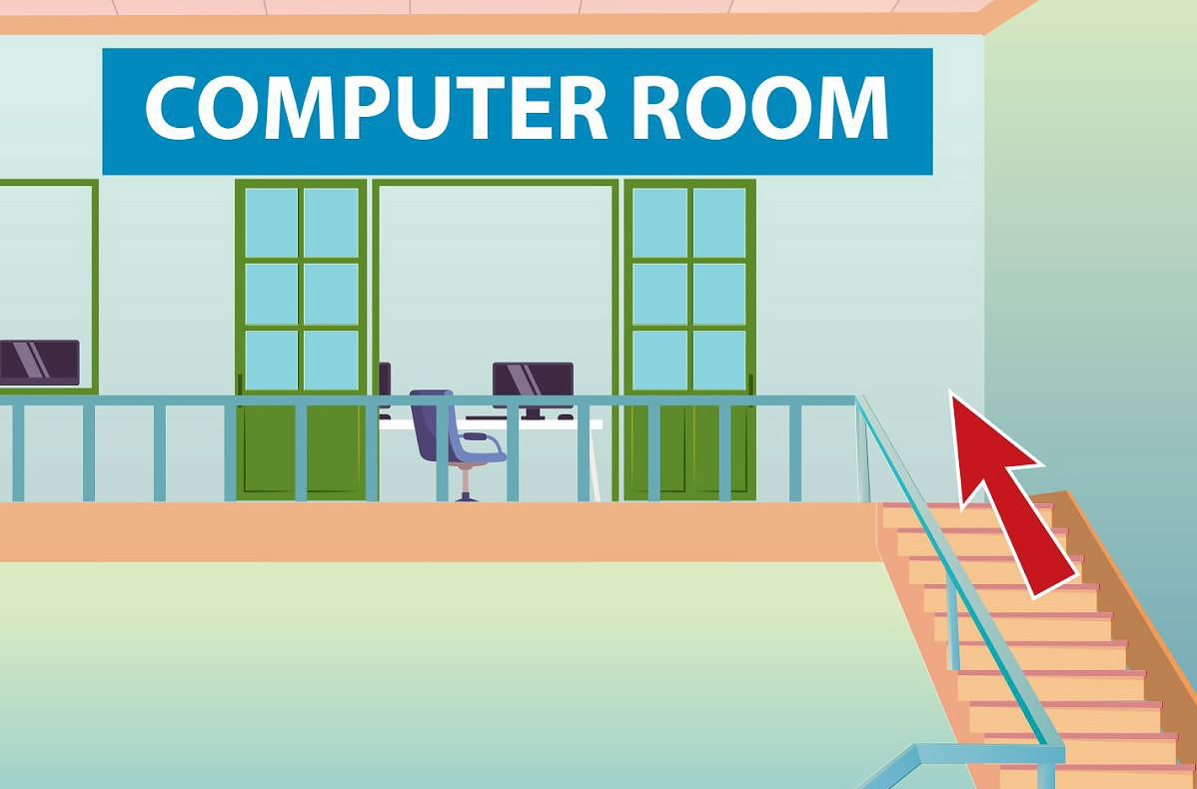
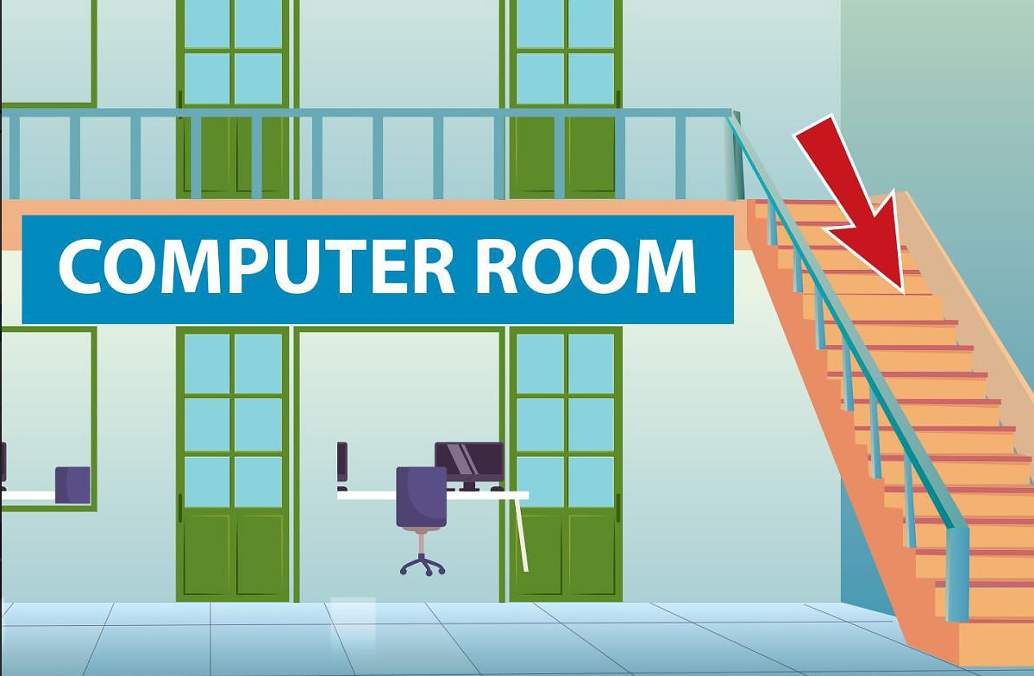
TEAM 1
TEAM 2
Go upstairs
Go downstairs

Slide 11
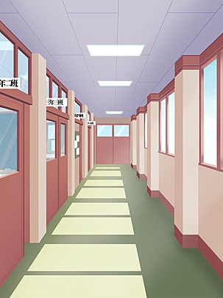
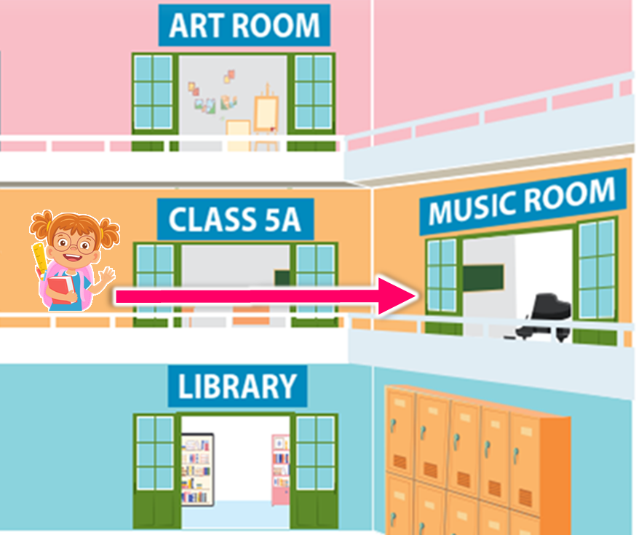
TEAM 1
TEAM 2
Go along
Go past

Slide 12
TEAM 1
TEAM 2
Turn left
Turn right

Slide 13
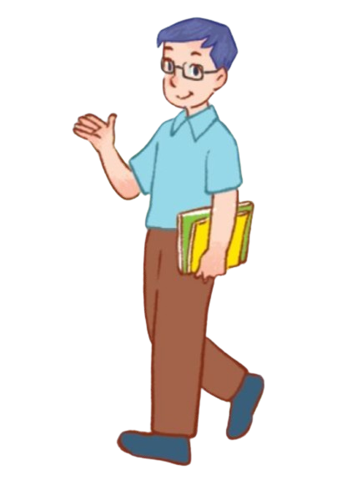
TEAM 1
TEAM 2
On the left
On the right

Slide 14
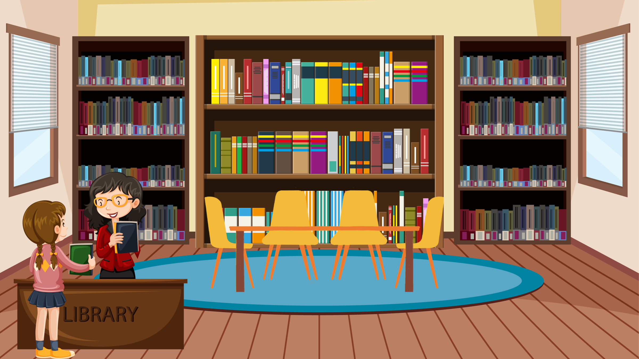
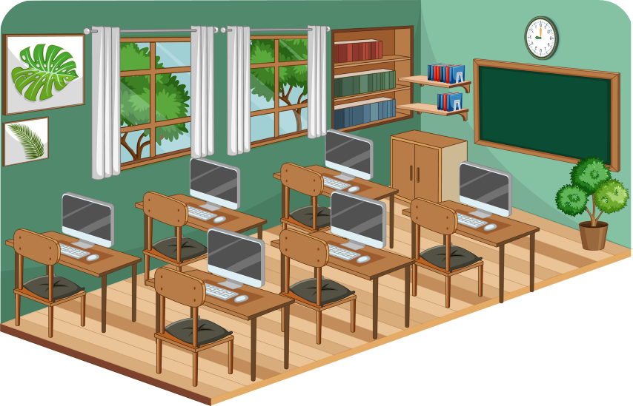
TEAM 1
TEAM 2
Computer room
Library

Slide 15
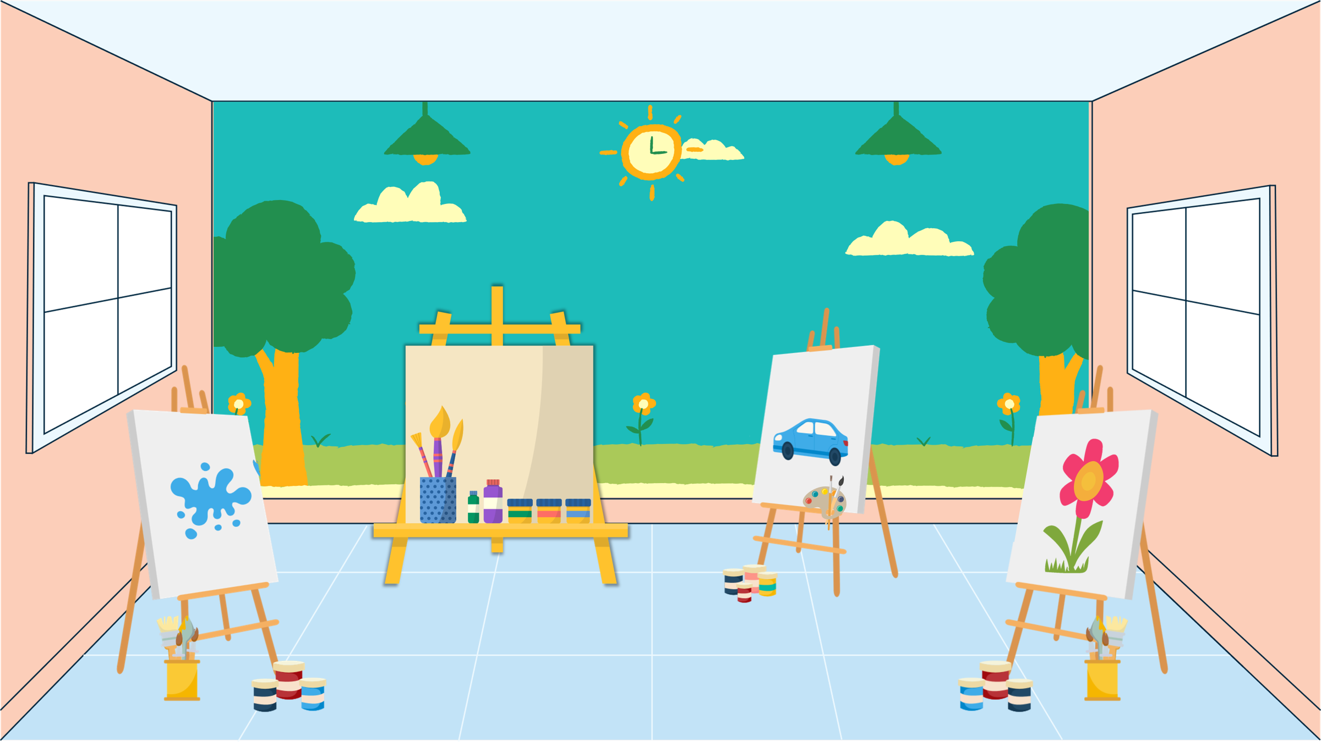
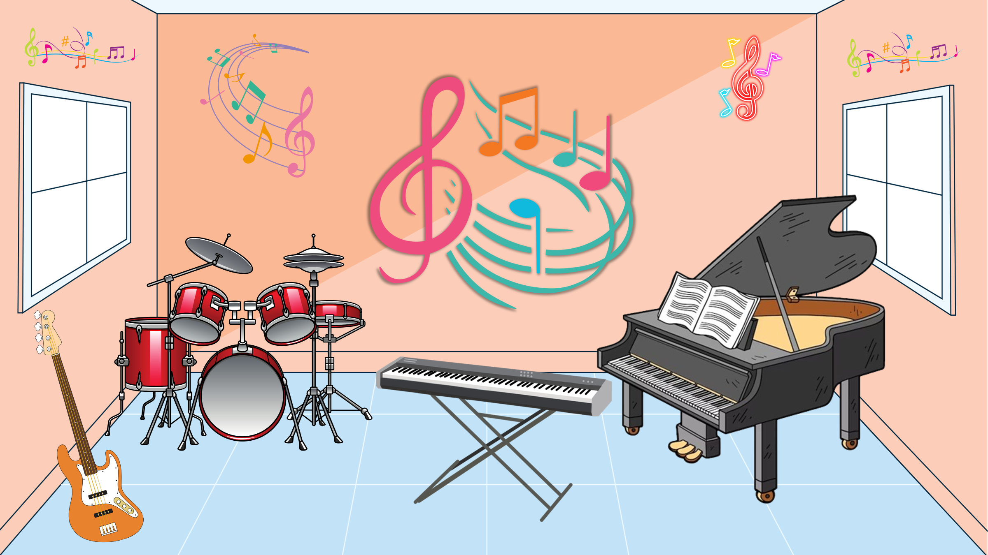
TEAM 1
TEAM 2
Art room
Music room

Slide 16
Excellent!

Slide 17
Review
Where's the ______?
It's on the ______.
art room
library
MsPham
0936082789
computer room
music room
third floor
second floor
first floor
ground floor

Slide 18
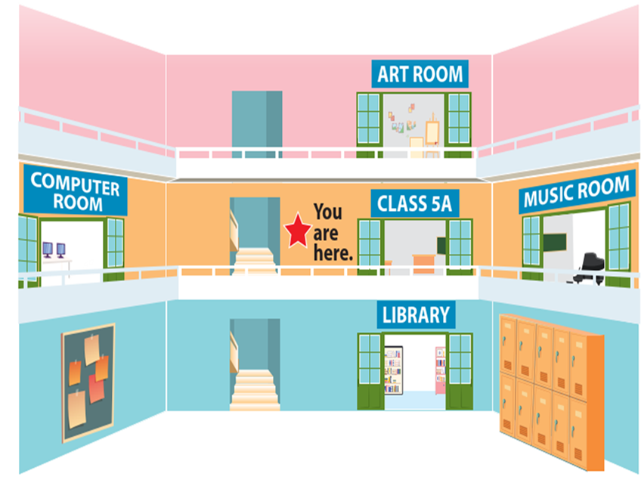
Review
Go upstairs.
It's on your left.
Go past
Class 5A
and turn right.
Go along
the corridor and turn left.
Go downstairs.
It's on your left.
Could you tell me the way
to the _____, please?

Slide 19
1
Listen and repeat.
MsPham
0936082789

Slide 20
https://www.facebook.com/msphampowerpoint
Read
Our school is in the centre of New York City. It is big and beautiful. Our school has a computer room and a library. The computer room is on the second floor. You go upstairs, and it is on the left. The library is on the second floor, too. You go past the computer room, and it is on the right. The library is my favourite room. I often read books there at break time.
Notes:
Click từng câu để nghe và nhắc lại

Slide 21
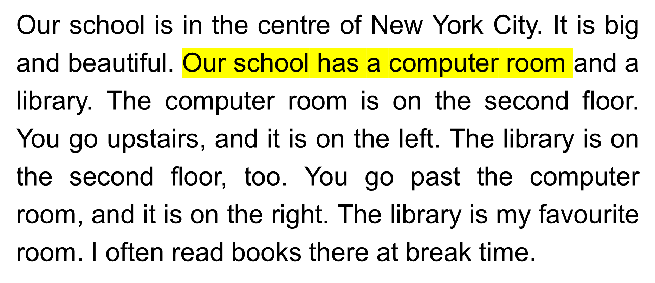
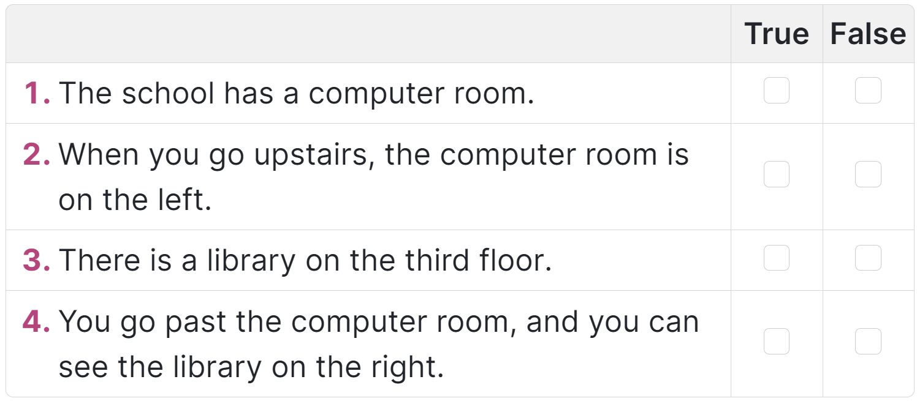
https://www.facebook.com/msphampowerpoint
https://www.facebook.com/msphampowerpoint
Tick True or False.
Notes:
Click từng câu để nghe và nhắc lại

Slide 22
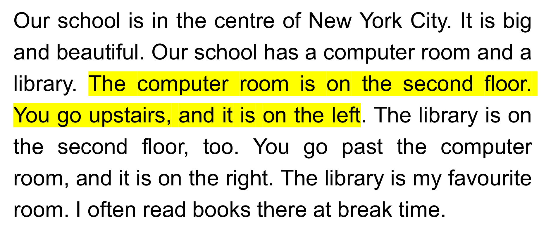
https://www.facebook.com/msphampowerpoint
https://www.facebook.com/msphampowerpoint
Tick True or False.
Notes:
Click từng câu để nghe và nhắc lại

Slide 23
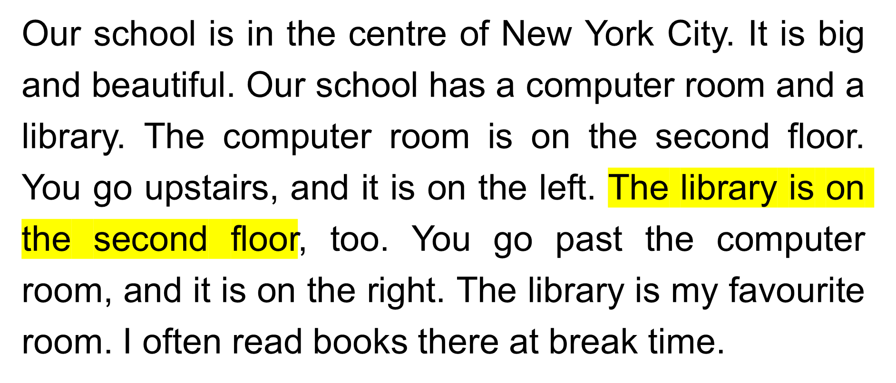
Tick True or False.
Notes:
Click từng câu để nghe và nhắc lại

Slide 24
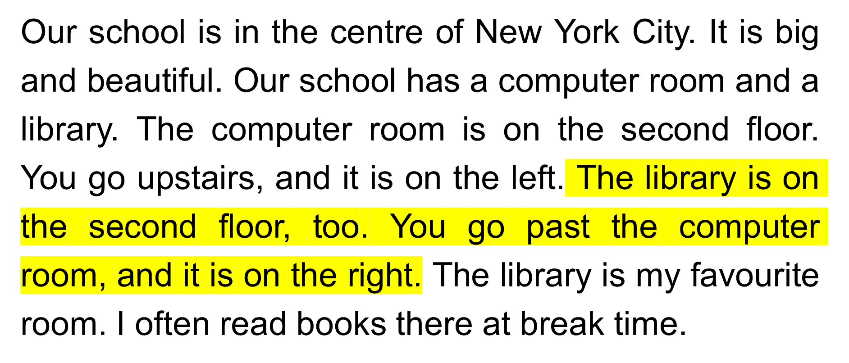
https://www.facebook.com/msphampowerpoint
Tick True or False.
Notes:
Click từng câu để nghe và nhắc lại

Slide 25
3
Let’s write.
MsPham
0936082789

Slide 26
Let’s write.
MsPham
0936082789

Slide 27
Your answer
MsPham
0936082789

Slide 28
4
MsPham
0936082789
Project

Slide 29
Project
Draw your favourite school with rooms.
Talk about your school with your partner and your class.

Slide 30
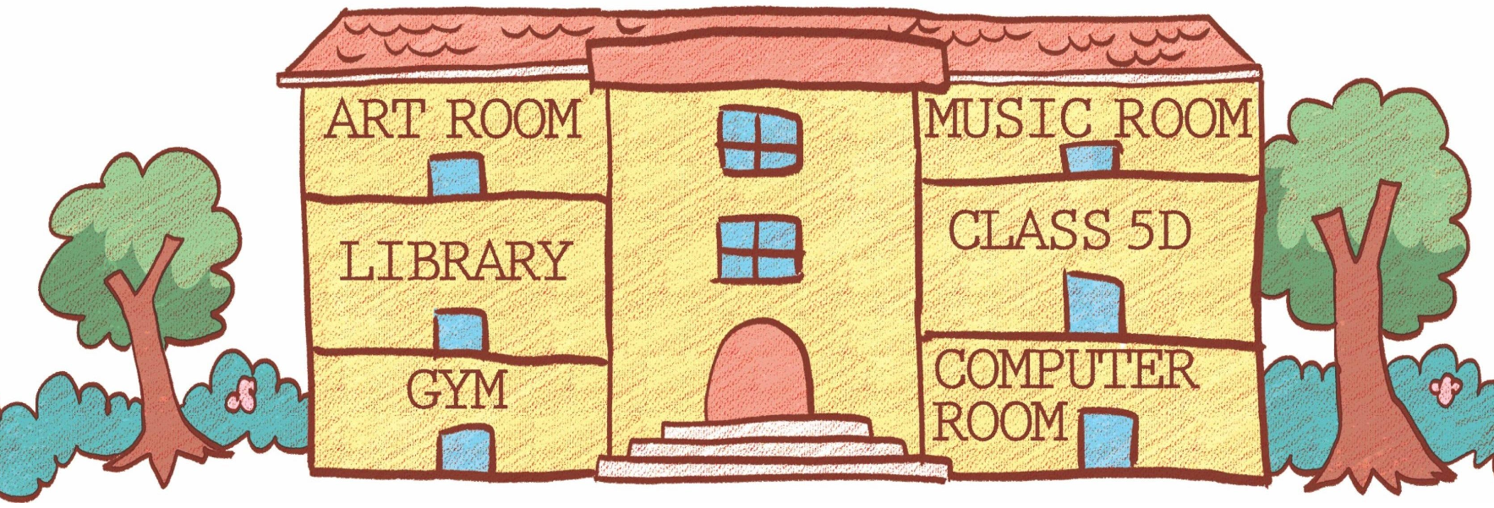
My answer
This is a picture of my favourite school
big and beautiful school
second floor
many room
my favourite
room
MsPham
0936082789
draw pictures with my friends
first floor
ground floor
This is a picture of my favourite school. It's a big and beautiful school. The school has many rooms in it. In the picture, you can see a gym, a computer room, a library, an art room, a music room and our classroom Class 5D. The gym and the computer room are on the ground floor. The library and Class 5D are on the first floor. The art room and the music room are on the second floor. My favourite room is the art room. I often draw pictures with my friends there.
Notes:
This is a picture of my favourite school. It's a big and beautiful school. The school has many rooms in it. In the picture, you can see a gym, a computer room, a library, an art room, a music room and our classroom Class 5D. The gym and the computer room are on the ground floor. The library and Class 5D are on the first floor. The art room and the music room are on the second floor. My favourite room is the art room. I often draw pictures with my friends there.

Slide 31
Your answer
This is a picture of my favourite school
MsPham
0936082789

Slide 32
5
Fun corner
and
wrap-up
MsPham
0936082789

Slide 33
MsPham-0936082789
Start
Notes:
Ms Huyền Phạm - 0936.082.789 – YOUTUBE: MsPham. Facebook: Dạy và học cùng công nghệ.

Slide 34
Ms Huyền Phạm
0936.082.789
Notes:
Ms Huyền Phạm - 0936.082.789 – YOUTUBE: MsPham. Facebook: Dạy và học cùng công nghệ.

Slide 35
How to play!
Read and order the words in 15s.
Correct → get stars.
PLAY

Slide 36
is / third / The / on /
floor. / the / library
Start
Answer
The library is on
the third floor.
Next

Slide 37
am / the / I / room /
art / for / looking
Start
Answer
I am looking for the art room.
Next

Slide 38
floor. / music / The / the /
room / is / on / second
Start
Answer
The music room is on the second floor.
Next

Slide 39
left / and / Go /
downstairs / turn
Start
Answer
Go downstairs and turn left.
Next

Slide 40
you / me / room, / the / the / tell /
please? / to / computer / way / Could
Start
Answer
Could you tell me the way to the computer room, please?
Next

Slide 41
Class / 5A? / is / Where
Start
Answer
Where is Class 5A?
Next

Slide 42
and / the / right. / corridor / along / Go / turn
Start
Answer
Go along the corridor and turn right.
Next

Slide 43
EXIT
Notes:
Ms Huyền Phạm - 0936.082.789 – YOUTUBE: MsPham. Facebook: Dạy và học cùng công nghệ.

Slide 44
Thank you
For joining!
https://www.facebook.com/msphampowerpoint

