Slide 1
Unit 7
Our favourite school activities
Lesson 1
Part: 1, 2, 3
https://www.facebook.com/msphampowerpoint

Slide 2
Table of contents
01.
Warm-up and review
02.
Look, listen and repeat.
MsPham
0936082789
03.
Listen, point and say.
04.
Let’s talk.
05.
Fun corner and wrap-up

Slide 3
1
Warm-up
and review
MsPham
0936082789

Slide 4
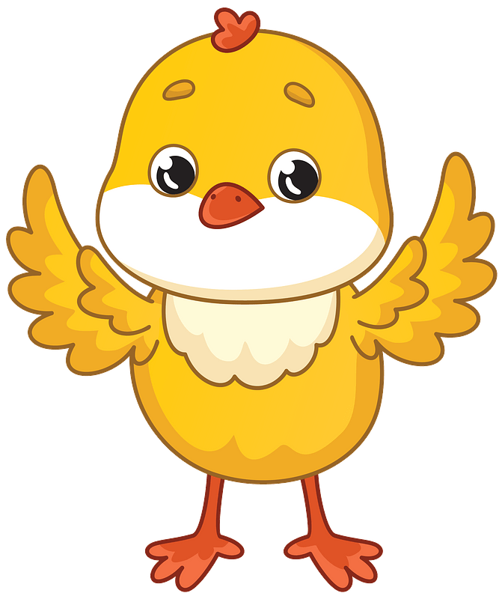
HATCHING EGGS
MsPham
0936082789
Start

Slide 5
Choose the best option.
What’s your favourite subject?
It’s maths.
A
B
C
Next

Slide 6
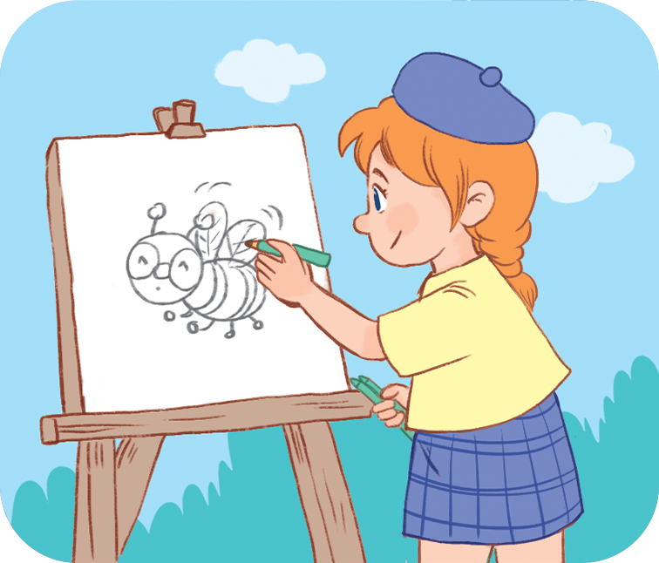
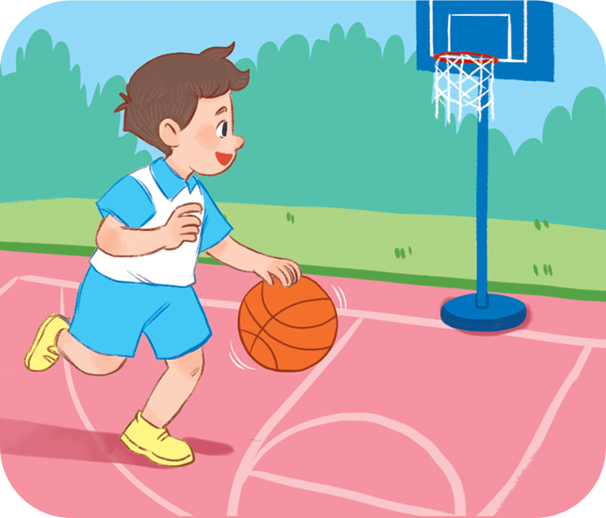
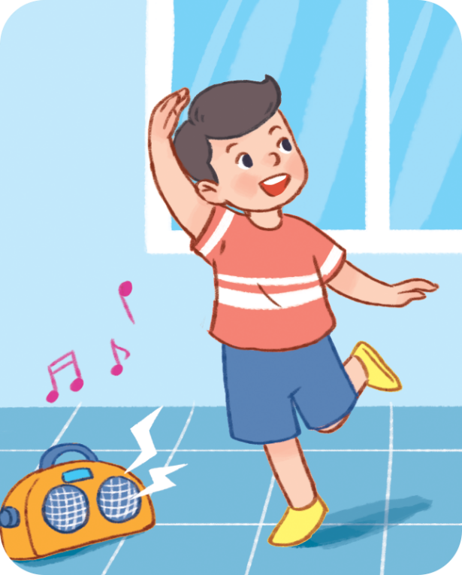
Choose the best option.
What do you like doing?
I like drawing.
A
B
C
Next

Slide 7
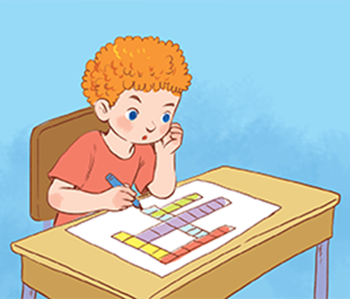
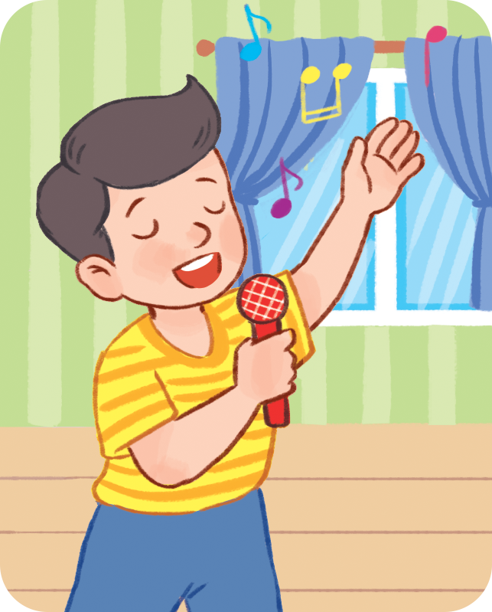
Choose the best option.
What is her hobby?
She likes reading books.
MsPham-0936082789
A
B
C
Next

Slide 8
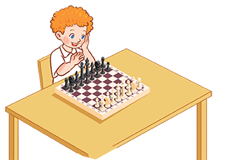
Choose the best option.
What is his hobby?
He likes __________.
playing
chess
playing volleyball
doing
word puzzles
A
B
C
Next

Slide 9
Choose the best option.
What is your hobby?
I like __________.
playing the violin
playing the guitar
riding
the bike
A
B
C
Next

Slide 10
Choose the best option.
What is he doing?
He is ________.
MsPham-0936082789
go to school
goes to school
going to school
A
B
C
Next

Slide 11
Choose the best option.
What is he doing?
He is ________.
having breakfast
have
breakfast
has
breakfast
A
B
C
Next

Slide 12
Choose the best option.
What are you doing?
MsPham-0936082789
He is
swimming.
She is
swimming.
I am
swimming.
A
B
C
Next

Slide 13
Good job!
MsPham-0936082789
MsPham-0936082789
End

Slide 14
2
Look, listen and repeat.
MsPham
0936082789

Slide 15
Look and listen
MsPham
0936082789

Slide 16
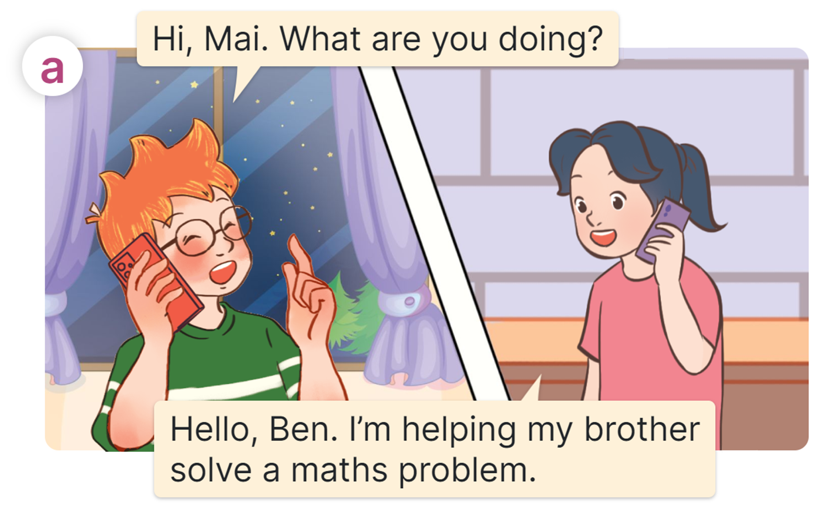
Listen and repeat
MsPham
0936082789

Slide 17
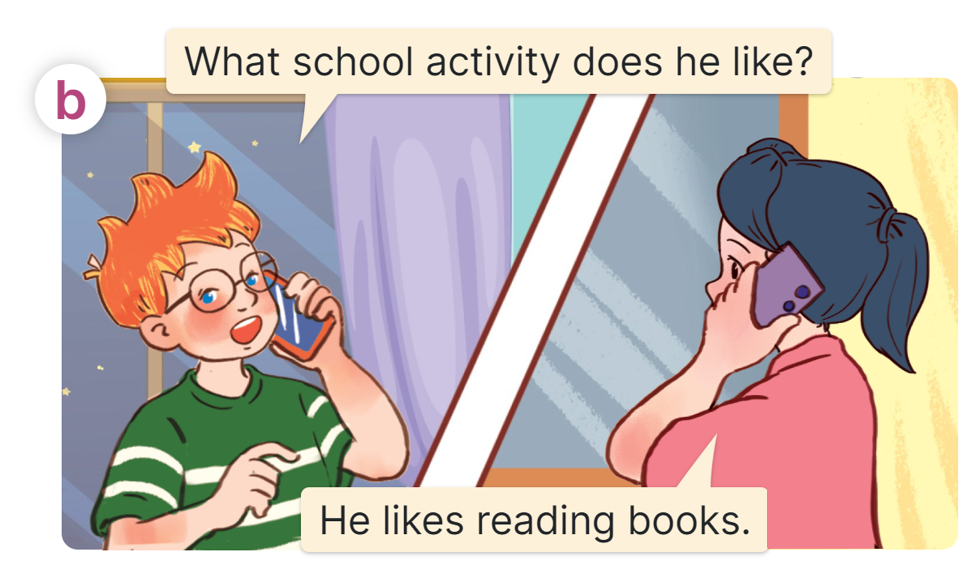
Listen and repeat
MsPham
0936082789

Slide 18
Look and read
MsPham
0936082789

Slide 19
Structures
Cách hỏi và trả lời ai đó thích hoạt động trường học nào:
What school activity does he / she like?
(Anh ấy/ Cô ấy thích hoạt động nào ở trường?)
He/She likes ___________.
(+ V-ing)
MsPham
0936082789
(Anh ấy/ Cô ấy thích _______)
https://www.facebook.com/msphampowerpoint

Slide 20
Grammar
Quy tắc thêm “ing” vào sau động từ:
1. Thêm “ing” vào sau hầu hết các động từ.
Eg: do → doing play → playing read → reading
2. Các động từ có tận cùng là chữ e, thì bỏ e và thêm “ing”.
Eg: dance → dancing solve - solving
MsPham
0936082789
https://www.facebook.com/msphampowerpoint

Slide 21
3
Listen, point and say.
MsPham
0936082789

Slide 22
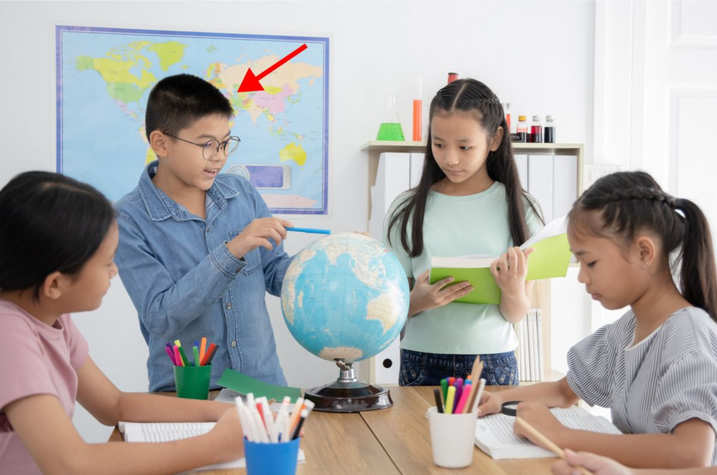
Vocabulary
do projects
/duː ˈprɒdʒekts/
MsPham
0936082789
Làm các bài tập dự án

Slide 23
Vocabulary
read books
/riːd ˈbʊks/
MsPham
0936082789
Đọc sách

Slide 24
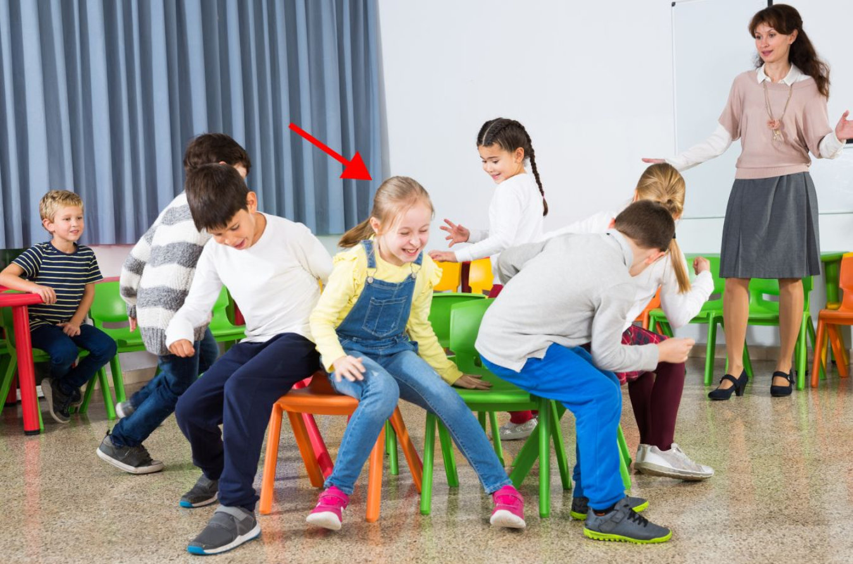
Vocabulary
play games
/pleɪ ɡeɪmz/
MsPham
0936082789
Chơi các trò chơi

Slide 25
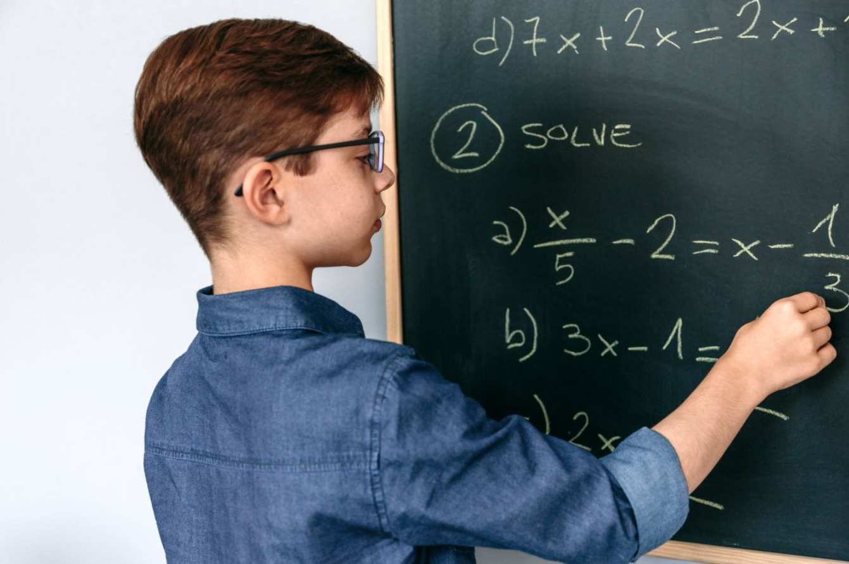
Vocabulary
solve maths problems
/sɒlv mæθs ˈprɒbləmz/
MsPham
0936082789
Giải các bài toán

Slide 26
Vocabulary
activity
/ækˈtɪvəti/
MsPham
0936082789
Hoạt động

Slide 27
Vocabulary
play games
: Chơi các trò chơi
: Làm các bài tập dự án
MsPham
0936082789
do projects
read books
: Đọc sách
solve maths problems
: Giải các bài toán
activity
:Hoạt động

Slide 28
Vocabulary check
Match
solve maths problems
1.
MsPham
0936082789
2.
read books
3.
play games
4.
do projects

Slide 29
Vocabulary check
Say aloud the missing words
do _________
1.
projects
MsPham
0936082789
2.
______ maths problems
solve
3.
play _______
games
read
4.
_______ books

Slide 30
Listen, point and say
What school activity
does he / she like?
MsPham
0936082789
do projects
read books
He / She likes ______.
play games
solve maths problems

Slide 31
Listen, point and say
What school activity
does he / she like?
What school activity
does he like?
He likes doing projects.
MsPham
0936082789
He / She likes ______.

Slide 32
Listen, point and say
What school activity
does he / she like?
What school activity
does she like?
He / She likes ______.
MsPham
0936082789
She likes reading books.

Slide 33
Listen, point and say
What school activity
does he / she like?
What school activity
does she like?
She likes playing games.
MsPham
0936082789
He / She likes ______.

Slide 34
Listen, point and say
What school activity
does he / she like?
What school activity
does he like?
He / She likes ______.
MsPham
0936082789
He likes solving maths problems.

Slide 35
Listen, point and say
What school activity
does he / she like?
MsPham
0936082789
He / She likes ______.

Slide 36
4
Let’s talk.
MsPham
0936082789

Slide 37
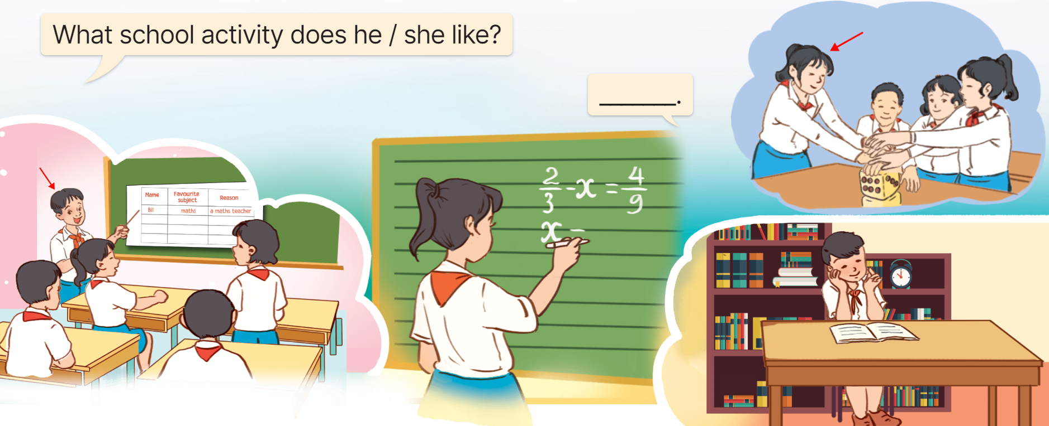
Let’s talk
MsPham
0936082789

Slide 38
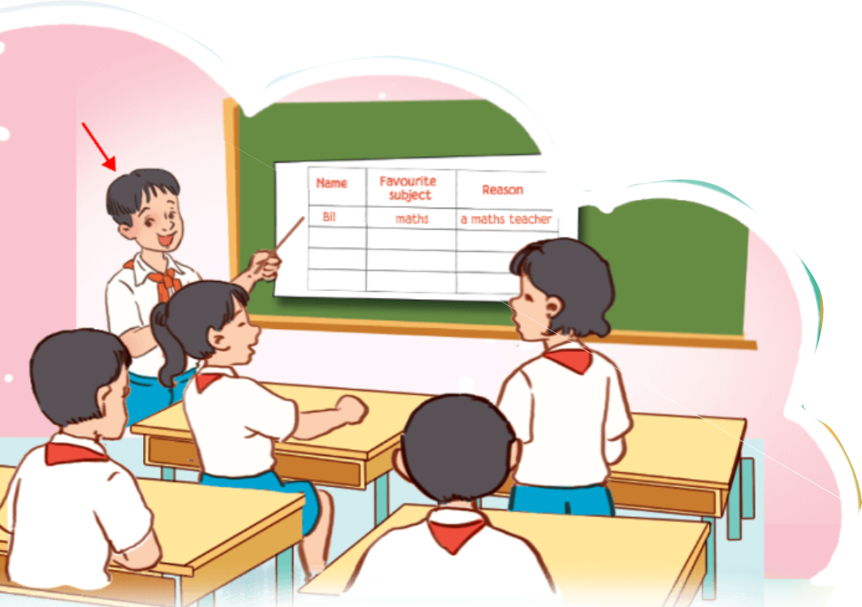
Let’s talk
What school activity
does he / she like?
What school activity
does he like?
______________.
He likes doing projects.
MsPham
0936082789

Slide 39
Let’s talk
What school activity
does he / she like?
What school activity
does he like?
______________.
He likes reading books.
MsPham
0936082789

Slide 40
Let’s talk
What school activity
does he / she like?
What school activity
does she like?
______________.
She likes solving maths problems.
MsPham
0936082789

Slide 41
Let’s talk
What school activity
does he / she like?
What school activity
does she like?
______________.
She likes
playing games.
MsPham
0936082789

Slide 42
5
Fun corner
and wrap-up
MsPham
0936082789

Slide 43
Keep or give
The box
Next

Slide 44
HOW TO PLAY
Make 2 teams
Answer the question
Then you must choose:
KEEP or GIVE THE GIFT to the other team.
BE CAREFUL!
The points in the gift can be GOOD or BAD.
Start

Slide 45
What school ______
does she like?
KEEP or GIVE
Check
activity

Slide 46
+10 point
Next

Slide 47
What school activity
does he ______?
KEEP or GIVE
Check
like

Slide 48
-3 point
Next

Slide 49
He ______ reading books.
KEEP or GIVE
Check
likes

Slide 50
+20 point
Next

Slide 51
What school activity does she like?
She likes ______ the internet.
KEEP or GIVE
Check
surfing

Slide 52
-5 point
Next

Slide 53
What school activity does Tom like?
He likes solving maths _______.
KEEP or GIVE
Check
problems

Slide 54
+10 point
Next

Slide 55
What school activity does she like?
She likes solving maths _______.
KEEP or GIVE
Check
likes

Slide 56
+10 point
Next

Slide 57
What school activity does she like?
She likes _________.
KEEP or GIVE
Check
playing games

Slide 58
-5 point
Next

Slide 59
What school activity does he like?
He likes doing _______.
KEEP or GIVE
Check
projects

Slide 60
+20 point
Next

Slide 61
GOOD JOB!
Exit

Slide 62
Review
What school activity
does he / she like?
He / She likes _______.
MsPham
0936082789
play games
read books
solve maths problems
do projects

Slide 63
MsPham
0936082789
Thank you
For joining!

