Slide 1
Unit 7
Our favourite school activities
Lesson 2
Part: 4, 5, 6
https://www.facebook.com/msphampowerpoint

Slide 2
Table of contents
01.
Warm-up and review
02.
Listen and tick.
MsPham
0936082789
03.
Read and complete.
04.
Let's play.
05.
Fun corner and wrap-up.

Slide 3
1
Warm-up
and review
MsPham
0936082789

Slide 4
The little penguins
MsPham-0936082789
PLAY
Notes:
MsPham-0936082789

Slide 5
What is the word?
group
work
MsPham-0936082789
Start
Check
Next
Notes:
MsPham-0936082789

Slide 6
What is the word?
useful
MsPham-0936082789
Start
Check
Next
Notes:
MsPham-0936082789

Slide 7
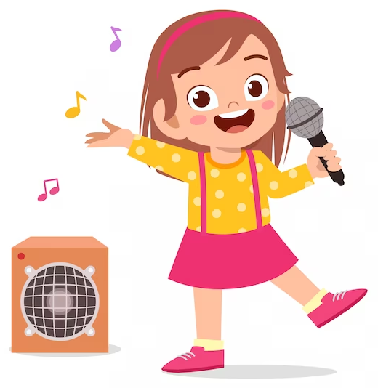
What is the word?
sing
MsPham-0936082789
Start
Check
Next
Notes:
MsPham-0936082789

Slide 8
What is the word?
fun
MsPham-0936082789
Start
Check
Next
Notes:
MsPham-0936082789

Slide 9
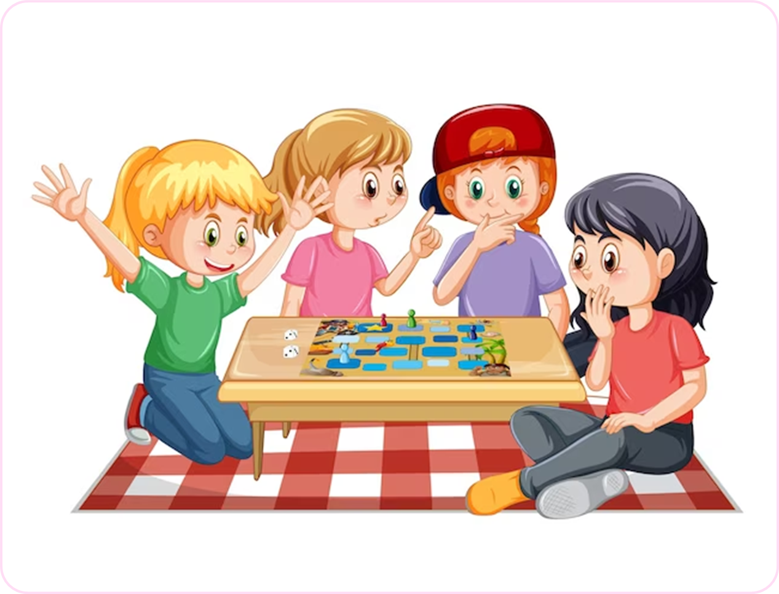
What is the word?
play
games
MsPham-0936082789
Start
Check
Next
Notes:
MsPham-0936082789

Slide 10
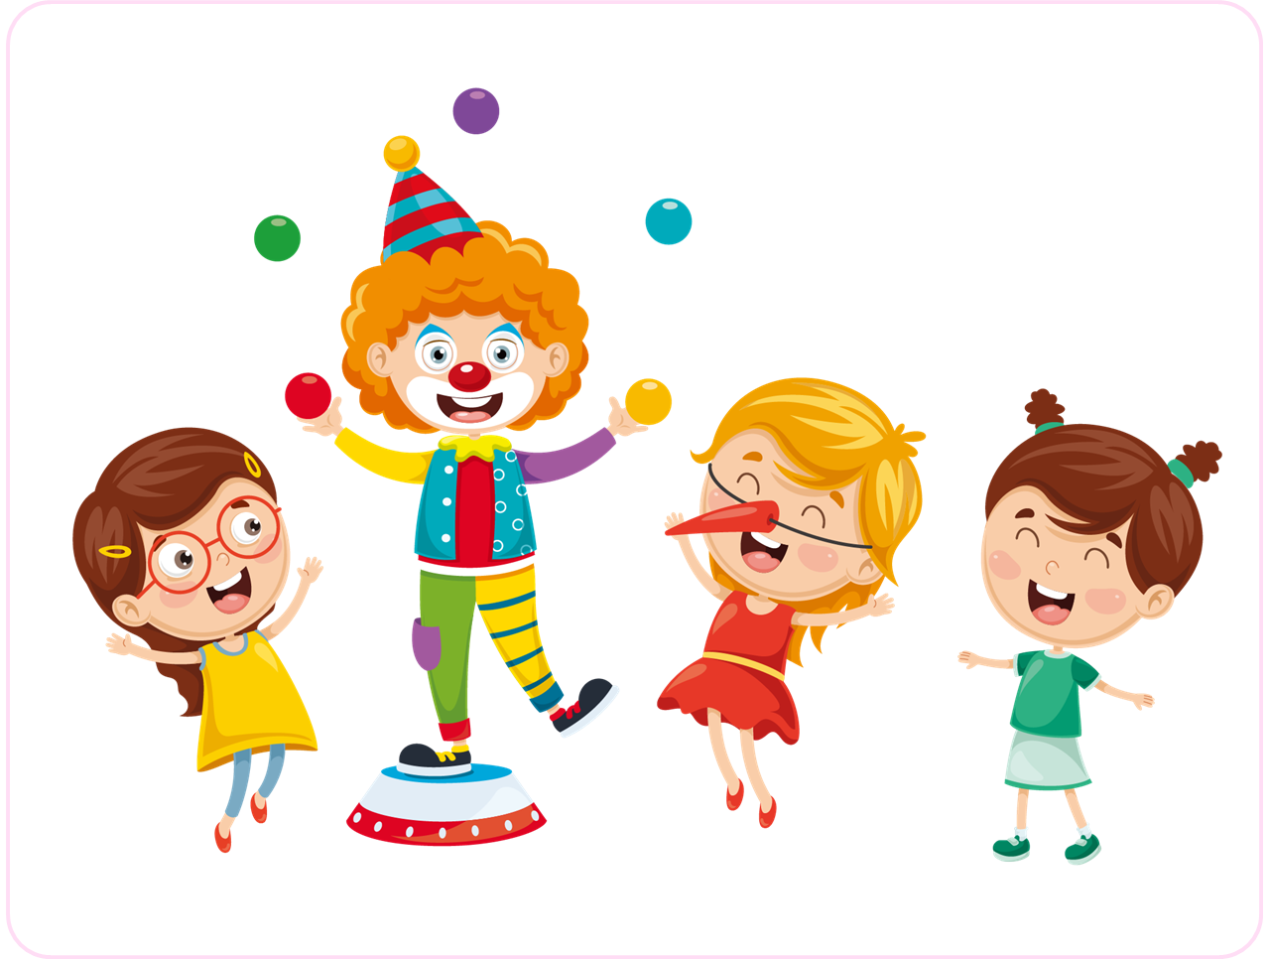
What is the word?
interesting
MsPham-0936082789
Start
Check
Next
Notes:
MsPham-0936082789

Slide 11
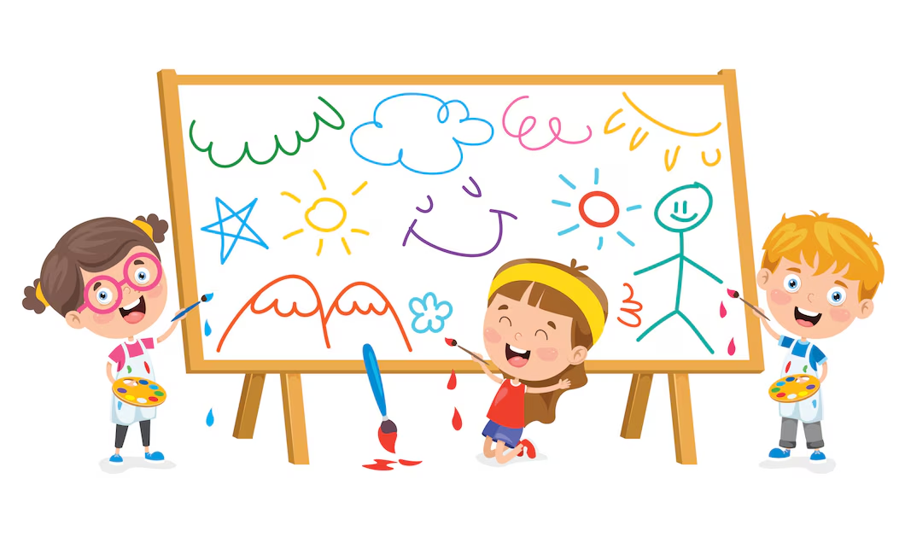
What is the word?
draw
MsPham-0936082789
Start
Check
Next
Notes:
MsPham-0936082789

Slide 12
Good job!
MsPham-0936082789
EXIT
Notes:
MsPham-0936082789

Slide 13
Review
What school activity does he/she like?
He/She likes _______?
Why does he/she like ___?
Because he/she thinks it’s ____.
MsPham
0936082789
playing games
reading books
solving maths problems
doing projects
fun
interesting
useful
good for group work

Slide 14
2
Listen and tick.
MsPham
0936082789

Slide 15
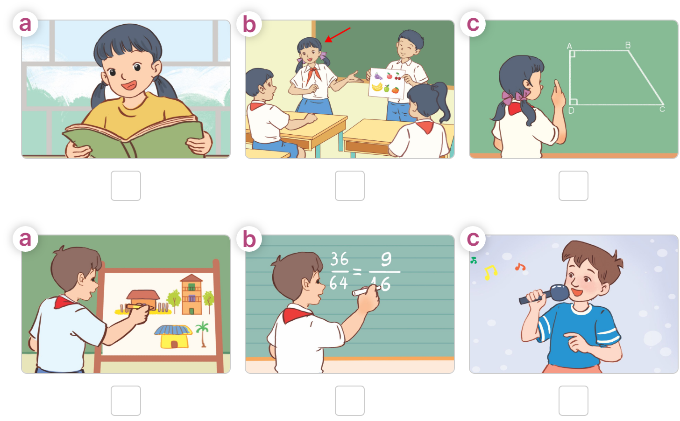
Listen and tick.
MsPham
0936082789

Slide 16
A: My sister doesn't like maths.
B: What school activity does she like?
A: She likes doing projects.
B: Why does she like it?
A: Because she thinks it's good for group work.
4.Listen and check.
MsPham
0936082789
Click vào ngôi sao để hiện / ẩn đoạn text

Slide 17
A: Why doesn't Minh like solving maths
problems?
B: Because he thinks it's difficult.
A: What school activity does he like?
B: He likes drawing pictures.
A: Why does he like it?
B: Because he thinks it's fun and easy.
Listen and check.
MsPham
0936082789
Click vào ngôi sao để hiện / ẩn đoạn text

Slide 18
5
Read and complete.
MsPham
0936082789

Slide 19
Read and complete.
MsPham
0936082789
https://www.facebook.com/msphampowerpoint

Slide 20
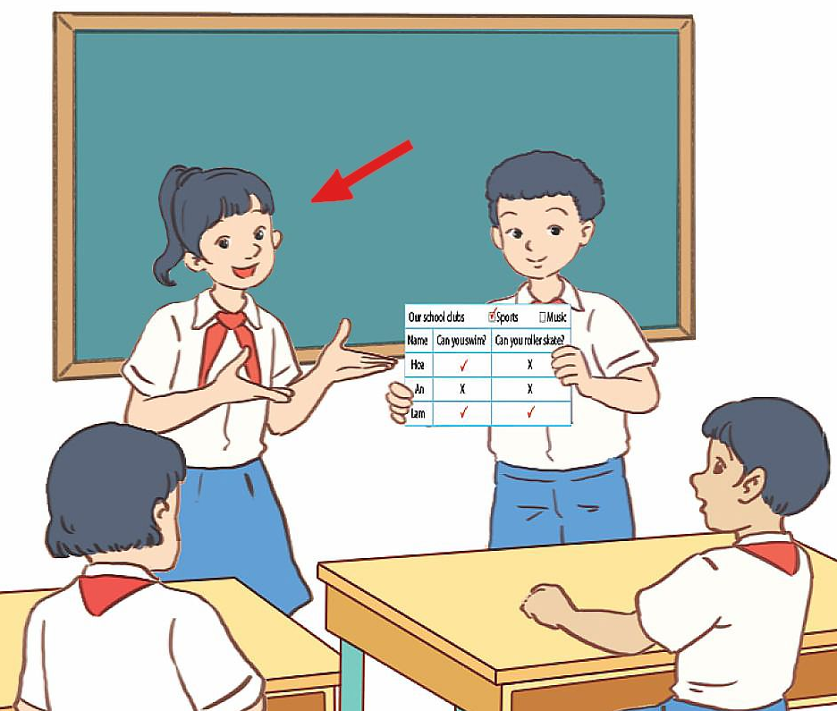
Let’s check
MsPham
0936082789
A: What school activity does your sister like?
B: She likes doing projects .
A: Why does she like it?
B: Because she thinks it's interesting.
____________.
https://www.facebook.com/msphampowerpoint

Slide 21
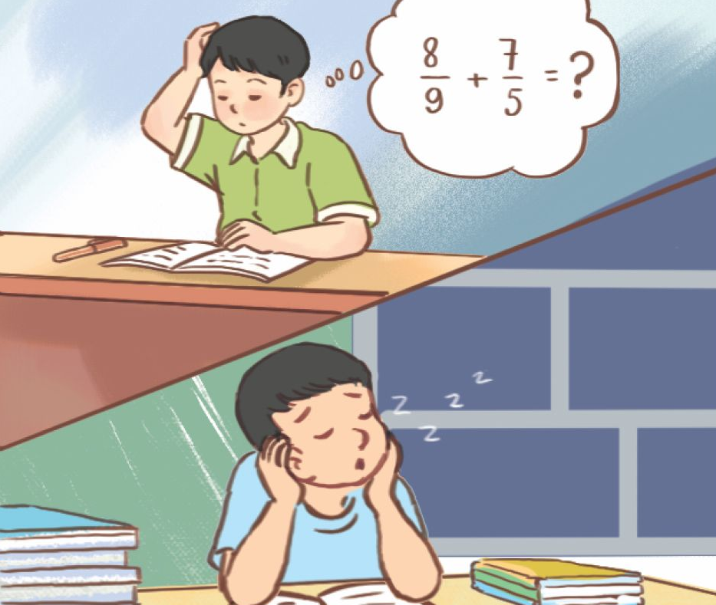
Let’s check
MsPham
0936082789
A: What school activities doesn't your brother like?
B: He doesn't like solving maths problems or
reading books.
A: Why doesn't he like them?
A: Because he thinks they aren't interesting.
_______________________
_________
https://www.facebook.com/msphampowerpoint

Slide 22
4
Let’s play
MsPham
0936082789

Slide 23
Listen and sing
Making sentences
MsPham
0936082789

Slide 24
5
Fun corner
and wrap-up
MsPham
0936082789

Slide 25
“likes” or “doesn’t like ”
Start

Slide 26
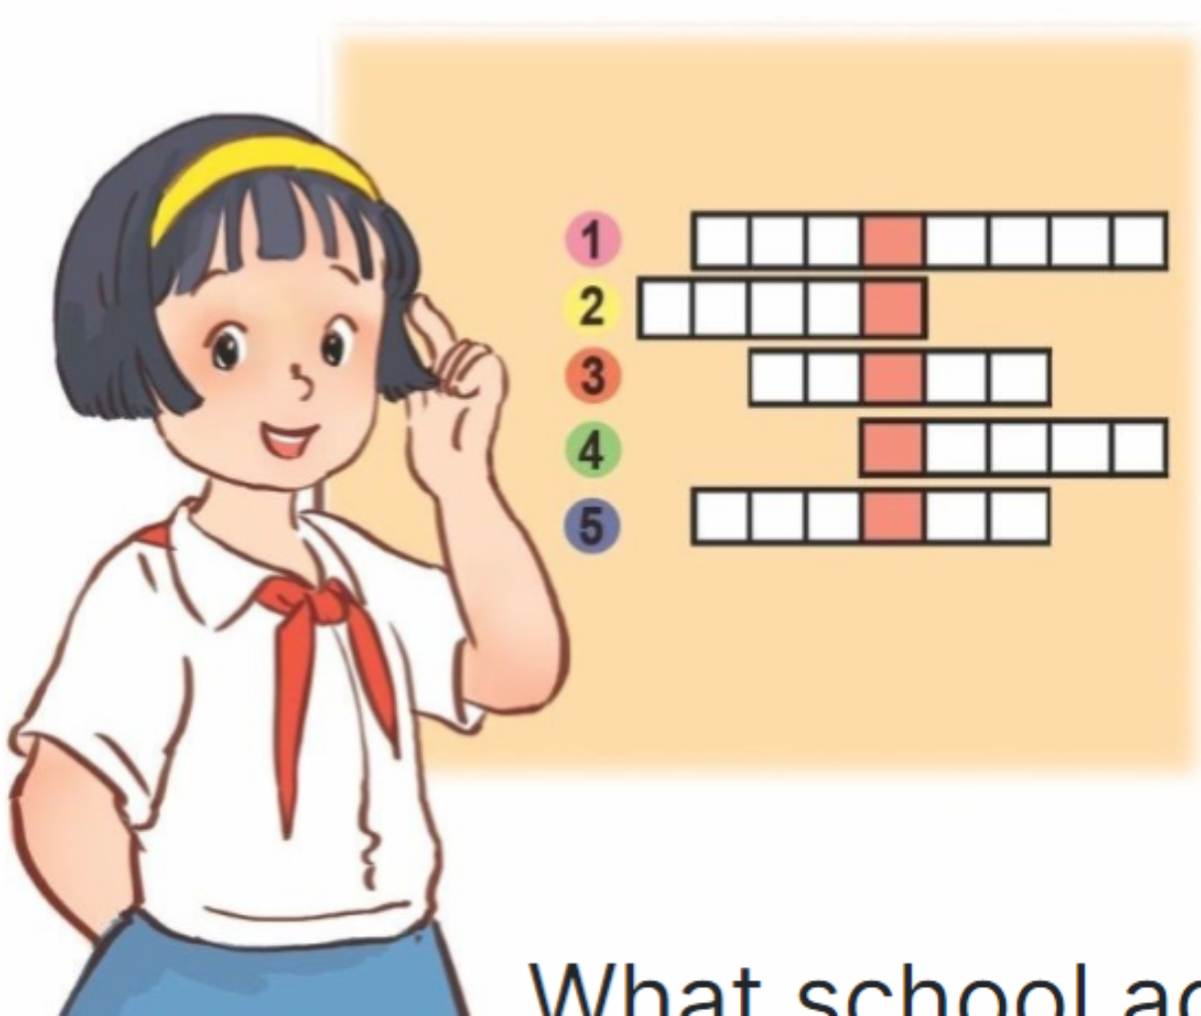
Check
Next
likes
She __________ playing games.

Slide 27
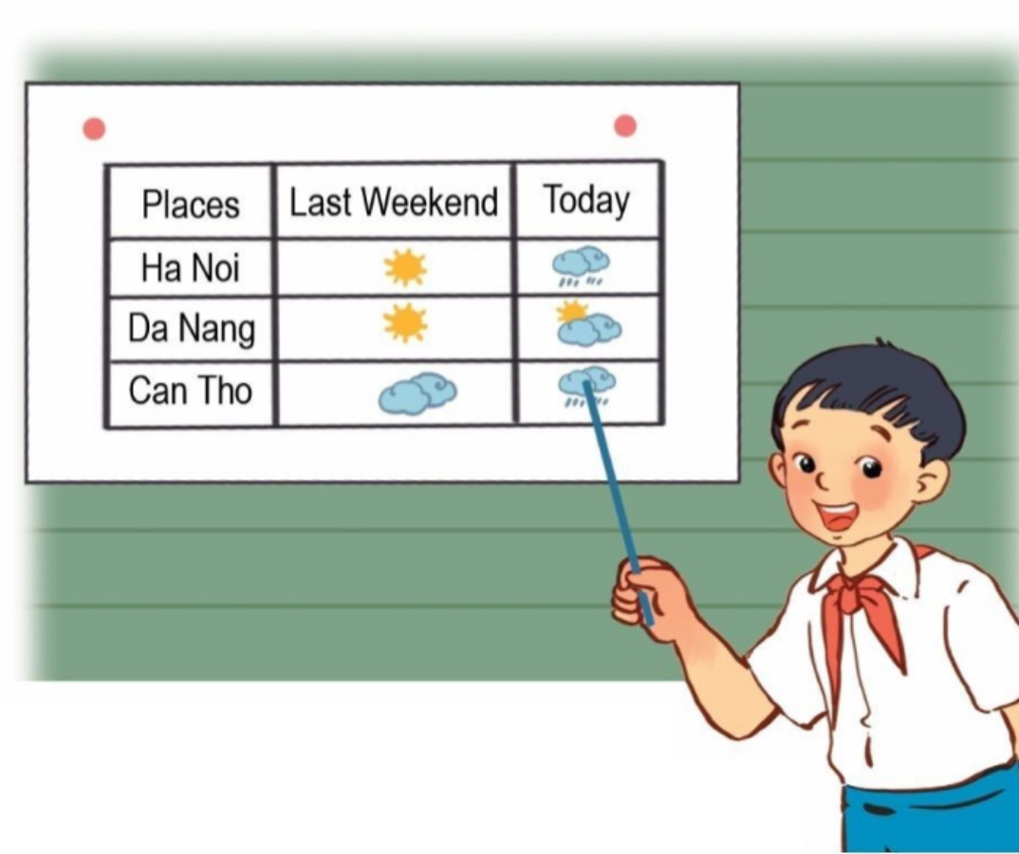
Check
Next
He __________ doing projects.
doesn’t like

Slide 28
Check
Next
likes
She __________ reading books.

Slide 29
Check
Next
doesn’t like
He ___________ solving a maths problem.

Slide 30
Check
Next
doesn’t like
She __________ dancing.

Slide 31
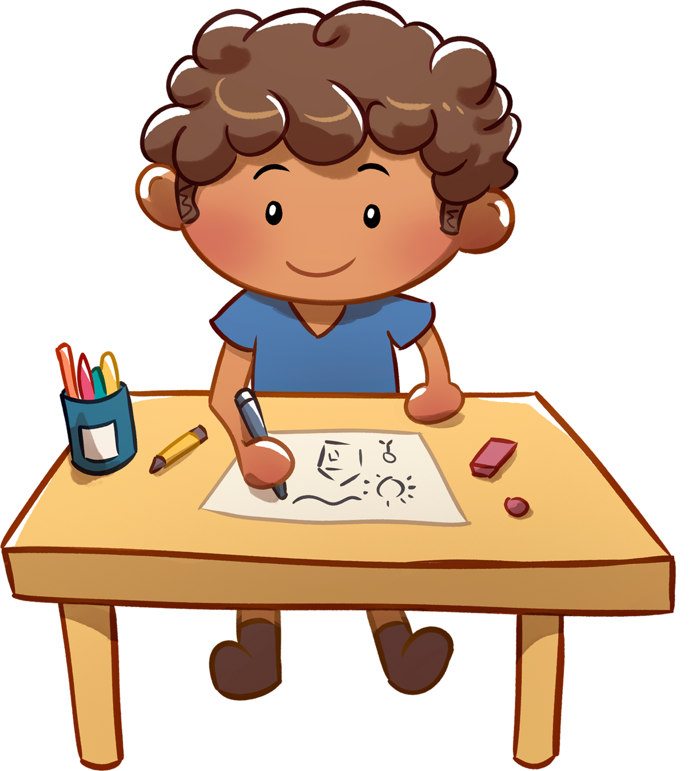
Check
Next
likes
He __________ drawing pictures.

Slide 32
Excellent!
End

Slide 33
Review
What school activity does he/she like?
He/She likes _______?
Why does he/she like ___?
Because he/she thinks it’s ____.
MsPham
0936082789
playing games
reading books
solving maths problems
doing projects
fun
interesting
useful
good for group work

Slide 34
MsPham
0936082789
Thank you
For joining!

