Slide 2
REVIEW 2.1

Slide 3
Table of Contents
1
2
3
4
Warm-up and review
Listen and tick.
Listen and number.
Fun corner and wrap-up

Slide 4
1
Warm-up and review

Slide 5
Colours
School things
Instructions
Activities
100
100
100
100
200
200
200
200
300
300
300
300
400
400
400
400
500
500
500
500
Notes:
Game:
Gv chia lớp thành 2 đội.
Gv cho hs từ mỗi đội chọn 1 chủ đề kèm với số điểm muốn nhận.
Gv click chuột vào số điểm tương ứng, hs trả lời câu hỏi.
Hs trả lời đúng thì đội sẽ được cộng điểm, trả lời sai không được điểm.
Đội nào nhiều điểm hơn khi trò chơi kết thúc sẽ là đội thắng cuộc.

Slide 6
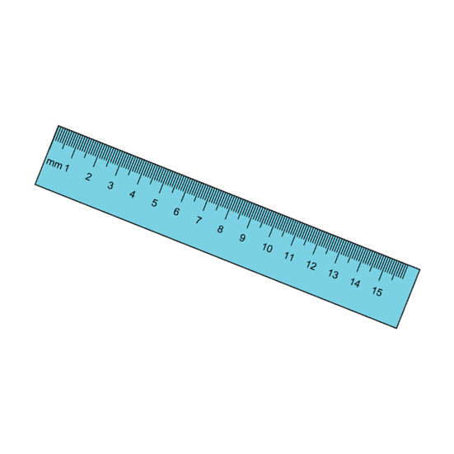
What colour is it?
It’s blue.

Slide 7
What colour is it?
It’s yellow.

Slide 8
What colour is it?
It’s pink.

Slide 9
What colour are they?
They’re green.

Slide 10
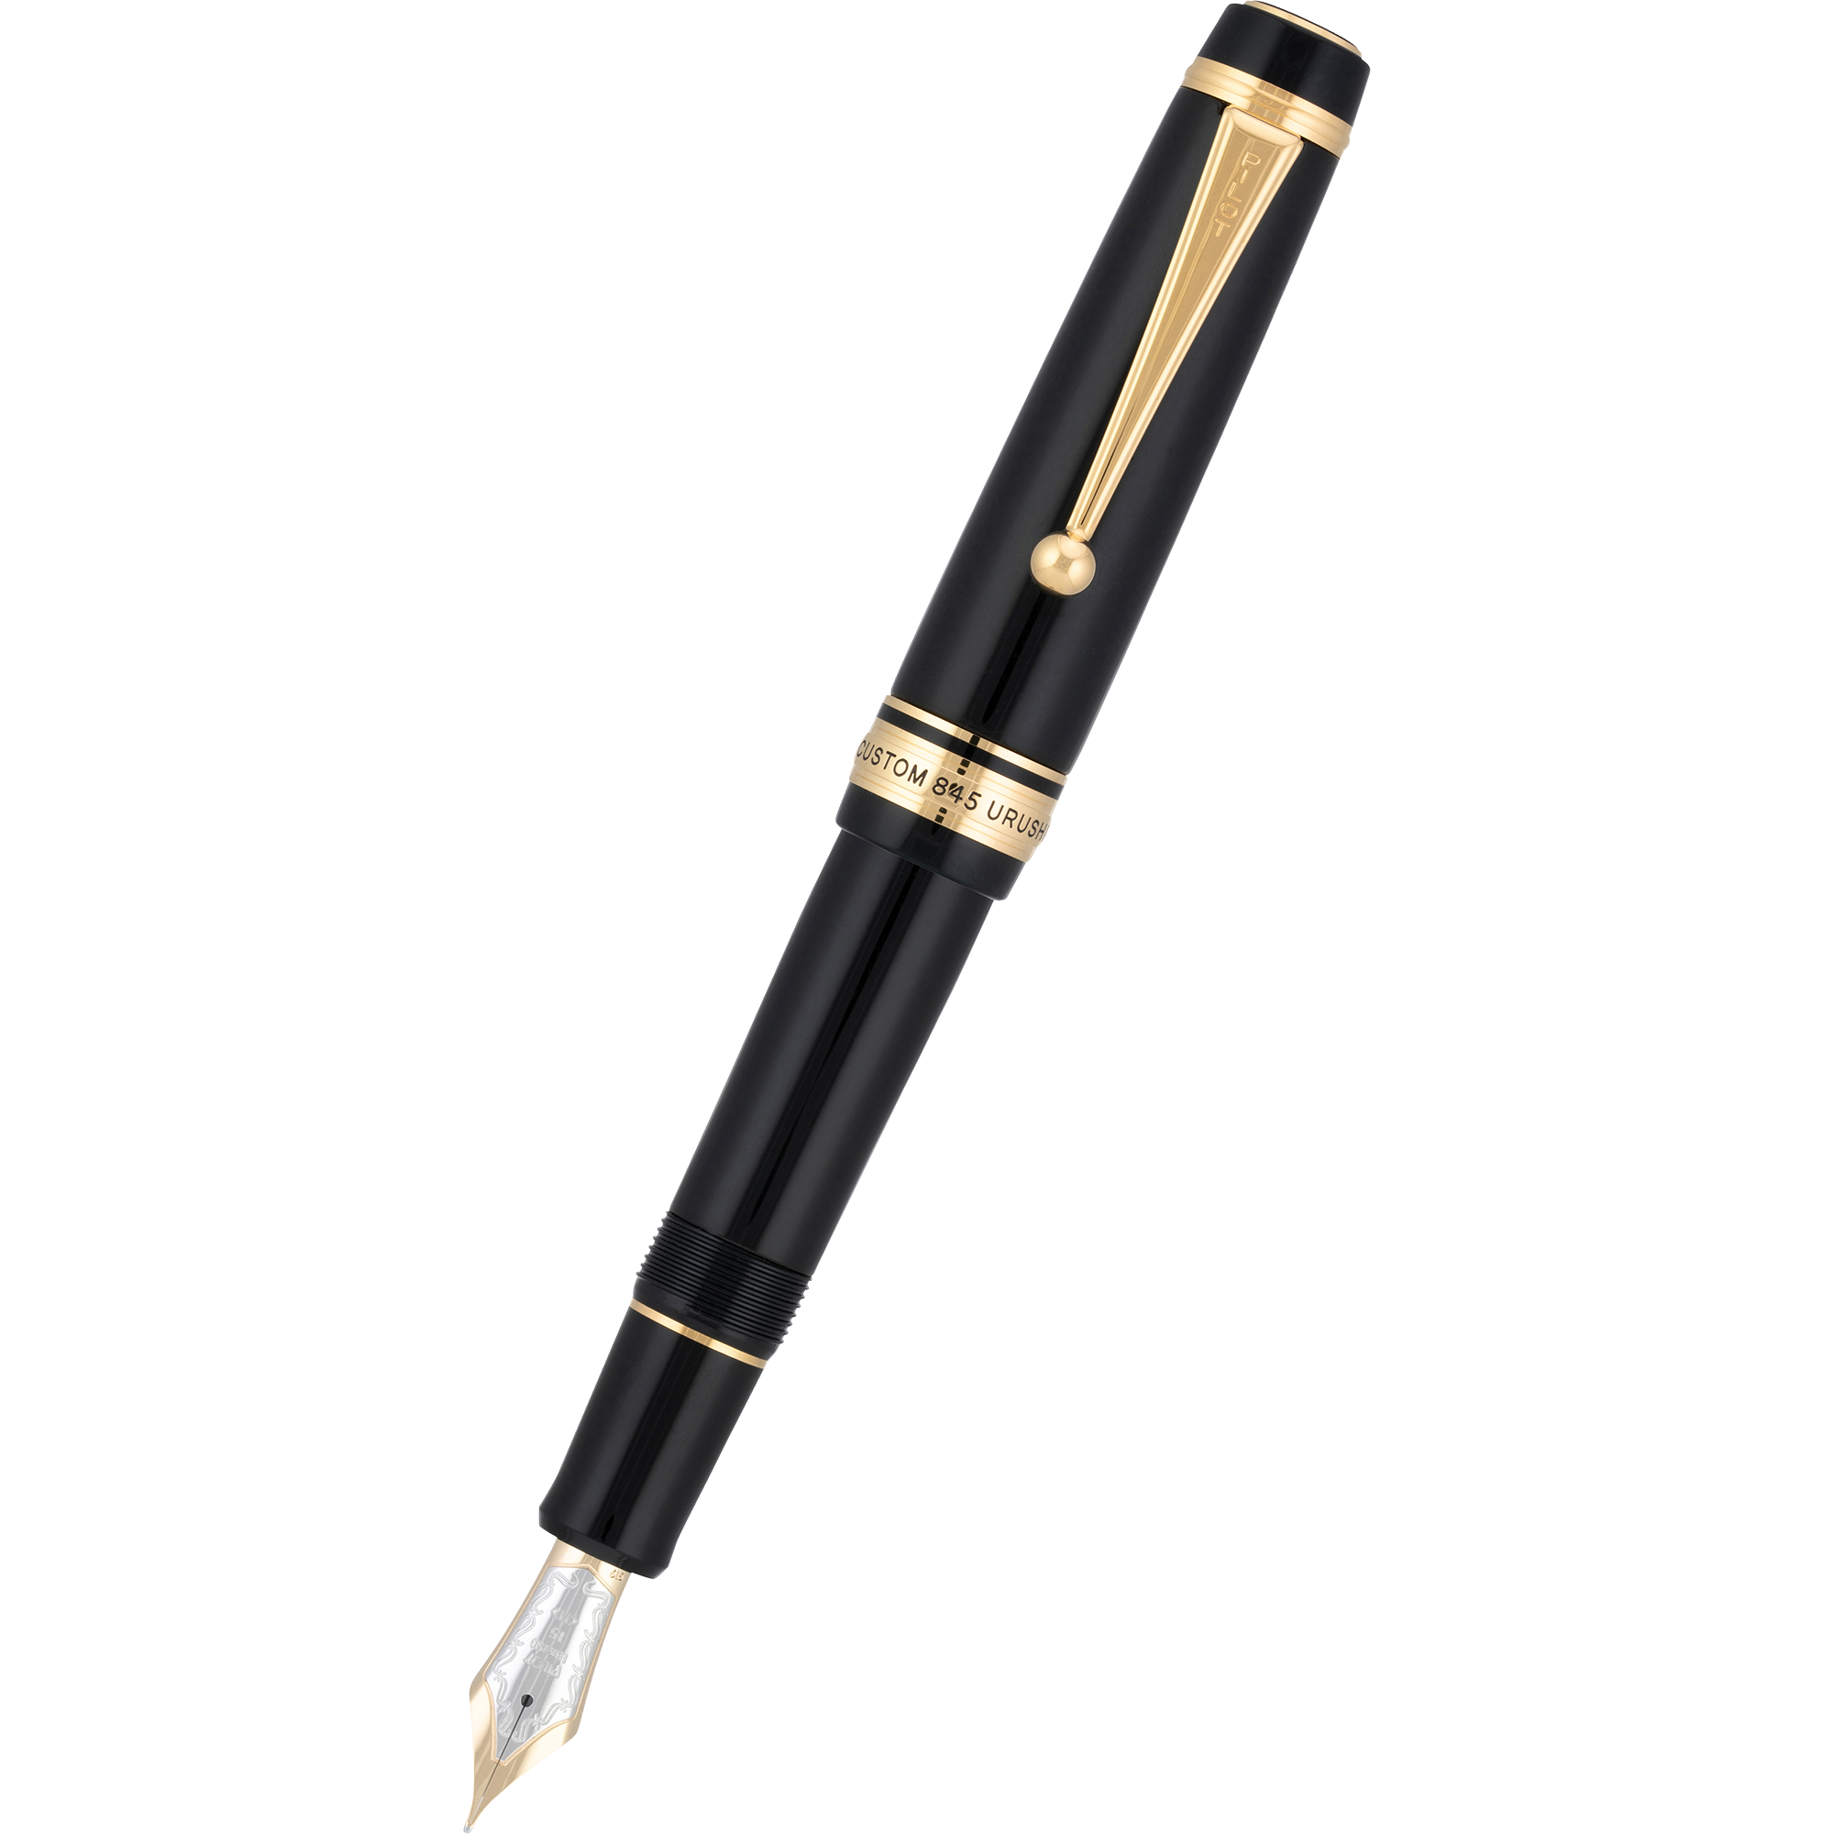
What colour are they?
They’re black.

Slide 11
Do you have ......................?
Yes, I do.

Slide 12
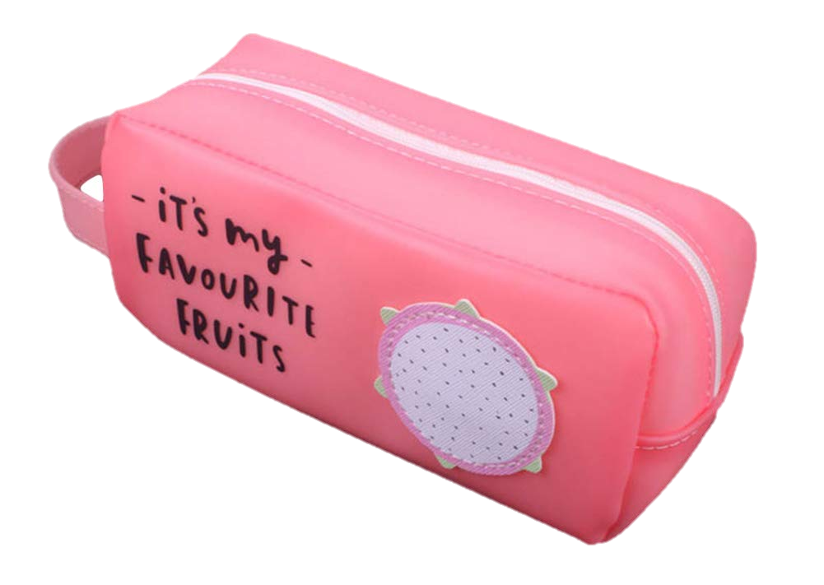
What colour is it?
It’s pink.

Slide 13
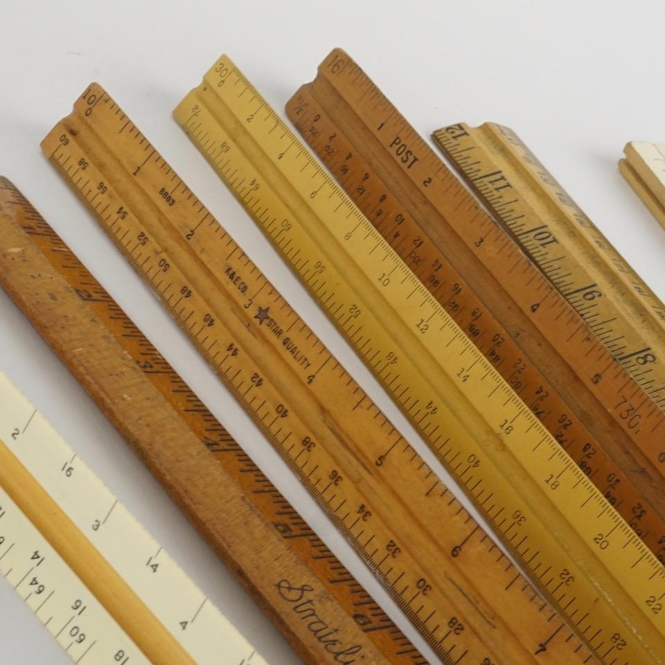
Do you have erasers?
No, I don’t. I have rulers.

Slide 14
Do you have books?
Yes, I do.

Slide 15
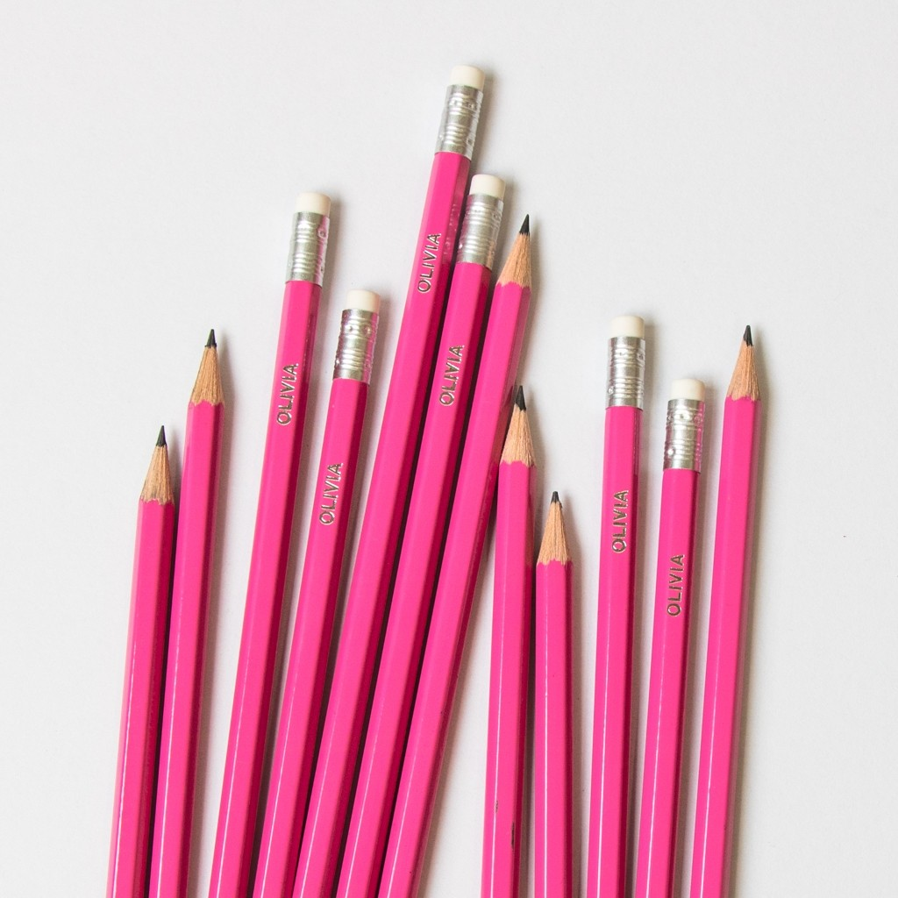
Do you have bags?
No, I don’t. I have pencils.

Slide 16
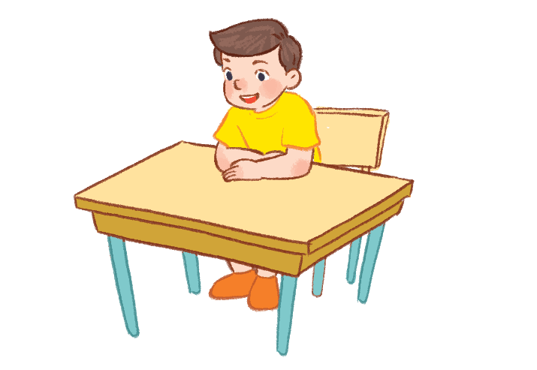
Sit down, please!

Slide 17
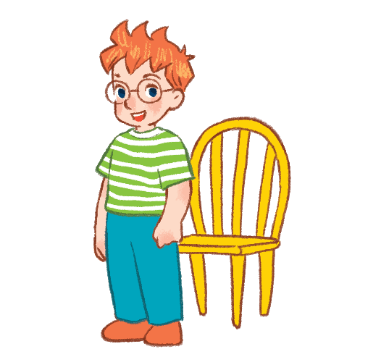
Stand up, please!

Slide 18
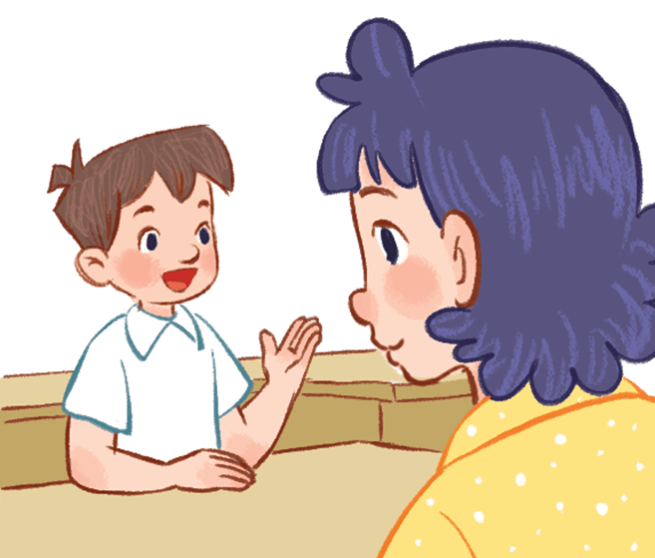
Vietnamese?
May I speak Vietnamese?

Slide 19
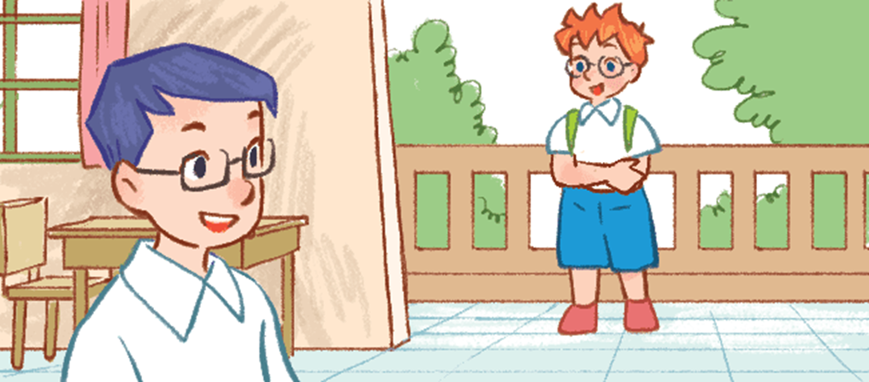
May I come in?

Slide 20
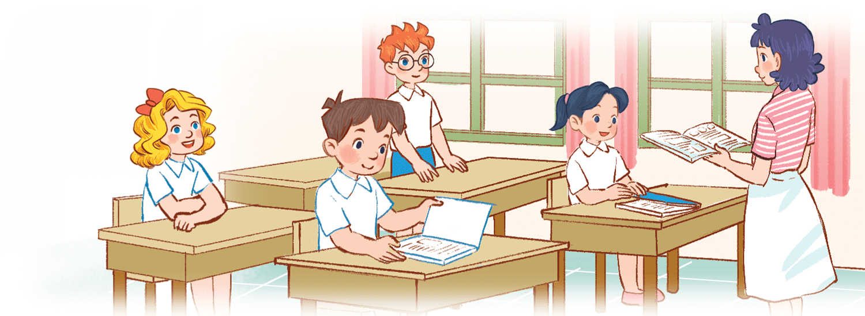
May I close the book?

Slide 21
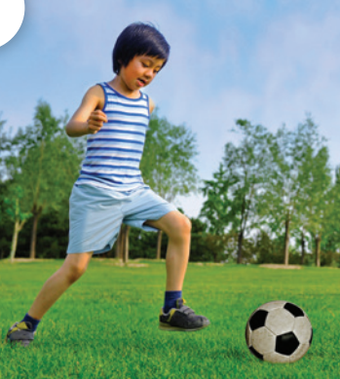
What do you do at break time?
I play football.

Slide 22
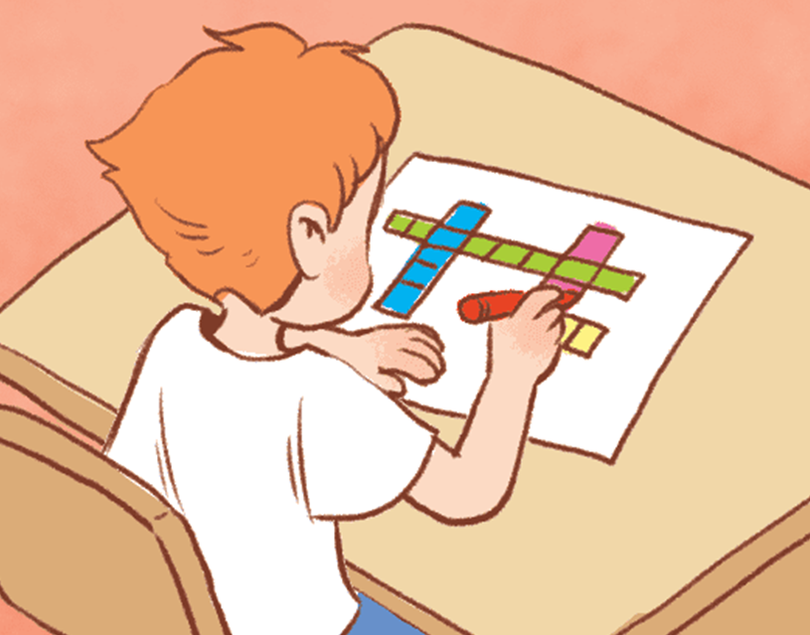
What do you do at break time?
I do word puzzles.

Slide 23
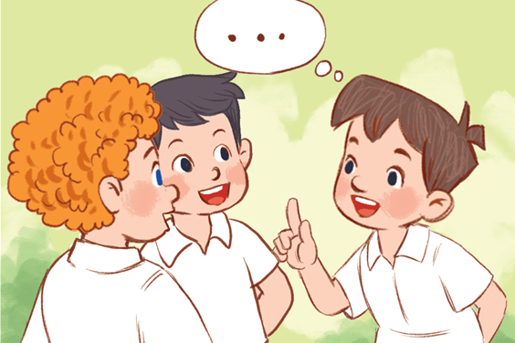
What do you do at break time?
I chat with my friends.

Slide 24
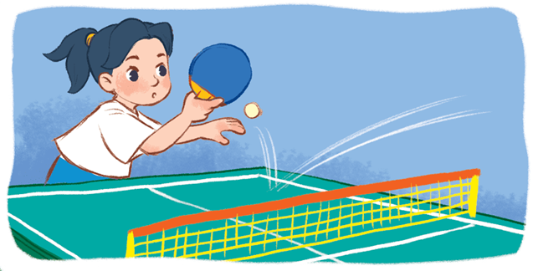
What do you do at break time?
I play table tennis.

Slide 25
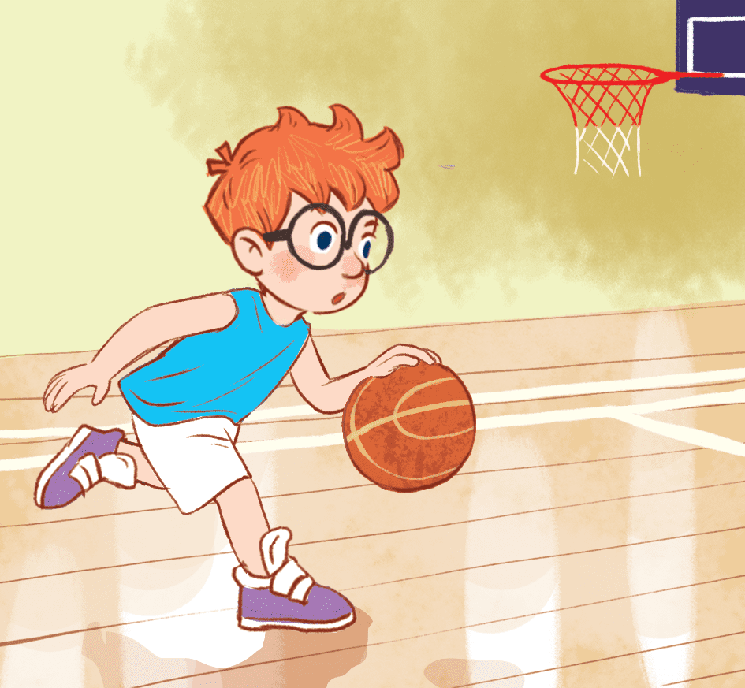
What do you do at break time?
I play basketball.

Slide 26
2
Listen and tick.

Slide 27
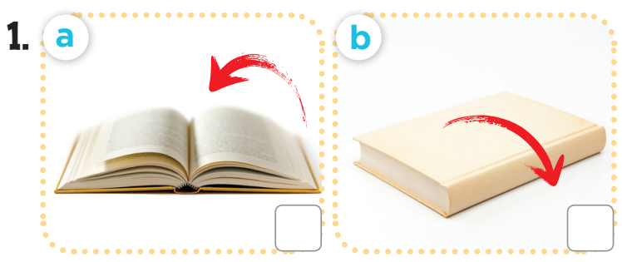
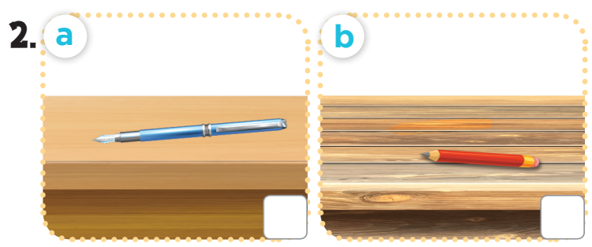
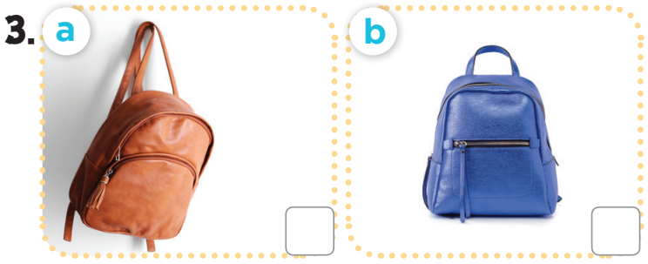
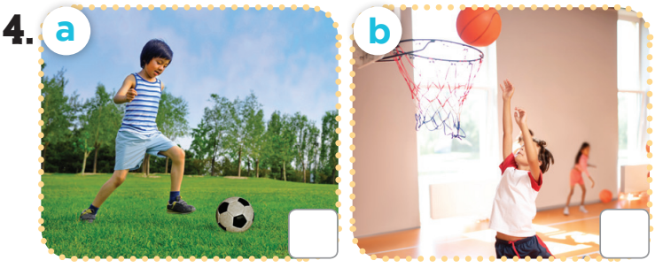
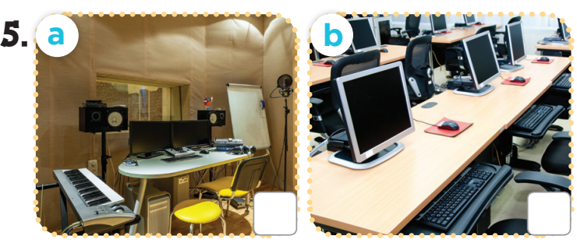

Slide 28
3
Listen and number.

Slide 29
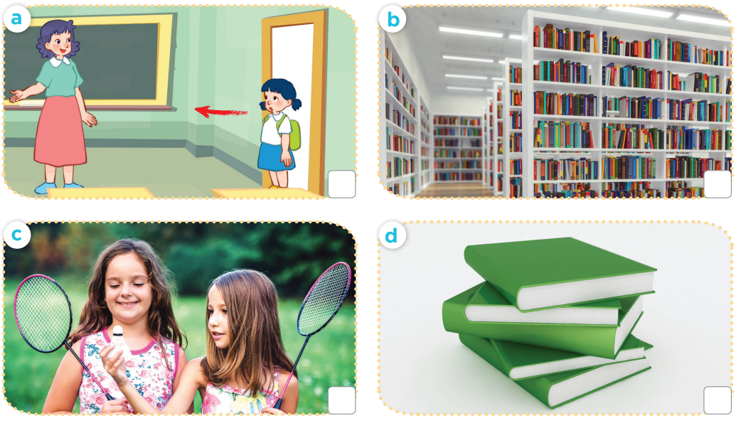

Slide 30
3
1
4
2

Slide 31
4
Fun corner and wrap-up

Slide 32
Notes:
Pupils work in groups. Each group has a set of questions related to the topics from unit 6 - 10.
Pupils ask and answer the questions in groups.
The fastest group to finish all the questions is the winner.

Slide 33
Website: hoclieu.vn
Fanpage: facebook.com/www.tienganhglobalsuccess.vn

