Slide 1



Slide 2
REVIEW 2.2

Slide 3
Table of Contents
1
2
3
4
Warm-up and review
Read and match.
Look, complete and read.
Ask and anwer.
5
Fun corner and wrap-up

Slide 4
1
Warm-up and review

Slide 5
Look and guess!

Slide 6
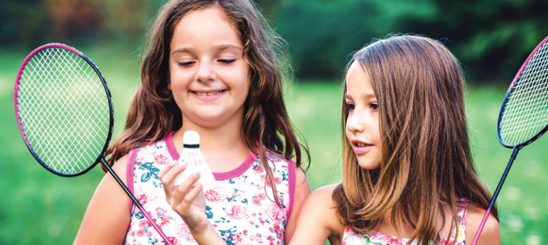

Slide 7


Slide 8
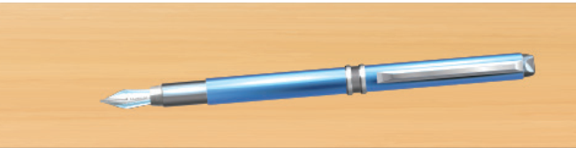

Slide 9
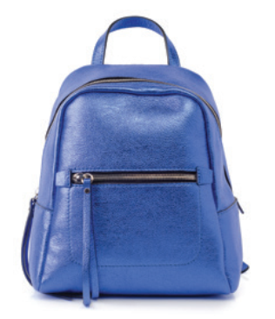

Slide 10


Slide 11
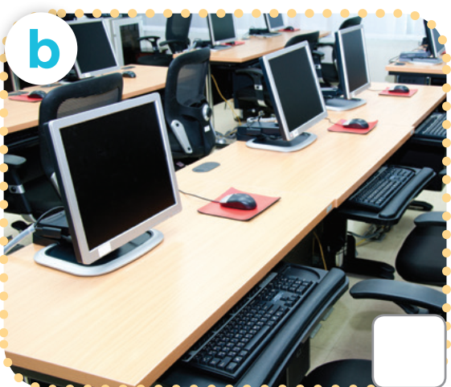

Slide 12
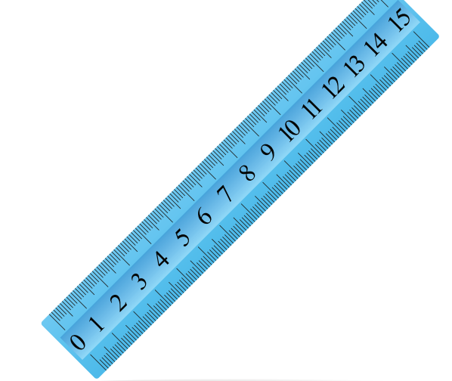

Slide 13
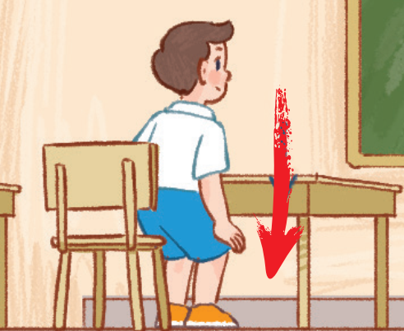

Slide 14
2
Read and match.

Slide 15
WHO IS FASTER?
Work in groups of 4-5 pupils.
Each group receives 1 set of sentences from the teacher.
Work together, match the questions with the answers.
The fastest one will be the winner.
Notes:
Giáo viên in các câu hỏi và trả lời của bài 3 trang 75 và cắt rời câu hỏi/trả lời thành các set để đưa cho hs.

Slide 16
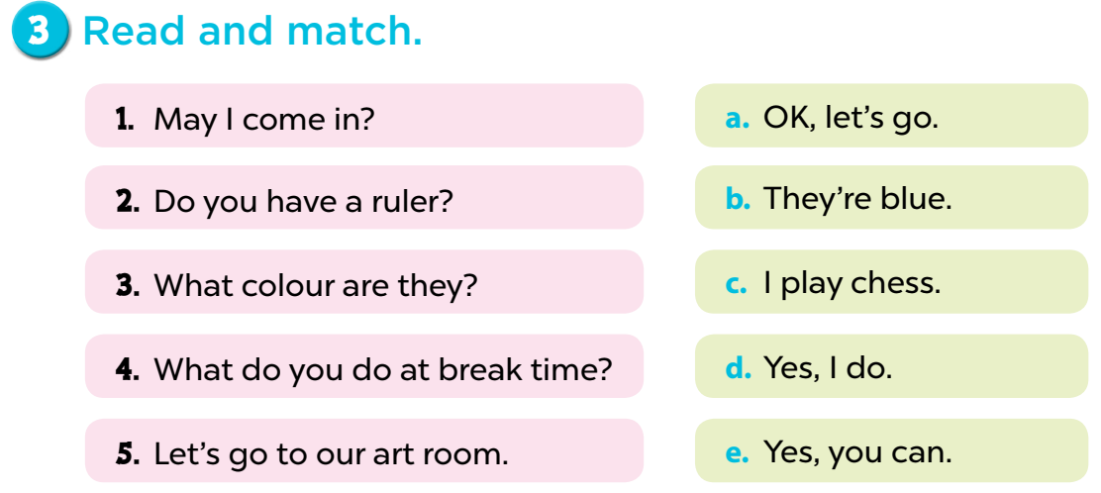

Slide 17
3
Look, complete and read.

Slide 18
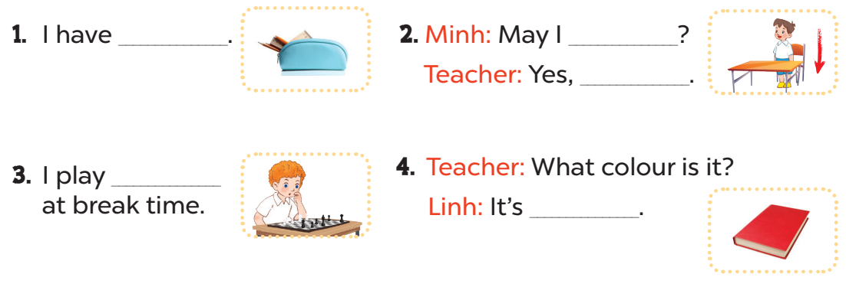
a pencil case
sit down
you can
chess
red

Slide 19
4
Ask and anwer.

Slide 20
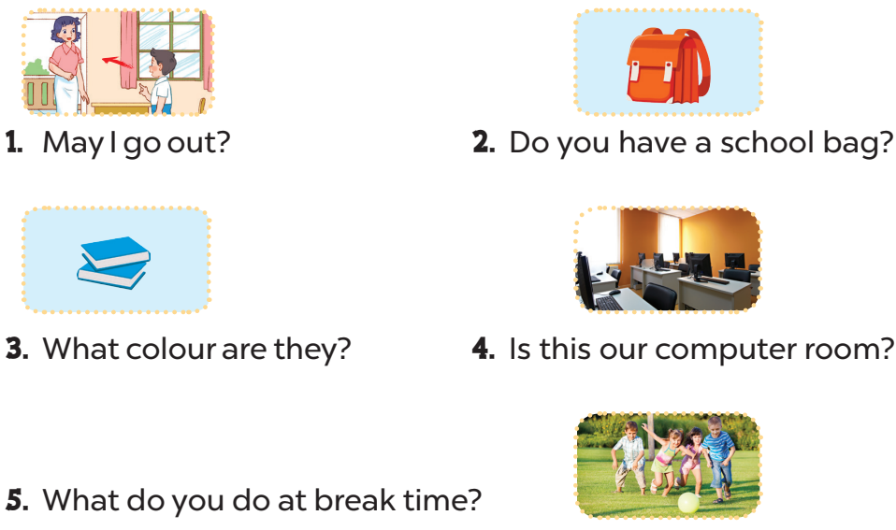
Yes, you can/No, you can’t.
Yes, I do.
They’re blue.
Yes, it is.
I play football.

Slide 21
5
Fun corner and wrap-up

Slide 22


Slide 23

1
2
3
4
TEAM 1
5
6
7
8
TEAM 2
9
10
11
12
TEAM 3
Notes:
Lucky number

Slide 24


What colour is it?
+ 2 points
It’s blue.

Slide 25
What colour is it?
+ 5 points
It’s yellow.

Slide 26


What colour are they?
+ 3 points
They’re green.

Slide 27
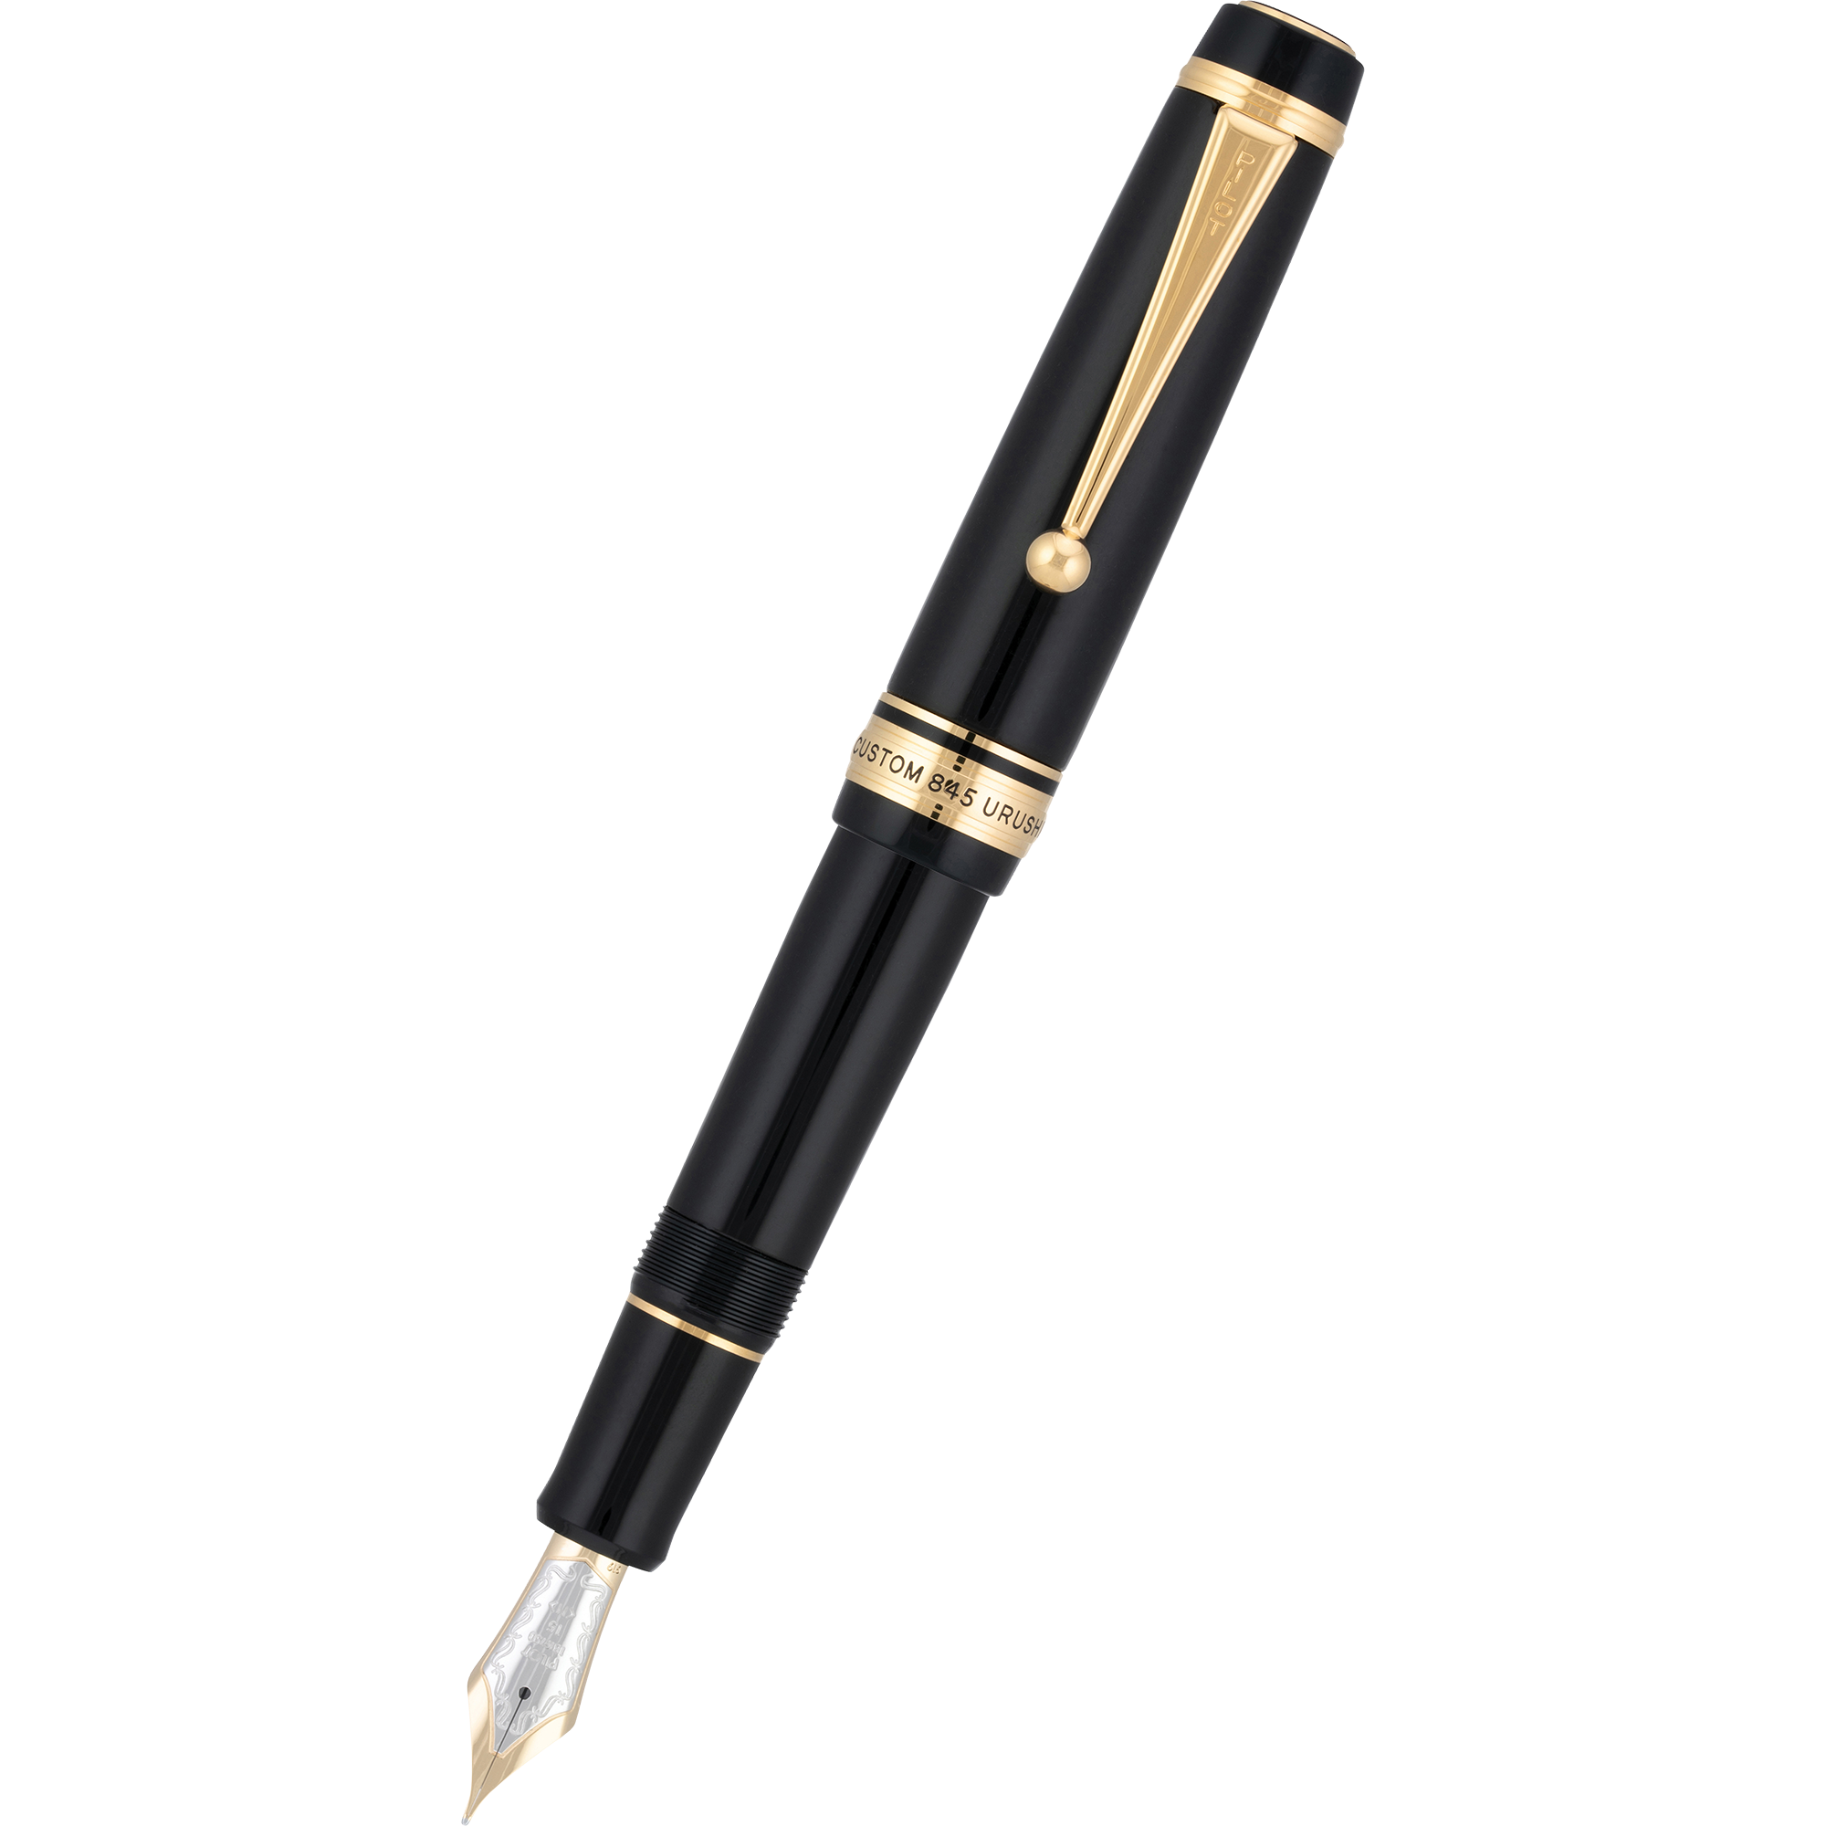
What colour are they?
- 3 points
They’re black.

Slide 28
Do you have ......................?
+ 4 points
Yes, I do.

Slide 29
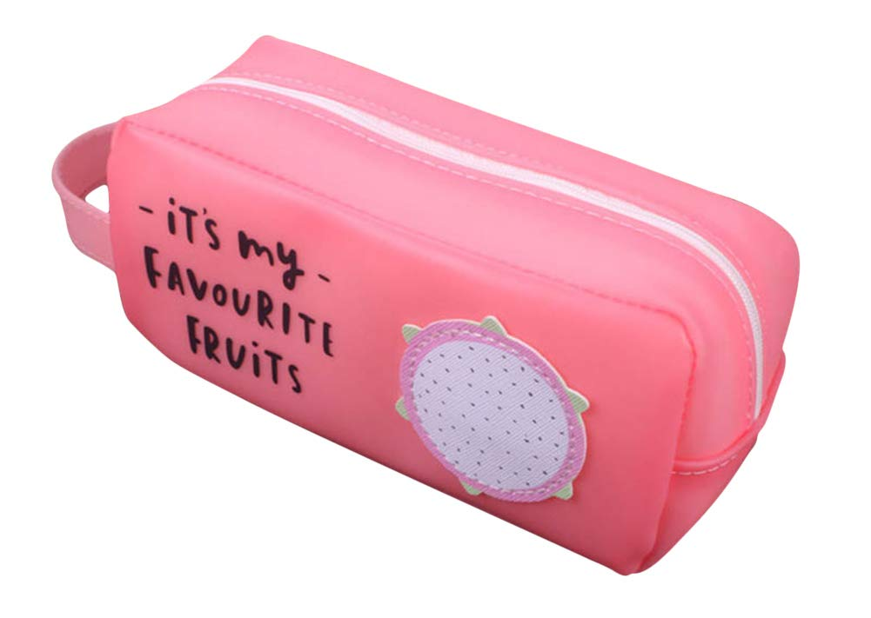
What colour is it?
- 5 points
It’s pink.

Slide 30
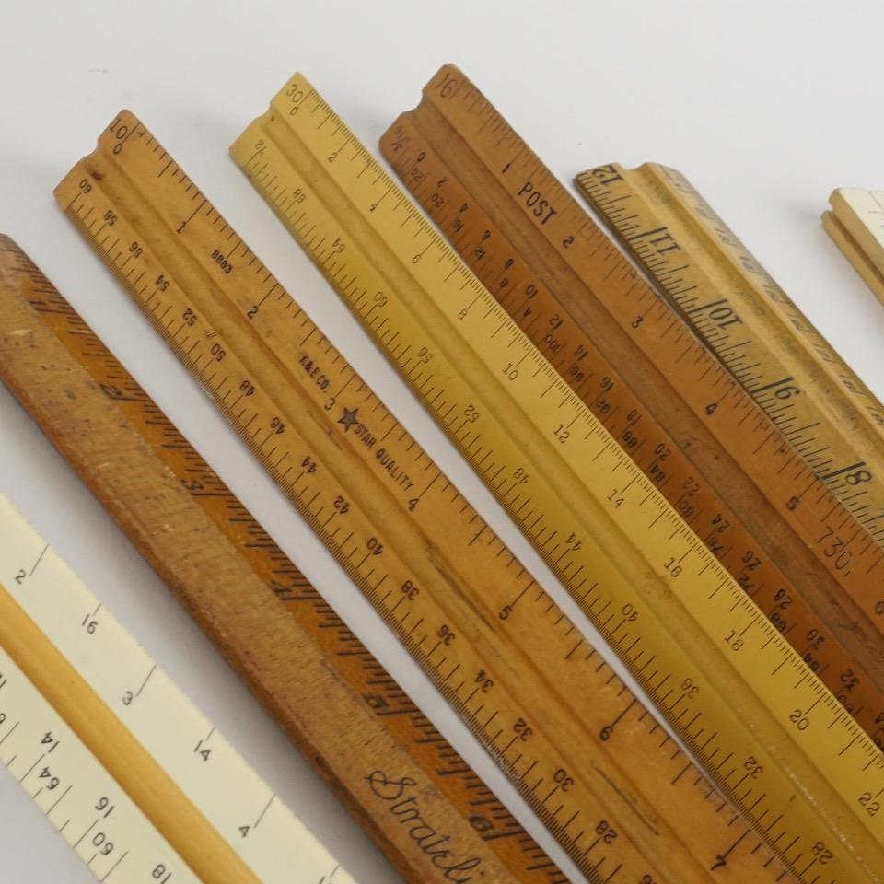
Do you have erasers?
+ 3 points
No, I don’t. I have rulers.

Slide 31
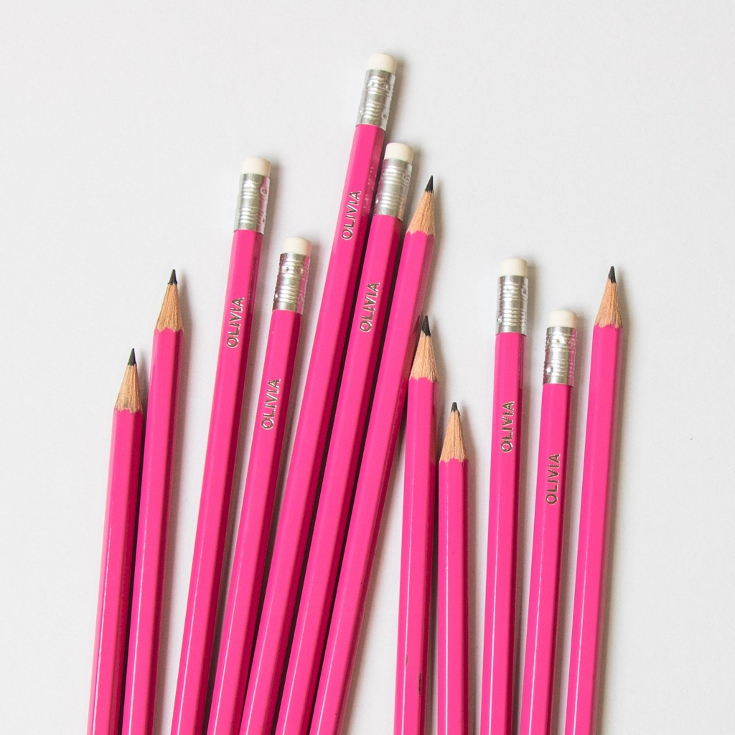
Do you have bags?
+ 1 points
No, I don’t. I have pencils.

Slide 32
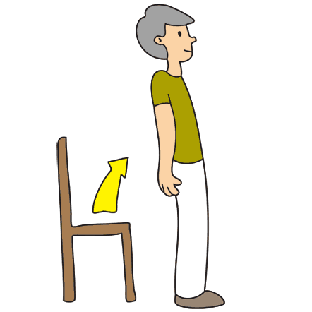
+ 5 points
Stand up, please!

Slide 33
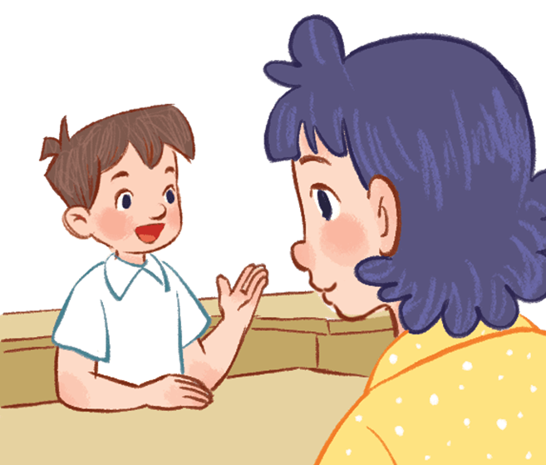
Vietnamese?
+ 10 points
May I speak Vietnamese?

Slide 34
What do you do at break time?
- 5 points
I play football.

Slide 35
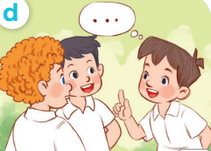
What do you do at break time?
+ 8 points
I chat with my friends.

Slide 36

Website: hoclieu.vn
Fanpage: facebook.com/www.tienganhglobalsuccess.vn

