Slide 1
PEOPLE’S COMMITTEE OF DAI LOC DISTRICT
DAI QUANG PRIMARY SCHOOL
WELCOME TO OUR CLASS !
Subject: English 3
Class: 3G
Teacher: Pham Thi My Chau

Slide 3
Tuesday, December 3rd , 2024
UNIT 8 : MY SCHOOL THINGS
*Lesson 1:
Part: 1, 2 & 3

Slide 4
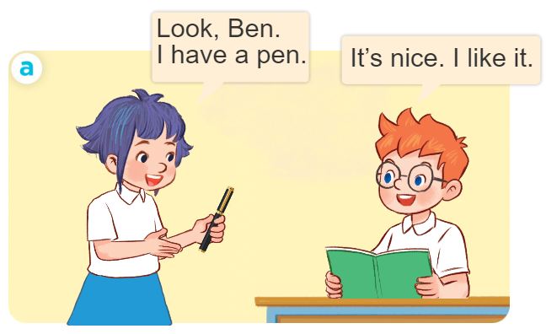
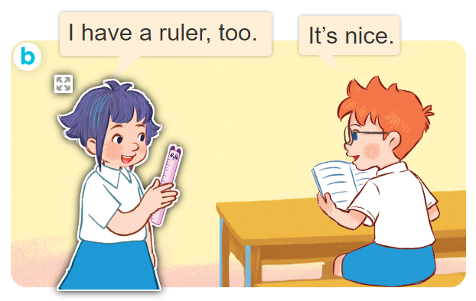
1. Look, listen and repeat.

Slide 5
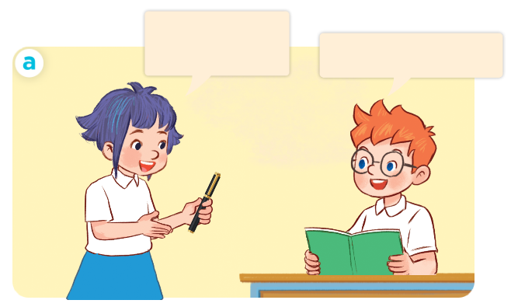
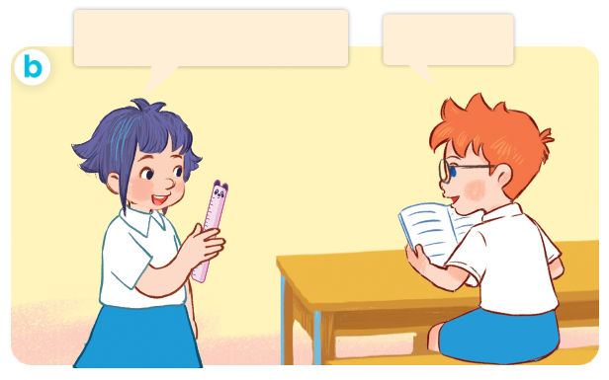
1. Look, listen and repeat.
I have a ruler, too.
It’s nice.
Look, Ben.
I have a pen.
It’s nice. I like it.

Slide 6
I/ New words
school things
/skuːl θɪŋz/
đồ dùng học tập

Slide 7
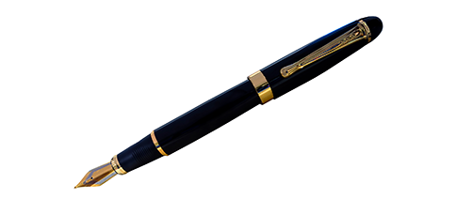
I/ New words
pen
/pen/
bút

Slide 8
I/ New words
book
/bʊk/
quyển sách

Slide 9
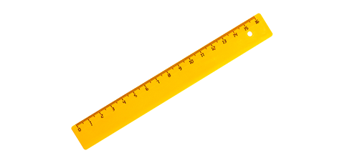
I/ New words
ruler
/ˈruːlə/
thước kẻ

Slide 10
I/ New words
school bag
/ˈskuːl bæg/
cặp sách

Slide 11
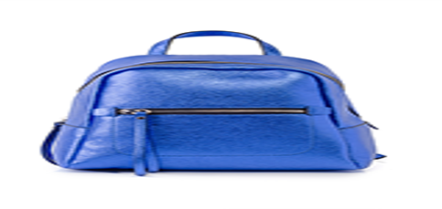
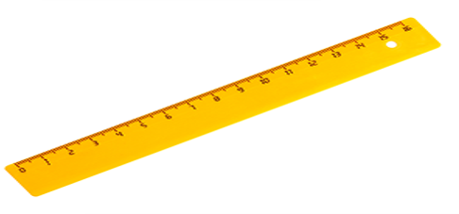
Review
school things
pen
book
ruler
school bag

Slide 12
Checking vocabulary
Match the pictures with the words.
a
b
c
d
e
school things
pen
ruler
school bag
book

Slide 13
I/ New words
school things: đồ dùng học tập
pen: bút
book: quyển sách
ruler: thước kẻ
school bag: cặp sách

Slide 14
II/ Model sentence
Dùng để nói bản thân có cái gì.
I have a pen.

Slide 15
2. Listen, point and say.
a
b
a pen
I have _________.
a pen
a ruler
c
d
a book
a school bag

Slide 16
a pen
I have _______.

Slide 17
a ruler
I have _______.

Slide 18
a book
I have _______.

Slide 19
a school bag
I have _____________.

Slide 20
3. Let’s talk.
I have _________.

Slide 21
Game
Lucky number
1
2
3
4
5
6
Notes:
Divide the class into 2 teams.
The teams take turns to choose a lucky number, say the word and make a sentence with that word, using the sentence model.
Give points to the teams.

Slide 22
I have a book.

Slide 23
I have a pen.

Slide 24
Lucky number
+ 1 points

Slide 25
I have a ruler.

Slide 26
I have a school bag.

Slide 27
Lucky number
+ 1 points

Slide 28
Tuesday, November 29th 2022
Unit 8: My school things
Lesson 1 ( 1, 2, 3)
1. Vocabulary
pen : bút mực
ruler : thước kẻ
book : quyển sách
school bag : cặp sách
2. Model sentence
I have a pen.

Slide 29
Homework
Learn by heart all the new words.
Read again the dialogue in part 1.

Slide 30
Facebook : Bùi Liễu
0968142780
Thank you!
Notes:
Facebook : Bùi Liễu
0968142780

