Slide 1
PEOPLE’S COMMITTEE OF DAI LOC DISTRICT
DAI QUANG PRIMARY SCHOOL
WELCOME TO OUR CLASS !
Subject: English 3
Class: 3G
Teacher: Pham Thi My Chau

Slide 2
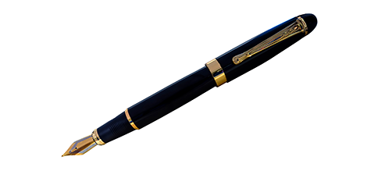
Guessing game
1
2
3
4
pen

Slide 3
Guessing game
1
2
3
4
ruler

Slide 4
Guessing game
1
2
3
4
school bag

Slide 5
Guessing game
1
2
3
4
book

Slide 6
Tuesday, December 3rd , 2024
UNIT 8 : MY SCHOOL THINGS
*Lesson 1:
Part: 4, 5 & 6

Slide 7
4/ Listen and tick
1
a
b
2
a
b

Slide 8
4/ Listen and tick
1
b
I have a pen.
2
a
I have a school bag.

Slide 9
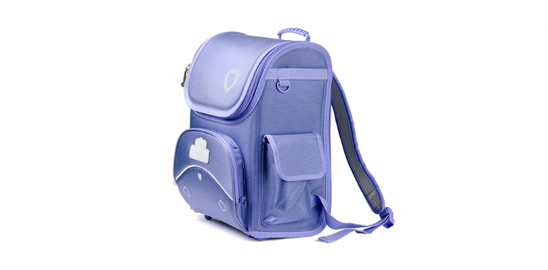
5. Look, complete and read.
______.
___________.
____________.
_________________.

Slide 10
6. Let’s sing.
School things
A book, a book, a book.
This is a book.
I have a book.
I have a book.
A pen, a pen, a pen.
This is a pen.
I have a pen.
I have a pen.

Slide 11
Tuesday, November 29th 2022
Unit 8: My school things
Lesson 1 ( 4, 5, 6)
4/ Listen and tick
1.b; 2a
5/ Look, complete and read
1/ pen
2/ a book
3/ have a ruler
4/ I have a school bag.
6/ Let’s sing.

Slide 12
Homework
Learn by heart all the new words.
Prepare new lesson

Slide 13
Facebook : Bùi Liễu
0968142780
Thank you!
Notes:
Facebook : Bùi Liễu
0968142780

