Slide 1
DAI LOC DEPARTMENT OF EDUCATION AND TRAINING
DAI QUANG PRIMARY SCHOOL
WELCOME TO OUR CLASS !
Subject: Tiếng Anh 3
Class: 3G
Teacher: Pham Thi My Chau

Slide 2
Let’s play!

Slide 3
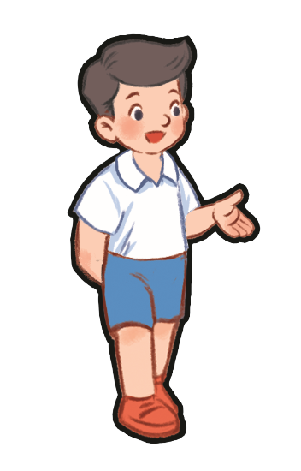
Do you have a pencil?
A. Yes, I do.
B. No, I don’t.

Slide 4
Do you have a ruler?
A. Yes, I do.
B. No, I don’t.

Slide 5
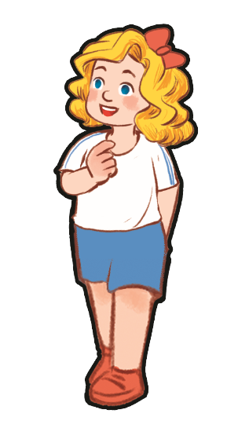
Do you have a book?
A. Yes, I do.
B. No, I don’t.

Slide 6
Do you have an eraser?
A. Yes, I do.
B. No, I don’t.

Slide 7
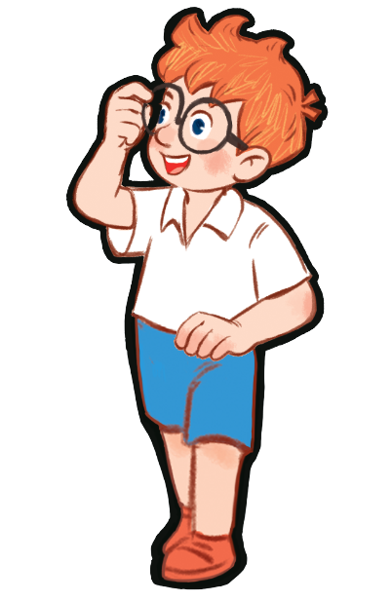
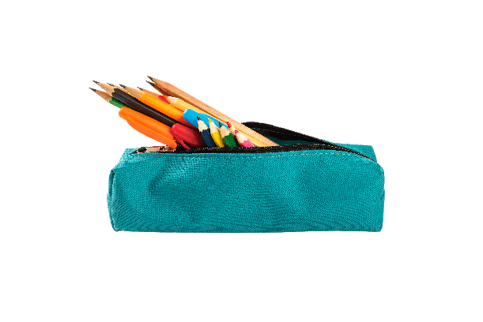
Do you have a pencil case?
A. Yes, I do.
B. No, I don’t.

Slide 8
Do you have a pencil case?
A. Yes, I do.
B. No, I don’t.

Slide 9
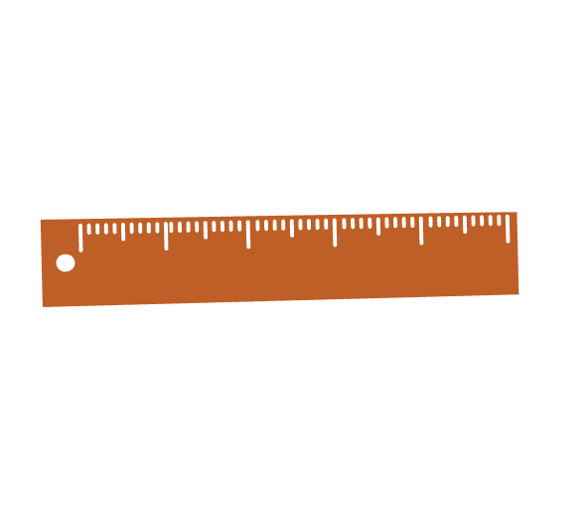
Do you have a ruler?
A. Yes, I do.
B. No, I don’t.

Slide 10
Do you have a pen?
A. Yes, I do.
B. No, I don’t.

Slide 11
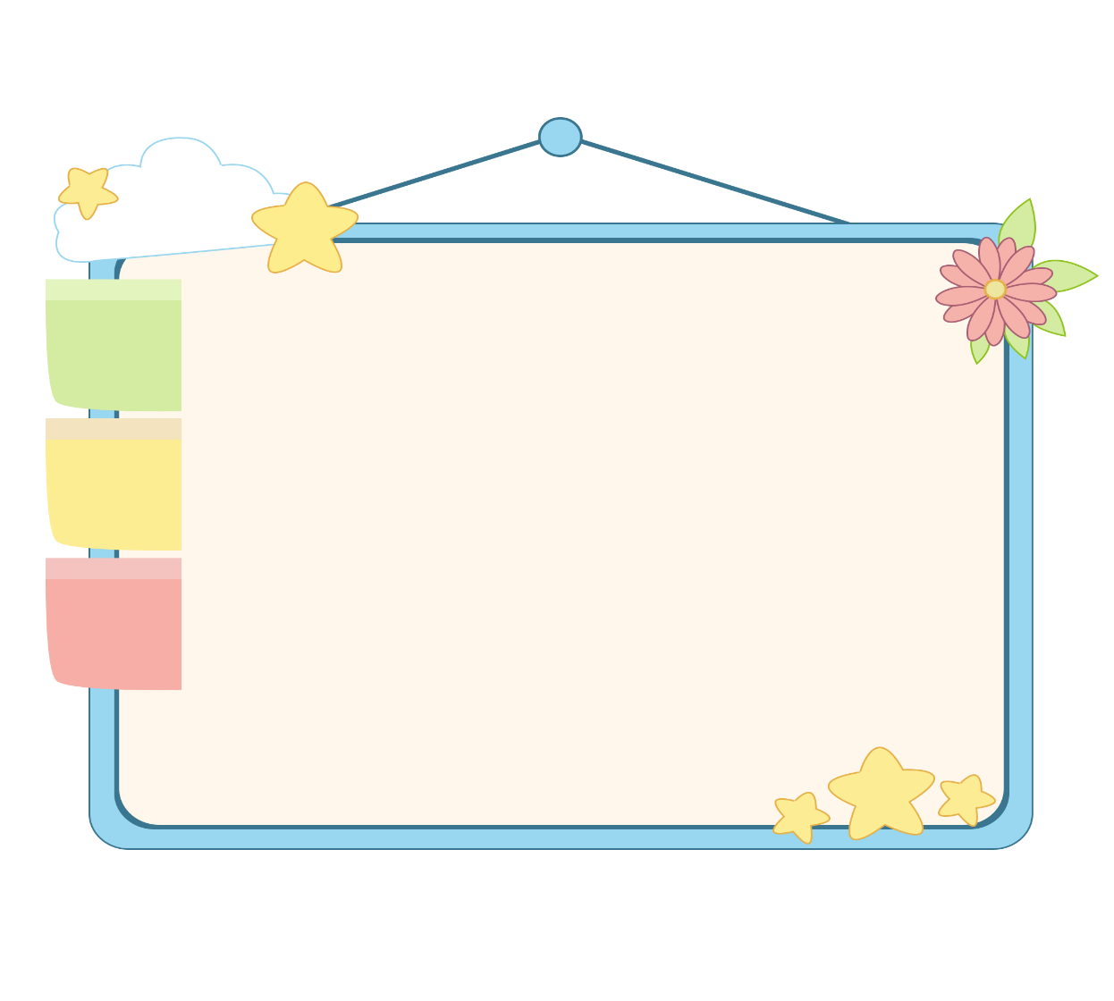
WELL DONE!

Slide 12
Thursday, December 5th , 2024
UNIT 8 : MY SCHOOL THINGS
*Lesson 2:
Part: 4, 5 & 6

Slide 13
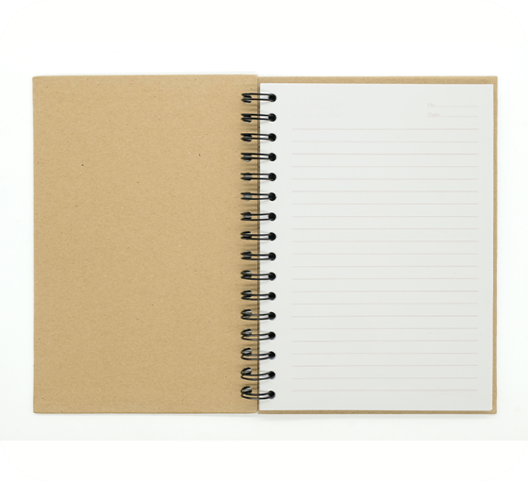
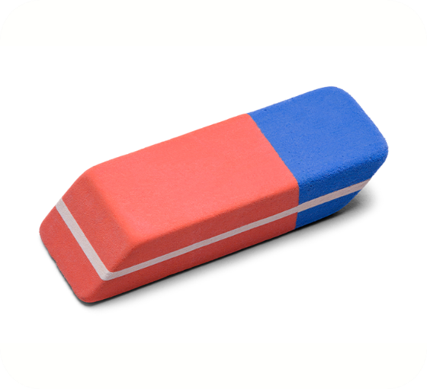
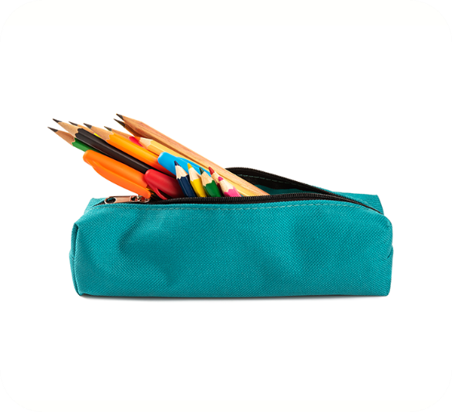
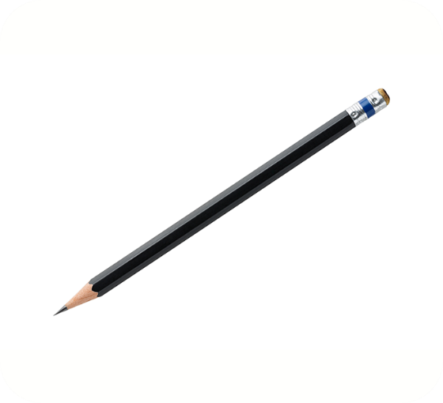
4. Listen and number.
3
4
1
2
a
b
c
d

Slide 14
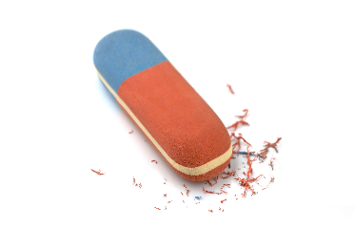
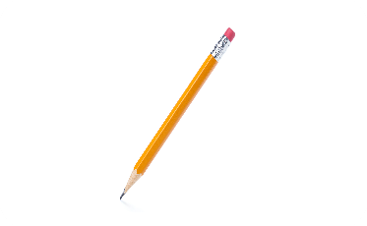
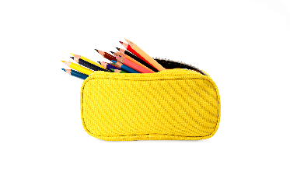
5. Read and match.
a
1. A: Do you have a notebook?
B: Yes, I do.
b
2. A: Do you have a school bag?
B: No, I don’t. I have a pencil case.
3. A: Do you have an eraser?
B: Yes, I do.
c
4. A: Do you have a pen?
B: No, I don’t. I have a pencil.
d
1 - d
2 - c
3 - a
4 - b

Slide 15
6. Let’s play.
Notes:
Facebook : Bùi Liễu
Mobile phone: 0968142780

Slide 16
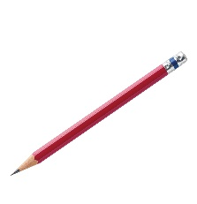
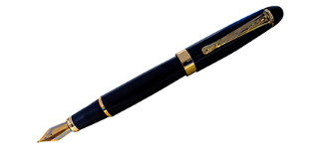
Matching game
pencil
pencil case
pen
Notes:
Click the card to show the words/picture. Click again to close it.

Slide 17
Matching game
book
eraser
pen
Notes:
Click the card to show the words/picture. Click again to close it.

Slide 18
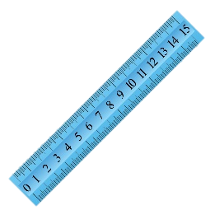
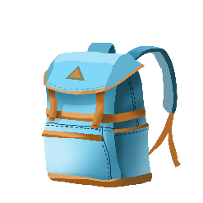
Matching game
notebook
school bag
ruler
Notes:
Click the card to show the words/picture. Click again to close it.

Slide 19
Wrap up
Notes:
Facebook : Bùi Liễu
0968142780

Slide 20
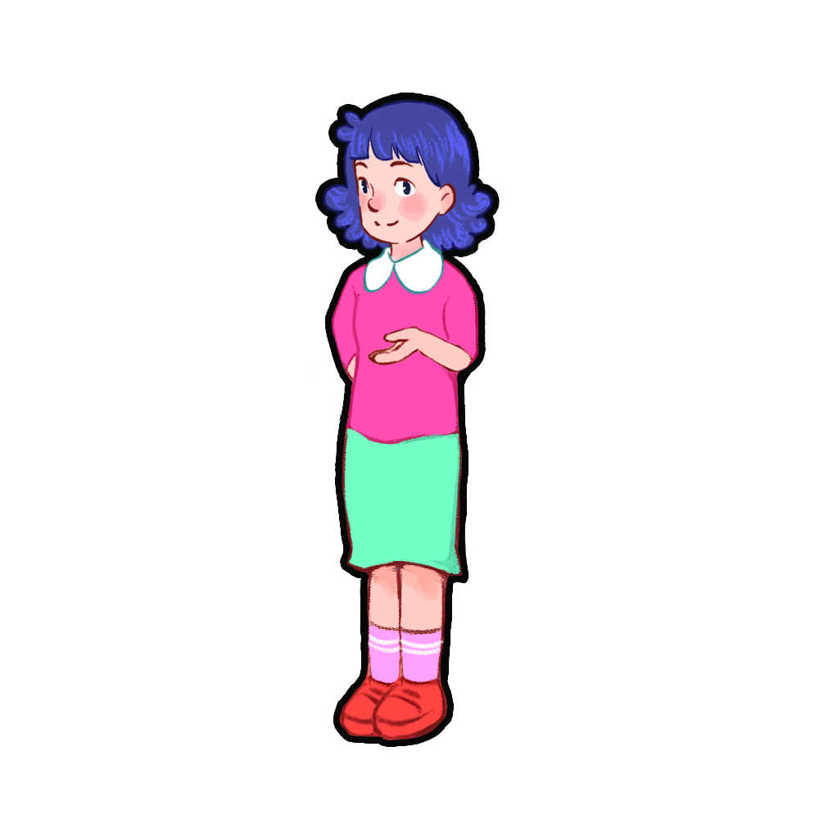
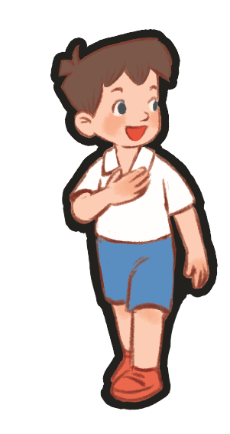
Show me: pencil, eraser, pen!
pencil, eraser, pen!
pencil, eraser, pen!
pencil, eraser, pen!
Notes:
Teacher tells pupils to put out their school things on the desk.
Ask them to show the school things with the correct order. (example: Show me: pencil, eraser, pen). Who can make it fastest is the winner.
Ask pupils to show those school things and repeat.

Slide 21
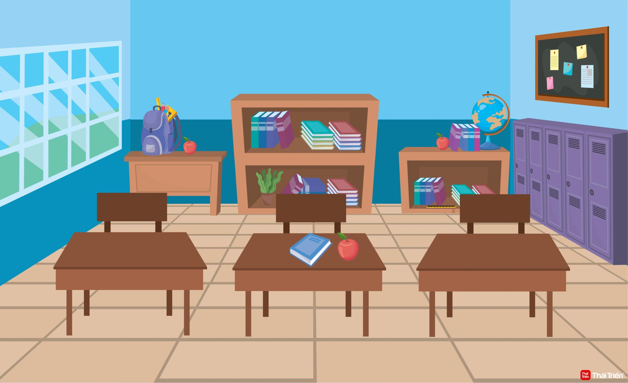
Do you have a ruler?
No, I don’t.
Yes, I do.
Yes, I do.
Notes:
Teacher tells pupils to put out their school things on the desk.
Ask them: Do you have a pen/book/ruler…?
Ask pupils if they have, say: Yes, I do. / if not: No, I don’t.

Slide 22
Homework
Learn by heart all the new words.
Read again the dialogue in part 1.
Notes:
Facebook : Bùi Liễu
0968142780

Slide 23
Thank you!
Notes:
Facebook : Bùi Liễu
0968142780

