Slide 1
Colours
Unit
9
Lesson 1
Notes:
Facebook : Bùi Liễu
Mobile phone: 0968142780

Slide 2
Warm-up

Slide 3
Choose the right answer.
a
b
c
Next
blue

Slide 4
Choose the right answer.
a
b
c
Next
red

Slide 5
Choose the right answer.
a
b
c
Next
yellow

Slide 6
Choose the right answer.
a
b
c
Next
What colour is it?
It’s yellow.

Slide 7
Choose the right answer.
a
b
c
Next
What colour is it?
It’s brown.

Slide 8
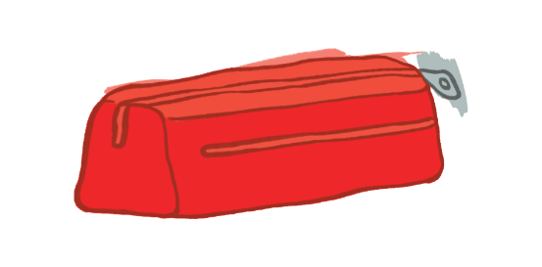
Choose the right answer.
a
b
c
Next
What colour is it?
It’s blue.

Slide 9
Choose the right answer.
a
b
c
Next
What colour is it?
It’s red.

Slide 10
Thank you!

Slide 11
4. Listen and tick.
a
b
1
a
b
2
Notes:
Facebook : Bùi Liễu
Mobile phone: 0968142780

Slide 12
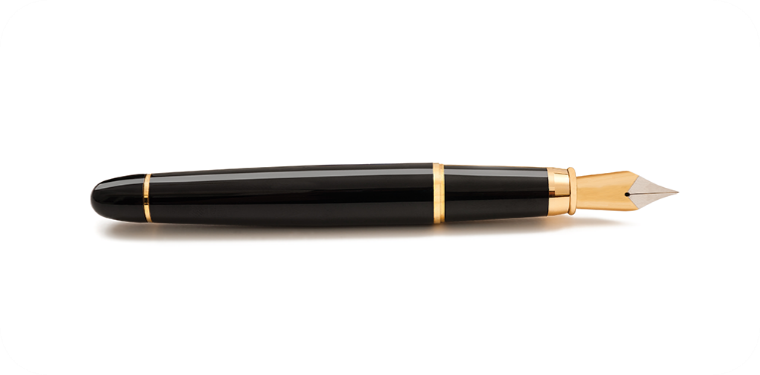
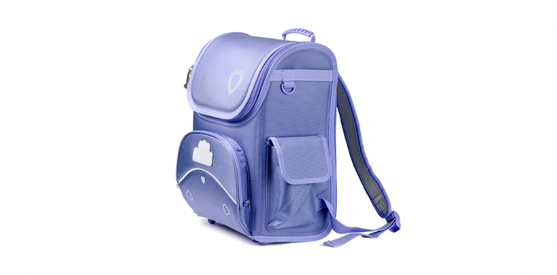
5. Look, complete and read.
______.
___________.
____________.
_________________.
Notes:
Facebook : Bùi Liễu
Mobile phone: 0968142780

Slide 13
5. Look, complete and read.
1. A: What colour is it?
2. A: What colour is it?
B: It’s ________.
B: ________.
3. A: ____ colour is it?
3. A: _________ is it?
B: It’s ________.
B: It’s ________.
Notes:
Facebook : Bùi Liễu
Mobile phone: 0968142780

Slide 14
5. Look, complete and read.
1. A: What colour is it?
yellow
B: It’s ________.
Notes:
Facebook : Bùi Liễu
Mobile phone: 0968142780

Slide 15
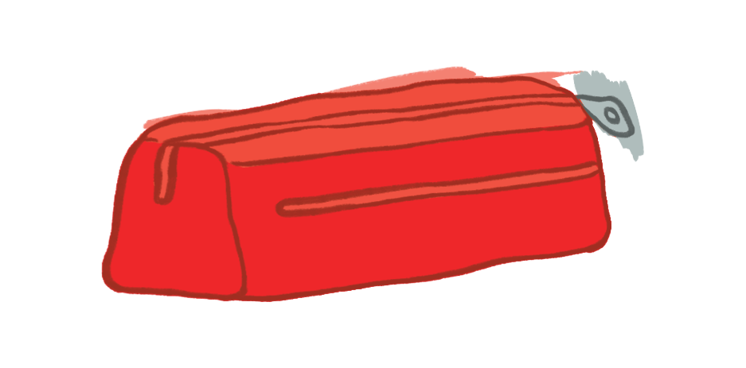
5. Look, complete and read.
2. A: What colour is it?
It’s red
B: ________.
Notes:
Facebook : Bùi Liễu
Mobile phone: 0968142780

Slide 16
5. Look, complete and read.
What
3. A: ______ colour is it?
brown
B: It’s ________.
Notes:
Facebook : Bùi Liễu
Mobile phone: 0968142780

Slide 17
5. Look, complete and read.
What colour
3. A: ___________ is it?
blue
B: It’s ______.
Notes:
Facebook : Bùi Liễu
Mobile phone: 0968142780

Slide 18
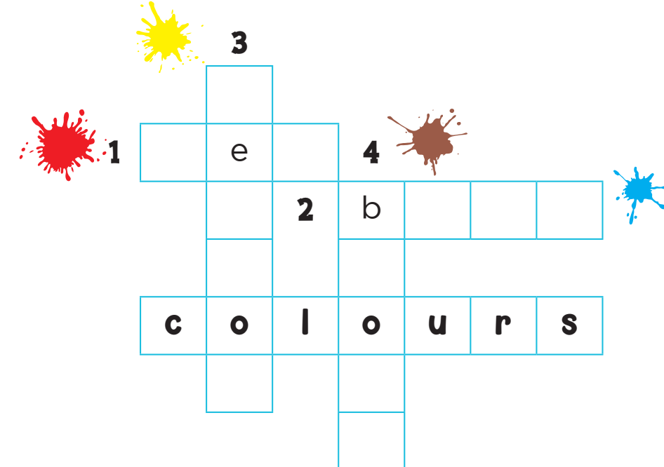
6. Let’s play.
y
l
l
w
r d
l u e
r
w
n

Slide 19
Wrap up

Slide 20
Vocabulary
colour
blue
brown
red
yellow
Notes:
Facebook : Bùi Liễu
Mobile phone: 0968142780

Slide 21
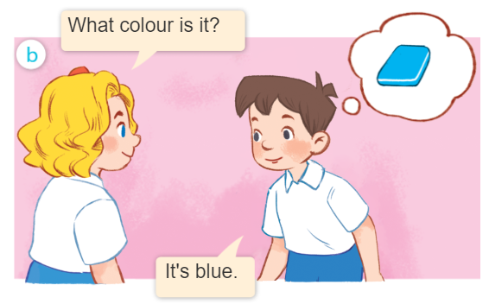
Structures
Khi muốn hỏi màu sắc của một đồ vật, ta sử dụng mẫu câu.
What colour is it?
- It’s _________.
(Nó có màu gì vậy?)
(Nó màu ______.)
Example:

Slide 22
Homework
Learn by heart all the new words.
Read again the dialogue in part 1.

Slide 23
Facebook : Bùi Liễu
0968142780
Thank you!
Notes:
Facebook : Bùi Liễu
0968142780

