Slide 1
Colours
Unit
9
Lesson 1 ( 1, 2, 3 )
Notes:
Facebook : Bùi Liễu
Mobile phone: 0968142780

Slide 2
Warm-up

Slide 3
PLAY
BASEBALL CUP

Slide 4
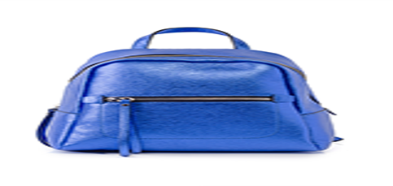
you
A. a school bag
B. a book
they
I have __________.
Close your book

Slide 5
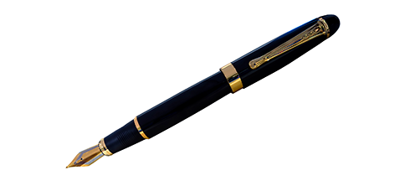
A. a notebook
you
B. a pen
they
I have ________.
Sing a song

Slide 6
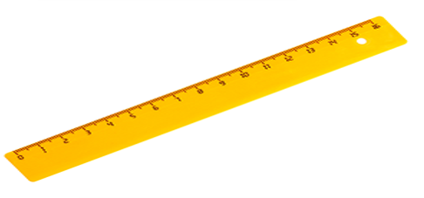
A. a pencil
you
B. a ruler
they
I have ________.
Sing a song

Slide 7
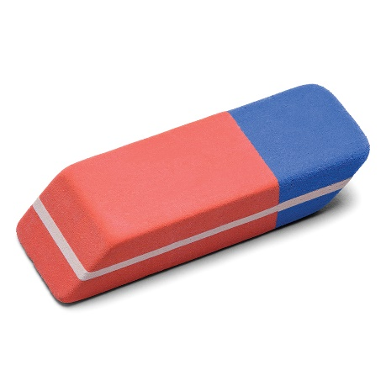
you
A. have a eraser
B. have an eraser
they
I ___________.
Sing a song

Slide 8
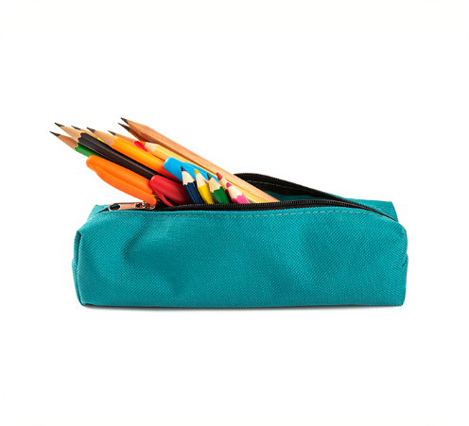
you
A. a pencil case
B. an pencil case
they
Do you have ________?
Yes, I do.
Close your book

Slide 9
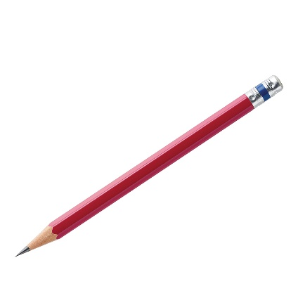
you
A. a pen
B. a pencil
they
Do you have ________?
Yes, I do.
Sing a song

Slide 10
you
A. I do
B. I don’t
they
Do you have an eraser?
Yes, _________.
Close your book

Slide 11
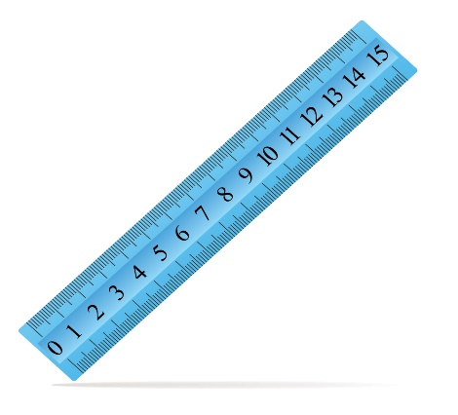
you
A. No, I don’t
B. Yes, I do
they
Do you have a ruler?
_______________.
Close your book

Slide 12
you
A. Yes, I do
B. I don’t
they
Do you have a notebook?
No, ___________.
Sing a song

Slide 13
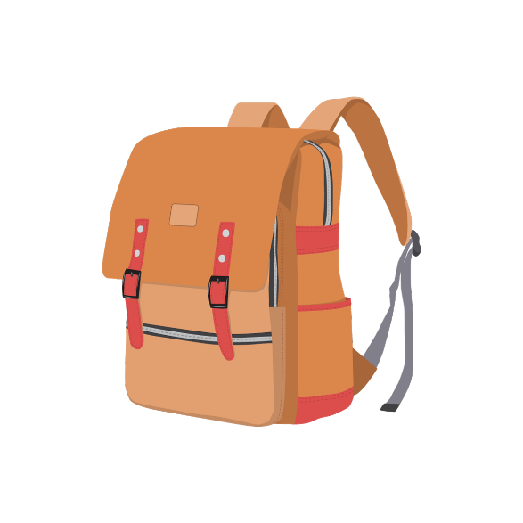
you
A. Yes, I do
B. No, I don’t
they
Do you have a school bag?
_______________.
Close your book

Slide 14
CONGRATULATION!
PLAY
TIME’S UP!

Slide 15
Contents
1
Look, listen and repeat.
2
Listen, point and say.
3
Let’s talk.
4
Listen and tick.
5
Look, complete and read.
6
Let’s play.
Notes:
Facebook: Bùi Liễu
0968142780

Slide 16
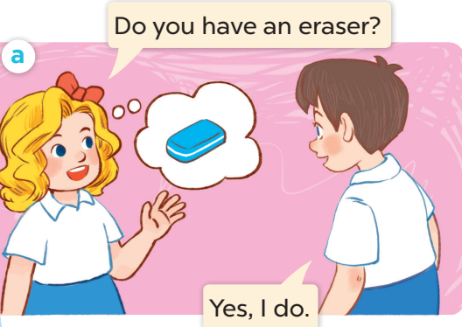
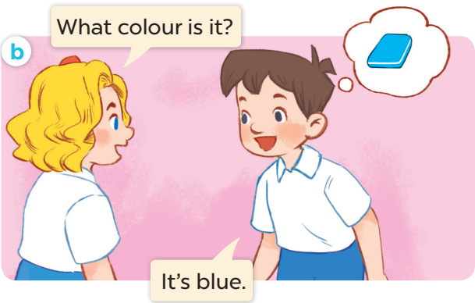
1. Look, listen and repeat.
Who are they?
Where are they?
What are they doing?
Notes:
Facebook : Bùi Liễu
Mobile phone: 0968142780

Slide 17
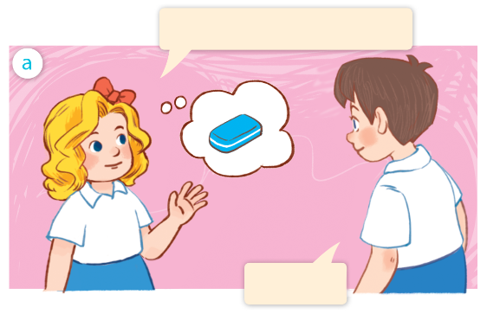
1. Look, listen and repeat.
Do you have an eraser?
Facebook : Bùi Liễu
0968142780
Yes, I do.
Notes:
Facebook : Bùi Liễu
Mobile phone: 0968142780

Slide 18
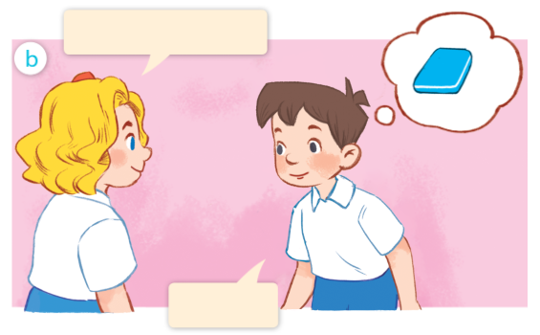
1. Look, listen and repeat.
What colour is it?
Facebook : Bùi Liễu
0968142780
It’s blue.
Notes:
Facebook : Bùi Liễu
Mobile phone: 0968142780

Slide 19
Vocabulary
Notes:
Facebook : Bùi Liễu
Mobile phone: 0968142780

Slide 20
Vocabulary
colour
/ˈkʌlə/
màu sắc
Notes:
Facebook : Bùi Liễu
Mobile phone: 0968142780

Slide 21
Vocabulary
blue
/bluː/
màu xanh da trời
Notes:
Facebook : Bùi Liễu
Mobile phone: 0968142780

Slide 22
Vocabulary
brown
/braʊn/
màu nâu
Notes:
Facebook : Bùi Liễu
Mobile phone: 0968142780

Slide 23
Vocabulary
red
/red/
màu đỏ
Notes:
Facebook : Bùi Liễu
Mobile phone: 0968142780

Slide 24
Vocabulary
yellow
/ˈjeləʊ/
màu vàng
Notes:
Facebook : Bùi Liễu
Mobile phone: 0968142780

Slide 25
Review
colour
blue
brown
red
yellow
Notes:
Facebook : Bùi Liễu
Mobile phone: 0968142780

Slide 26
Vocabulary
colour: màu sắc
blue: màu xanh da trời
brown: màu nâu
red: màu đỏ
yellow: màu vàng
Notes:
Facebook : Bùi Liễu
Mobile phone: 0968142780

Slide 27
Checking vocabulary
Match the pictures with the words.
a
b
c
d
e
colour
brown
red
yellow
blue

Slide 28
Structures
Notes:
Facebook : Bùi Liễu
Mobile phone: 0968142780

Slide 29
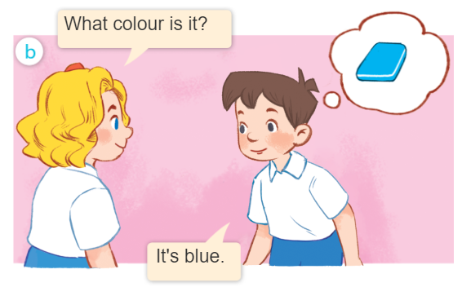
Structures
Khi muốn hỏi màu sắc của một đồ vật, ta sử dụng mẫu câu.
What colour is it?
- It’s _________.
(Nó có màu gì vậy?)
(Nó màu ______.)
It’s = it is
Example:

Slide 30
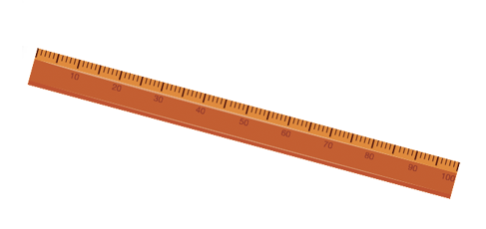
2. Listen, point and say.
a
b
What colour is it?
blue
brown
It’s _______.
c
d
red
yellow

Slide 31
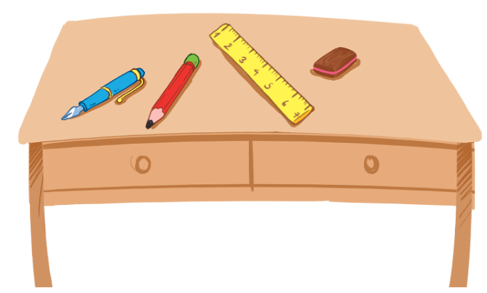
3. Let’s talk.
What colour is it?
It’s _______.
4
1
2
3

Slide 32
Homework
Learn by heart all the new words.
Read again the dialogue in part 1.

Slide 33
Facebook : Bùi Liễu
0968142780
Thank you!
Notes:
Facebook : Bùi Liễu
0968142780

