Slide 1
PEOPLE’S COMMITTEE OF DAI LOC DISTRICT
DAI QUANG PRIMARY SCHOOL
WELCOME TO OUR CLASS !
Subject: English 4
Class: 4D
Teacher: Pham Thi My Chau

Slide 2
Let’s play!

Slide 3
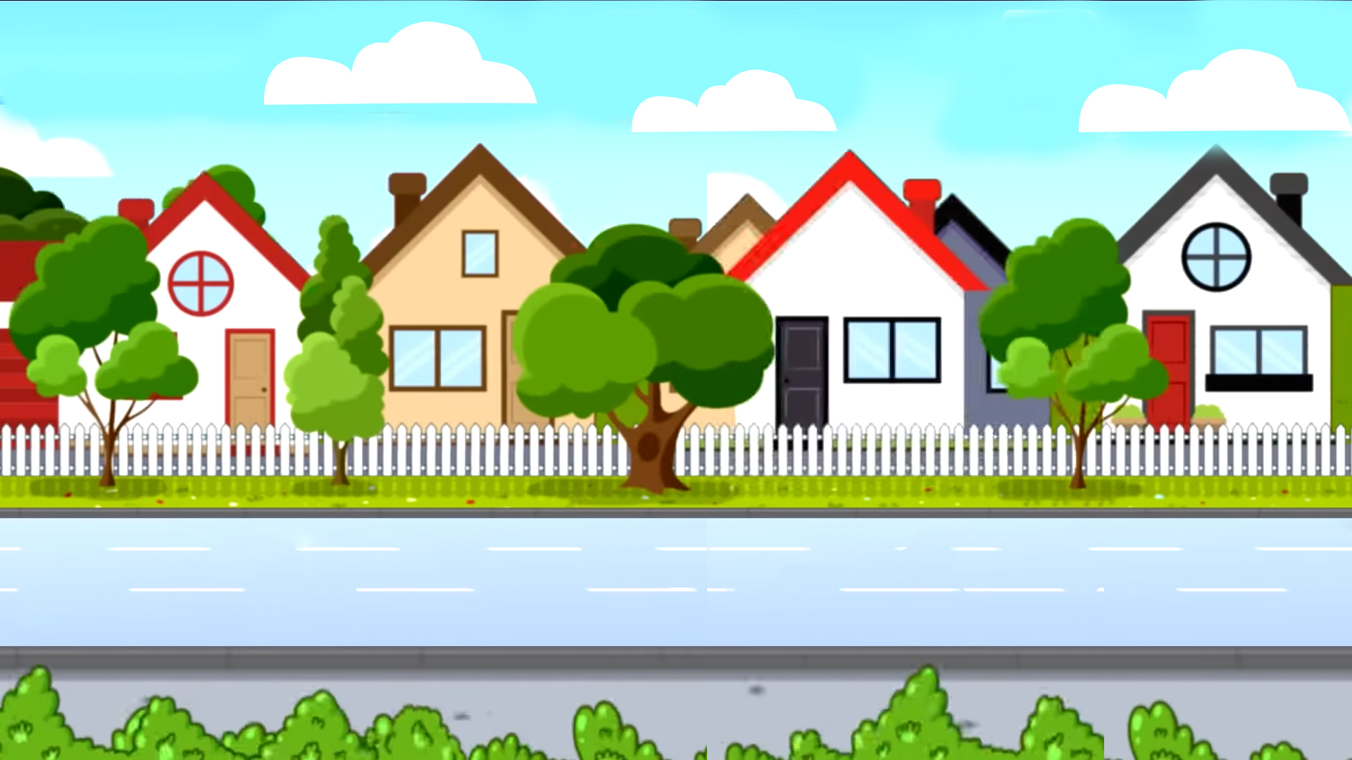
School bus
Play

Slide 4
H/s nhìn hình và nói, cô giáo nhấn “check” để hiển thị đáp án.
Question 1/8
English
Check
Next

Slide 5
Question 2/8
history and geography
Check
Next

Slide 6
Question 3/8
art
Check
Next
Notes:
Facebook : Bùi Liễu
Mobile phone: 0968142780

Slide 7
Question 4/8
music
Check
Next

Slide 8
Question 5/8
maths
Check
Next
Notes:
Facebook : Bùi Liễu
Mobile phone: 0968142780

Slide 9
Question 6/8
science
Check
Next

Slide 10
Question 7/8
Vietnamese
Check
Next
Notes:
Facebook : Bùi Liễu
Mobile phone: 0968142780

Slide 11
Question 8/8
science and art
Check
Next

Slide 12
End

Slide 13
Tuesday, December 3rd , 2024
UNIT 8 : MY FAVOURITE SUBJECT
*Lesson 1:
Part: 1, 2 & 3

Slide 14
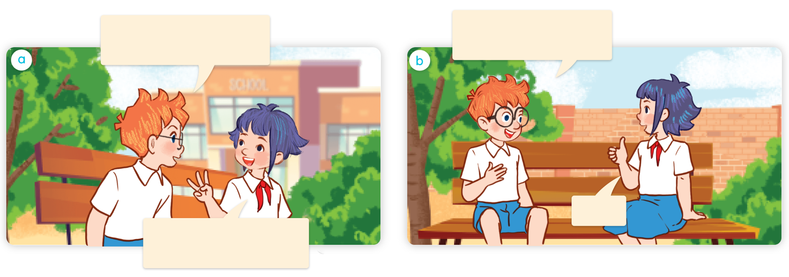
1. Look, listen and repeat.
Hi, Linh. What subjects do you have today?
I like art. What’s your favourite subject?
a
b
It’s PE.
I have English, science and maths.

Slide 15
Vocabulary

Slide 16
Vocabulary
PE (physical education)
/ˌpiː ˈiː/ (/ˌfɪzɪkl edʒuˈkeɪʃn/)
môn Thể dục,
môn Giáo dục thể chất

Slide 17
Vocabulary
IT (information technology)
/aɪ ˈtiː/ (/ˌɪnfəˌmeɪʃn tekˈnɒlədʒi/)
môn Tin học,
môn Công nghệ thông tin

Slide 18
Review
PE (physical education)
IT (information technology)

Slide 19
Match
1
2
3
4
PE
IT
music
art
a
b
c
d

Slide 20
1. Look, listen and repeat.
Hi, Linh. What subjects do you have today?
I like art. What’s your favourite subject?
a
b
It’s PE.
I have English, cience and maths.

Slide 21
II/ Model sentence
Hỏi “môn học yêu thích của bạn”:
What’s your favourite subject?
It’s PE.
it’s = it is
(Môn học yêu thích của bạn là gì?)
(Đó là ______.)

Slide 22
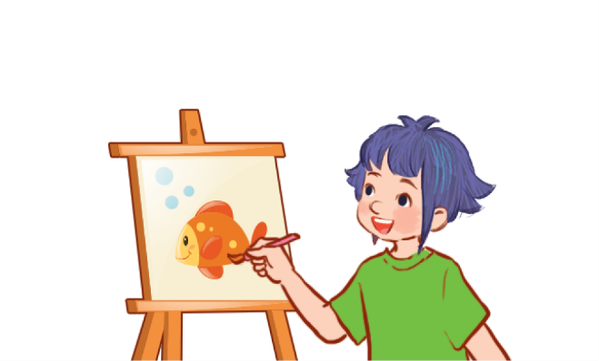
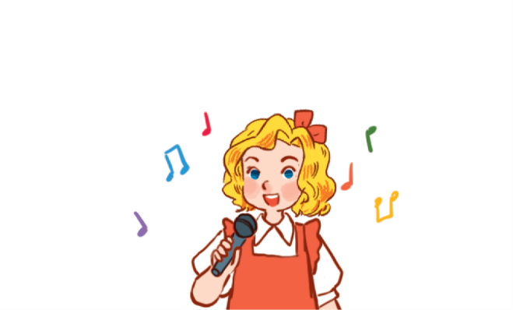
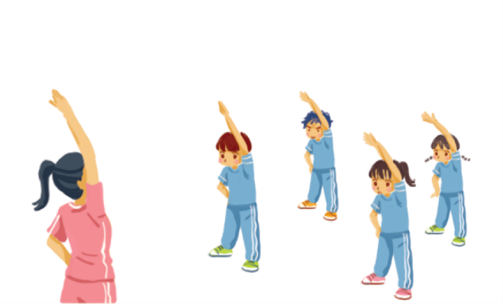
2. Listen, point and say.
a
b
What’s your favourite subject?
art
music
It’s ______.
c
d
PE
IT

Slide 23
2. Listen, point and say.
art
What’s your favourite subject?
It’s art.

Slide 24
2. Listen, point and say.
music
What’s your favourite subject?
It’s music.

Slide 25
2. Listen, point and say.
PE
What’s your favourite subject?
It’s PE.

Slide 26
2. Listen, point and say.
IT
What’s your favourite subject?
It’s IT.

Slide 27
3. Let’s talk.

Slide 28
Let’s play!

Slide 29
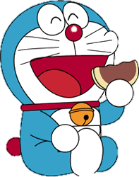
DORAEMON

Slide 30
Facebook : Bùi Liễu
0968142780
A: IT
B: art
C: music
D: PE

Slide 31
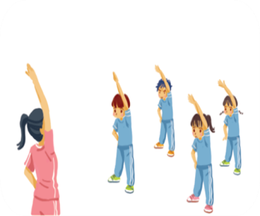
A: art
B: PE
C: music
D: IT
Notes:
Facebook : Bùi Liễu
Mobile phone: 0968142780

Slide 32
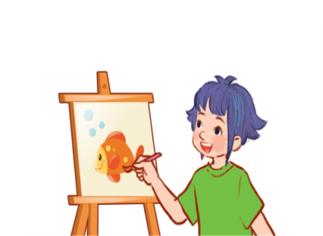
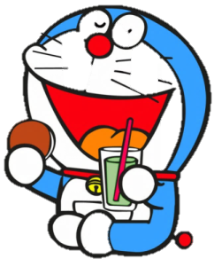
A: IT
B: PE
C: art

Slide 33
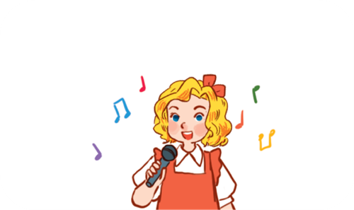
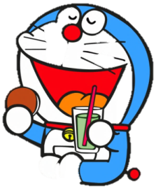
A: art
B: PE
D: music

Slide 34
Facebook : Bùi Liễu
0968142780
What’s your favourite _______?
It’s PE.
A: food
B: subjects
C: drink
D: subject

Slide 35
_______ your favourite subject?
It’s IT.
A: Who’s
B: Where’s
C:When’s
D: What’s

Slide 36
PE
physical ___cation
A: edu
B: adu
C: egu
D: idy

Slide 37
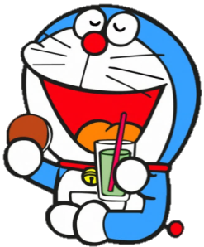
IT
Information techno____
A: logi
B: logy
C: loge
D: nogy

Slide 38
Good job!

Slide 39
Wrap up

Slide 40
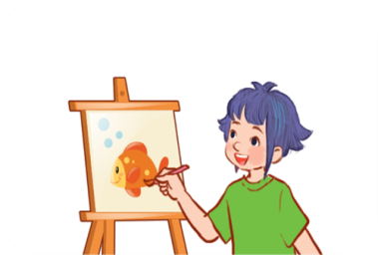
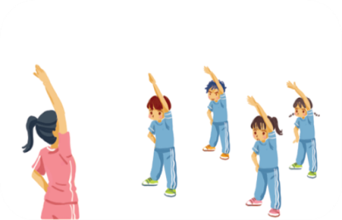
Unit 8 lesson1
What’s your favourite subject?
It’s ______.
IT
art
music
PE

Slide 41
Homework
Learn by heart all the new words.
Read again the dialogue in part 1.

Slide 42
Thank you!

