Slide 1
PEOPLE’S COMMITTEE OF DAI LOC DISTRICT
DAI QUANG PRIMARY SCHOOL
WELCOME TO OUR CLASS !
Subject: English 4
Class: 4D
Teacher: Pham Thi My Chau

Slide 2
Facebook : Bùi Liễu
0968142780
Let’s play!

Slide 3
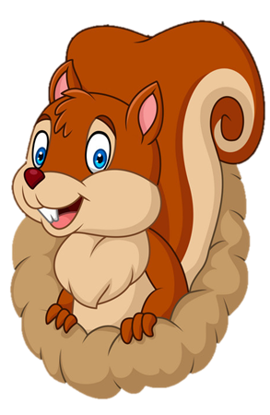
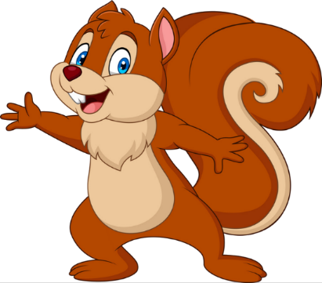
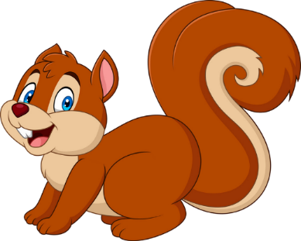
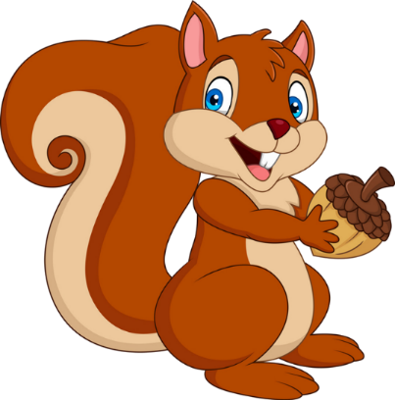
Facebook : Bùi Liễu
Mobile phone: 0968142780
PLAY
NEXT

Slide 4
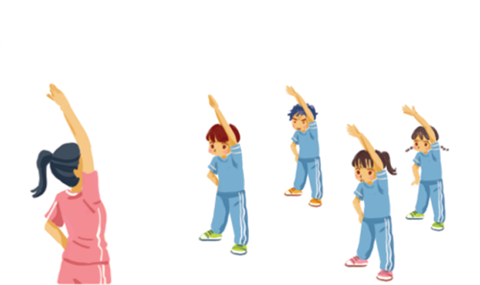
Facebook : Bùi Liễu
Mobile phone: 0968142780
A. IT
B. PE

Slide 5
A. IT
B. PE

Slide 6
A. English
B. Vietnamese

Slide 7
A. IT
B. maths
Facebook : Bùi Liễu
Mobile phone: 0968142780

Slide 8
A. art
B. PE

Slide 9
Facebook : Bùi Liễu
Mobile phone: 0968142780
A. art
B. music

Slide 10
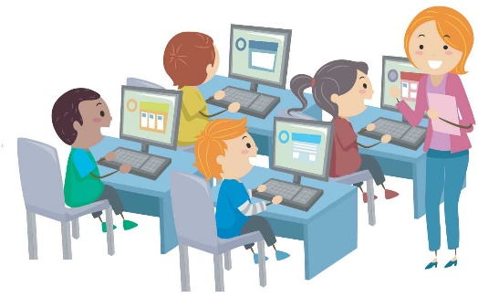
What’s your favourite subject?
A. It’s IT.
B. It’s maths.
Facebook : Bùi Liễu
Mobile phone: 0968142780

Slide 11
What’s your favourite subject?
A. It’s music.
B. It’s PE.

Slide 12
Mary: What’s your favourite _____?
Lucy: It’s maths.
A. subject
B. subjects
Facebook : Bùi Liễu
Mobile phone: 0968142780

Slide 13
Mary: _____ your favourite subject?
Lucy: It’s PE.
A. When’s
B. What’s

Slide 14
Good job!

Slide 15
Thursday, December 5 ^{th} , 2024
UNIT 8 : MY FAVOURITE SUBJECT
*Lesson 2:
Part: 4, 5 & 6

Slide 16
4. Listen and number.
a
b
c
d
3
1
4
2

Slide 17
A: Why do you like art ?
B: Because I want to be a painter.
A: Why do you like Maths ?
B: Because I want to be a maths teacher.
A: Why do you like music ?
B: Because I want to be a singer.
A: Why do you like English ?
B: Because I want to be an English teacher.

Slide 18
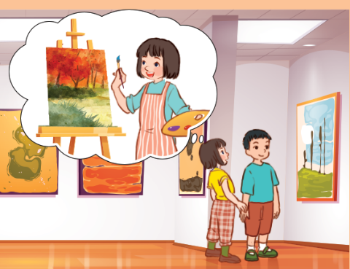
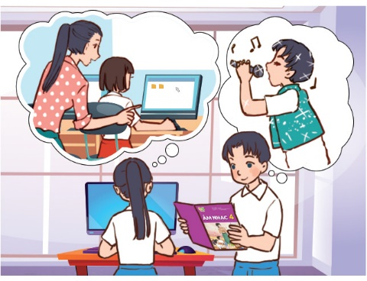
5. Look, complete and read.
1.
A: What’s your favourite subject?
B: It’s art. I like it.
A: _______ do you like art?
B: Because I want to be a ______.
Why
painter
2.
A: I like IT. It’s my favourite _______.
B: Why do you like it?
A: _______ I want to be an IT teacher.
How about you ?
B: My favourite subject is ________. I want to be a singer.
subject
Because
music

Slide 19
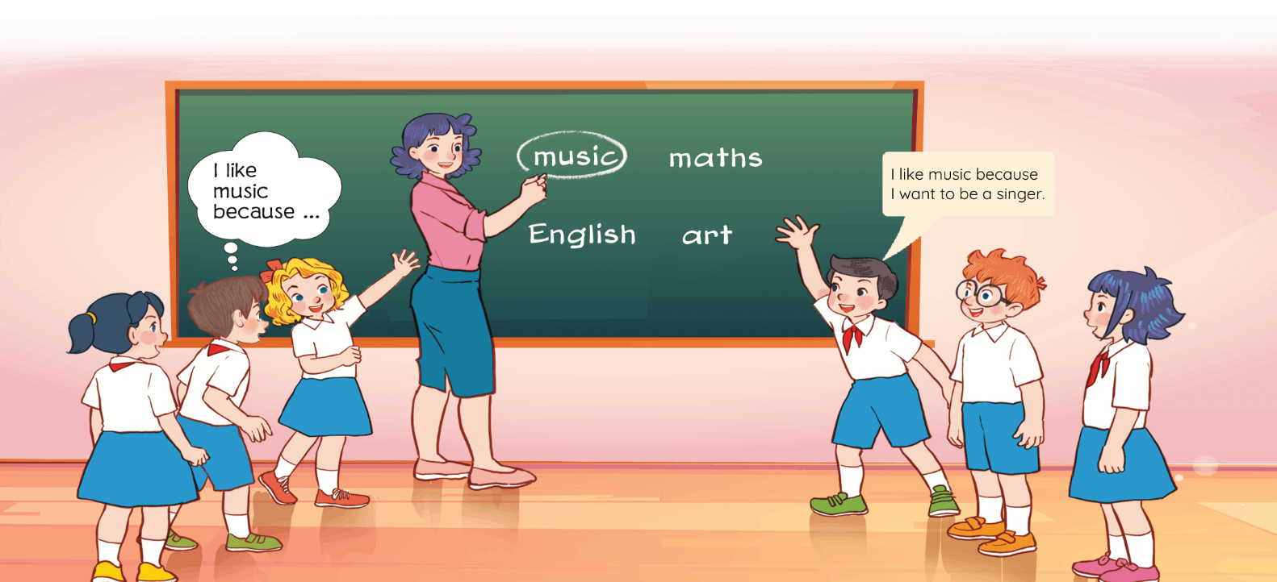
6. Let’s play.

Slide 20
Facebook : Bùi Liễu
0968142780
Let’s play!

Slide 21
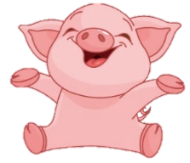
Luật chơi:
Các đội lần lượt chọn các số từ 1-10.
Trả lời đúng được cộng, trả lời sai bị trừ số điểm đã mở.
Ngôi sao xanh được +200 điểm khi trả lời đúng, trả lời sai không bị trừ điểm
Ngôi sao đen bị -200 điểm khi trả lời sai, trả lời đúng không bị trừ điểm.
Lucky number
PLAY

Slide 22
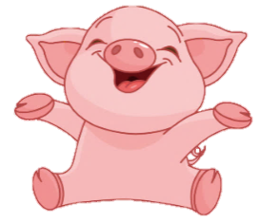
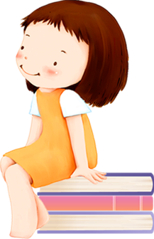
2
100
4
1
3
200
100
-200
Facebook : Bùi Liễu
0968142780
7
100
5
6
+200
200
8
100
9
10
100
200

Slide 23
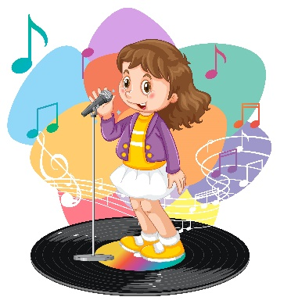
Facebook : Bùi Liễu
0968142780
Back
A. painter
B. singer
C. IT teacher

Slide 24
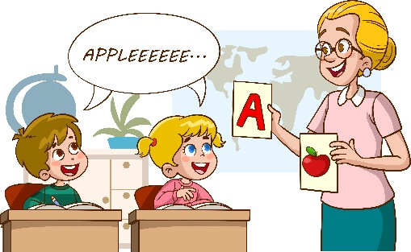
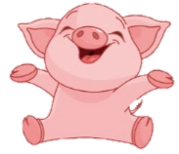
Back
A. English teacher
B. maths teacher

Slide 25
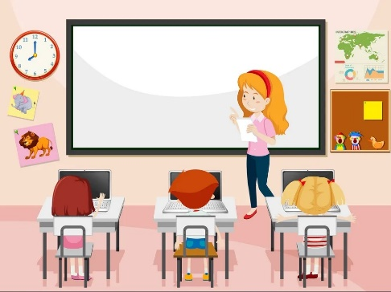
Back
A. singer
B. maths teacher
C. IT teacher

Slide 26
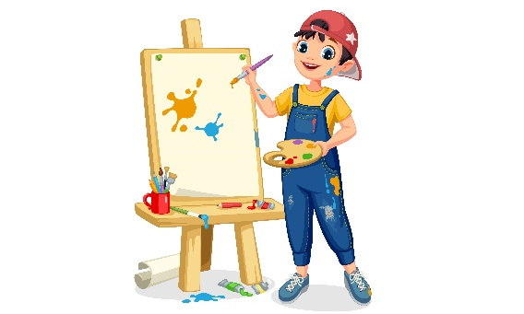
Back
A. teacher
B. painter

Slide 27
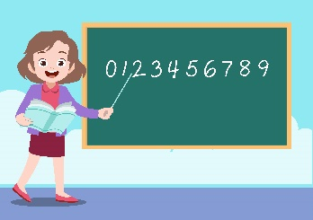
Back
A.
B.
C.

Slide 28
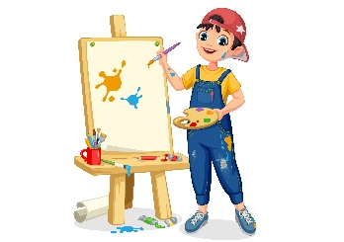
Back
A.
B.
C.

Slide 29
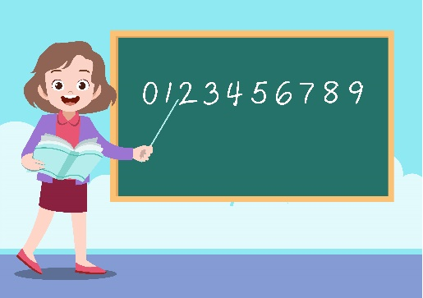
Back
A. English teacher
B. maths teacher

Slide 30
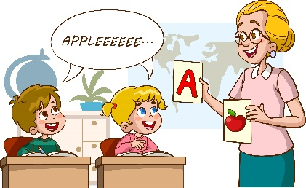
____ do you like English?
Because I want to be an English teacher.
Back
A. When
B. Why

Slide 31
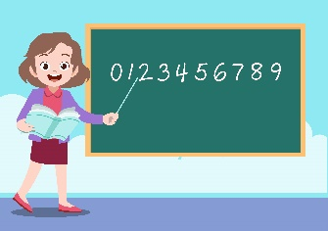
A: Why do you like art?
B: Because I want to be a painter.
Back
A.
B.
C.

Slide 32
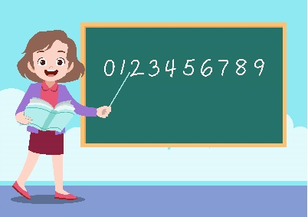
Why do you like maths?
_____ I want to be a maths teacher.
Back
A. But
B. So
C. Because

Slide 33
Great!

Slide 34
Homework
Learn by heart all the new words.
Prepare new lesson Lesson 3.

Slide 35
Thank you!
Facebook: Bùi Liễu
0968142780

