Slide 2
Unit 9 Our outdoor activities
Lesson 2 - Period 3

Slide 3
Table of contents
01
Warm-up and Review
02
Activity 1. Look, listen and repeat.
03
Activity 2. Listen, point and say.
04
Activity 3. Let’s talk.
05
Fun corner and Wrap-up

Slide 4
01
Warm-up and Review

Slide 6
Were you at the ____ yesterday?
No, we weren’t.
Yes, we were.

Slide 7
02
Activity 1.
Look, listen and repeat.

Slide 8
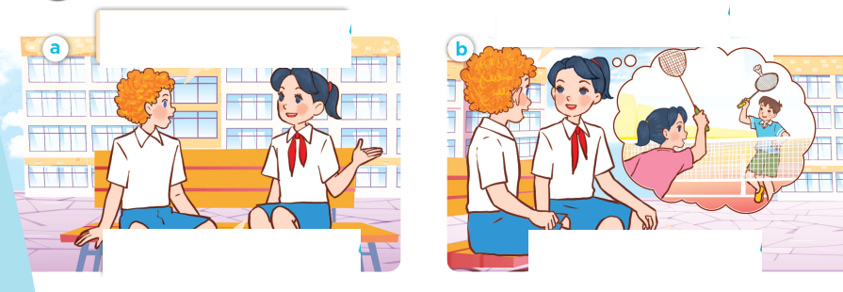
Look, listen and repeat.

Slide 9
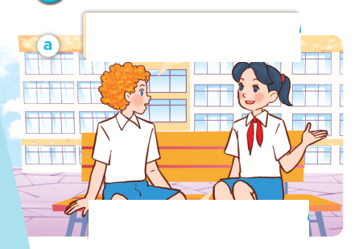
Look, listen and repeat.
I didn’t see you and Minh last Saturday. Where were you?
We were at the sports centre.
Notes:
Nháy vào hội thoại để nghe lại âm thanh từng câu.

Slide 10
Look, listen and repeat.
What did you do there?
We played badminton.
Notes:
Nháy vào hội thoại để nghe lại âm thanh từng câu.

Slide 11
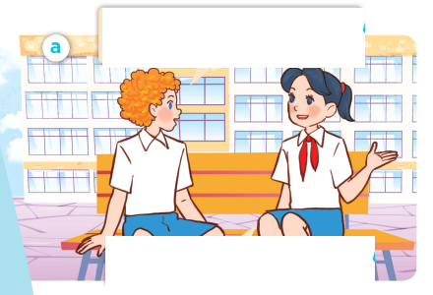
Look, listen and repeat.
I didn’t see you and Minh last Saturday. Where were you?
What did you do there?
We were at the sports centre.
We played badminton.

Slide 12
Where were you?
We were ____.
What did you do there?
We _______.

Slide 13
03
Activity 2.
Listen, point and say.

Slide 14
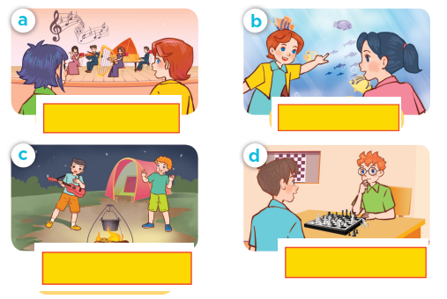
Listen, point and say.

Slide 15
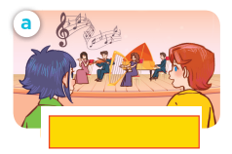
Listen, point and say.
listen to music

Slide 16
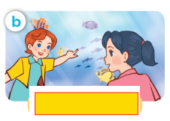
Listen, point and say.
watch the fish

Slide 17
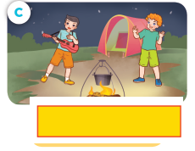
Listen, point and say.
dance around
the campfire

Slide 18
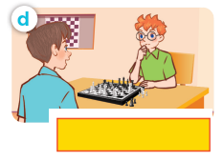
Listen, point and say.
play chess

Slide 19
What did you do yesterday?
We ____.

Slide 20
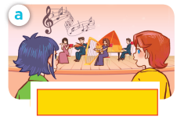
Listen, point and say.
What did you do yesterday?
We listened to music.
listen to music

Slide 21
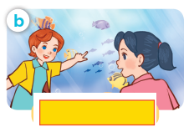
Listen, point and say.
What did you do yesterday?
We watched the fish.
watch the fish

Slide 22
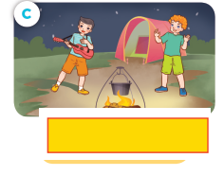
Listen, point and say.
What did you do yesterday?
We danced around the campfire.
dance around the campfire

Slide 23
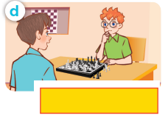
Listen, point and say.
What did you do yesterday?
We played chess.
play chess

Slide 24
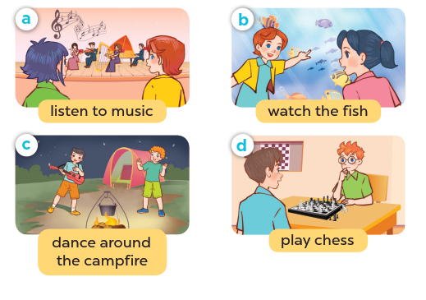
What did you do yesterday?
We ____.

Slide 25
04
Activity 3. Let’s talk.

Slide 26
Let’s talk.

Slide 27
05
Fun corner and Wrap-up

Slide 28
What were you yesterday?
We ____.
What did you do there?
We ____.

Slide 29
05
Fun corner and Wrap-up

Slide 30
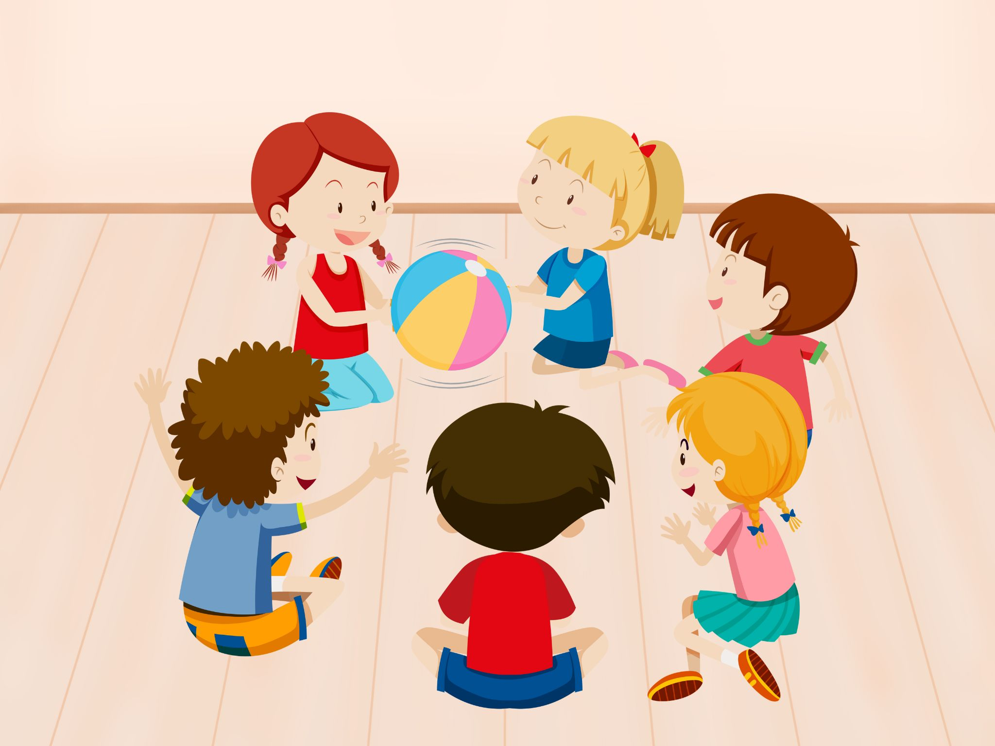
PASS THE BALL
Notes:
Giáo viên nháy choột để bật nhạc và dừng nhạc. Dừng nhạc bạn nào cầm bóng thì trả lời câu hỏi.

Slide 31
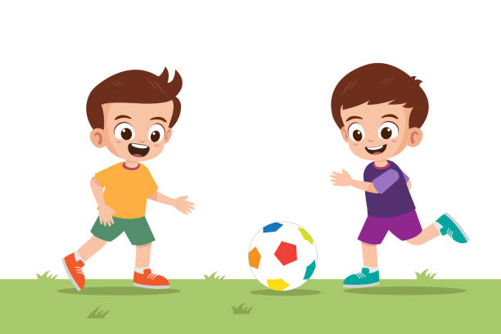
Fill in the blanks.
What ___ you do yesterday?
did
played football
We ____________.

Slide 32
PASS THE BALL
Notes:
Giáo viên nháy choột để bật nhạc và dừng nhạc. Dừng nhạc bạn nào cầm bóng thì trả lời câu hỏi.

Slide 33
Fill in the blanks.
What did you ___ yesterday?
do
We watched the ______.
dolphin

Slide 34
PASS THE BALL
Notes:
Giáo viên nháy choột để bật nhạc và dừng nhạc. Dừng nhạc bạn nào cầm bóng thì trả lời câu hỏi.

Slide 35
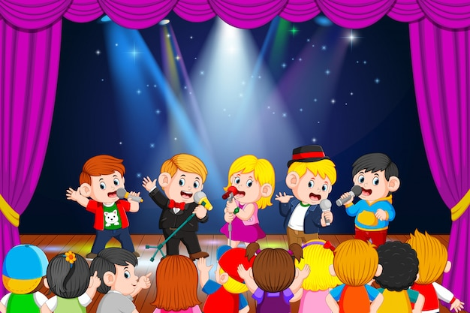
Fill in the blanks.
What did you do __________?
yesterday
We _______ to music.
listened

Slide 36
PASS THE BALL
Notes:
Giáo viên nháy choột để bật nhạc và dừng nhạc. Dừng nhạc bạn nào cầm bóng thì trả lời câu hỏi.

Slide 37
Fill in the blanks.
What did you
___________do yesterday?
We __________
the campfire.
danced around

Slide 38
Very Good!

