Slide 2

Unit 9
Our outdoor activities
Lesson 2 - Period 4

Slide 3
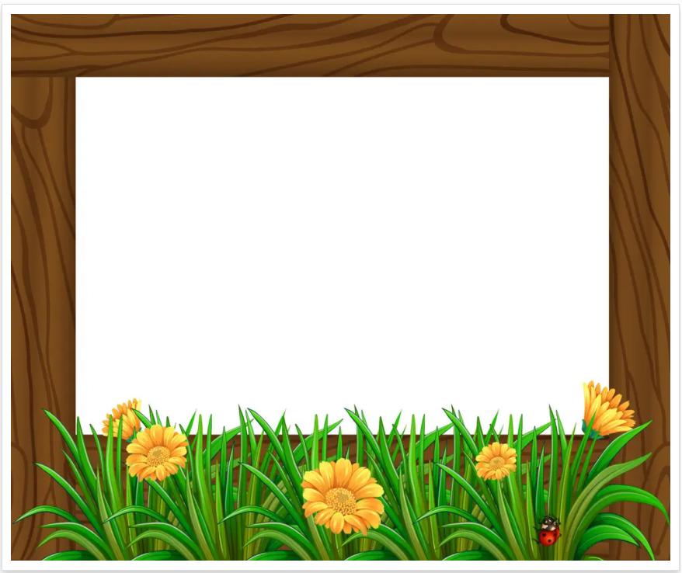
Table of contents
01
Warm-up and Review
02
Activity 4. Listen and circle.
03
Activity 5. Read and complete.
04
Activity 6. Let’s sing.
05
Fun corner and Wrap-up

Slide 4
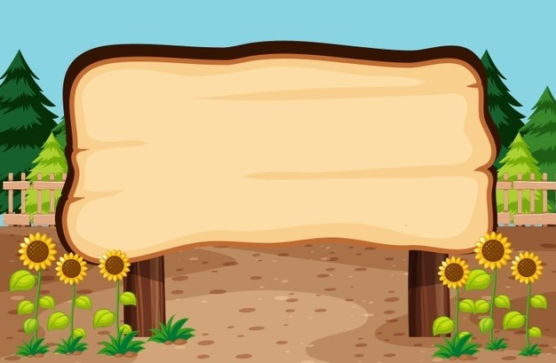

01
Warm-up and Review

Slide 5



What did you do yesterday?
We ____.

Slide 6
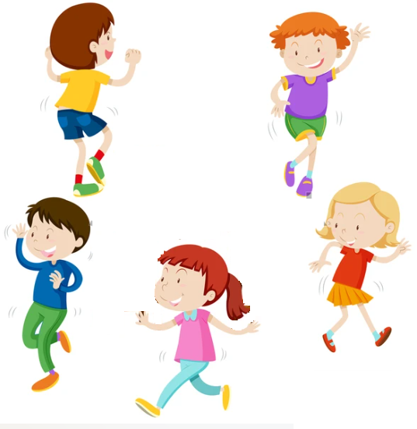
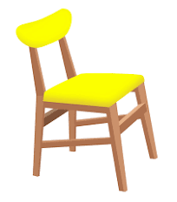
Hot Seat
Game

Slide 7
Notes:
Giáo viên nháy chuột để bật nhạc và dừng nhạc. Dừng nhạc bạn nào ngồi được vào ghế thì trả lời câu hỏi. Trả lời đúng thì được thưởng còn trả lời sai thì đến lượt bạn khác trả lời.

Slide 8

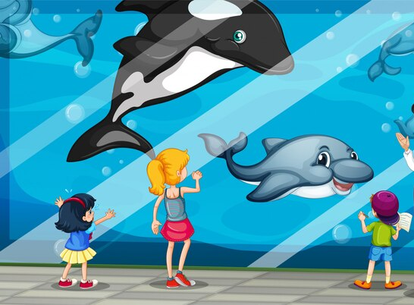
What did you do yesterday?

Slide 9
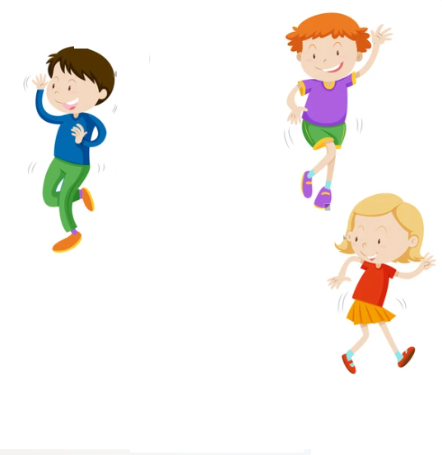
Notes:
Giáo viên nháy chuột để bật nhạc và dừng nhạc. Dừng nhạc bạn nào ngồi được vào ghế thì trả lời câu hỏi. Trả lời đúng thì được thưởng còn trả lời sai thì đến lượt bạn khác trả lời.

Slide 10
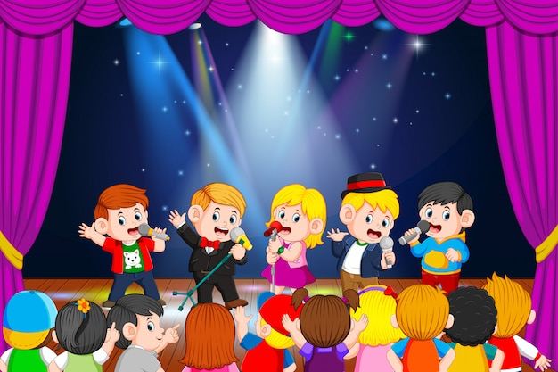
What did you do yesterday?

Slide 11
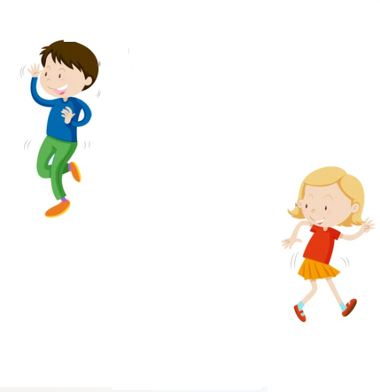
Notes:
Giáo viên nháy chuột để bật nhạc và dừng nhạc. Dừng nhạc bạn nào ngồi được vào ghế thì trả lời câu hỏi. Trả lời đúng thì được thưởng còn trả lời sai thì đến lượt bạn khác trả lời.

Slide 12

What did you do yesterday?

Slide 13
Notes:
Giáo viên nháy chuột để bật nhạc và dừng nhạc. Dừng nhạc bạn nào ngồi được vào ghế thì trả lời câu hỏi. Trả lời đúng thì được thưởng còn trả lời sai thì đến lượt bạn khác trả lời.

Slide 14
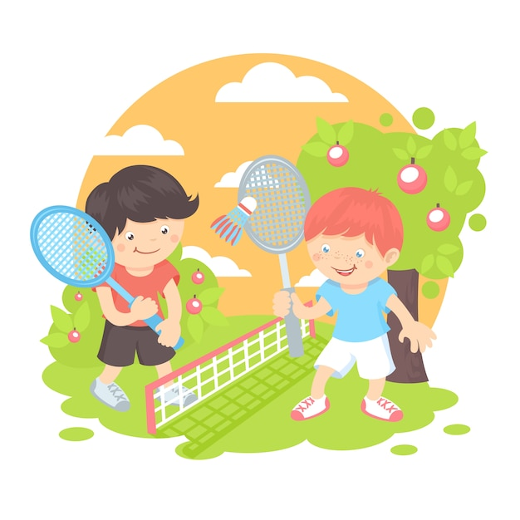
What did you do yesterday?

Slide 15
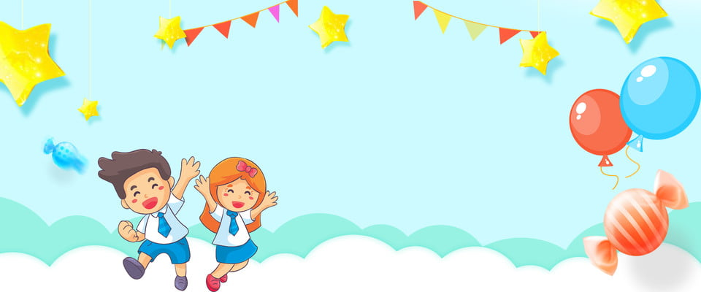

Very Good!

Slide 16
02
Activity 4. Listen and circle.

Slide 17

Listen and circle.
1. Where were you last Sunday? - We were at the ____.
a. campsite b. funfair
2. What did you do in the morning? - We ____ around the lake.
a. cycled b. walked
3. What did you do in the afternoon? - We visited the ____.
  a. farm b. zoo
4. What did you do in the evening? – I _____.
a. played the guitar b. danced around the campfire

Slide 18
Listen and circle.
1. Where were you last Sunday? - We were at the ____.
a. campsite b. funfair

Slide 19
Listen and circle.
2. What did you do in the morning? - We _______ around the lake.
a. cycled b. walked

Slide 20
Listen and circle.
3. What did you do in the afternoon? - We visited the ____.
  a. farm b. zoo

Slide 21
Listen and circle.
4. What did you do in the evening? – I _____.
a. played the guitar b. danced around the campfire

Slide 22
Listen and circle.
1. Where were you last Sunday? - We were at the ____.
a. campsite b. funfair
2. What did you do in the morning? - We ____ around the lake.
a. cycled b. walked
3. What did you do in the afternoon? - We visited the ____.
  a. farm b. zoo
4. What did you do in the evening? – I _____.
a. played the guitar b. danced around the campfire

Slide 23
03
Activity 5.
Read and complete.

Slide 24
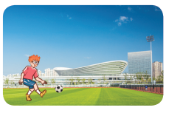
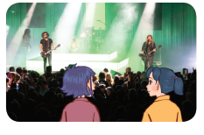
Read and complete.

Slide 25
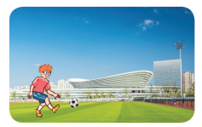
Read and complete.
1. A: Where were you last weekend?
B: I was at the ____________.
A: What did you do there?
B: I ____________.
sports centre
played football

Slide 26
Read and complete.
2. A: Were you and Mai at the theatre yesterday?
B: Yes, ________.
A: What did you ____ there?
B: We ________________.
we were
do
listened to music

Slide 27
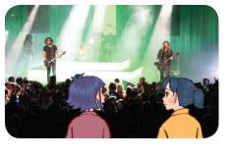
Read and complete.
1. A: Where were you last weekend?
B: I was at the ____________.
A: What did you do there?
B: I ____________.
2. A: Were you and Mai at the theatre yesterday?
B: Yes, _______.
A: What did you ___ there?
B: We ______________.
sports centre
played football
we were
do
listened to music

Slide 28
04
Activity 3. Let’s sing.

Slide 29
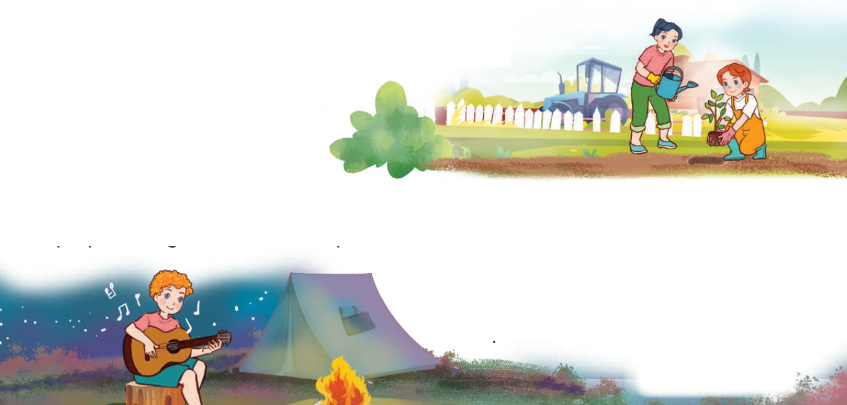
Let’s sing.
What did you do?
Where were you yesterday?
I was at the campsite.
What did you do there?
I played the guitar.
I played the guitar at the campsite.
Where were you yesterday?
We were at the farm.
What did you do there?
We planted trees.
We planted trees at the farm.

Slide 30
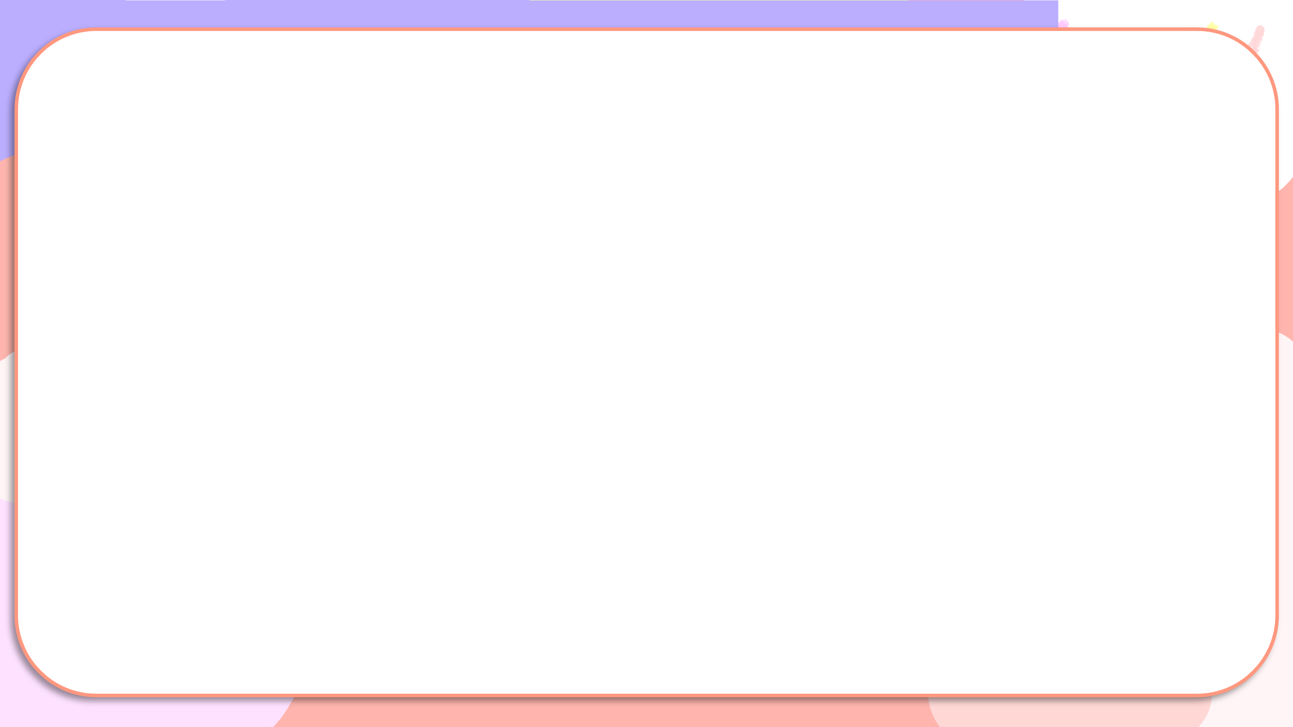
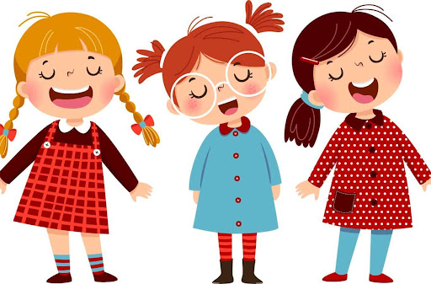
What did you do?
Where were you yesterday?
I was at the campsite.
What did you do there?
I played the guitar.
I played the guitar at the campsite.
Where were you yesterday?
We were at the farm.
What did you do there?
We planted trees.
We planted trees at the farm.

Slide 31
05
Fun corner and Wrap-up

Slide 32


MATCHING
GAME

Slide 33
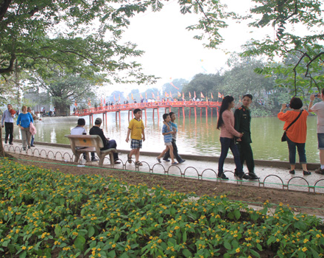
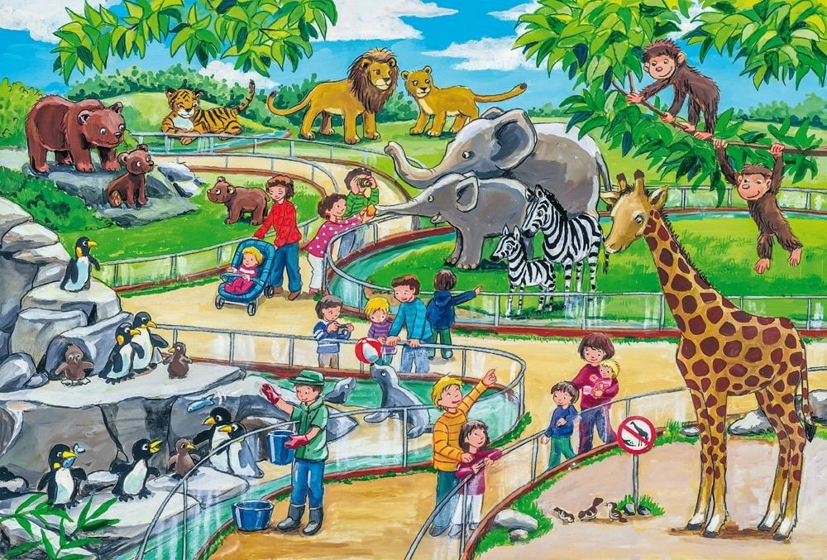
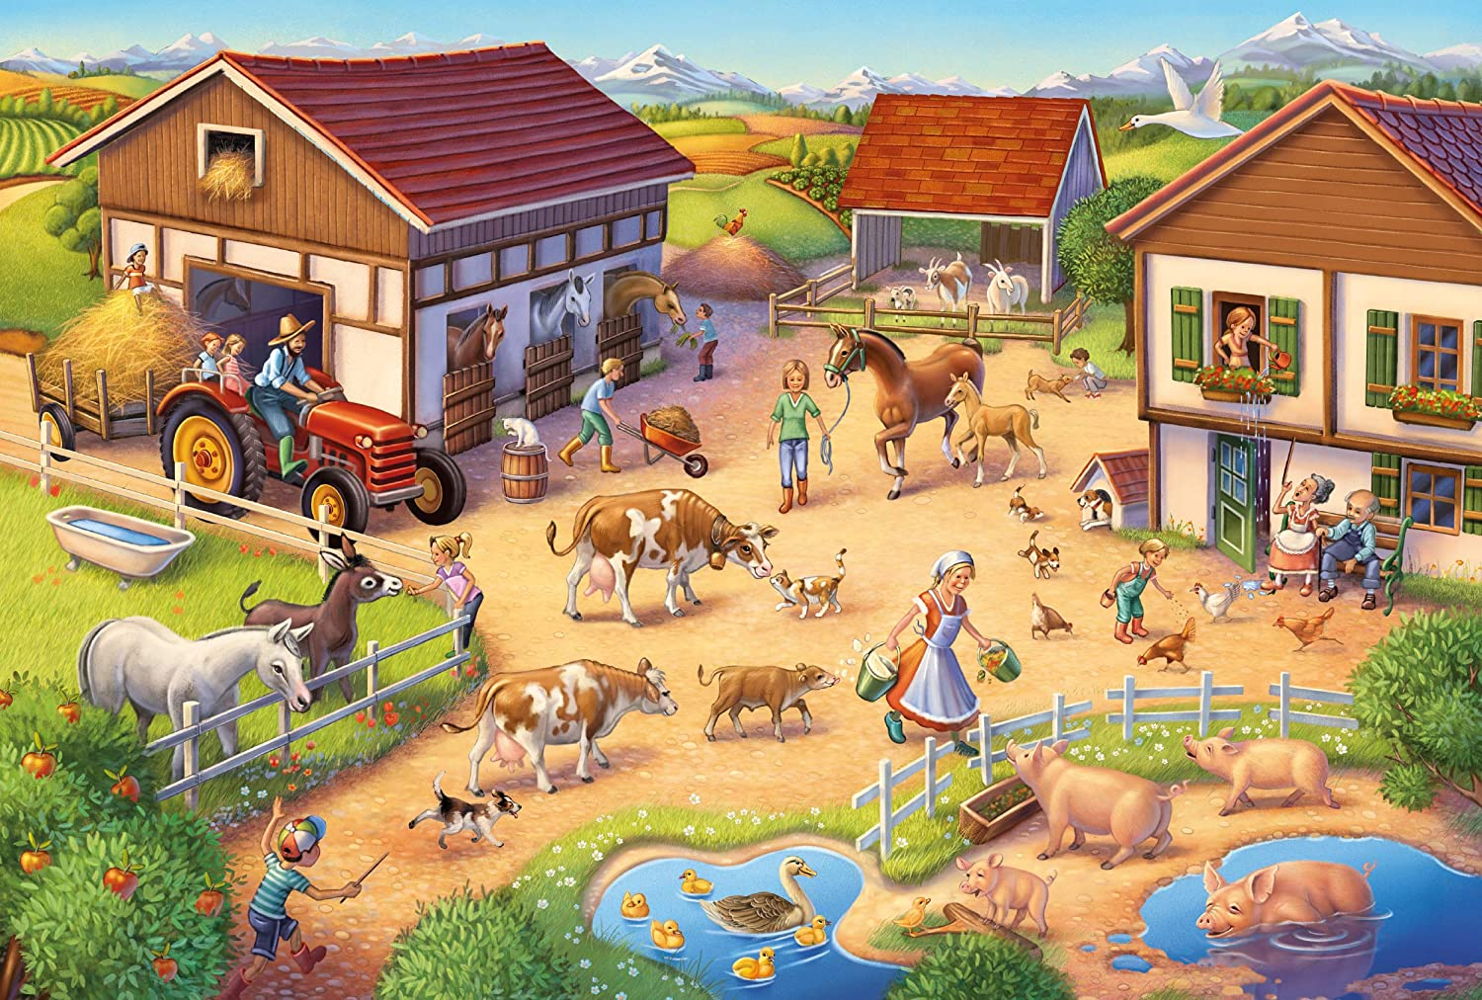
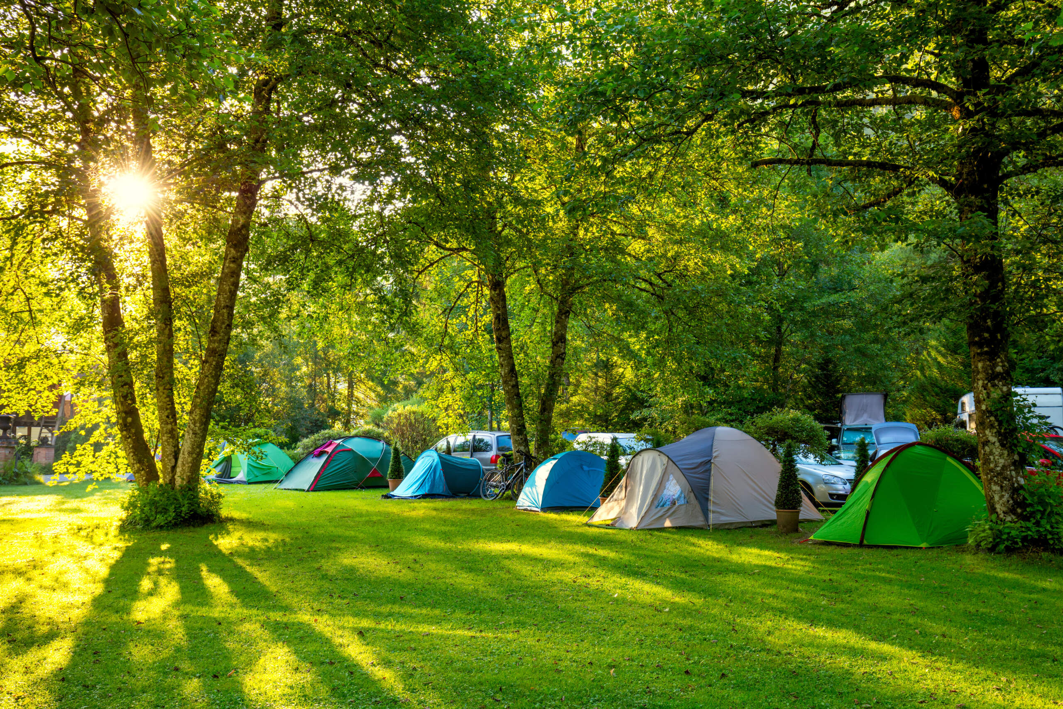
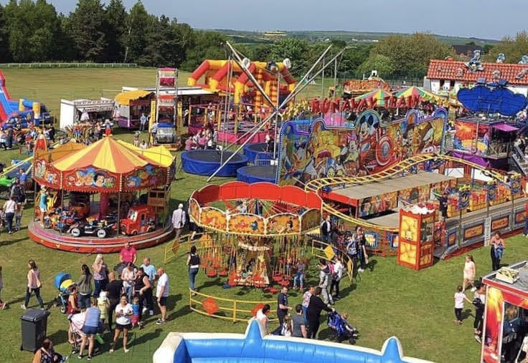
Matching
1
2
3
4
5
at the zoo
at the funfair
at the campsite
walked around the lake.
at the farm

