Slide 2

Unit 9
Our outdoor activities
Lesson 3 - Period 5

Slide 3
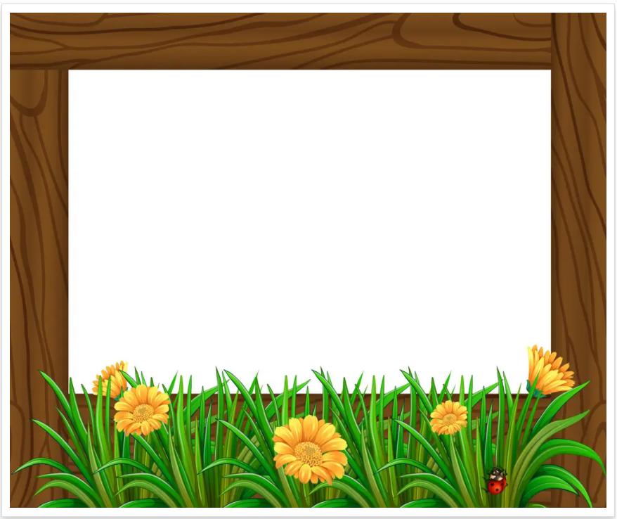
Table of contents
01
Warm-up and Review
02
Activity 1. Listen and repeat.
03
Activity 2. Circle, listen and check.
04
Activity 3. Let’s chant.
05
Fun corner and Wrap-up

Slide 4
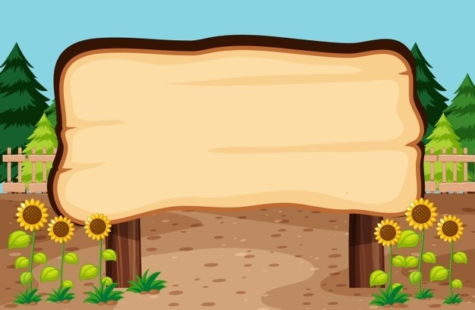

01
Warm-up and Review

Slide 5
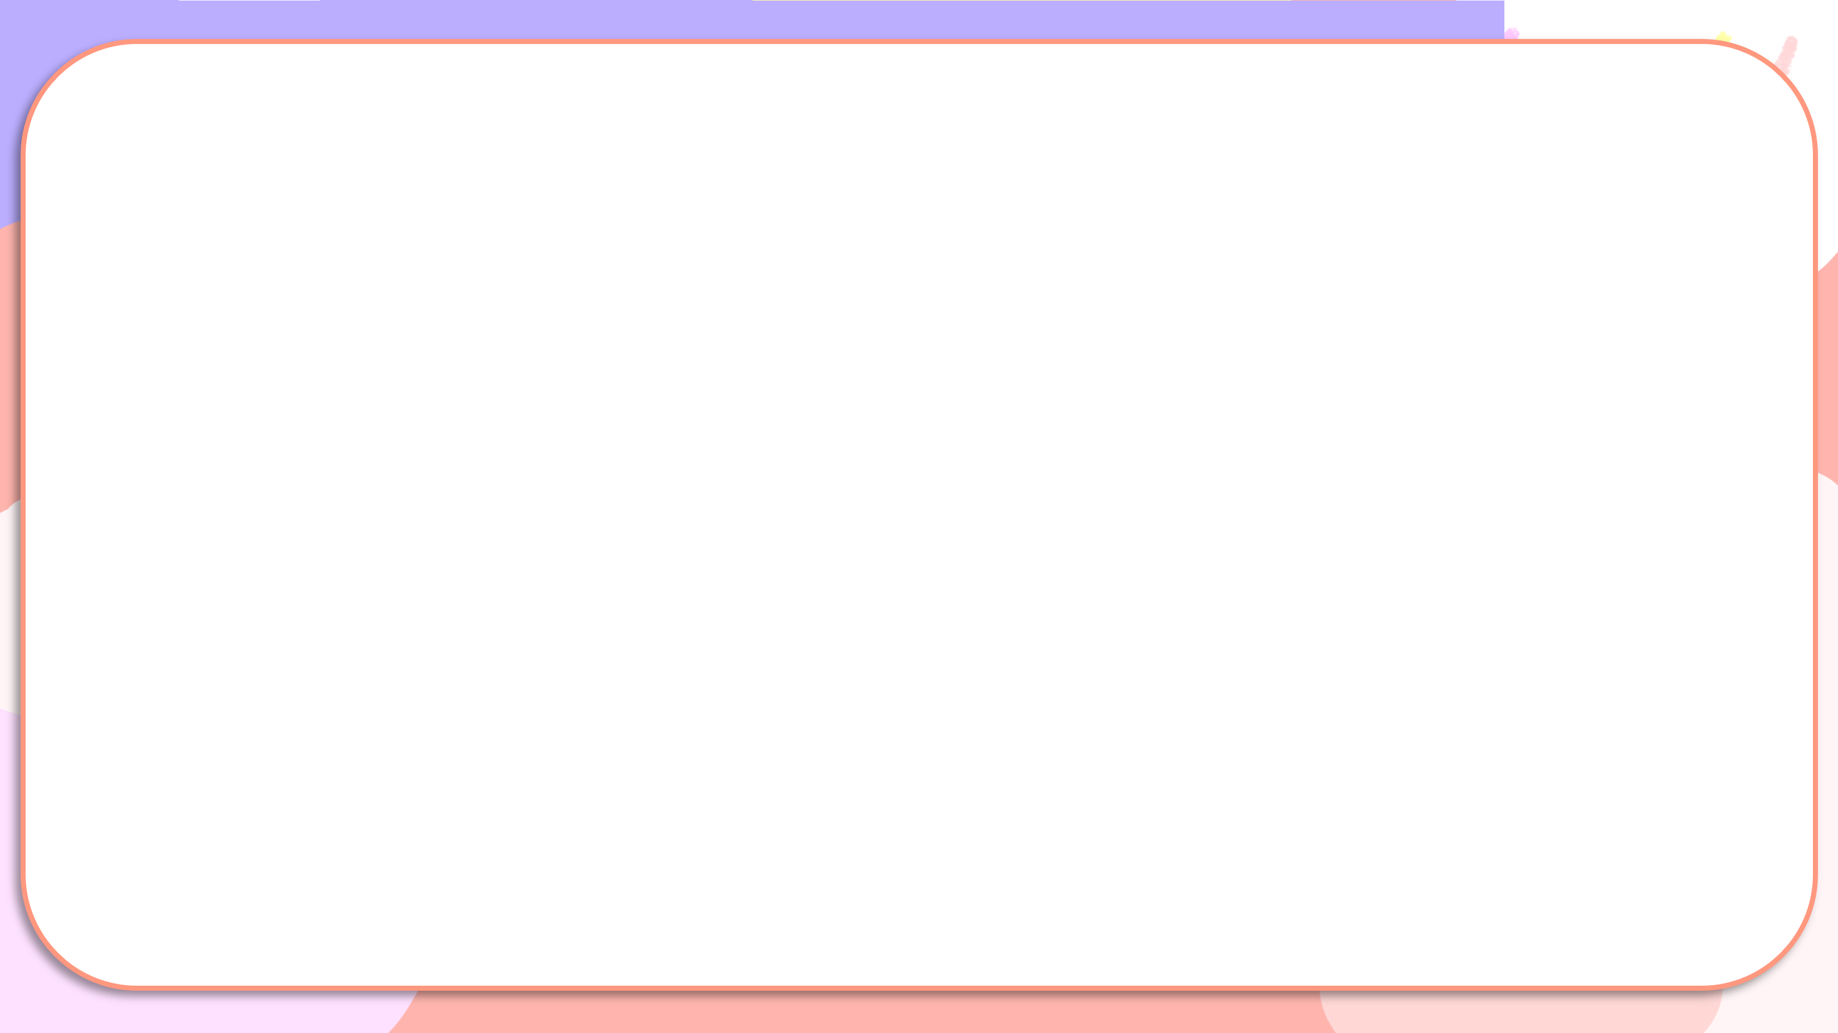
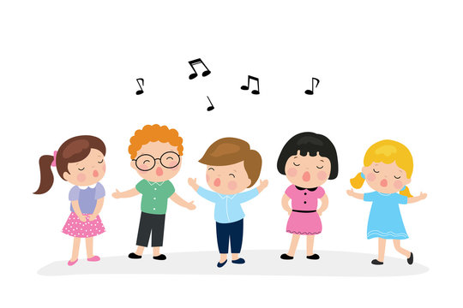
What did you do?
Where were you yesterday?
I was at the campsite.
What did you do there?
I played the guitar.
I played the guitar at the campsite.
Where were you yesterday?
We were at the farm.
What did you do there?
We planted trees.
We planted trees at the farm.

Slide 6
What did you do?
Notes:
HS hát với nhạc

Slide 7
02
Activity 1. Listen and repeat.

Slide 8

Listen and repeat.
'
cinema
I was at the cinema yesterday.
'

Slide 9
Listen and repeat.
'
'
bakery
We were at the bakery yesterday.

Slide 10
Listen and repeat.
'
cinema
I was at the cinema yesterday.
'
'
'
bakery
We were at the bakery yesterday.

Slide 11
03
Activity 2.
Circle, listen and check.

Slide 12
Circle, listen and check.
1.
a. bakery
b. tomorrow
c. pagoda
2.
a. cinema
b. October
c. tomorrow
3.
a. bakery
b. stadium
c. afternoon

Slide 13
Circle, listen and check.
1.
a. bakery
b. tomorrow
c. pagoda

Slide 14
Circle, listen and check.
2.
a. cinema
b. October
c. tomorrow

Slide 15
Circle, listen and check.
3.
a. bakery
b. stadium
c. afternoon

Slide 16
Circle, listen and check.
1.
a. bakery
b. tomorrow
c. pagoda
2.
a. cinema
b. October
c. tomorrow
3.
a. bakery
b. stadium
c. afternoon

Slide 17
04
Activity 3. Let’s chant.

Slide 18
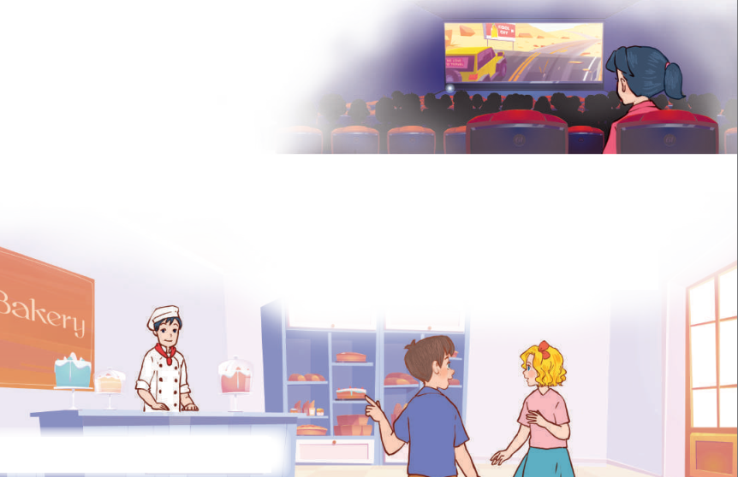
Let’s chant.
Yesterday, I was at the cinema.
I wanted to watch a film.
The film was interesting.
I liked the film.
Yesterday, we were at the bakery.
We wanted to buy some cakes.
The cakes were delicious.
We loved the cakes.

Slide 19
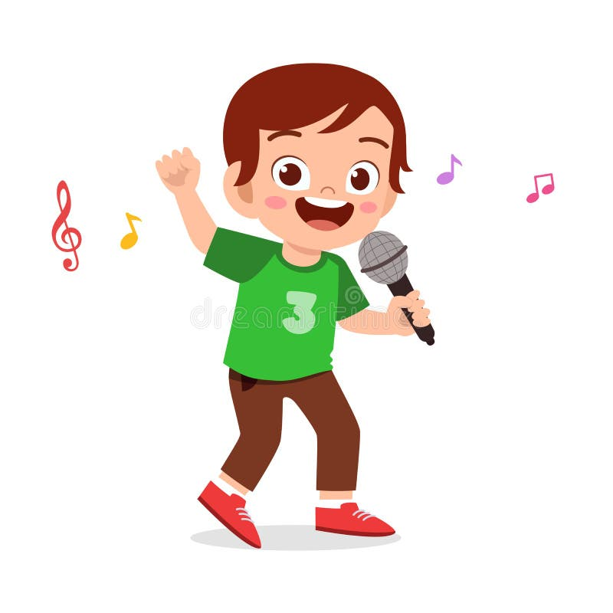

Let’s chant.
Yesterday, I was at the cinema.
I wanted to watch a film.
The film was interesting.
I liked the film.
Yesterday, we were at the bakery.
We wanted to buy some cakes.
The cakes were delicious.
We loved the cakes.

Slide 20
05
Fun corner and Wrap-up

Slide 21

Notes:
Cách chơi: Chia lớp thành 2 đội chơi, Cho phát âm thanh kèm xuất hiện từ.
Đội 1 nếu trọng âm rơi vào âm đầu thì đứng lên không phải thì ngồi
Đội 2 nếu trọng âm rơi vào âm tiết thứ 2 thì đứng lên không phải thì ngồi.
Nếu tất cả HS cùng đúng thì được cộng điểm.

Slide 22

'
bakery

Slide 23
'
delicious

Slide 24
'
guitar

Slide 25
'
interesting

Slide 26
'
yesterday

Slide 27
'
October

Slide 28
'
cinema

Slide 29


Very Good!

