Slide 1
Wednesday, December 25th 2024
Unit
10
Break time
activities
Lesson 1

Slide 2
Warm-up

Slide 3
Find the correct picture.
1
2
3
4
blue

Slide 4
Find the correct picture.
1
2
3
4
green

Slide 5
Find the correct picture.
1
2
3
4
orange

Slide 6
Find the correct picture.
1
2
3
4
It’s yellow.

Slide 7
Find the correct picture.
1
2
3
4
It’s red.

Slide 8
Find the correct picture.
1
2
3
4
It’s blue.

Slide 9
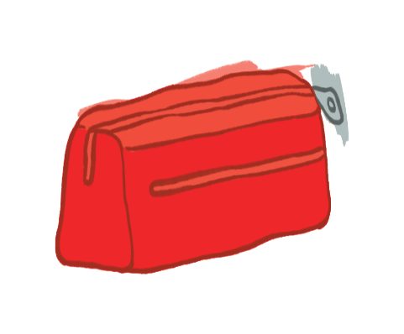
Find the correct picture.
1
2
3
4
It’s brown.

Slide 10
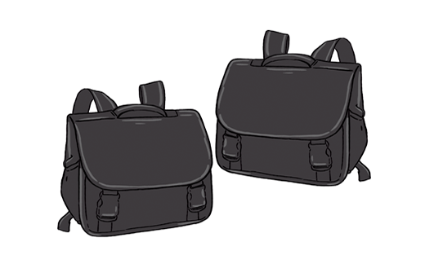
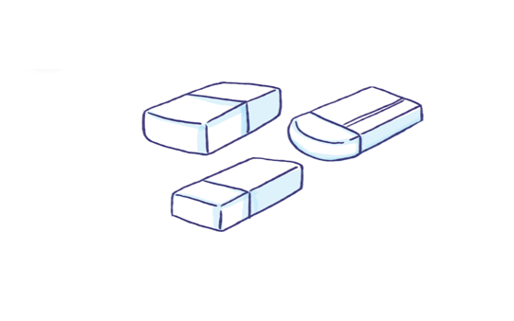
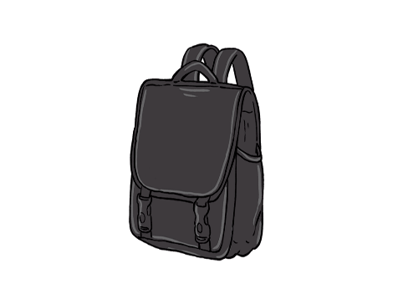
Find the correct picture.
1
2
3
4
They’re black.

Slide 11
Find the correct picture.
1
2
3
4
They’re orange.

Slide 12
Find the correct picture.
1
2
3
4
They’re green.

Slide 13
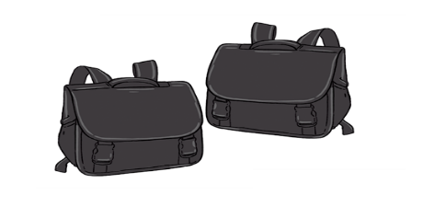
Find the correct picture.
1
2
3
4
They’re white.

Slide 14
Thank you!

Slide 15
Contents
Facebook : Bùi Liễu
0968142780
Listen and repeat.
Listen, point and say.
Let’s chant.
Listen and tick.
Look, complete and read.
Project.
Notes:
Facebook : Bùi Liễu
Mobile phone: 0968142780

Slide 16
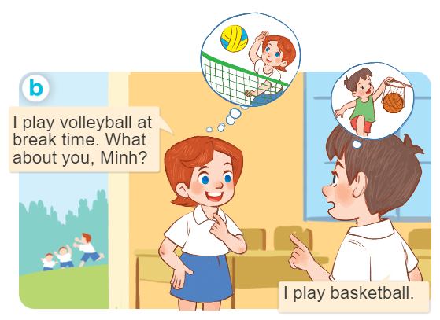
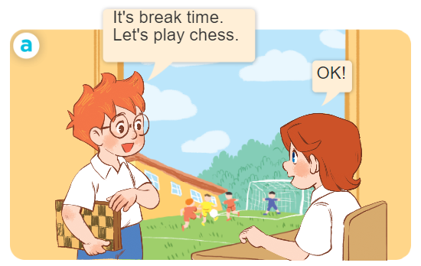
1. Look, listen and repeat.
Who are they?
Where are they?
What are they doing?
Notes:
Facebook : Bùi Liễu
Mobile phone: 0968142780

Slide 17
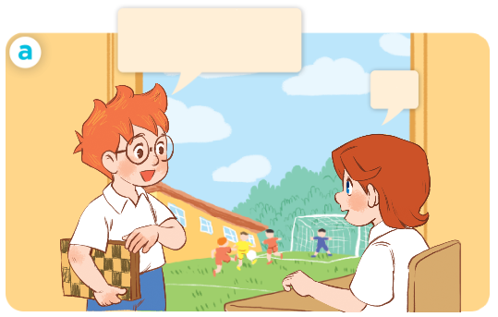
1. Look, listen and repeat.
It’s break time.
Let’s play chess.
Facebook : Bùi Liễu
0968142780
OK.

Slide 18
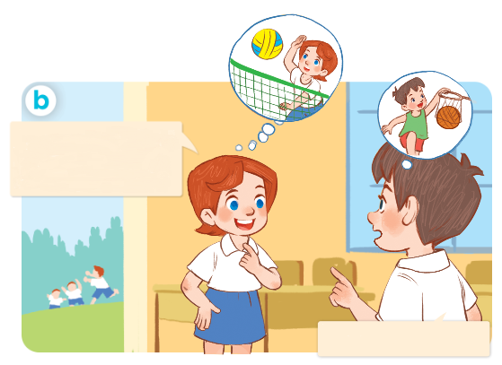
1. Look, listen and repeat.
Facebook : Bùi Liễu
0968142780
I play volleyball at break time. What about you, Minh?
I play basketball.
Notes:
Facebook : Bùi Liễu
Mobile phone: 0968142780

Slide 19
Vocabulary

Slide 20
Vocabulary
break time
/ˈbreɪk taɪm/
giờ ra chơi

Slide 21
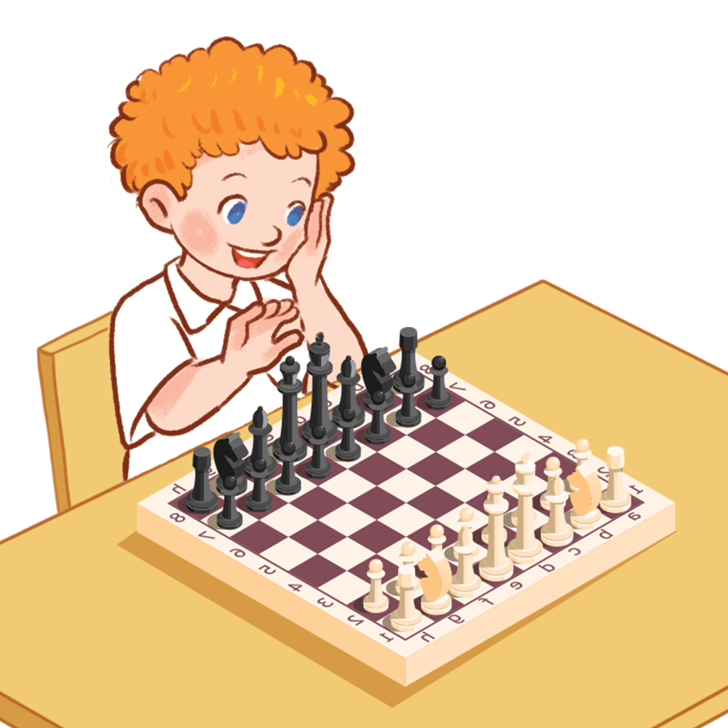
Vocabulary
play chess
/pleɪ tʃes/
chơi cờ
Notes:
Facebook : Bùi Liễu
Mobile phone: 0968142780

Slide 22
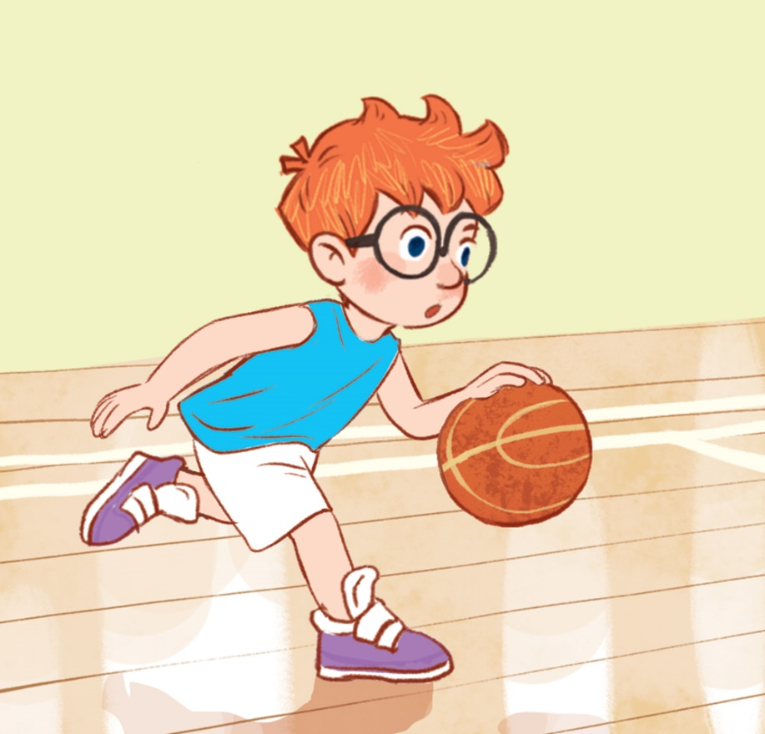
Vocabulary
play basketball
/pleɪ ˈba:skɪtbɔ:l/
chơi bóng rổ

Slide 23
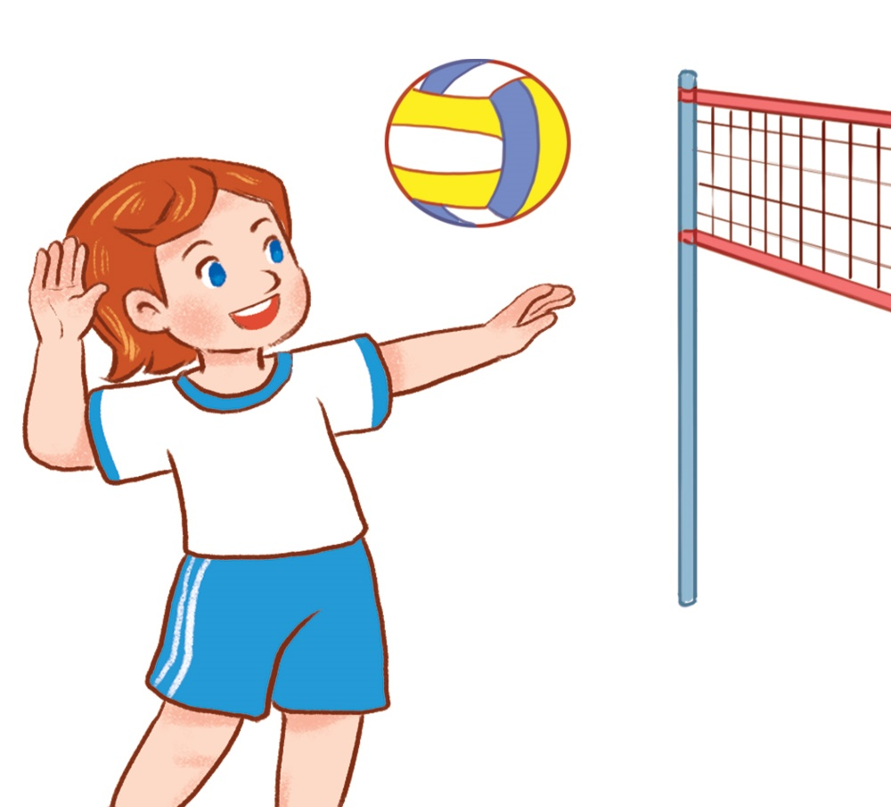
Vocabulary
play volleyball
/pleɪ /ˈvɒl.i.bɔːl/
chơi bóng chuyền
Notes:
Facebook : Bùi Liễu
Mobile phone: 0968142780

Slide 24
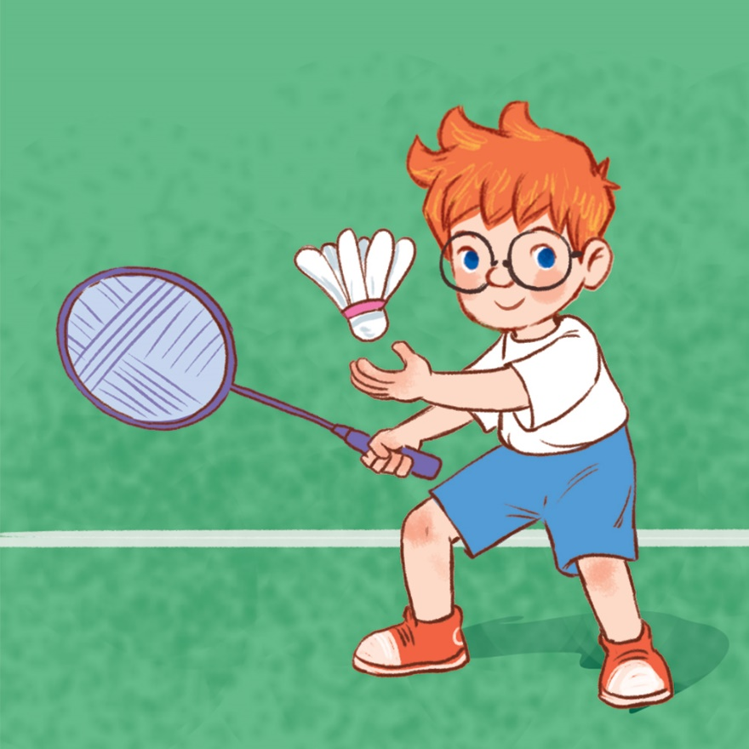
Vocabulary
play badminton
/pleɪ ˈbædmɪntən/
chơi cầu lông

Slide 25
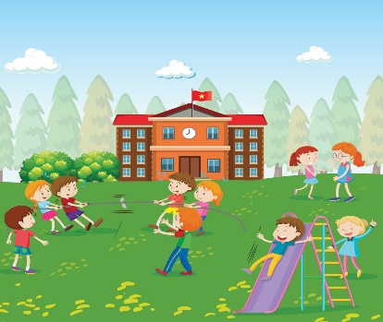
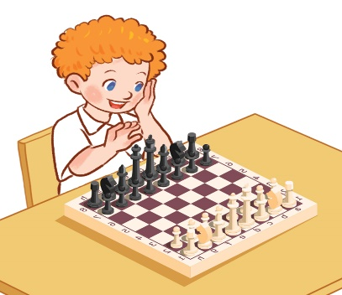
Review
break time
play chess
play basketball
play volleyball
play badminton
Notes:
Facebook : Bùi Liễu
Mobile phone: 0968142780

Slide 26
Vocabulary
break time : giờ ra chơi
play chess: chơi cờ
play basketball: chơi bóng rổ
play volleyball: chơi bóng chuyền
play badminton: chơi cầu lông

Slide 27
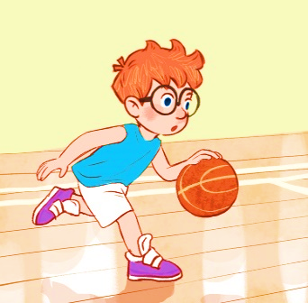
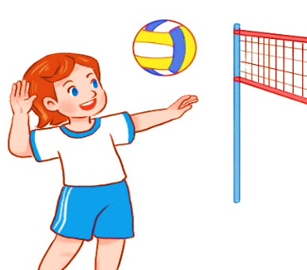
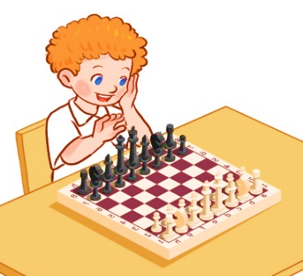
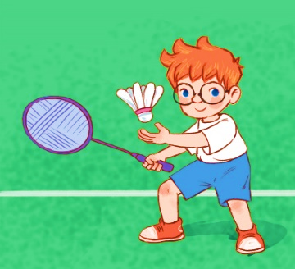
Checking vocabulary
Match the pictures with the words.
1
2
3
4
5
a. play
basketball
b. play
volleyball
c. play
chess
d. play
badminton
e.
break time

Slide 28
Structures
Notes:
Facebook : Bùi Liễu
Mobile phone: 0968142780

Slide 29
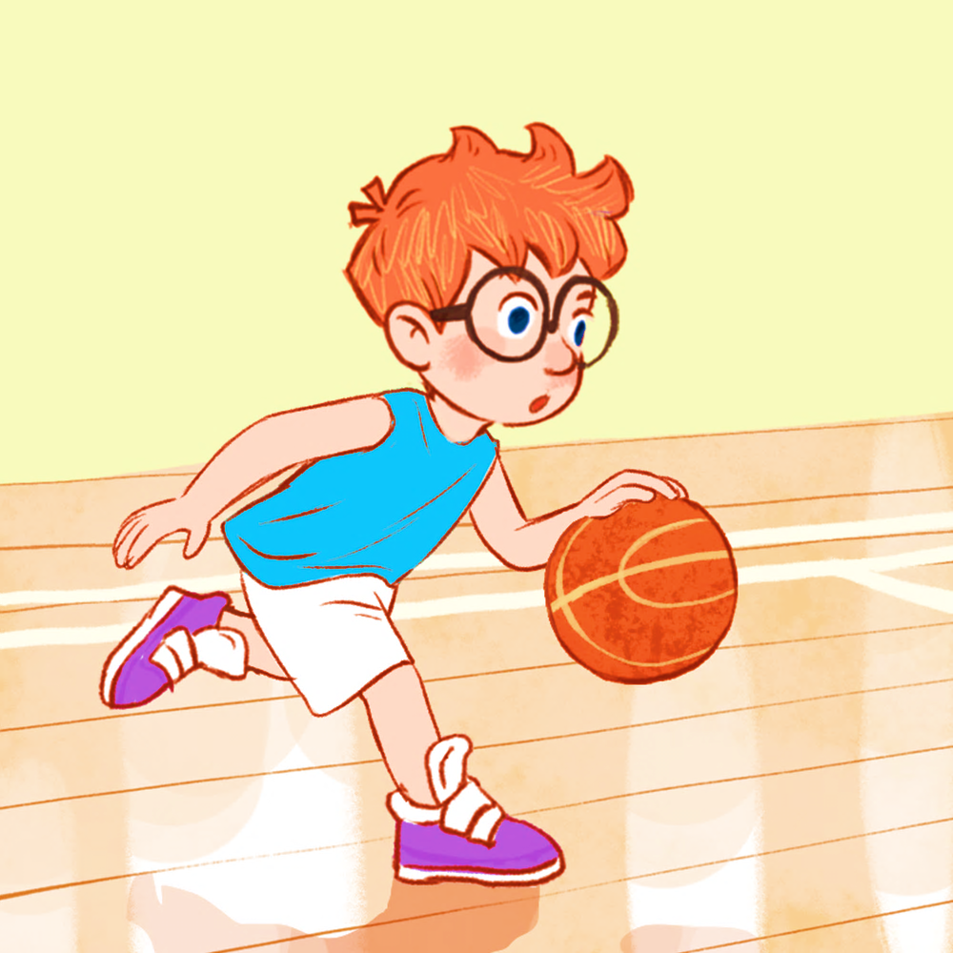
Structures
Khi muốn nói mình làm gì vào giờ ra chơi, các em nói:
- I ______ at break time.
(Tớ ____vào giờ ra chơi.)
Example:
I play basketball.

Slide 30
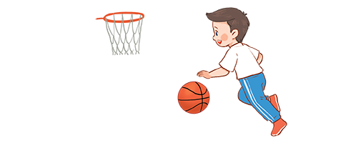
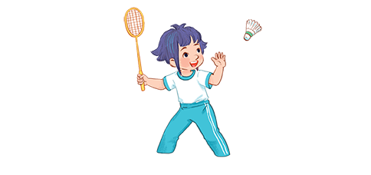
2. Listen, point and say.
a
b
I ______ at break time.
play chess
play volleyball
c
d
play basketball
play badminton

Slide 31
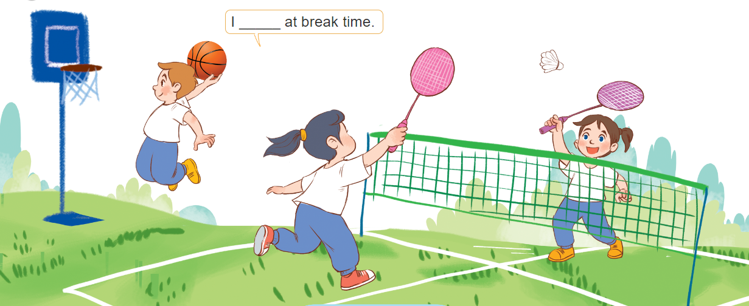
3. Let’s talk.
I ____ at break time .

Slide 32
Let’s play!
Notes:
Facebook : Bùi Liễu
Mobile phone: 0968142780

Slide 34
I __________ at break time.
A. play volleyball
B. play basketball
C. play badminton

Slide 35
I __________ at break time.
A. play chess
B. play badminton
C. play volleyball

Slide 36
I __________ at break time.
A. play badminton
B. play chess
C. play volleyball

Slide 37
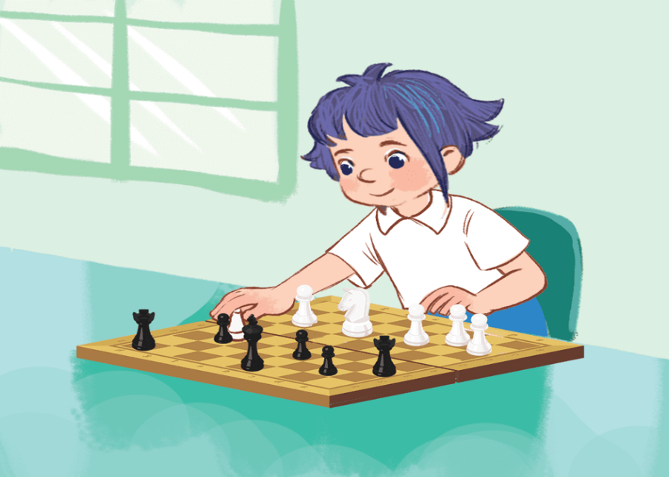
I __________ at break time.
A. play chess
B. play volleyball
C. play basketball

Slide 38
I play basketball ___ break time.
A. on
B. in
C. at

Slide 39
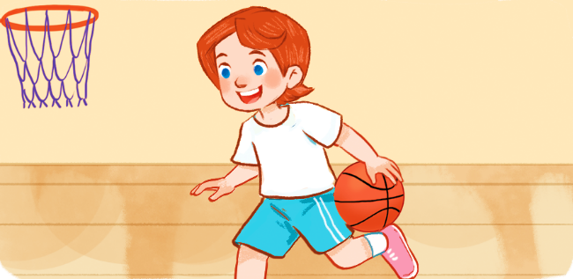
I ___ basketball at break time.
A. plays
B. play

Slide 40
I play chess at _________.
A. break time
B. time break

Slide 42
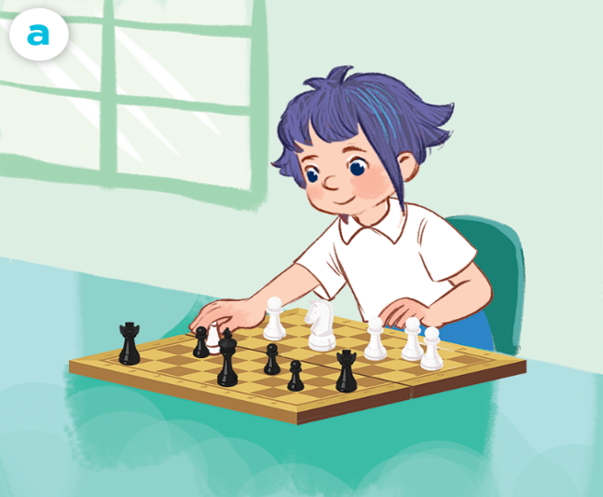
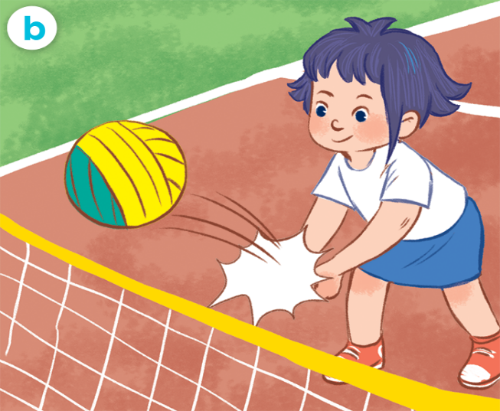
4. Listen and tick.
a
b
1
a
b
2
Notes:
Facebook : Bùi Liễu
Mobile phone: 0968142780

Slide 43
5. Look, complete and read.
____________
________
____________
____________
Notes:
Facebook : Bùi Liễu
Mobile phone: 0968142780

Slide 44
6. Let’s sing.
It’s break time.
Notes:
Facebook : Bùi Liễu
Mobile phone: 0968142780

Slide 45
6. Let’s sing.
It’s break time.
Notes:
Facebook : Bùi Liễu
Mobile phone: 0968142780

Slide 46
Wrap up

Slide 47
Vocabulary
break time
play chess
play basketball
play volleyball
play badminton
Notes:
Facebook : Bùi Liễu
Mobile phone: 0968142780

Slide 48
Structures
Khi muốn nói mình làm gì vào giờ ra chơi, các em nói:
- I ______ at break time.
(Tớ ____vào giờ ra chơi.)
Example:
I play basketball.

Slide 49
Homework
Learn by heart all the new words.
Read again the dialogue in part 1.

Slide 50
Thank you!
Notes:
Facebook : Bùi Liễu
0968142780

