Slide 1
Unit
10
Break time
activities
Lesson 2

Slide 2


Warm-up

Slide 3





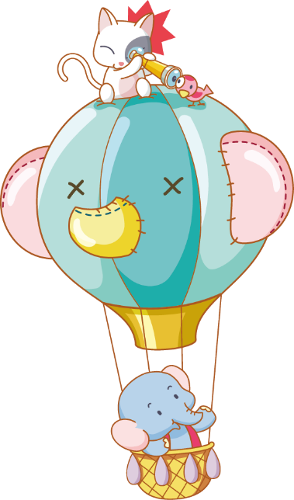





Luật chơi:
Chia lớp thành 2 đội
Bấm nút để quay, màu để dừng
Trả lời đúng được cộng điểm, nhường quyền trả lời cho đội bạn.
Kết thúc trò chơi đội nhiều điểm hơn sẽ chiến thắng.
PLAY

Slide 4

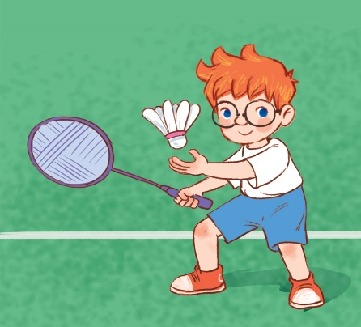



27
I ________ at break time.
20
I play badminton.
I play chess.
A.
B.
QUESTION
I play volleyball.
I play basketball.
C.
D.

Slide 5
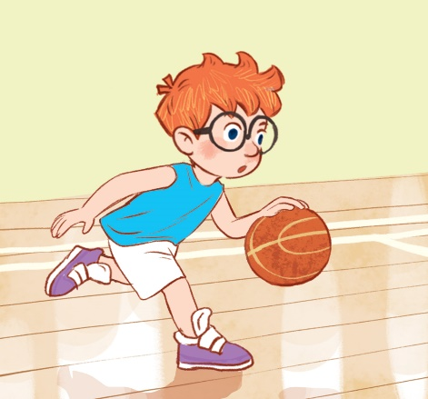
I _______ at break time.
10
I play volleyball.
I play basketball.
A.
B.
QUESTION
I play chess.
I play badminton.
C.
D.

Slide 6
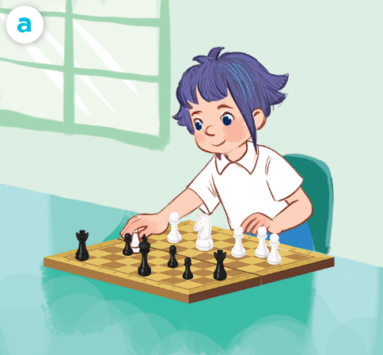
I _________ at break time.
10
I play basketball.
I play volleyball.
A.
B.
QUESTION
I play badminton.
I play chess.
C.
D.

Slide 7
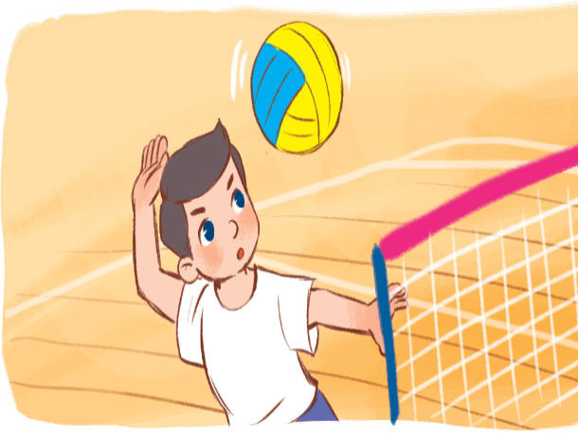
I ________ at break time.
20
I play chess.
B.
I play basketball.
A.
QUESTION
I play volleyball.
I play badminton.
C.
D.

Slide 8
I ____ chess.
20
play
plays
A.
B.
QUESTION
I’m American.
I’m American.
C.
D.

Slide 9
I play volleyball ___ break time.
10
in
at
A.
B.
QUESTION

Slide 10

Notes:
.

Slide 11






Contents
Look, listen and repeat.
Listen, point and say.
Let’s chant.
Listen and number.
Read and match.
Let’s play.
Notes:
Facebook : Bùi Liễu
Mobile phone: 0968142780

Slide 12
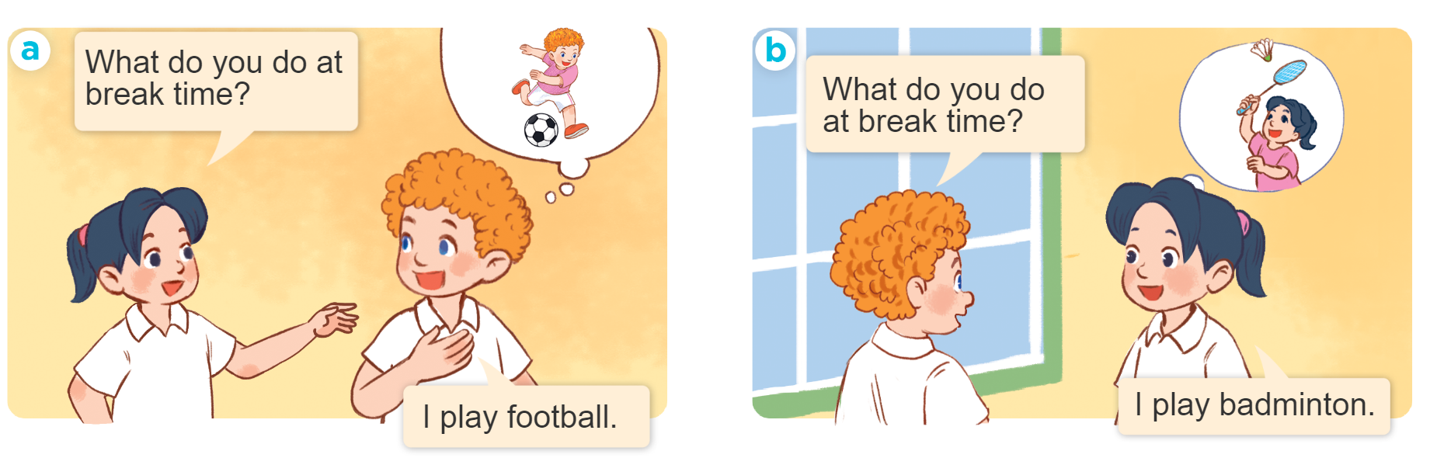
1. Look, listen and repeat.
Who are they?
Where are they?
What are they doing?
Notes:
Facebook : Bùi Liễu
Mobile phone: 0968142780

Slide 13
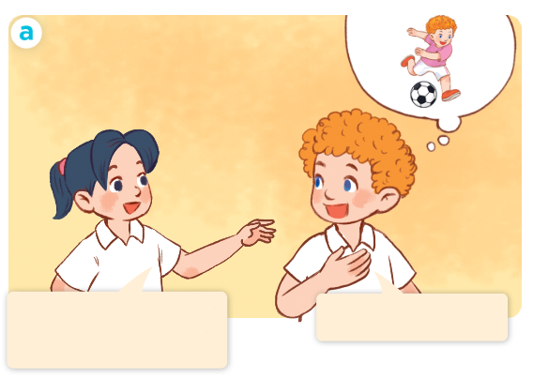
1. Look, listen and repeat.
Click on the sentences to hear the sound.
I play football.
What do you do at break time?

Slide 14
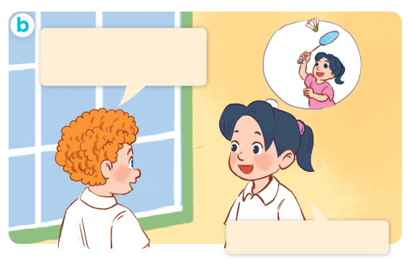
1. Look, listen and repeat.
What do you do
at break time?
I play badminton.
Click on the sentences to hear the sound.
Notes:
Facebook : Bùi Liễu
Mobile phone: 0968142780

Slide 15
Vocabulary

Slide 16
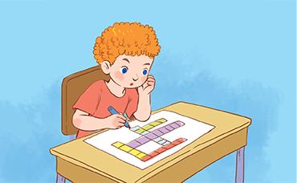


Vocabulary
do word puzzles
/dʊ wɜːd ˈpʌzəlz/
chơi trò chơi ô chữ

Slide 17
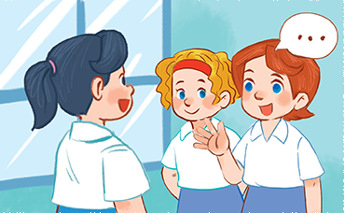
Vocabulary
chat with
my friends
/ʧæt wɪð maɪ frendz/
nói chuyện với các bạn

Slide 18
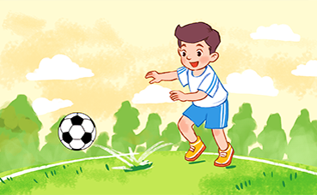
Vocabulary
play football
/pleɪ ˈfʊtbɔːl/
chơi đá bóng

Slide 19
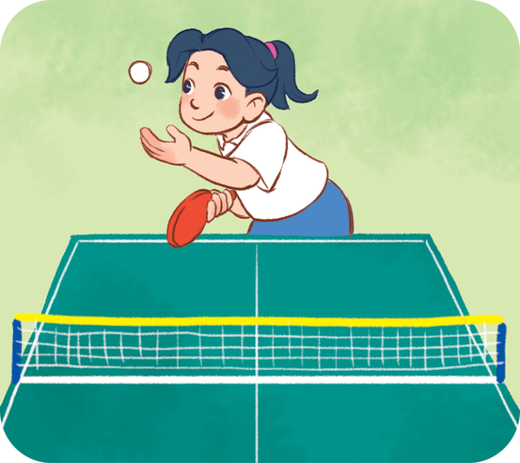
Vocabulary
play
table tennis
/pleɪ ˈteɪbəl ˈtenɪs/
đánh bóng bàn

Slide 20
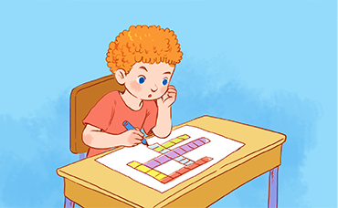
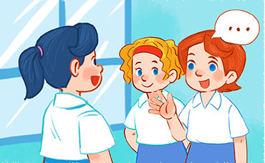
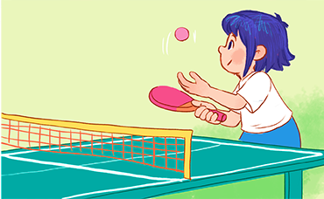
Review
do word puzzles
chat with my friends
play football
play table tennis

Slide 21
Vocabulary
do word puzzles : chơi trò chơi ô chữ
chat with my friends: nói chuyện với các bạn
play football: chơi đá bóng
play table tennis: đánh bóng bàn

Slide 22
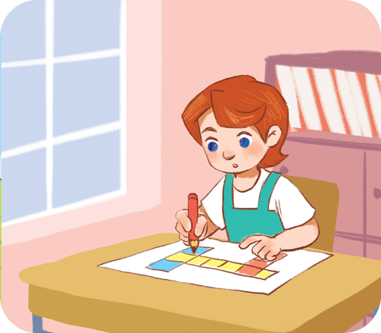
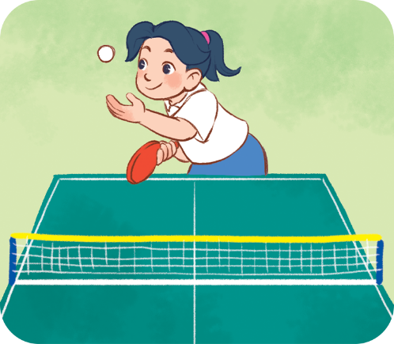
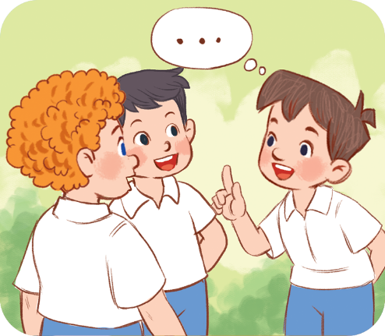
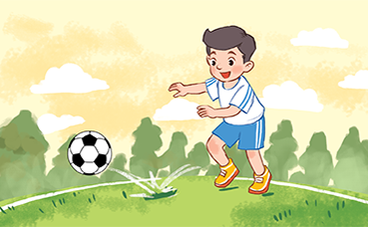
Checking vocabulary
Match the pictures with the words.
1
2
3
4
do w_rd puzzl_s
ch_t with my fri_nds
o
e
a
e
pl_y tabl_ tenn_s
pl_y fo_tb_ll
a
e
i
a
o
a

Slide 23
Structures

Slide 24
Structures
Khi muốn hỏi bạn làm gì vào giờ ra chơi, các em hỏi:
What do you do at your break time?
I ______________.
(Bạn làm gì vào giờ ra chơi?)
(Tớ ___.)
Example:

Slide 25
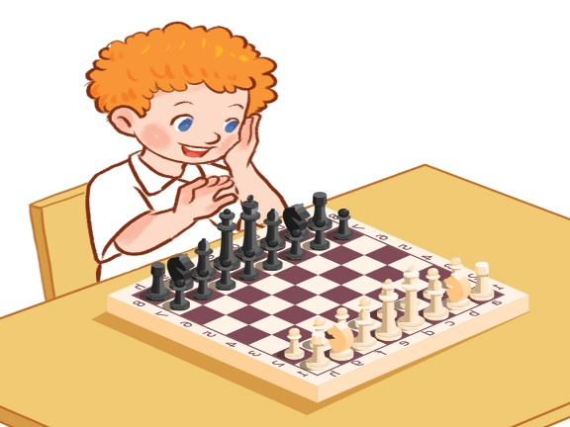
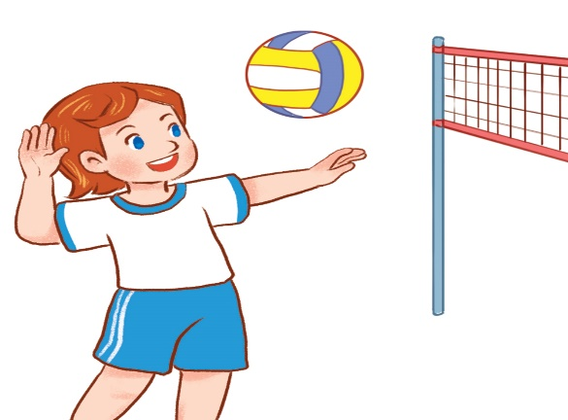
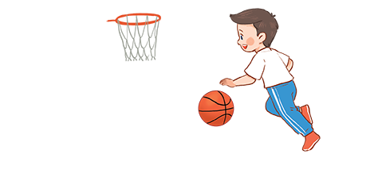
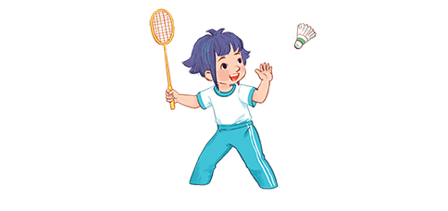
2. Listen, point and say.
a
b
I ______ at break time.
play chess
play volleyball
c
d
play basketball
play badminton

Slide 26
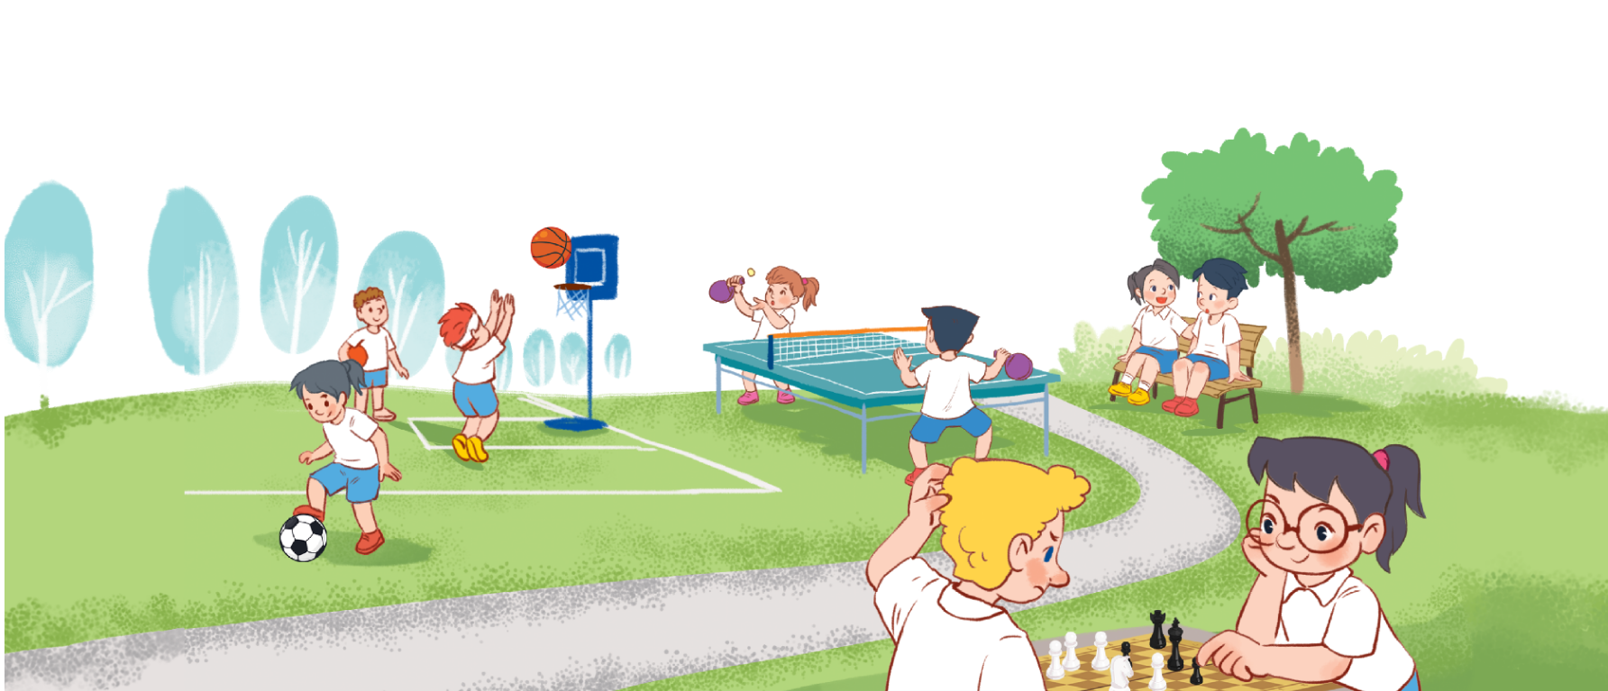
3. Let’s talk.
What do you do at break time?
_______

Slide 27

Let’s play!

Slide 28






Click hình chú Thỏ hoặc chú Rùa khi chọn đáp án.

Slide 29
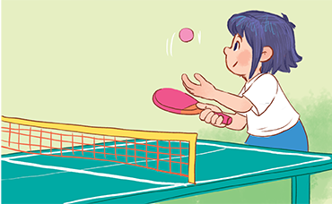

What do you do at your break time?
I __________________.
A. play table tennis
B. play badminton

Slide 30
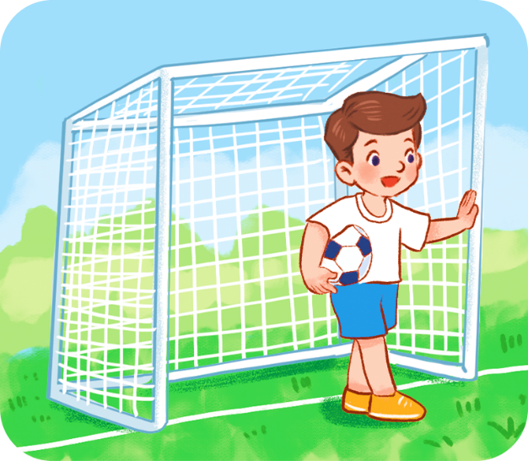
What do you do at your break time?
I __________________.
A. play volleyball
B. play football

Slide 31

What do you do at your break time?
I __________________.
A. do word puzzles
B. play chess

Slide 32

What do you do ___ your break time?
A. at
B. in

Slide 33

What do you do at your break time?
I __________________.
A. play basketball
B. chat with my friends

Slide 34

What do you do at your break time?
I _______________.
A. does word puzzles
B. do word puzzles.

Slide 35
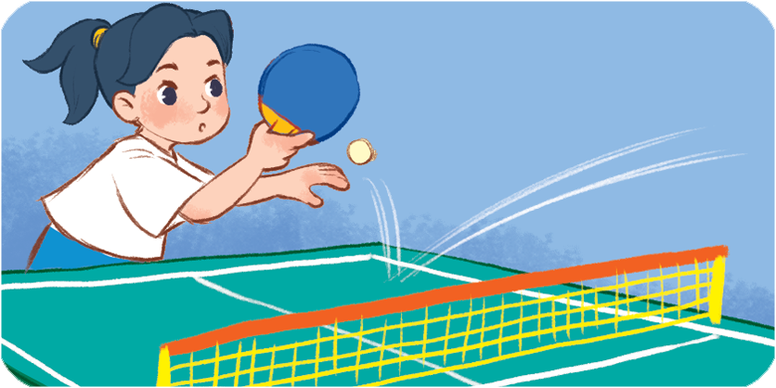
What do you do at your break time?
I ________ table tennis.
A. plays
B. play

Slide 36
What do you do at your ______?
A. break time.
B. time break.

Slide 37


Slide 38

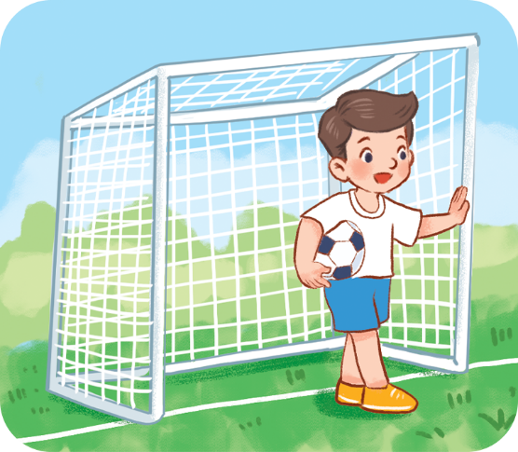


4. Listen and number.
2
4
3
1
a
b
c
d

Slide 39
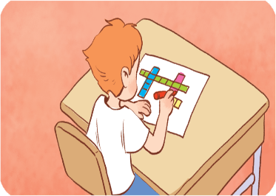
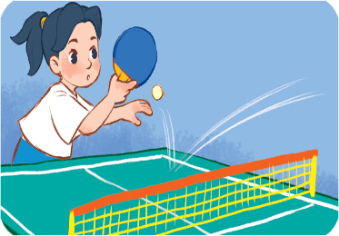
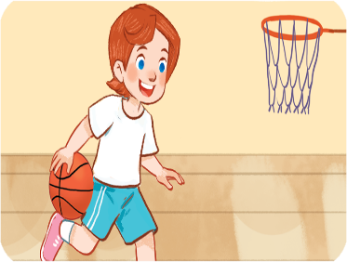
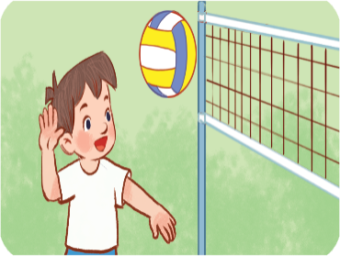
5. Read and match.
a
1. I play table tennis.
b
2. I play basketball.
c
3. I play volleyball.
4. I do word puzzles.
d
1 - b
2 - c
3 - d
4 - a

Slide 40
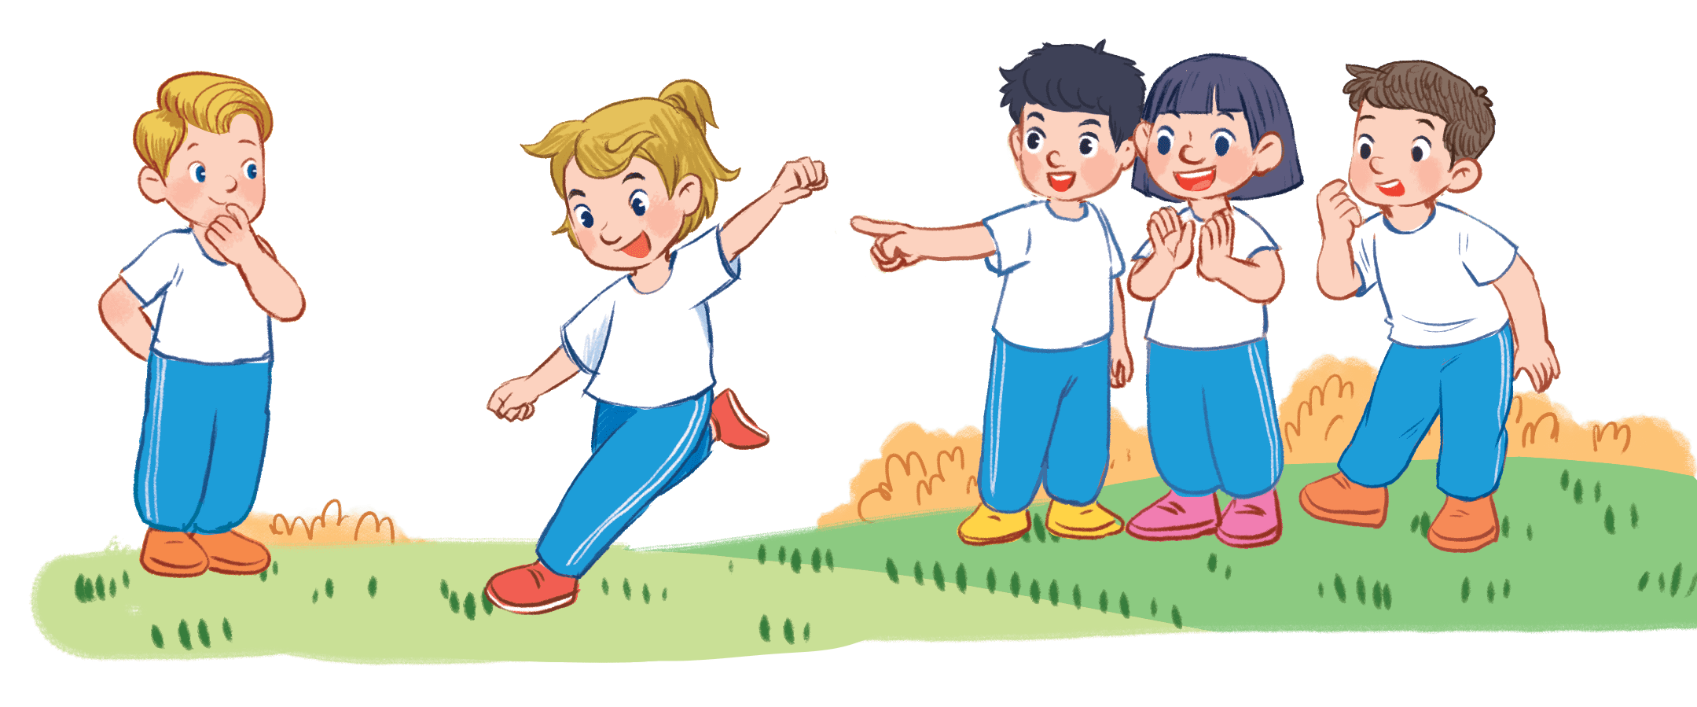
6. Let’s play.
Miming game
play football
Notes:
Facebook : Bùi Liễu
Mobile phone: 0968142780

Slide 41

Wrap up

Slide 42
Vocabulary
do word puzzles
chat with my friends
play football
play table tennis

Slide 43
Structures
Khi muốn hỏi bạn làm gì vào giờ ra chơi, các em hỏi:
What do you do at your break time?
I ______________.
(Bạn làm gì vào giờ ra chơi?)
(Tớ ___.)
Example:

Slide 44
Homework
Learn by heart all the new words.
Read again the dialogue in part 1.

Slide 45

Thank you!

