Slide 1
Unit
10
Break time
activities
Lesson 3

Slide 2


Warm-up

Slide 3

Let’s play!
Notes:
Facebook : Bùi Liễu
Mobile phone: 0968142780

Slide 4
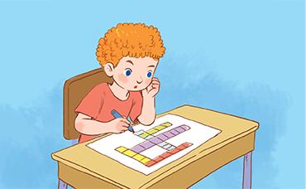
I _____________ at break time.
5
3
1
4
6
9
7
2
0
10
8
Question 1/8
Click the clock to start the timer.
Time out
A. do word puzzles.
B. play chess.
C. chat with my friends.
D. play football.
Notes:
Click the clock to start the timer.

Slide 5
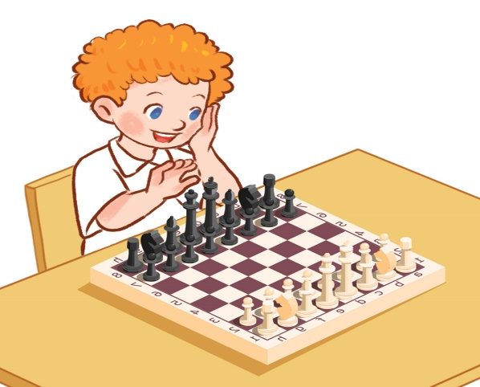
I _____________ at break time.
5
3
1
4
6
9
7
2
0
10
8
Question 2/8
Click the clock to start the timer.
Time out
A. play volleyball.
B. play badminton.
C. play chess.
D. play table tennis.
Notes:
Click the clock to start the timer.

Slide 6
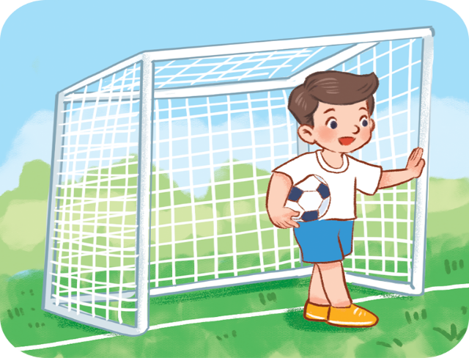
I _____________ at break time.
5
3
1
4
6
9
7
2
0
10
8
Question 3/8
Click the clock to start the timer.
Time out
A. play football.
B. play badminton.
C. play table tennis.
D. play chess.
Notes:
Click the clock to start the timer.

Slide 7
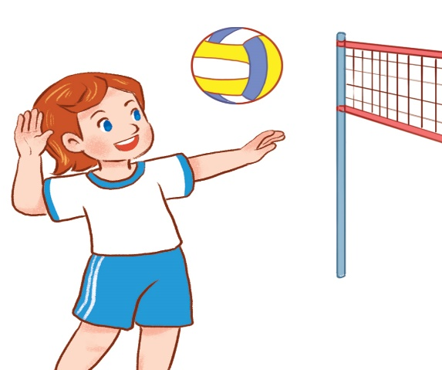
What do you do at break time?
5
3
1
4
6
9
7
2
0
10
8
Question 4/8
Click the clock to start the timer.
Time out
A. I play basketball.
B. I play volleyball.
C. I play badminton.
D. I play table tennis.
Notes:
- Click the clock to start the timer.

Slide 8
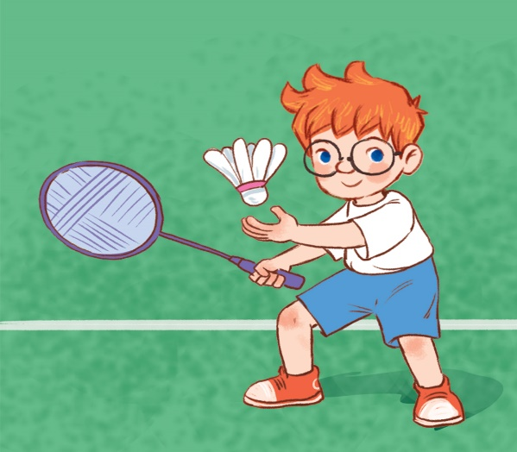
What do you do at break time?
5
3
1
4
6
9
7
2
0
10
8
Question 5/8
Click the clock to start the timer.
Time out
A. I play football.
B. I chat with my friends.
C. I do word puzzles.
D. I play badminton.
Notes:
Click the clock to start the timer.

Slide 9
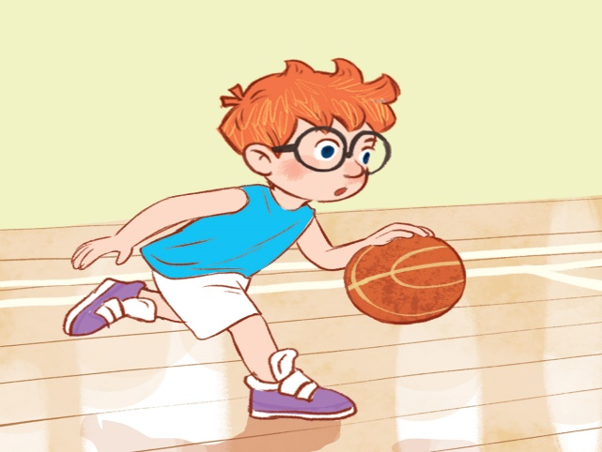
I _____________ at break time.
5
3
1
4
6
9
7
2
0
10
8
Question 6/8
Click the clock to start the timer.
Time out
A. play badminton.
B. play football.
C. play basketball.
D. play table tennis.
Notes:
Click the clock to start the timer.

Slide 10
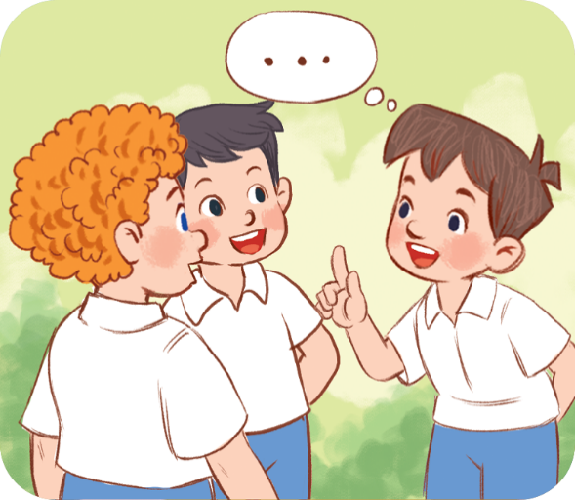
What do you do at break time?
5
3
1
4
6
9
7
2
0
10
8
Question 7/8
Click the clock to start the timer.
Time out
A. I play football.
B. I chat with my friends.
C. I play chess.
D. I play volleyball.
Notes:
- Click the clock to start the timer.

Slide 11
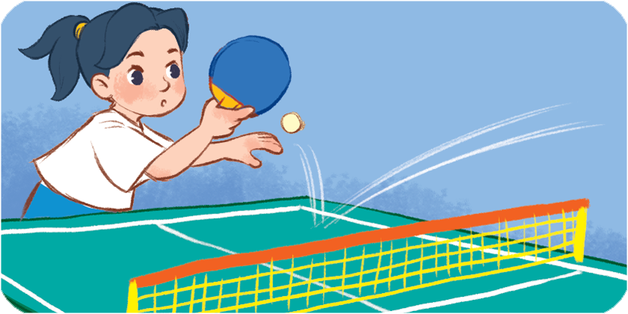

What do you do at break time?
5
3
1
4
6
9
7
2
0
10
8
Question 8/8
Click the clock to start the timer.
Time out
A. I play chess.
B. I play football.
C. I chat with my friends.
D. I play table tennis.
Notes:
Click the clock to start the timer.

Slide 12

Thank you!
Notes:
Facebook : Bùi Liễu
0968142780

Slide 13






Contents
Listen and repeat.
Listen and circle.
Let’s chant.
Read and tick.
Let’s write.
Project.
Notes:
Facebook : Bùi Liễu
Mobile phone: 0968142780

Slide 14

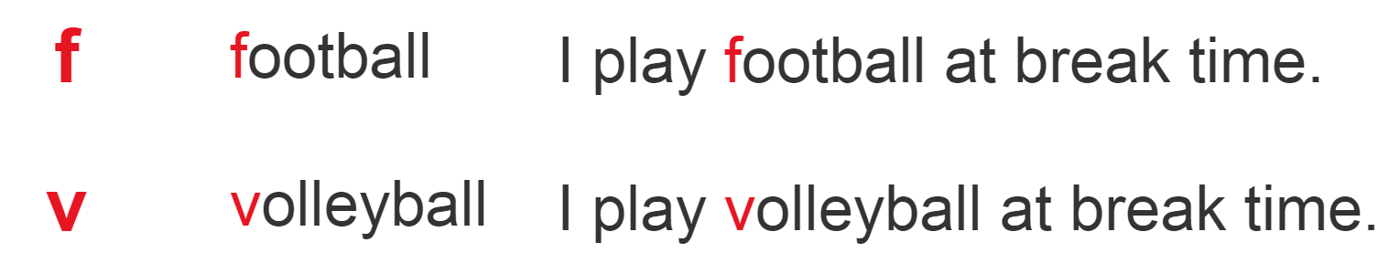
1. Listen and repeat.
Notes:
Facebook : Bùi Liễu
Mobile phone: 0968142780

Slide 15
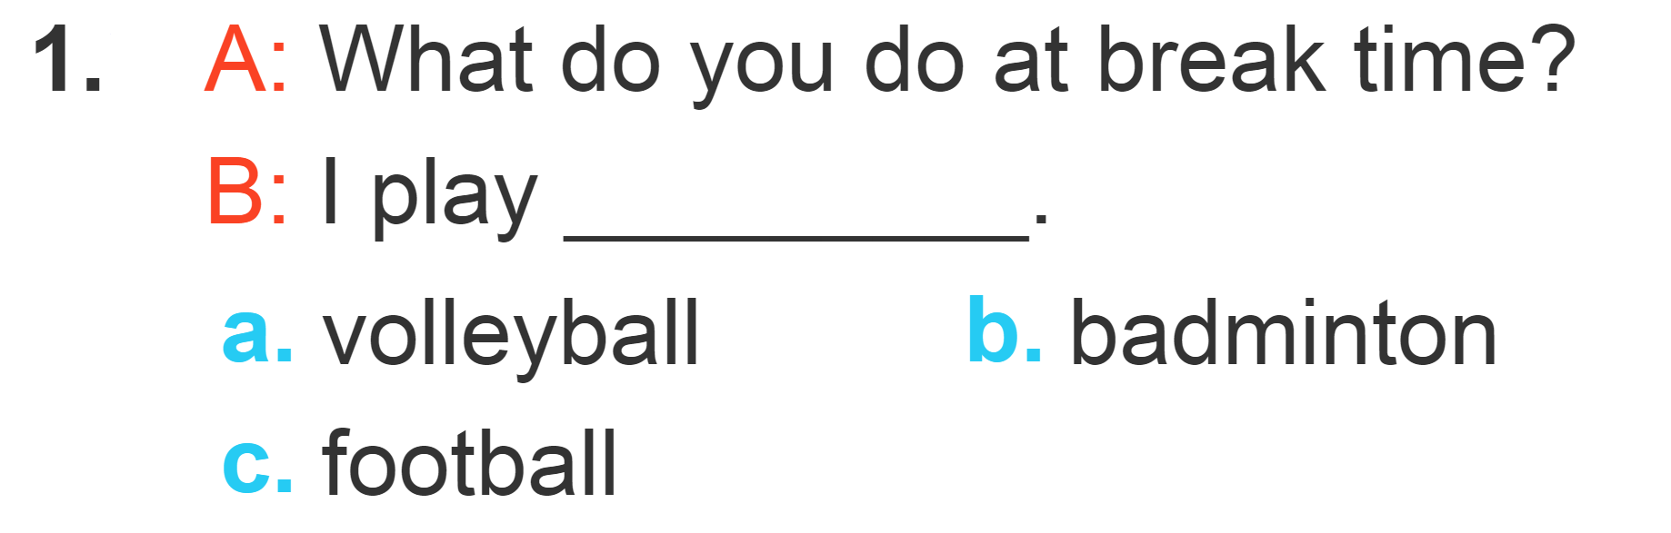
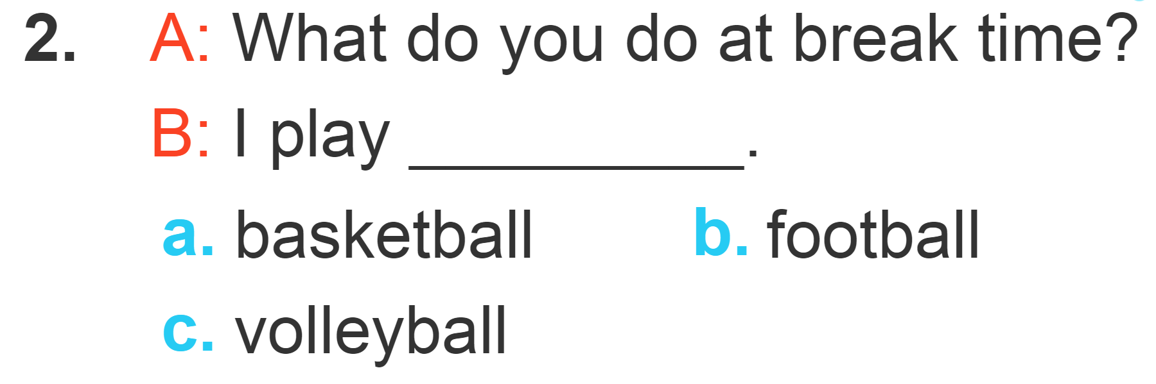
2. Listen and circle.

Slide 16
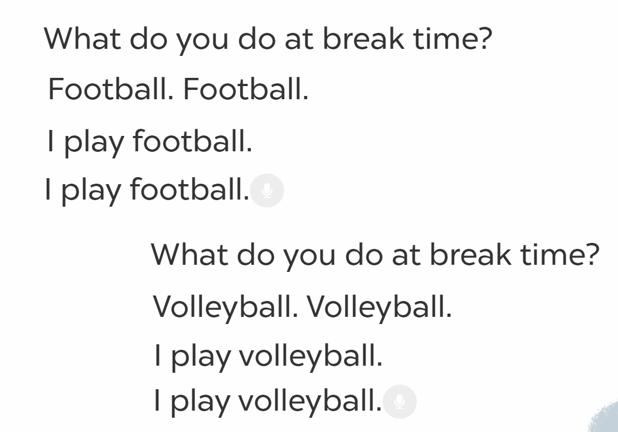
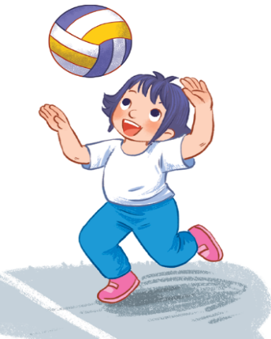

Facebook : Bùi Liễu
Mobile phone: 0968142780
3. Let’s chant.

Slide 17
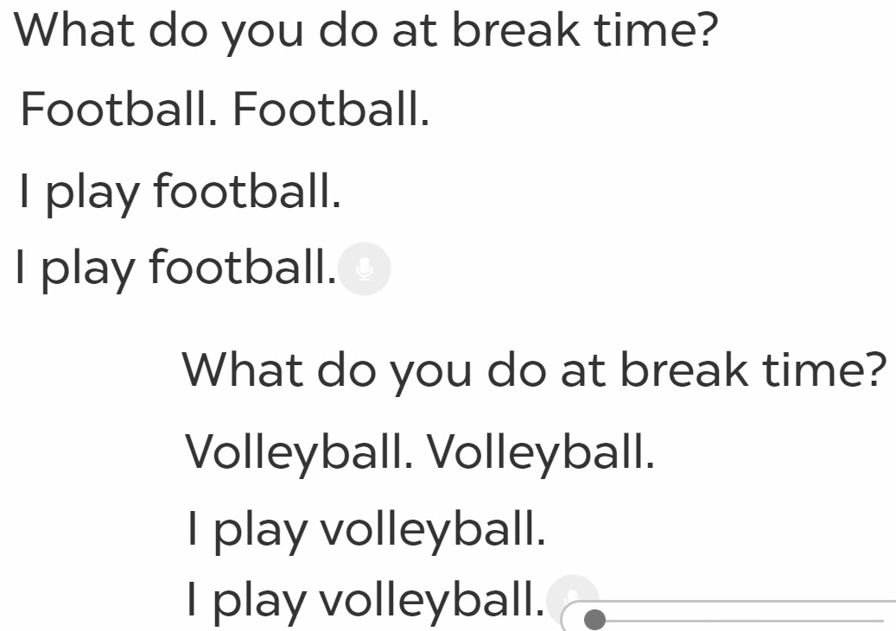

3. Let’s chant.

Slide 18
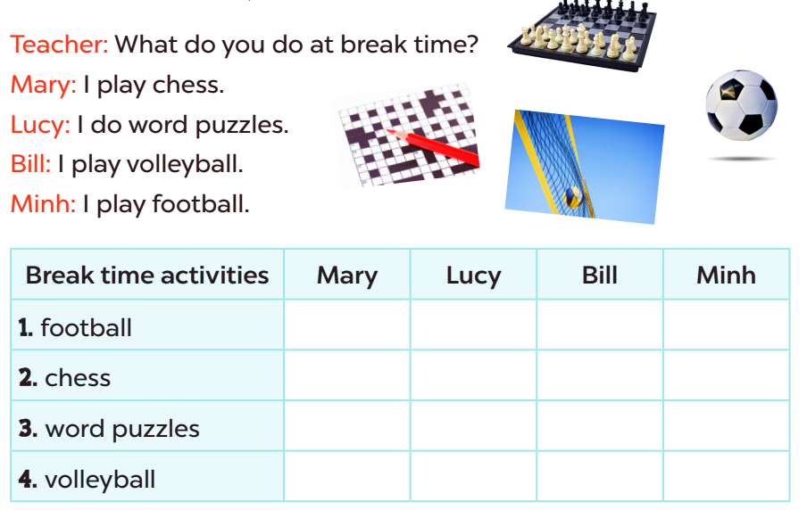

Facebook : Bùi Liễu
Mobile phone: 0968142780
4. Read and tick.
Notes:
Facebook : Bùi Liễu
Mobile phone: 0968142780

Slide 19
Let’s play!
Notes:
Facebook : Bùi Liễu
Mobile phone: 0968142780

Slide 20

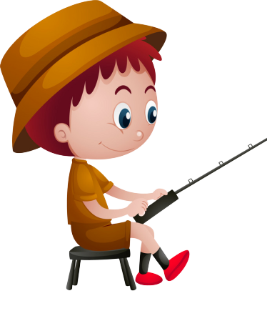


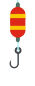

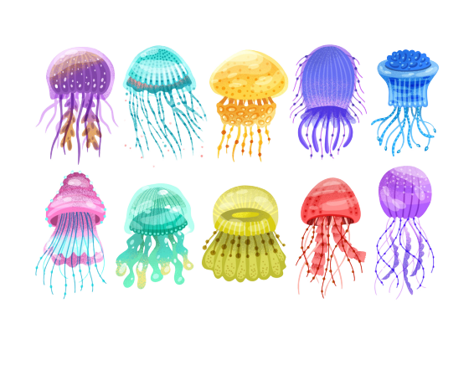




GO FISHING
Game
PLAY

Slide 21












EXIT
7
6
4
2
8
1
5
3
13
Click vào con cá có số để chuyển tới câu hỏi
12
11
14
15

Slide 22

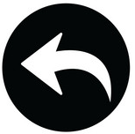
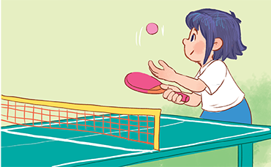

trả lời xong thì nhấn click mũi tên để quay lại chọn con cá
A
play table tennis.
B
play badminton.
C
play football.
D
STOVE
I ______ at break time.

Slide 23

A
play chess.
B
play badminton.
C
play basketball.
D
Climb
I ______ at break time.

Slide 24

A
play basketball
B
play football
C
play table tennis
D
May
I ______ at break time.

Slide 25

A
do word puzzles.
B
play volleyball.
C
play chess.
D
Watch
I ______ at break time.

Slide 26

A
play badminton
B
chat with my friends
What do you do at break time?
I ____________.
C
play chess
D
Next to

Slide 27
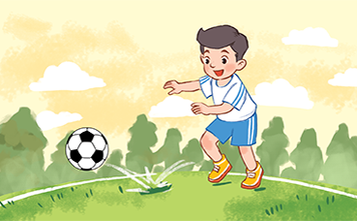
A
play football
B
play basketball
What do you do at break time?
I ____________.
C
play volleyball
D
Next to

Slide 28
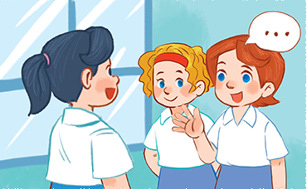
A
play table tennis
B
do word puzzles
What do you do at break time?
I ____________.
C
chat with my friends
D
They likes sport.

Slide 29
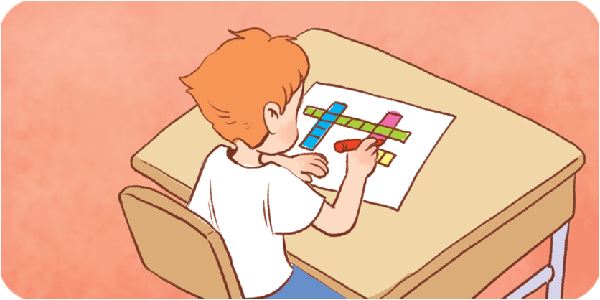
A
do word puzzles
B
play badminton
What do you do at break time?
I ____________.
C
play volleyball
D
She should take some warm water.

Slide 30
Thank you!
Notes:
Facebook : Bùi Liễu
Mobile phone: 0968142780

Slide 31
5. Let’s write.
It is break time. I am in the school ______________ .
I play __________. I like playing ______________.

Slide 32
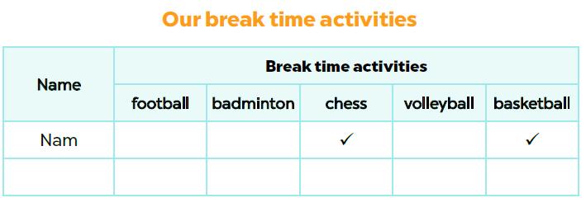
6. Project
Notes:
Facebook : Bùi Liễu
Mobile phone: 0968142780

Slide 33
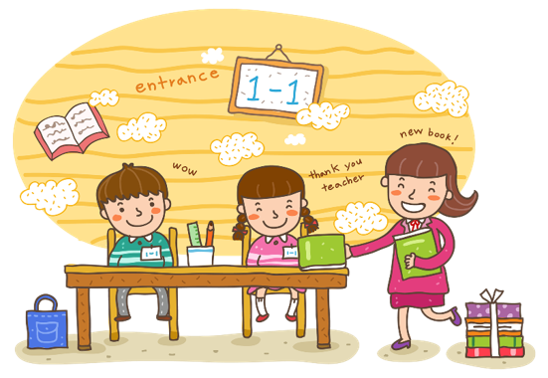
Wrap up

Slide 34
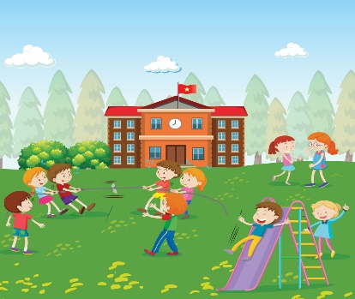




Vocabulary
break time
play chess
play basketball
play volleyball
play badminton
Notes:
Facebook : Bùi Liễu
Mobile phone: 0968142780

Slide 35
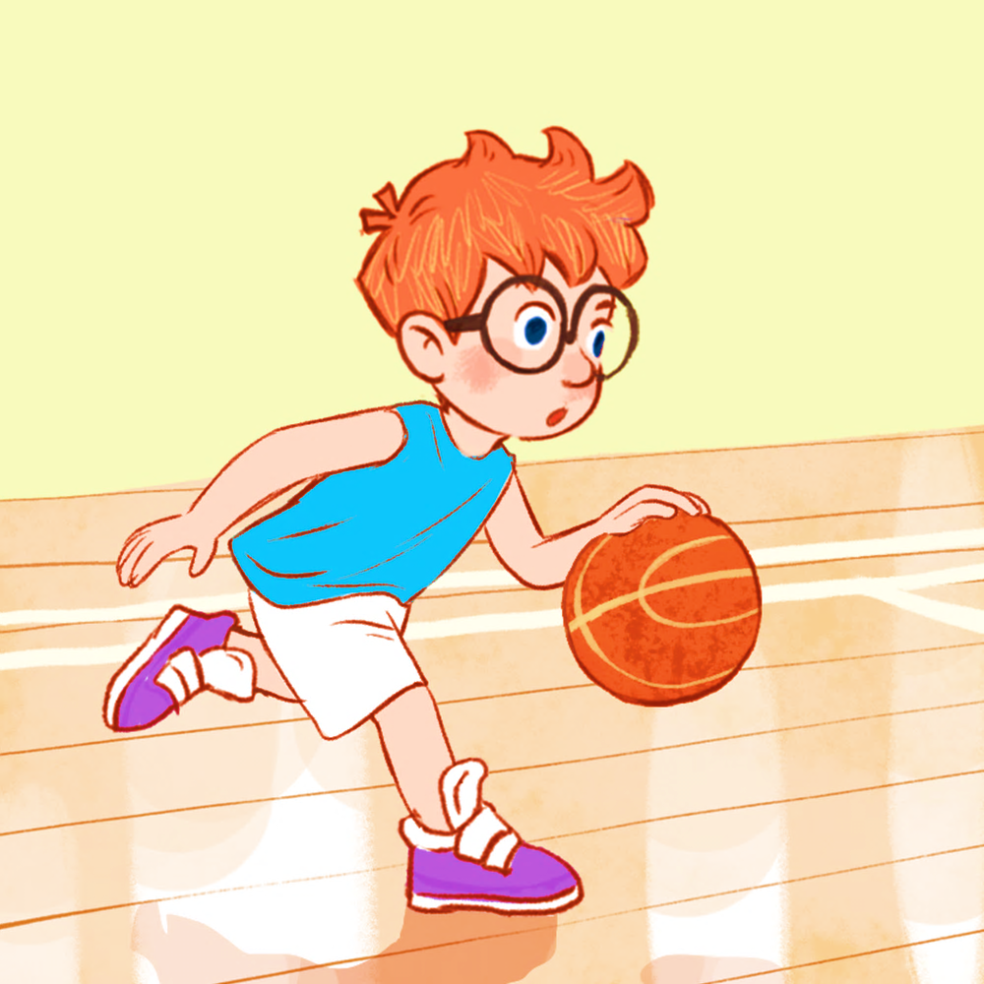
Structures
Khi muốn nói mình làm gì vào giờ ra chơi, các em nói:
- I ______ at break time.
(Tớ ____vào giờ ra chơi.)
Example:
I play basketball.

Slide 36
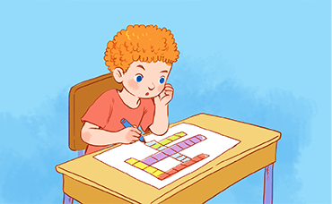
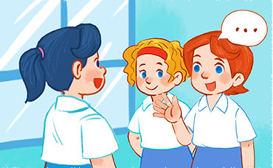
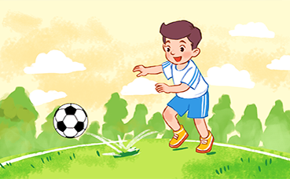
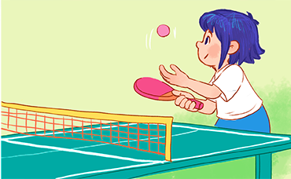
Vocabulary
do word puzzles
chat with my friends
play football
play table tennis
Notes:
Facebook : Bùi Liễu
Mobile phone: 0968142780

Slide 37
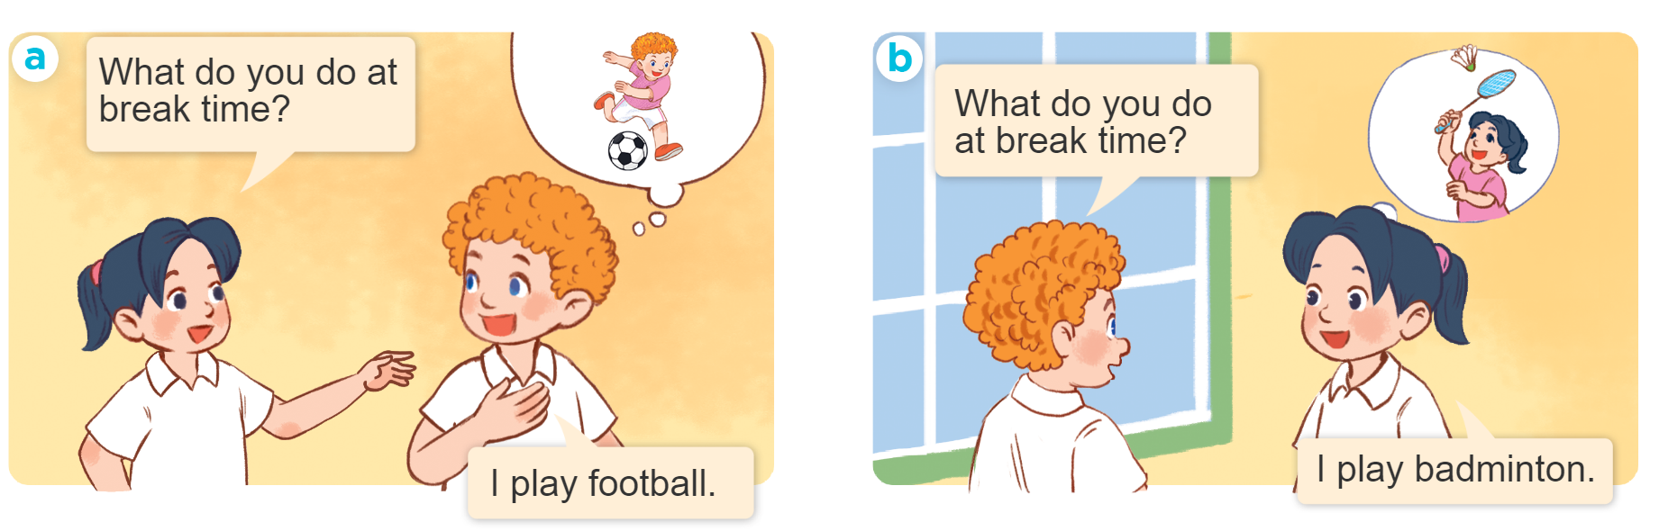
Structures
Khi muốn hỏi bạn làm gì vào giờ ra chơi, các em hỏi:
What do you do at your break time?
I ______________.
(Bạn làm gì vào giờ ra chơi?)
(Tớ ___.)
Example:

Slide 38
Homework
......................................
......................................

Slide 39
Thank you!

